Slide 1
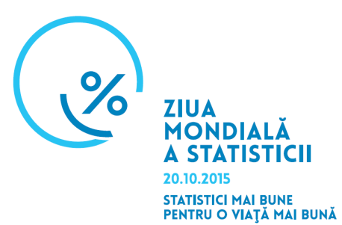
Development of Gender Statistics
In Republic of Moldova
Nadejda Cojocari
National Bureau of Statistics
Republic of Moldova
Notes:
??? Mai editeaza!

Slide 2
Content:
National legal framework in ensuring gender equality;
Mainstreaming of gender perspective in data production;
Engagement mechanism with users;
Dissemination and communication of gender statistics;
Next steps;

Slide 3
National legal framework (I)
The Law on Equal Opportunities of Men and Women(2006)
The law on ensuring equality(2012)
National Program to Ensure Gender Equality for 2010-2015 years, including Action Plan
Other strategic documents.

Slide 4
National legal framework (II)
The legal framework is crucial:
According to The Law on Equal Opportunities of Men and Women adopted in 2006, NBS is responsible for collection, processing and compilation of gender statistics, but central and local public administration, political parties and other socio-political organizations, legal entities and individuals involved in entrepreneurial activities, will provide to NBS all the needed data disaggregated by sex (art.22).
According to the National Development Strategy of National Bureau of Statistics, one of the main priority is promotion of availability of statistical data disaggregated by sex in all areas of statistics and development of gender statistics aimed at providing data support for evidence based policy making related to insuring equality of chances between women and men.

Slide 5
Mainstreaming of gender perspective in data production (I)
The production of gender statistics concerns the entire national statistical system because: • it covers data from different sources and statistical fields. • it involves planning, data collection, data analysis and dissemination; and • it is NOT limited to the compilation of sex-disaggregated statistics from various fields and their dissemination in gender- focused publications or other products. • it should be revised regularly from policy making perspective, but also should take into account data quality measurement criteria.

Slide 6
Mainstreaming of gender perspective in data production (II)
To adequately reflect gender issues, statistics need to: • focus on area of concern where women and men may not have equal opportunities or status, or their lives are affected differently; • take into account specific population groups where gender inequality is likely to be present or more pronounced; • use concepts, definitions and measurement methods that can reflect status of women and men, gender roles in society;
use data from different sources where collections tools are reliable.

Slide 7
Mainstreaming of gender perspective in data production (III)
It is important to have a demand from policy makers!
According to the Action Plan of National Program to Ensure Gender Equality for 2010-2015, there were specific actions to be taken by NBS in order to improve the data availability for production of gender statistics:
Reconciliation of professional and private life (2010)
School to work transition (2014)
Violence against women (2010)
Time Use Survey (2011)

Slide 8
Engagement mechanism with users (I)
User advisory groups
Annual consultation board in the context of revision NBS work plan
Inter-ministerial working group coordinating the implementation process of production and dissemination of gender statistics, namely the gender focal points
• User satisfaction surveys:
– can consider views of individual organisation in depth.
– can employ mix of survey methods, e.g. interview methods for major users
and mail-back questionnaires for other users.
• Workshops or seminars:
– can be convened to discuss directions and priorities in gender statistics,
including data gaps.
– can also be used to develop partnerships and coordinate plans across
organisations.

Slide 9
Engagement mechanism with users (II)
User satisfaction survey
Dedicated survey to gender statistics users, 2008
The main goal of the survey:
i) to identify the need of current and potential users (areas and indicators), to assess the level of usage and access of gender statistics; ii) and to assess the content of statistical publication Women and Men published by NBS.
User satisfaction survey of overall NBS
The main goal of the survey:
i) to assess the level of users satisfaction with statistical products in order to improve the policy and practices of NBS, including institutional functionality in the framework of quality management.
2009 – no gender statistics considered
2012 – gender statistics considered

Slide 10
Results…
NBS is the main source of information for more than 85% of users;
Users are more interested in data from population domain, labour force, prices and salary data, BUT gender statistics are still one of the area underused by users;
Users would prefer to have more data available online (76%) and only 23% - printed publications;
Need for a different approaches in tackling main target group of users;
There is an increase demand for data analysis.

Slide 11
Engagement mechanism with users (II)
Development of harmonized set of gender sensitive indicators:
1. In 2008 a harmonized set of indicators in a gender sensitive manner has been developed in the context of MDGs: -full set: 209 indicators, of which 101 are available, 53 need some adjustment, and 55 are not available - short set: 118 indicators, of which 15 are partially available (data collection mechanism should be adjusted) 2. In 2012 the initial set of indicators has been revised according to the 8 main strategic objectives of National Program on Ensuring Gender Equity (NPEGE) for 2010-2015: - main indicators: 36 indicators - additional indicators: 123 indicators, of which 65 are available, 30 need some adjustment, and 25 are not available.
- short metadata available

Slide 12
Dissemination of gender statistics (I)
Dissemination strategy involves to engage effectively with different target groups of data users and to deliver the information to those who need it, in the format that they need it, and when they need it
Types of products used to disseminate gender statistics
Press releases and statistical publications containing data disaggregated by sex;
Statistical publications presenting results of specific surveys;
Statistical publications focused on gender issues;
Analytical reports or articles;
Online StatBank.

Slide 13
Dissemination of gender statistics (II)
Publications containing data disaggregated by sex:
Statistical Yearbook
Children of Moldova
Health Protection
Education in Moldova
Aspects of the standard of living
Labor force market in Moldova

Slide 14
Dissemination of gender statistics (II)
Statistical publications presenting results of specific surveys:
Population census
Women and Men on the Labour Market
Entrepreneurship
Violence against women
Time use survey
Women and Men in agriculture (agricultural census)
School to work transition

Slide 15
Dissemination of gender statistics (III)
Statistical publications focused on gender issues: Women and Men in the Republic of Moldova:
2004, 2005, 2009 editions: data are presented in tables and graphs
2008 edition – the first publication with short descriptive analysis which helps user to understand better the history behind the figures
2013 edition – the second publication with data analysis, including data on Women and Men at the regional level
2015/2016- new edition

Slide 16
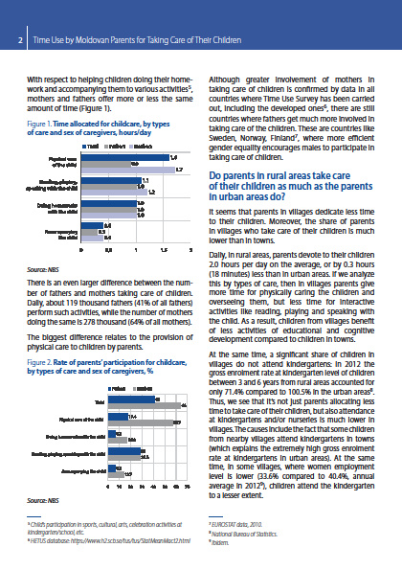
Dissemination of gender statistics (IV)
Analytical reports (prepared by experts using data from NBS)
Time Use Survey
first collaboration with think-tank organization in presenting and communication of data
New way to disseminate data:
10 analytical reports on time-use by women and men in Moldova have been prepared on the following topics:
Taking care of children Education
Mode of transportation Time use by people with
Health and lifestyle disabilities
Importance of unpaid work Volunteering and participatory activities
Social life and entertainment Time spend for traveling
Violence against women, combining quantitative with qualitative

Slide 17
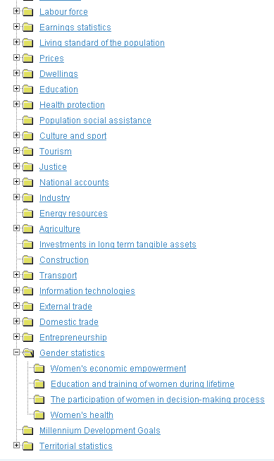
Dissemination of gender statistics (V)
On line database“StatBank”
Starting with 2014 a separate compartment dedicated to Gender statistics has been created;
It is structured in 4 subsections according to the main policy making decision area
Data are available for 2008-2014 time series and it includes 42 indicators from 52 of the Minimum Set of Gender Indicators recommended by United Nations Statistics Division
Gender indicators that are not presented in other compartments

Slide 18
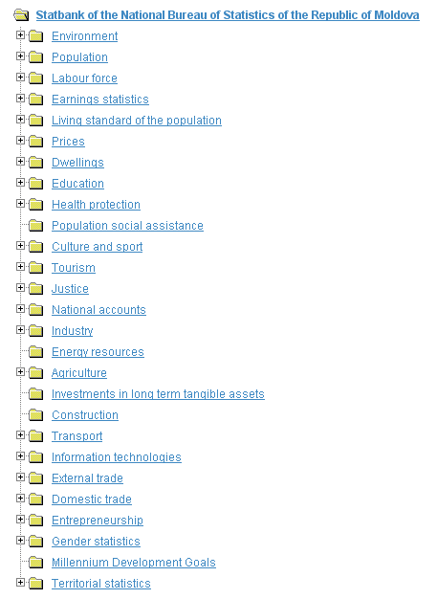
Dissemination of gender statistics (VI)
Online database“StatBank”
Data disaggregated by sex are available in other sections:
Population
Labor force
Earning statistics
Education
Health statistics
Social protection
Justice
Territorial statistics

Slide 19
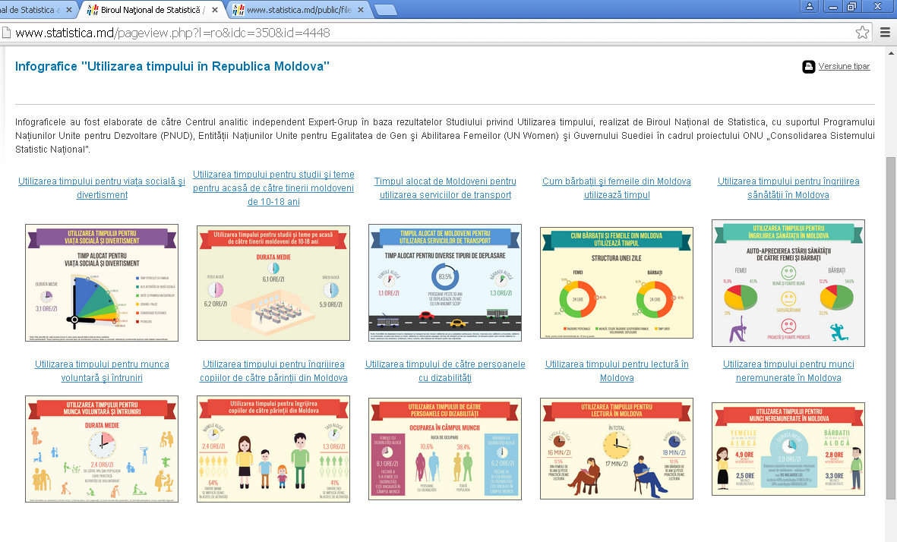
Dissemination of gender statistics (VII)
New way to communicate gender statistics: infographs

Slide 20
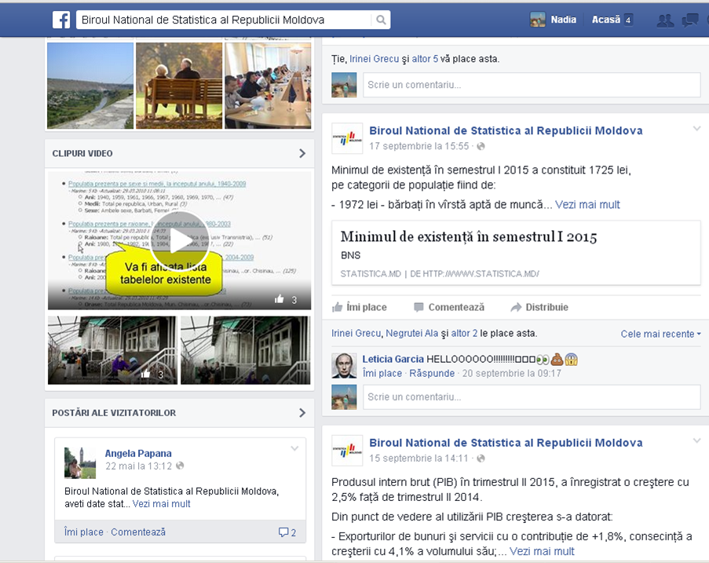
Dissemination of gender statistics (VIII)
Starting with 2010 data are disseminated through facebook

Slide 21
Next steps
To present data in a user friendly way taking into account the need of different group of users, to disseminate data to a wide range of users
To maintain and expand on line database on gender statistics
To develop an effective communication plan for different statistical products
To promote statistical literacy overall and including gender statistics
To ensure the continuity of launched activities
To develop a national roadmap for localizing SDGs from a perspective from gender statistics
In 2016 to revise the set of indicators according to the PNAEG 2016-2020

Slide 22
Thank you for your attention! www.statistica.md
gender@statistica.md

