Slide 1
Gender aspect in population census in Finland
UNECE Work Session on Gender Statistics,
13 March 2012
Marjut Pietiläinen

Slide 2
Population Census 2010 in Finland contains data describing
Population structure
Families
Educational structure of population
Employment
Dwellings and housing conditions
Buildings and free-time residences

Slide 3
Population with educational qualifications by age in 1970 and 2010, %

Slide 4
Population aged 15 or over by field of education 2010, %

Slide 5
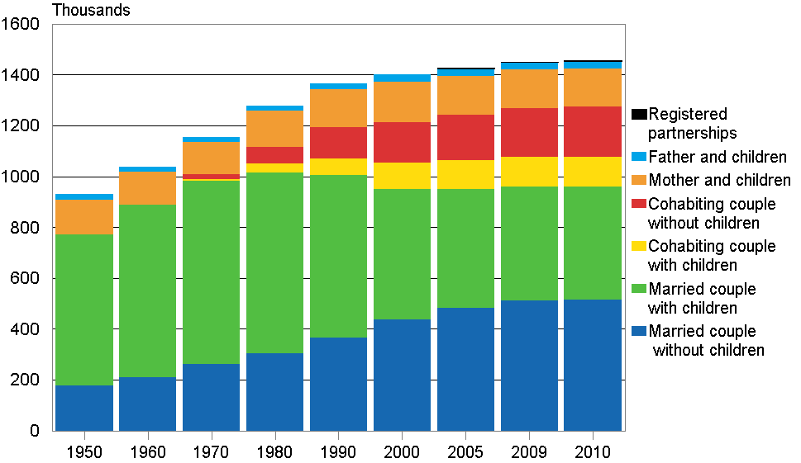
Families by type 1950−2010

Slide 6
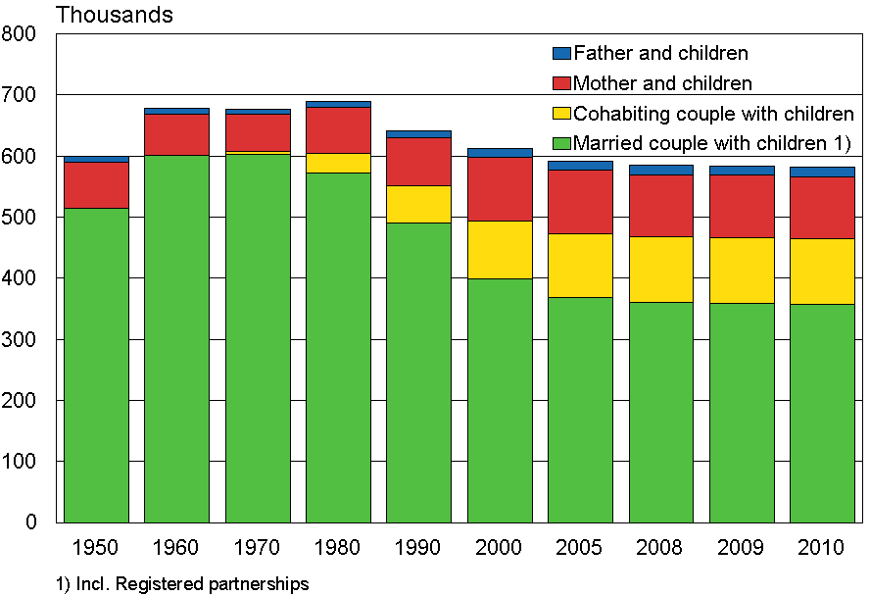
Families with underage children 1950−2010

Slide 7
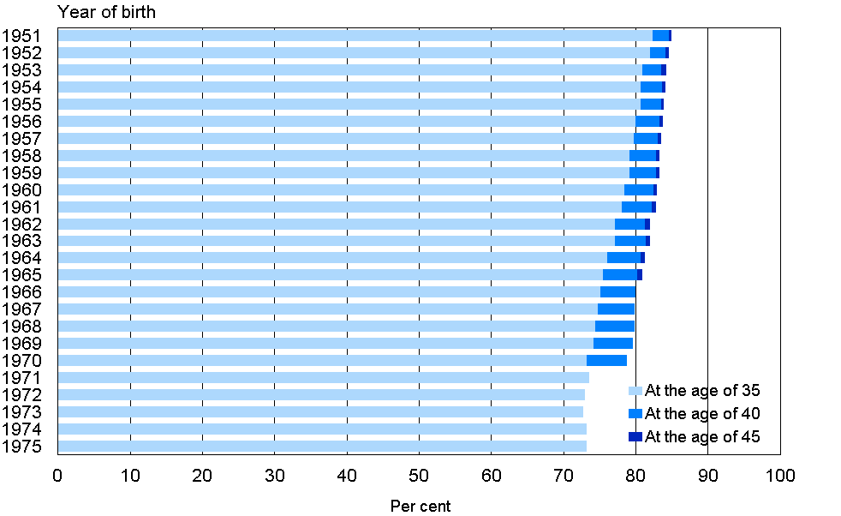
Share of 35, 40 and 45-year-old women having given birth among women born in 1951 to 1975

Slide 8
Women and men living alone in Finland as a proportion of age group in 1990 and 2010,%

Slide 9
Challenges
Single-parent families: Children are registered as resident at the address of one parent only even if they regularly live with each parent in turn and parents look after them jointly (joint custody)
Several generations living together
Co-habiting couples of same sex
Lack of data on education for the immigrant population
Lack of data on educational qualifications attained abroad
Lack of data by gender on the citizens of other countries who are working in Finland
Gender experiencing out of the reach of statistics

Slide 10
Further information
Statistics Finland
http://tilastokeskus.fi/index_en.html
Gender equality
http://tilastokeskus.fi/tup/tasaarvo/index_en.html
Population census
http://tilastokeskus.fi/tup/vl2010/index_en.html

Slide 11
Thank you!

