Slide 1
Workshop on Consumer Price Indices Minsk, Belarus,11-13 September 2019
Documentation and Communication
The Principles of Official Statistics, the Generic Statistical Business Process Model (GSBPM) and the Generic Statistical Law
Carsten Boldsen, UNECE

Slide 2
Principles of official statistics
Generic Statistical Business Process Model - GSBPM
Generic Statistical Law

Slide 3
Principles of Official Statistics
Adopted by UN General Assembly in 2014
Principle 1. Relevance, impartiality and equal access
“Official statistics provide an indispensable element in the information system of a democratic society, serving the government, the economy and the public with data about the economic, demographic, social and environmental situation. To this end, official statistics that meet the test of practical utility are to be compiled and made available on an impartial basis by official statistical agencies to honour citizens' entitlement to public information.”

Slide 4
Fundamental Principles of Official Statistics
NSO decides on statistical methods and procedures based on strictly professional ground
Confidentiality: data are only used for statistical purposes
Official statistics should be produced efficiently
- Requires access to relevant data sources and cooperation with other organisations
Statistics should be made publicly available on an impartial basis to all users

Slide 5
Publication
Users should have access to statistics at the same time
CPIs should be available
in user friendly format
in form of time series with a fixed index reference period
long time series - a minimum of 5 years is recommended
publication of only monthly comparing the current period with the previous period, or cumulative series is not suitable for time series analysis.
Documentation of methods & processes should be available to facilitate correct understanding and use of the statistics

Slide 6
Generic Statistical Business Process Model GSBPM
Distinguishes 8 phases of statistical production and sub-processes within each phase
New version (5.1) of January 2019
Why GSBPM?
To define and describe statistical processes in a coherent way
To compare and benchmark processes within and between organisations
To make better decisions on production systems and organisation of resources

Slide 7
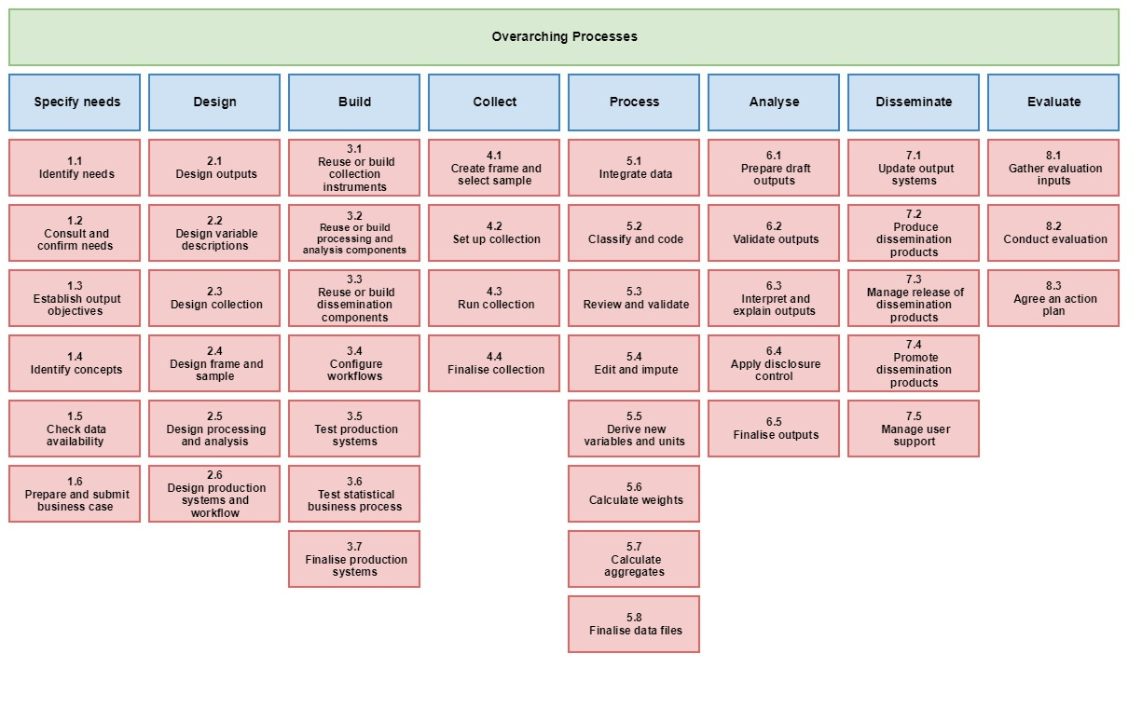
GSBPM

Slide 8
GSBPM
1. Specify needs
1.1 Identify needs
1.2 Consult & confirm needs
1.3 Establish output objectives
1.4 Identify concepts
1.5 Check data availability
1.6 Prepare business case
5. Processes
5.1 Integrate data
5.2 Classify & code
5.3 Review & validate
5.4 Edit & impute
5.5 Derive new variables & units
5.6 Calculate weights
5.7 Calculate aggregates
5.8 Finalise data files

Slide 9
Key features of GSBPM
Should be applied flexibly – it is not a rigid framework
Sub-processes do not have to be followed in a strict order
It is a matrix, through which there are many possible paths
Some iterations of a regular process may skip certain sub-processes

Slide 10
Generic Statistical Law
Endorsed by CES in 2016
Tailored to EECCA countries
Provides recommendations and best practices for national statistical legislation
Aims to strengthen the legal basis of national statistical systems, the professional independency of NSOs and production of high quality statistics

Slide 11
Key elements of modern statistical law
The National Statistical System, its Responsibilities and Rights
Main Principles of Official Statistics
Safeguards to Professional Independence and Chief Statistician
Strategic Coordination and Programming
Strong Mandate to Access Data, Strict Confidentiality
Quality Commitment and Assessment
User Services and Communication
Development of Statistics with National and International Partners

Slide 12
Generic Statistical Law
Fully in line with the Fundamental Principles of Official Statistics and the European Statistics Code of Practice
Enhances public trust and promotes the use of official statistics
Provides a model and key reference when amending national statistical legislation
Needs to be adjusted to each country's legislative environment
Encourages adoption of new forward looking practices e.g. reuse of data, microdata for scientific research…

Slide 13
More information
GSBMP
Guidance and more details on how to use GSBPM is available in English and Russian on
https://statswiki.unece.org/display/GSBPM
Generic Statistical Law
English, French and Russian version is available from
http://www.unece.org/index.php?id=45114

