Slide 1
www.stat.gov.kz
Inclusion of Seasonal products in the CPI in the Republic of Kazakhstan
Consumer Price Index Workshop
for Eastern Europe, Caucasus and Central Asia
11-13 September 2019
Minsk. Belarus
Ukibasov KI Price Statistics Department Committee on Statistics Ministry of National Economy of the Republic of Kazakhstan Tel. +7 7172 74-95-36 E-mail: ka.ukibasov@economy.gov.kz

Slide 2
METHODOLOGICAL STANDARDS REGULATING THE PROCEDURE OF ACCOUNTING FOR SEASONAL GOODS
Consumer Price Index Guidelines: Theory and Practice, 2004.
European Commission Regulation (EC) №330 / 2009 “Seasonal goods standards»
Practical Guide to the CPI, 2009.
"Consumer Price Index Methodology" on December 30, 2015 № 230
"Methodology for monitoring prices for consumer goods and services” of September 22, 2017 № 135
www.stat.gov.kz 2

Slide 3
CONSUMER PRICE INDEX
Consumer basket for the CPI
275 | 344 | 435 | 508 | 510
1995 | 2000 | 2002 | 2008-2015 | 2016-2019
Revised once every 5 years
Set of goods and services
The structure of the CPI basket, in%
non-food
products
paid services
food
products
food
products
paid services
non-food
products
www.stat.gov.kz 3

Slide 4
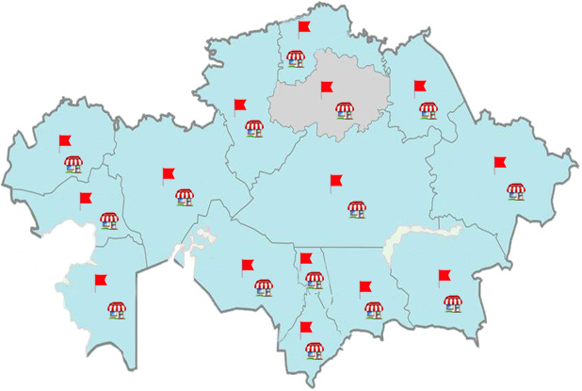
SCOPE
geographical coverage - urban and rural settlements. A total of 86 settlements.
basic population - the entire population, spending on the territory of the country.
Capital:
Square:
Population:
Currency:
Nur-Sultan
2.7 million sq. Km
(9th place in the world)
~ 18.5 million.
Kazakhstani Tenge (KZT)
More than 120 thousand price quotes for 510 goods and services are collected monthly in the country
The sample involves more than 11 thousand objects of trade and services
Throughout the country, prices are recorded from 332 registers.
www.stat.gov.kz four

Slide 5
Seasonal Products
Strongly seasonal
Weakly seasonal
Implemented during the year, but their price varies from season to season
Available in one-half of the year “during the season"
Certain types of clothing and footwear, sports and other goods
Certain types of fruits and vegetables, fish and other
Methods of quality adjustment
Imputation of middle class
Direct comparison of prices
www.stat.gov.kz five

Slide 6
METHODS FOR ACCOUNTING SEASONAL GOODS
Constant
weights
method
Two basic methods are used in international practice
Variable
weights
method
weight of goods
For a year remain unchanged
!
!
Weight of the goods vary within a group of goods
THE REPUBLIC OF KAZAKHSTAN
Price registration
Methods of calculation
Methods of quality adjustment
according to the seasonality calendar
Counter-seasonal estimation - changes in the prices of “off-season” goods are estimated using changes in the prices of goods “in the season”
Conditional calculation of the general average
Conditional calculation of the middle class
www.stat.gov.kz 6

Slide 7
CALENDAR OF STRONGLY SEASONAL GOODS
 | January | February | March | April | May | June | July | August | September | October | November | December
Women's fur coat |  |  |  | x | x | x | x | x | x
Coat for men |  |  |  | x | x | x | x | x | x
Jacket for school-age children winter |  |  |  | x | x | x | x | x | x
Fur hat for men |  |  |  | x | x | x | x | x | x
Fur hat female |  |  |  | x | x | x | x | x | x
Men's winter boots |  |  |  | x | x | x | x | x | x
Women's winter boots |  |  |  | x | x | x | x | x | x
Boots, shoes for boys Winter |  |  |  | x | x | x | x | x | x
Boots, girls winter boots |  |  |  | x | x | x | x | x | x
Sled |  |  |  | x | x | x | x | x | x
Warm mens’ jacket |  |  |  | x | x | x | x | x | x
Overalls (suit) to a winter preschool children |  |  |  | x | x | x | x | x | x
Female jackets from a synthetic to a warmer |  |  |  | x | x | x | x | x | x
Men’s coat demi seasonal |  |  |  |  | x | x | x | x
Women's coat demi-seasonal (of thick cloth) |  |  |  |  | x | x | x | x
Women’s coat on synthetic insulated lining |  |  |  |  | x | x | x | x
Men's shoes |  |  |  |  | x | x | x | x
Women's demi boots |  |  |  |  | x | x | x | x
coal |  |  |  |  | x | x | x | x
Men's sandals, summer shoes | x | x | x |  |  |  |  |  |  | x | x | x
Women's summer shoes leather, sandals | x | x | x |  |  |  |  |  |  | x | x | x
summer shoes, sandals for boys | x | x | x |  |  |  |  |  |  | x | x | x
girls' summer shoes, sandals | x | x | x |  |  |  |  |  |  | x | x | x
Roller-skates | x | x | x |  |  |  |  |  |  | x | x | x
www.stat.gov.kz 7

Slide 8
Thanks for attention!

