Slide 1
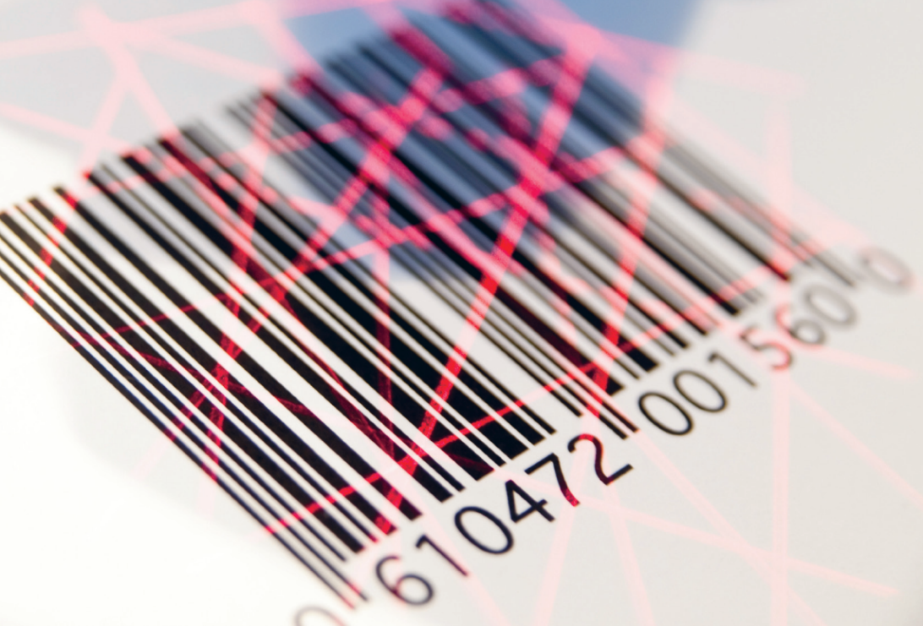
Scanner data as data source How to start, recommendations

Slide 2
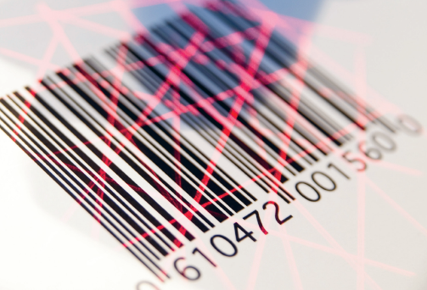
Objectives
    Explain the advantages and disadvantages of scanner data
    Give an overview of the different ways of using scanner data
    Highlight the main challenges
    Give general recommendations (in line with Eurostat)

Slide 3
Definition of scanner data
“Detailed data on sales of consumer goods obtained by ‘scanning’ the bar codes for individual products at electronic points of sale in retail outlets. The data can provide detailed information about quantities, characteristics and values of goods sold as well as their prices.” *
* Consumer price index manual, 2004

Slide 4
Advantages of scanner data (1)
  Increased data quality:
    precise sampling method according to turnover (best selling items)
    price collection during a longer period instead of a single day
    scanner data usually include every transactions from every single outlet nationwide (full survey per item and survey period)
    sales, promotions and other offers are fully covered
    increased item sample size

Slide 5
Advantages of scanner data (2)
  Smaller burden of workload for the retail chains
  Reduced costs (?)
    Depends on the price collection system
    Burden transfer from stores to the statistical office

Slide 6
«Disadvantages»
  Quality assurance of the supplied data is difficult:
    no influence on data collection
    Increased data checks necessary
  Dependence on retailers
    Risk though greatly reduced by independent data supply by each retailer
    Emergency plan
  Huge amount of data requiring appropriate IT structure
    Initial costs for development not to be underestimated
    New Software is needed for scanner data price collection

Slide 7
Ways of using scanner data for the CPI (1)
  Using scanner data to compute the CPI
Substitute the price collection in the field with scanner data maintaining the same procedures of sampling and the same calculation methodology (static approach)
Substitute the price collection in the field with scanner data using adapted sampling techniques but maintaining standard calculation methods of the elementary indexes (dynamic approach)
Use full potential of scanner data with adapted sampling and computation methods

Slide 8
Ways of using scanner data for the CPI (2)
  Sales volumes of items can change regularly, thus sample must be updated
  → ensuring representativeness
  Items should not be replaced all the time when they are still sold / each time QA necessary
  → ensuring continuity
Representativeness
Continuity

Slide 9
Ways of using scanner data for the CPI (3)
  Using scanner data for analyses, controls
  Use scanner data for controlling the price collection done in the field
  Data source for testing other calculation formulas

Slide 10
Challenges to be faced with the use of scanner data
Collaboration with retail chains
Scanner data supply
Quality and risk management
Allocation to the COICOP (mapping)
Sampling and computation
IT

Slide 11
A. Collaboration with retail chains (1)
  First steps
    Market analysis: target the biggest chains => best is to introduce scanner data in the CPI for a significant market share (legitimacy)
    Contact people for each chain: marketing managers, IT managers, other high-level managers
    Survey among the biggest chains: to check if they are basically ready and if the data are available in the form you need (for free if possible)

Slide 12
A. Collaboration with retail chains (2)
  Advanced collaboration
    Conclusion of individual agreements with each retail chain to assure the collaboration and the scanner data supply
    Adaptation of the legal base on Statistics surveys to make scanner data delivery compulsory
    Involving the biggest retail chains in the price statistics (Swiss experience => biggest retail chains are active members of the expert group following the revisions of the Swiss CPI)

Slide 13
B. Scanner data supply (1)
  Contents
  Scanner data at item code level (in order to calculate a unit value)
  The contents of the information you want to receive from the retail chains must be defined => which variables
  Specificities of each retail chain have to be taken into account
  Structure
  The structure of the information you want to receive must be defined

Slide 14
B. Scanner data supply (2)
  Aggregation
  Need of scanner data in an aggregated form – cover the longer period as possible – includes the greater number of outlets as long as homogenous
  Transmission
  Timing of deliveries regarding your goals must be defined, if possible weekly deliveries
  Provision should be automated and secure

Slide 15
C. Quality and risk management (1)
  Quality framework : regular checks are necessary at different levels
    Retailers
    Test price collections
    Quantitative and qualitative controls by statistical office
  Dependence on retailers : statistical office has no influence on data collection
  Emergency plans in case of problems with the scanner data supply

Slide 16
C. Checks on the received data (2)
    Formal checks: correct format, total number of records, missing values, number of changed records/values (per variable), number of new / deleted items etc
    More detailed checks for items in the sample: Each change in master data is checked (quantities etc), validation rules for turnover, comparison with average price in the same survey position etc

Slide 17
C. Checks on the outcomes (3)
    Outcomes are checked more or less the same way as it is the case with traditionally collected prices and indices
    Finding explanations from different sources, eg
      Internet / online-shops, printed materials (flyers etc.) etc
      Retailers (direct contact)
    Analysing indices in the short and long run (seasonal aspects, long-term and short term tendencies etc.)

Slide 18
Swiss example of an emergency plan
    Regulated in a separate amendment to the contract with the private market research institute
    Price collectors go to the outlets to collect prices manually
    Must be put into effect by the 14th day of a month if
      no data is delivered at all (if the data from the first week is delivered, this one could be used for index calculation)
      or if the data quality is not ok
      and if no short time solution can be found with the retail chain
    Has never been needed so far

Slide 19
D. Mapping : allocation of items to the COICOP (1)
  Scanner data from EACH retailer contain thousands of different items
  Main challenge: these items have to be allocated to the COICOP to make them usable for the CPI. In other words there is a need of information to link the retail chains structures and the COICOP

Slide 20
D. Mapping (2)
  Three elements to consider when developing a solution for the allocation
    In-store numbers vs. EAN/GTIN
    Allocation on aggregated level vs. item level
    Who allocates (in-house staff or market research institute)
Notes:
20

Slide 21
E. Sampling and computation (1)
  Maintaining the actual sampling techniques and computation methodology (static approach) has several advantages
    Better data source
    Basically the same methods of sampling as with traditional price collection but best selling articles can be pinpointed
    Calculation methodology can be maintained unchanged
    Reduced costs
    Smaller burden of workload for the retail chains
  => Risk is low
Notes:
21

Slide 22
E. Sampling and computation (2)
  Adapting the sampling techniques and the computation methodology (dynamic approach) is more demanding
    New sampling techniques and computation methods involves usually radical philosophical changes in actual methods of computing the CPI
    Product groups with numerous range changes, price skimming, products highly related with technology or fashion can lead to chain drifts if not treated properly
  => This may lead to some risks
Notes:
22

Slide 23
E. Sampling and computation (3)
  Use of the full potential of scanner data
    International experience in this direction is increasing but not yet in a standardized way
    Use of very demanding index computation methods can lead to problems in a production context (explaining the variations, etc.)
Notes:
23

Slide 24
F. IT
  Using scanner data for the CPI involves to develop specific IT-tools for:
    Managing the scanner data
    Sampling
    Computation

Slide 25

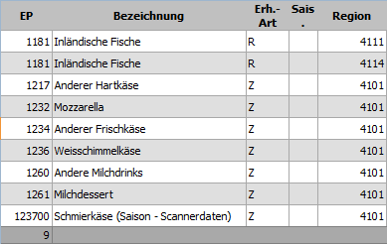
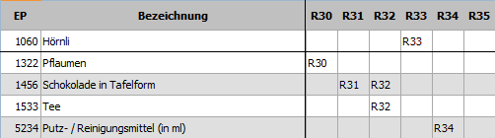

Lists of warnings
List of positions where selected items have a turnover = 0 in the actual period
R1
Master data
Positions without selected items

Slide 26
Treatment of seasonal products with care
  Specific positions should be created to treat the seasonal products and allow to stipulate the specific collection months
  Separate validation rules for monitoring sales movements are implemented for seasonal items, to prevent the software generating irrelevant warnings outside the season
  Outside the specific collection months, no prices are surveyed
  For the index computation, the regulation on seasonal products for the HICP is applied outside the scanner data module

Slide 27
General recommendations (1)
  Due to the many methodical difficulties related to scanner data it is recommended to substitute the price collection in the field with scanner data step by step :
    Gradual integration of outlets and product groups: Start with food/near-food groups (less demanding in quality adjustments and more stable product ranges)
    Next steps: extension to non food products and to explore more demanding sampling and computation methods

Slide 28
General recommendations (2)
    Obtain scanner data directly from the outlet- formal agreement
    Test
    Collect data at item code level
    Aggregation (time) over a week
    Suitable quality framework

Slide 29
Conclusions
  The way of using scanner data has to be defined at the beginning
  Collaboration with retail chains is a central point
  Solution for the allocation to the COICOP is necessary
  Gradual approach allows to take immediate advantage of the most important benefits of scanner data without being exposed to any major risks
  IT is also a main challenge to manage scanner data

Slide 30
Questions
  Do you use scanner data in your country or do you have the intention to use this data source ?
  If yes, what approach do you have ?
  If no, why ?

