Slide 1
UNECE Workshop on Consumer Price Indices
Session 9: Quality Control
Presentation by Cengiz Erdoğan, TurkStat
October 10-13
Istanbul, Turkey

Slide 2
Quality Controls
Quality controls are carried out with two steps in Turkish CPI.
Before the dissemination of CPI data
After the dissemination of CPI data

Slide 3
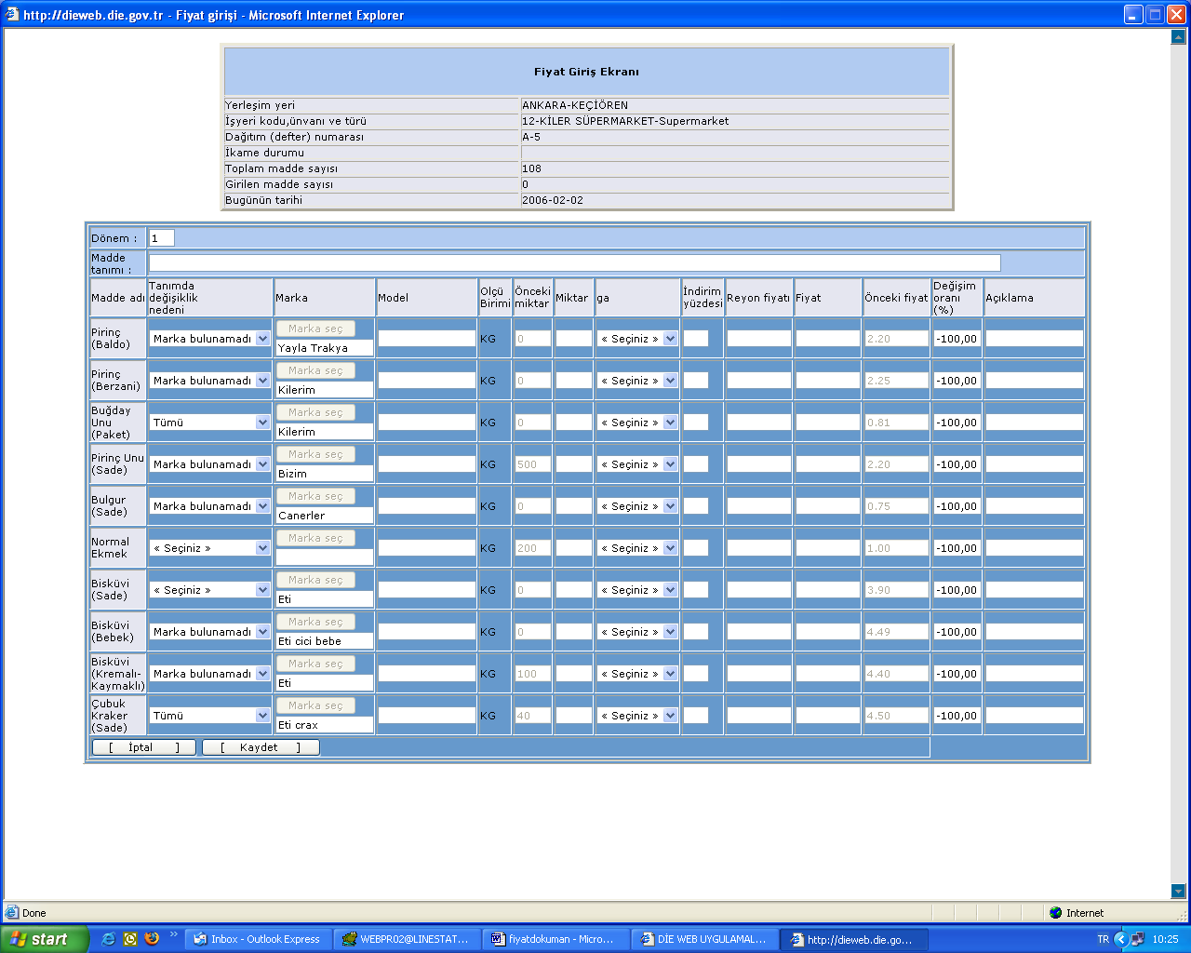
Quality Control Before the Dissemination

Slide 4
Quality Control Before the Dissemination
Price is automatically calculated by considering quantity, discount as a percentage and rayon price.
By comparing the preceding price and current price, if change rate exceeds %20 limit, system gives warning. This is the first alert for the price collector.

Slide 5
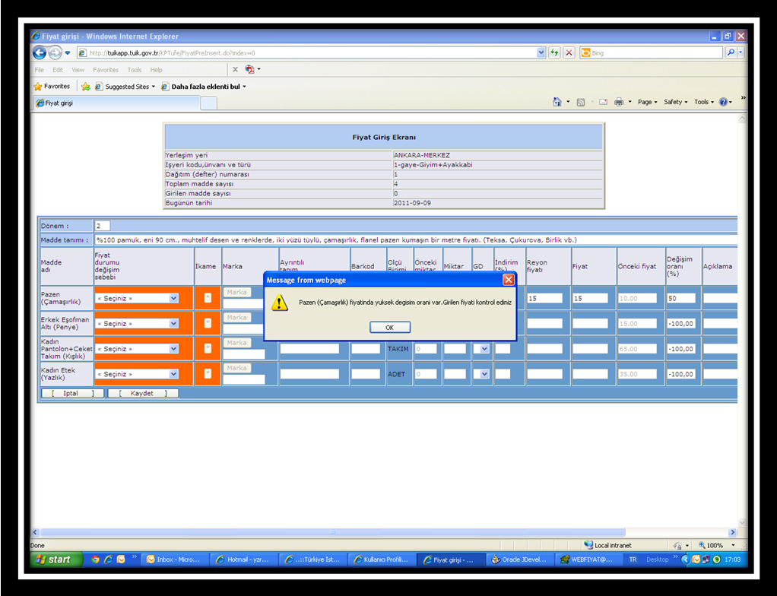
Quality Control Before the Dissemination

Slide 6
Quality Control After Dissemination
CATI is an interactive front-end computer system that aids interviewers to ask questions over the telephone. The answers are then keyed into the computer system immediately by the inteviewer.
The computer program controls branching to or skipping amoung questions and validates the data as it is entered. CATI application has been used in TURKSTAT since 2006.

Slide 7
Quality Control After Dissemination
The smart electronic form also performed on-line checks on the responses keyed in and alerted the interviewer of inconsistent or doubtful answers. The outlet or renter is not called twice in a year.

