Slide 1
Status of Reporting of Data According to BPM6 and GFSM 2014—Reporting of Balance Sheet Data and the IMF’s Efforts to Improve Cross-Sector Consistency of Data
Workshop on the Implementation of the 2008 SNA in EECCA Countries and Linkages with BPM6 and GFSM 2014
Istanbul (May 6–8, 2015)
Florina Tanase, Deputy Division Chief, IMF Statistics Department

Slide 2
Overview
Part I: Status of Reporting of Data according to BPM6 and GFSM 2014
Part II: IMF’s Efforts to Improve Cross-Sector Consistency of Data

Slide 3
Part I: Status of Reporting of Data according to BPM6 and GFSM 2014

Slide 4
BPM6 Conversion
Balance of payments (BOP) and International Investment Position (IIP) data on a BPM6 basis were first released by the IMF in the August 2012 IFS and in the December 2012 BOPSY
As of April 2015, 106 economies have reported their data on a BPM6 basis. For other economies, STA continues to convert data reported on a BPM5 basis to a BPM6 basis, through a conversion formula agreed with the economy
The BPM6 Compilation Guide was posted in November 2014 on http://www.imf.org/external/pubs/ft/bop/2007/bop6comp.htm
In October 2014, the IMF Committee on Balance of Payments Statistics agreed that the IMF will start releasing pre-2005 data on a BPM6 basis in 2015 (currently, only data from 2005 are released)

Slide 5
International Investment Position
As of April 2015, 143 economies (including all G20) are reporting IIP data to STA (including all G20 economies)
Quarterly IIP reporters
The number of economies reporting quarterly IIP data increased to 95 in April 2015
18 G20 economies (including the Euro Area) currently report quarterly IIP data

Slide 6
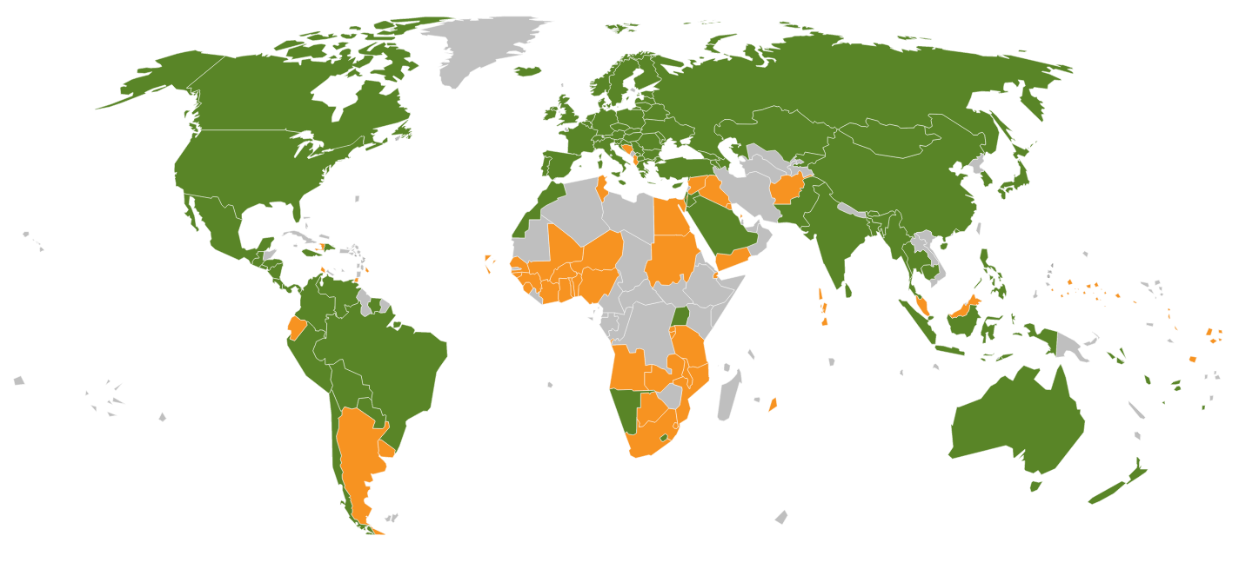
International Investment Position
143 Reporters:
95 Quarterly
48 Annual

Slide 7
Coordinated Portfolio Investment Survey
The end-June 2014 CPIS survey results were posted on the IMF website in March 2015: http://cpis.imf.org
61 economies reported the core items*
* To participate in the CPIS, an economy must provide position data of its holding of securities (separately for equity, long-term debt instruments, and short-term debt instruments) broken down by the economy of residency of the issuer

Slide 8
Coordinated Portfolio Investment Survey
The following CPIS enhancements were first implemented with
end-June 2013 data (for 56 economies) released in March 2014:
Frequency: From annual to semiannual data
Timeliness: Dissemination reduced from 11 months to 9 months after the measurement date
Scope: On an encouraged basis, the reporting of data on:
Institutional sector of nonresident debtor (issuer)
Institutional sector of resident holder cross-classified by institutional sector of nonresident issuer for 25 economies with systemically important financial sectors (more granular data on a “from-whom-to-whom” basis)
Short (negative) positions
Economies are also encouraged to report additional detail on the currency composition of holdings, as well as on their portfolio investment liabilities. The concepts and principles underlying the CPIS are aligned with the BPM6

Slide 9
Coordinated Direct Investment Survey
Preliminary results for end-2013 and revised data for 2009-2012 were released in December 2014
91 economies reported end-2009 data, 97 end-2010 data, 103 end-2011 data, 103 end-2012 data, and 90 reported preliminary end-2013 data
New CDIS platform/portal was also launched in December 2014 (http://data.imf.org/CDIS)
Revised Metadata questionnaire and further user-friendly query reports were made available

Slide 10
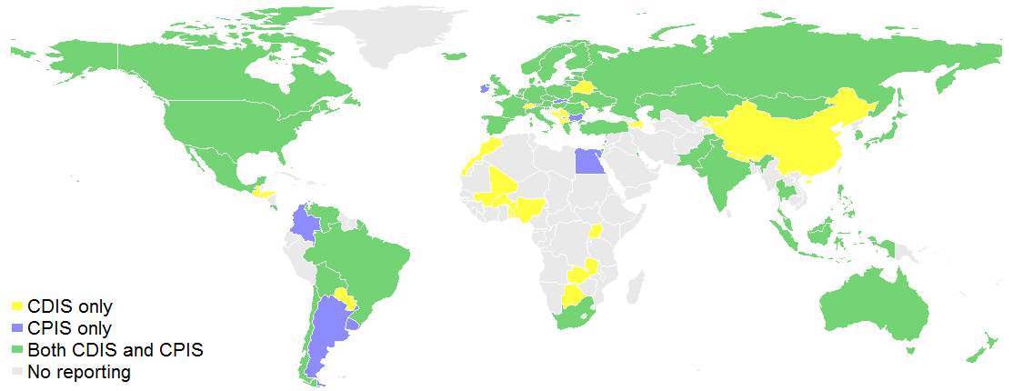
CDIS and CPIS Reporters (as of December 2014, for 2013 data)

Slide 11
External Debt Statistics
The 2013 External Debt Statistics: Guide for Compilers and Users (2013 EDS Guide) was posted in May 2014 at: http://www.tffs.org/edsguide.htm
In October 2014, the World Bank released for the first time the 2014Q2 external debt statistics (QEDS) based on the 2013 EDS Guide/BPM6 guidelines: http://datatopics.worldbank.org/debt/home
All 71 SDDS subscribers and about 40 GDDS participants report quarterly external debt data to the QEDS

Slide 12
Government Finance Statistics
The 2014 GFSM now available at:
http://www.imf.org/external/Pubs/FT/GFS/Manual/2014/gfsfinal.pdf
Aligned with the 2008 SNA and BPM6
Deepens the existing methodological guidance; and introduces some new concepts and presentations, including presentational tables on contributions to changes in net worth and on contingent liabilities

Slide 13
Growing Number of Countries Reporting to GFS Yearbook
Source: Government Finance Statistics Yearbook

Slide 14
A More Transparent Presentation of Gross Debt

Slide 15
Presentation of Gross Debt: A Country Example

Slide 16
Reporting to the Quarterly Public Sector Debt Statistics Database
Source: QPSD database, World Bank.
A total of 64 countries reported public sector debt statistics for 2014Q3.

Slide 17
GFS: Looking Forward
Promoting reporting of data on a GFSM 2014 basis by all countries
Improving data quality and filling data gaps
Greater use of GFS in macro-fiscal analysis
Newly established Government Finance Statistics Advisory Committee (first meeting during March 9-10, 2015) to help promote compilation and use of GFS

Slide 18
Part II: IMF’s Efforts to Improve Cross-Sector Consistency of Data

Slide 19
STA’s Cross-Sector Consistency Group
The Cross-Sector Consistency Group (CSCG) was established in mid-March 2012 in recognition of the importance of addressing inconsistencies in data that are reported to STA for different economic sectors
The CSCG’s main objective is to enhance the consistency of macroeconomic datasets reported to STA to facilitate economic analysis and support IMF bilateral and multilateral surveillance

Slide 20
CSCG: Key Findings
Common reasons for inconsistencies:
coverage of institutional units and/or of financial instruments
valuation of financial instruments
accrual versus cash recording
errors in source data
different time of recording; etc.
But also methodological differences between main statistical manuals

Slide 21
CSCG: Key Findings
In 2014, an expert conducted a review of:
System of National Accounts 2008 (2008 SNA),
Balance of Payments and International Investment Position Manual (BPM6)
Draft of the combined Monetary and Financial Statistics Manual and MFS Compilation Guide (MFSMCG)
Government Finance Statistics Manual 2014 (GFSM 2014) (pre-publication draft)
Handbook on Securities Statistics (HSS) (pre-publication draft)
The expert’s findings were taken into account in the final version of the GFSM 2014 released in March 2015; and are being incorporated in the final version of the MFSMCG that is near completion

