Slide 1
Use of statistics for economic governance and surveillance in the European Union Macroeconomic Imbalance Procedure
John Verrinder
Eurostat

Slide 2
Outline
Policy context
Macroeconomic surveillance and the Macroeconomic Imbalances Procedure
MIP indicators: the role of Eurostat in improving quality
Indicators in the Statistical Annex 2015
Future work

Slide 3
Policy context:
The economic, financial and sovereign debt crisis
EU policy initiatives:
Six-Pack Regulation: enhanced economic policy coordination and surveillance, including MIP
MIP: surveillance mechanism
- part of "European Semester"
- preventive and corrective arm

Slide 5
Macroeconomic Imbalances Procedure (MIP)
Scoreboard of relevant macro-economic and macro-financial indicators
Currently 11 headline indicators
Neither policy targets nor policy instruments
Supplemented by economic judgment and country specific expertise
Thresholds defined by the European Commission
Composition may evolve over time
Annual exercise - results published in the Alert Mechanism Report (AMR)

Slide 6
Macroeconomic Imbalances Procedure
Alert Mechanism Report (AMR)
One of the starting documents for the MIP
Initial screening device
identifies countries for in-depth reviews
MIP scoreboard + economic reading

Slide 7
Macroeconomic Imbalances Procedure
In-depth reviews (IDRs)
The Commission determines if imbalances exist
No imbalance
Imbalances, which require monitoring and policy action
Imbalances, which require monitoring and decisive policy action
Imbalances, which require specific monitoring and decisive policy actions
Excessive imbalances, which require specific monitoring and decisive policy action
Excessive imbalances, which require decisive policy action and the activation of the Excessive Imbalance Procedure
Programme countries not covered but under tight surveillance

Slide 8
MIP Headline Indicators Scoreboard
External Imbalances
Balance of Payments
Current account
Net international investment
Competitiveness
Real effective exchange rate (REER)
Share of world exports
Nominal unit labour cost
Internal Imbalances
House price index
Private sector credit flow
Private sector debt
General government debt
Unemployment rate
+
Total financial sector liabilities
(since second exercise)

Slide 10
Data sources
Main providers: National Statistical Institutes and Eurostat
Some BoP, NIIP and FA statistics co-produced with National Central Banks
REER indicators compiled by the European Commission Economic and Financial Affairs DG
Figure for total world exports by the International Monetary Fund

Slide 11
The role of Eurostat
Ensure statistical support for the MIP
Produce and supply the relevant statistical data
Ensure high quality of data - CoP
Set up and implement a quality and monitoring framework for MIP relevant statistics
Provide methodological support in the process of choice and definition of indicators
Foster harmonisation and documentation of production processes

Slide 12
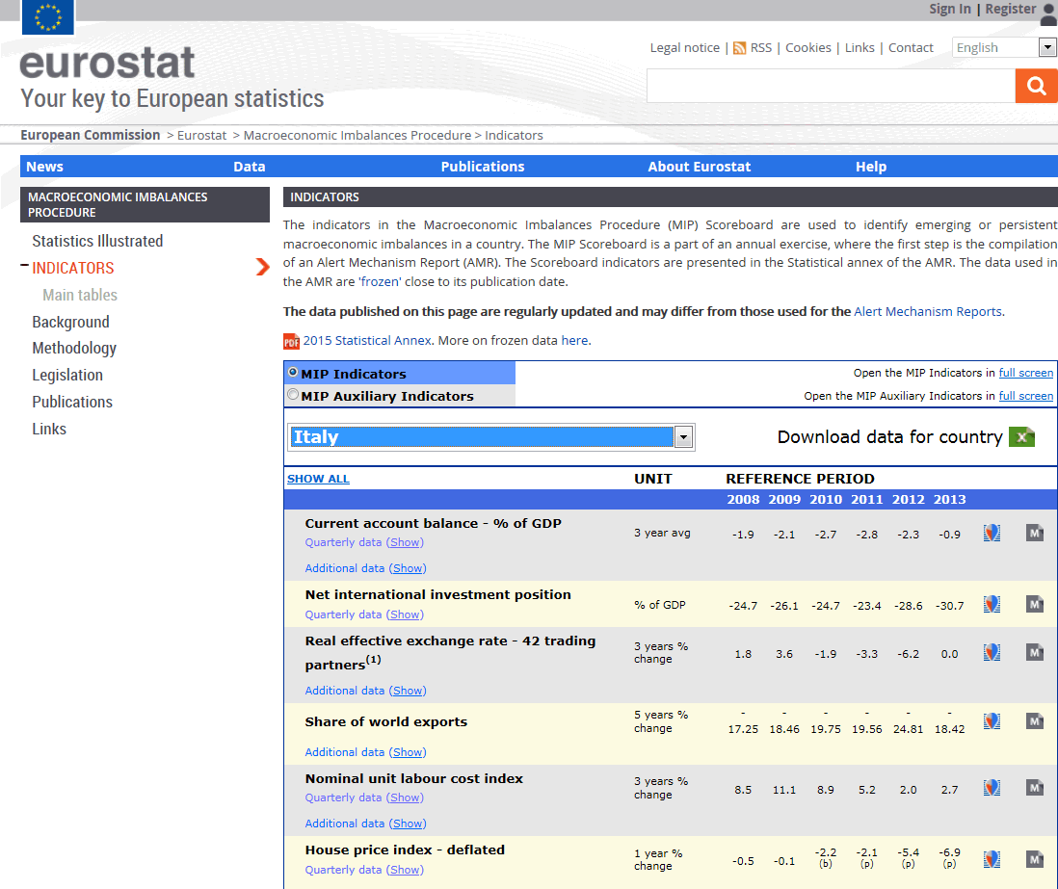

Slide 13
Statistical challenges
Comparability, Reliability, Consistency
Inventories and quality monitoring
Data coverage: last 10 years (longer when considering data transformations)
Backward data calculation
- ESA 2010
- BPM6

Slide 14
The Statistical Annex 2015
11 headline indicators
+
28 auxiliary indicators (8 social indicators)
- Activity rate
- Long-term unemployment rate
- Youth unemployment rate
- % of young people not in employment, education or training
- people at risk of poverty or social exclusion
- At risk of poverty rate
- Severely materially deprived people
- People living in households with very low work intensity

Slide 15
Future work
Continue efforts to guarantee data quality
Annually quality assessment report (Eurostat/ECB)
Statistical support in the review of the scoreboard composition
Enhance MIP scoreboard accessibility
Built a network of national MIP correspondents

