Slide 1
Construction and update of a poverty measure
UNITED NATIONS ECONOMIC COMMISSION FOR EUROPE
CONFERENCE OF EUROPEAN STATISTICIANS
Seminar on Poverty Measurement
Geneva, 5-6 May 2015
Why, What and How
João Pedro Azevedo
Global Lead
Minh Nguyen
Economist

Slide 2
WHAT IS POVERTY?
Poverty is pronounced deprivation in well-being, and comprises many dimensions
Basic concept of monetary poverty | Multidimensional aspects
Low incomes and the inability to acquire the basic goods and services necessary for survival with dignity | Low levels of health and education Poor access to clean water and sanitation Inadequate physical security, lack of voice Insufficient capacity and opportunity to better one’s life

Slide 3
WHAT ARE THE PRINCIPLES OF A GOOD POVERTY MEASURE?
It must be understandable and easy to describe
It must conform to a common sense notion of poverty
It must fit the purpose for which it is being developed
It must be technically solid
It must be operationally viable
It must be easily replicable

Slide 4
WHY DO WE WANT TO UPDATE OUR MEASURE POVERTY?
To better compare the poverty of different households and regions in the country
To better compare poverty over time
To better compare poverty between countries at a global level
To better compare poverty between countries at a regional level
To better monitor poverty
To better define a poverty reduction strategy
To better evaluate the impact of a poverty reduction strategy
The answer to some of these questions will condition the properties and choices of a poverty indicator

Slide 5
POVERTY MEASURES
Poverty
Objective
Monetary
Non-monetary
Subjective
Direct surveys
Relative
Absolute
Basic Needs Approach
Anthropometric needs

Slide 6
HOW TO MEASURE MONETARY POVERTY?
A welfare measure for individuals, used to derive a distribution of living standards
A poverty line, threshold below which individuals are classified as poor
A poverty index, summary statistics of poverty in population
Non poor
Threshold
Poor

Slide 7
HOUSEHOLD WELFARE
Consumption and income are most widely used
Some theoretical advantages of consumption measures
Some policy advantages of income measures
Both types of household welfare measure need proper adjustments in terms of:
Price differences (CPI; Purchasing Power Parity; etc.)
Normalize the size of a household (Per capita vs. per adult equivalent scale)

Slide 8
ADJUSTMENTS FOR HOUSEHOLD EXPENDITURES: PRICE ADJUSTMENT
Which is more?
20 Somoni in 1990, TJK vs. 30 Somoni in 2010, TJK
Adjustment - Use CPI
30 Somoni in 2013, TJK vs. $6 in 2013, USA
Adjustment - Use PPP
20 Somoni in 2010, Dushambe vs. 20 Somoni in 2010, GBAO
Adjustment - Use Spatial Price Index

Slide 9
ADJUSTMENTS FOR HOUSEHOLD EXPENDITURES: ADULT EQUIVALENCE SCALE VS. PER CAPITA
Do children spend less than adults?
Many countries replace the number of children with adult equivalent scales (based on daily caloric needs)
Maybe food consumption but non-food consumption?
The World Bank usually recommends “per capita” for simplicity and transparency

Slide 10
POVERTY LINES
International measures
$1.25 and $2 per day per capita evaluated at 2005 PPP
Regional measures
$2.5 and $4 for LAC and $2.5 and $5 for ECA
National measures
Country specific poverty lines, which are linked to a daily calorie requirement (usually around 2100 kcal per capita per day)

Slide 11
NORMATIVE OR EMPIRICAL BASKETS?
Nothing ensures that the items of a normative baskets will be available for consumption
There is no guarantee that these items have prices that can be estimated robustly
Nothing ensures that the products from a normative food basket can be consumed by a significant fraction of the population (products that are not part of the population food habits).
The normative baskets, use multiple criteria (caloric, protein intake, micro nutrients, % protein of animal origin, etc.) end up being ad hoc baskets that depend largely on the expert who built them. The criteria of transparency, acceptance by consensus and reproducibility are hardly met in this case.
An empirical basket is preferable

Slide 12
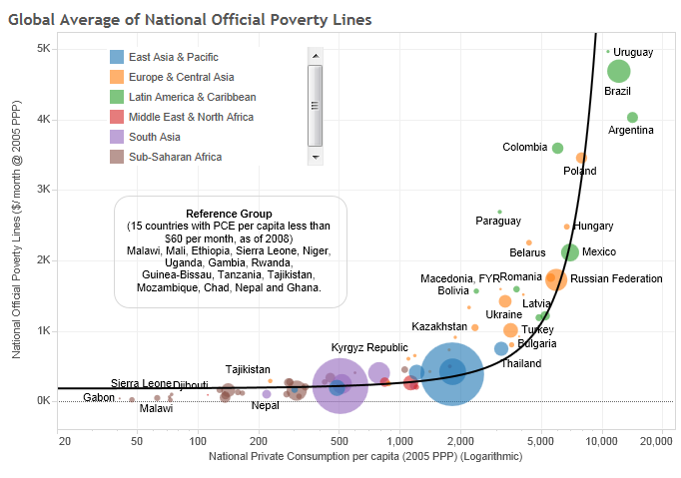
WHY DO WE NEED AN INTERNATIONAL DOLLAR PER DAY POVERTY LINE?
National official poverty lines are a function of preferences,
norms and level of economic development
Note: the ECA Team for Statistical development would like to thank Shaohua Chen and Prem Sangraula for sharing their data

Slide 13
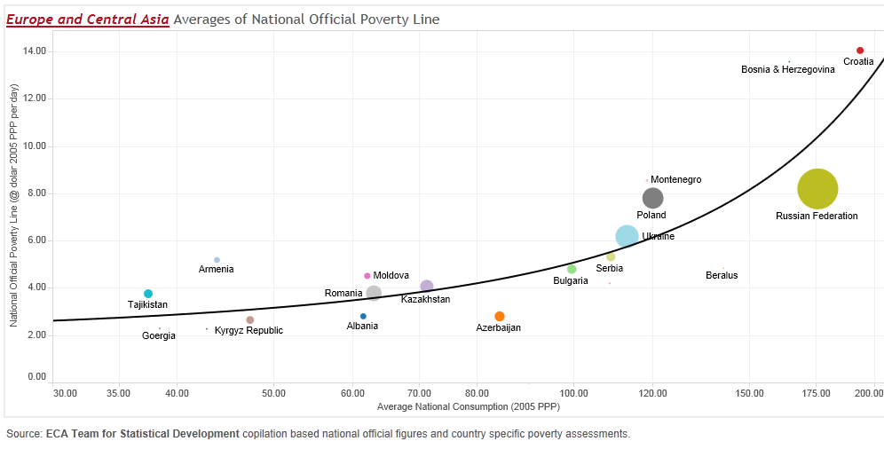
REPLICATING A SIMILAR EXERCISE ONLY WITH THE ECA COUNTRIES GIVES US AN AVERAGE REGIONAL POVERTY LINE OF 2.5 USD-PPP

Slide 14
FOR ANY GIVEN METHODOLOGY TO ESTIMATE A POVERTY LINE, FINAL RESULTS CAN BE DRIVEN BY…
Preferences
Countries, households or individuals might have different aspirations, as their level of economic development increase.
Relative or Weakly-Relative Poverty line argument
Circumstances
There might be exogenous structural factors that might affect the consumption patterns of different countries at different points in time
Demographics, Natural endowments, Climate

Slide 15
…AND BOTH DEMOGRAPHIC AND CLIMATE CIRCUMSTANCES STAND OUT IN ECA
The average dietary energy requirements is positively correlated with the national official absolute poverty lines, and show very distinct regional patterns, reflecting distinct demographic compositions.
Many of the ECA countries are among the few with sub-zero average monthly temperatures.
Source: FAO
Source: World Bank Climate Change Knowledge Portal (http://climateknowledgeportal.worldbank.org)

Slide 16
POVERTY INDEX
Poverty Headcount Rate
The most used measure, including WBG Goal of “Ending Extreme Poverty” and MDG 1
A proportion of population below the poverty line
A limitation: Insensitive to how far from the poverty line the poor are. Other indices like Poverty Gap Index and Severity of Poverty Index can address this issue

Slide 17
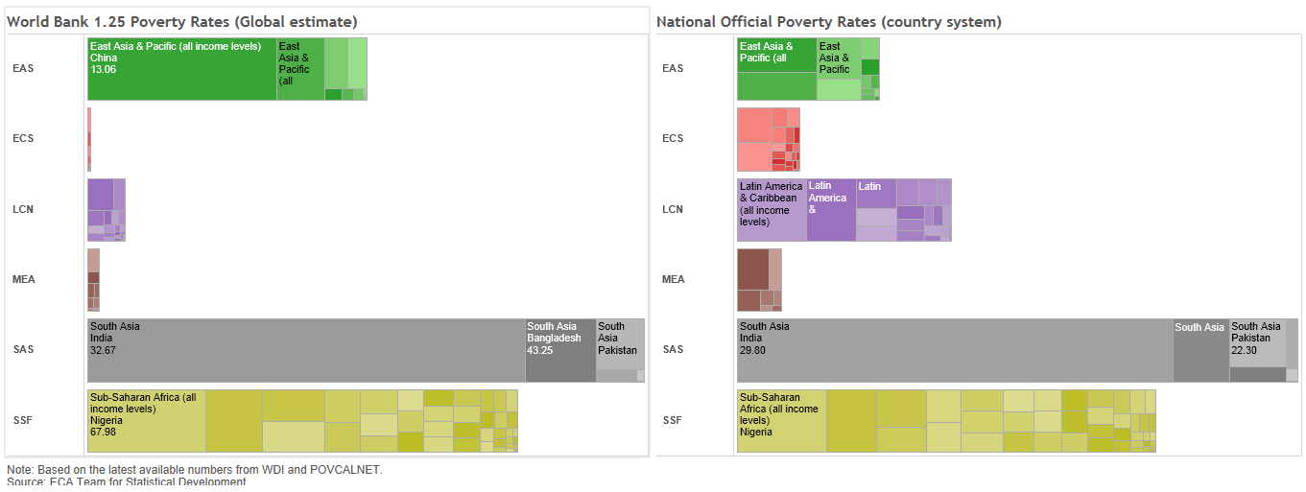
IN A FEW REGIONS THERE ARE IMPORTANT DIFFERENCES BETWEEN THE GLOBAL AND NATIONAL POVERTY NUMBERS…
…and reflects the different levels of economic development

Slide 18
BUT ANY MEASURE OF POVERTY IS JUST A MEANS TO AN END. THE MOST IMPORTANT OBJECTIVE IS TO UNDERSTAND HOW POLICIES CAN HELP REDUCE THE POVERTY RATE…
TURKEY (5 USD-PPP)
TAJIKISTAN (2.5 USD-PPP)
Source: Azevedo and Atamonov (2013)
Source: Azevedo, Atamonov and Rajabov (2013)

Slide 19
BY HELPING IDENTIFYING THE WINNERS AND LOSERS OF POLICY CHOICES MADE IN OUR COUNTRIES…
Top 60
Top 60
Those in the bottom 40 percent can differ over time for several reasons:
Demographics
Migration
Markets
Incentives
Bottom 40
Bottom 40
Period T
Period T+5

Slide 20
… AND ULTIMATELY UNDERSTAND THE DRIVERS OF INTRA AND INTER GENERATIONAL MOBILITY
CLASS TRANSITIONS IN TAJIKISTAN FROM 2003 TO 2009
 | Origin (in 2003) | 2009
2003 |  | Poor | Vulnerable | Middle Class
Poor | 71.8 | 48.4 | 38.8 | 12.8 | 100
Vulnerable | 22.1 | 29.2 | 46.7 | 24.1 | 100
Middle class | 6.1 | 15.6 | 54.5 | 29.9 | 100
Total | 100 | 43.6 | 40.8 | 15.6 | 100
Source: Azevedo, Atamanov and Rabajov (2013) based on TLSS.
Notes: Transition matrix is based on synthetic panel for 2003-2009. Threshold for poor is 162 somoni and for middle class 294 somoni per month. Explanatory variables include year of birth cohort, number of children, education of the head of household, rural/urban and regional dummies, and different interactions between these variables and means are the regional level. Sample: head of households 25-55 years of age.

Slide 21
FINAL CONSIDERATIONS
Clarity, transparency and simplicity are the most critical aspects of any poverty measure
Clear institutional architecture
Open methodological guidelines
Access to the survey data
Clear calendar for the release of the numbers

Slide 22
REFERENCES
Azevedo, Joao Pedro & Atamanov, Aziz & Rajabov, Alisher, 2014. "Poverty reduction and shared prosperity in Tajikistan : a diagnostic,"Policy Research Working Paper Series 6923, The World Bank.
Azevedo, Joao Pedro & Atamanov, Aziz, 2014. "Pathways to the middle class in Turkey : how have reducing poverty and boosting shared prosperity helped?,"Policy Research Working Paper Series 6834, The World Bank.
Deaton, A., & Zaidi, S. (2002). Guidelines for constructing consumption aggregates for welfare analysis. Living Standard Measurement Survey Working Paper No. 135.
Ravallion, M. (1998). “Poverty Lines in Theory and Practice.” LSMS Working Paper No. 133,World Bank, Washington, DC.
Ravallion, M. (1992). “Poverty Comparisons: A Guide to Concepts and Methods.” LSMS Working Paper No. 88, World Bank, Washington, DC.
Ravallion, M. (2008). “Poverty Lines." The New Palgrave Dictionary of Economics. Second Edition. Eds. Steven N. Durlauf and Lawrence E. Blume. Palgrave Macmillan. The New Palgrave Dictionary of Economics Online. Palgrave Macmillan. 17 September 2013
Ravallion, M. (2012). “Poor or Just Feeling Poor” World Bank Policy Research Working Paper 5968.

