Slide 1
Poverty statistics of Mongolia
M.Oyuntsetseg
Statistician
Population and Social Statistics Department
04 May 2015

Slide 2
Contents
Legal framework
Methodology
Household Socio-Economic Survey
Data dissemination

Slide 3
Legal framework
LAW ON STATISTICS
Article 6. System of official statistical indicators and the basis for its production
2) population and social statistics;
d/ household and population income, expenditure and consumption;
e/ population nutrition, sufficiency, calorie, nutrition indicators, quality indicators and hygienic indicators;
f/ living standards and poverty;
Article 7. Conducting censuses and surveys
1) The National Statistical Commission is responsible for conducting the following censuses and surveys:
d/ Household socio-economic survey every quarter;

Slide 4
Methodology
Poverty analysis requires three main elements
1st. A welfare indicator, both measurable and acceptable, to rank all population accordingly
2nd. An appropriate poverty line to be compared against the chosen indicator in order to classify individuals in poor and non-poor
3rd. A set of measures that combine individual welfare indicators into an aggregated poverty figure.

Slide 5
Methodology
Welfare indicator:
Income?
or
Consumption?
Consumption
in the short-run though, say a year, consumption is likely to be more stable than income
households are often able to smooth out their consumption
consumption is also less affected by seasonal patterns than income
consumption is generally an easier concept than income for the respondents to grasp
Which one?

Slide 6
The construction of the consumption aggregate
Methodology
1st. It must be as comprehensive as possible given the available information
2nd. Market and non-market transactions are to be included
The consumption aggregate comprises five main components:
Food
Non-food
Housing
Durable goods
Energy

Slide 7
Food component
Methodology
1st. All possible sources of consumption are included
2nd. Only food that was actually consumed
3rd. Non-purchased food items need to be valued and included in the welfare measure
The method to collect
In the capital and in aimag centers – diary
In soum centers and in the countryside – a recall

Slide 8
The poverty line – Absolute the Cost of Basic Needs method was employed to estimate the nutrition-based poverty line If a person cannot afford the cost of the basket, this person will be considered to be poor. The poverty line comprises two main components: food + non-food
Methodology

Slide 9
Methodology
Food poverty line
2100 calories per person per day
Reference group – bottom 40% of the population
A food bundle
Caloric conversion factors were used to transform the food bundle into calories
Median unit values were derived in order to price the food bundle
The average caloric intake of the food bundle was estimated

Slide 10
Methodology
For instance
1430 calories - the average daily caloric intake of the bottom 40% of the population in Mongolia
789 tugrug – the daily value of the food bundle (per person)
1159 tugrug = (789*2100)/1430 – the value of the daily food poverty line
35253 tugrug =1159*(365/12) – the value of the monthly food poverty line

Slide 11
Methodology
2. Non-food poverty line
Non-food poverty line – the average non-food consumption of the population whose total consumption is similar to the food poverty line
The food shares of the reference group
A simple non-parametric calculation as suggested in Ravallion

Slide 12
Methodology
For instance
The food shares of the reference group is 56.5% = 35253 tugrug
Poverty line is: 35253/(56.5/100) = 62394 тugrug (per person per month)

Slide 13
Methodology
In summary:
Welfare indicator is
Consumption
Comparable indicator is
Absolute poverty line

Slide 14
Methodologies
“Poverty Manual”, World Bank, August 2005
“Designing Household Survey Questionnaires for Developing Countries” World Bank, 2000
“Guidelines for constructing consumption aggregates for welfare analysis”, Deaton. A, Zaidi. S, World Bank, 2002
“Poverty comparisons”, Ravallion. M, 1992
“Poverty lines in theory and practice”, Ravallion. M, 1998
“A class of decomposable poverty measures”, Foster. J, Greer. J, Thorbecke. E, 1984
“Poverty estimation methodology”, developed based on the above mentioned guidelines and approved by the NSO Chairman.

Slide 15
History of the Household Socio Economic Survey
Household Income and Expenditure Survey (HIES), since 1966 till July 2007, every quarter
Living Standards Measurement Survey, 1995, 1998, 2002-2003, 3 times
Household Socio-Economic Survey (HSES)
Every quarter since July 2007

Slide 16
Types of HSES
Household Socio-Economic Survey
Short
Main goal:
Estimate income, expenditure and consumption
Years:
2013, 2015, ......
Sample size:
11232 households
/Ulaanbaatar-3600, aimag centers-2640, rural areas-4992/
Long
Main goal:
Estimate key poverty indicators + income, expenditure and consumption
Years:
2014, 2016, .....
Sample size:
16200 households
/Ulaanbaatar-3600, aimag centers-5400, rural areas -7200/

Slide 17
Classifications
Code for administrative and territorial units of Mongolia MNS-5641-1:2006
Classification of Individual Consumption by Purpose /COICOP-HBS, 2003/
Classification for Economic activities ISIC-4.0
International Standard Classification on Occupations ISCO-08

Slide 18
Data system
Interviewers 92, supervisors 24.
92 interviewers collect information by tablets from selected households
92 interviewers check the data and send it to the data server at NSO
24 supervisors check the data from the data server and send it to the supervisors data server at NSO.
Household
Within 1st of each month
Within 2nd of each month
Within 5th and 8th of each month
3 days have to check the data for supervisors

Slide 19
Data dissemination
Indicators
Household income and expenditure
Monthly average income per household and composition
Monthly average expenditure per household and composition
Monthly average per capita food consumption
Composition of daily foodstuff consumption and calories per person
Main poverty measures
Poverty headcount
Poverty gap
Severity of poverty
Inequality
Gini coefficient
Consumption change by group (decile, quintile)

Slide 20
Data dissemination
Indicators
Living indicators
Number of Household members, by poverty status
Household assets, by poverty status: dwelling, livestock, money, etc
Household head characteristics, by poverty status: age, sex, employment, education
Educational level of population, by poverty status
Employment of population, by poverty status
Health of population, by poverty status
We estimate indicators by using sampling weight at the following
levels.
National average
Location: Urban and rural;
Capital city, aimag centers, soum centers, and rural areas
Regions: West, Khangai, East, Central and Ulaanbaatar

Slide 21
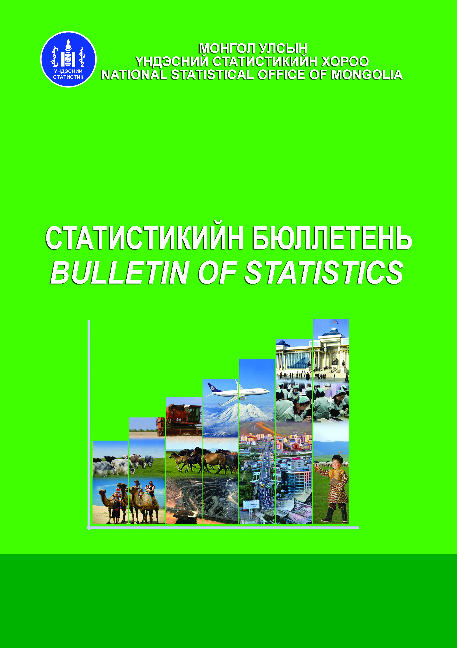
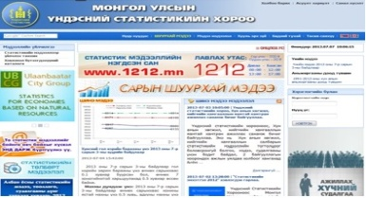
Data dissemination
1. Quarterly results:
2. Annual results:
Period:
1-st quarter – April
2-nd quarter – July
3-rd quarter – Oct
4-th quarter – Jan, next year
Indicator:
Monthly average income and expenditure of households
Period: annual
Indicator:
Household income and expenditure
Poverty measures
Inequality
Other indicators
3. Poverty profile
4. WWW.1212.mn:
Period: every year
Indicator: Comprehensive
Published year: 2002/03, 2007/08, 2010, 2011, 2012
- Update database with the most recent data
- Database of anonymized micro data of surveys

Slide 22
Thank you for your attention
The Government Building III
Baga Toiruu-44
Ulaanbaatar-20а, Мongolia Tel: (976)-11-329125 Fax: (976)-11-324518
E-mail: international@nso.mn
www.nso.mn
www.1212.mn

