Slide 1
Vulnerability to Poverty in Georgia: Testing Different Approaches
Cesar Cancho
Poverty GP ECA
Workshop on measuring poverty and vulnerability (UNECE)
Geneva, May 4th, 2015

Slide 2
Summary
Vulnerability defined a at risk of falling into poverty at t+1
Estimating vulnerability in Georgia in 2011
2 using panel data (LC-OJ & DL)
2 using cross-sectional data (regression-based & multiples of poverty line)
Preliminary analysis of the accuracy of predictions of falling into poverty
Estimates based on typical multiples of poverty line lower than other methods described.
Contemporaneous regressions can, under certain conditions, result in comparable estimates than panel-data based methods.
Effectiveness identifying falls into poverty for panel data and regression-based estimations is comparable.

Slide 3
Outline
1. Vulnerability definitions
2. Empirical results
3. Summary

Slide 4
Outline
1. Vulnerability definitions
2. Empirical results
3. Summary

Slide 5
Lopez-Calva and Ortiz-Juarez (2014) (1)
Panel data
Poverty transition matrix:
Poor and Non-poor combinations
Probabilities of being poor at t+1, using t data
$p_{it}=E\left({poor}_{it+1}|X_{it}\right)=F\left(X_{it}∙β_{t}\right)$ (1)
$X_{it}$ used to estimate income at t:
${lnY}_{it}=∝+X_{it}{∙β}_{t}+ε_{i}$ (2)
For a given $\left[p_{t}−ε,p_{t}+ε\right]$ in (1), $\hat{{lnY}_{∗t}}$ is obtained through (2) using $\overline{X_{∗t}}$.

Slide 6
Lopez-Calva and Ortiz-Juarez (2014) (2)
Predicted income
Lower volatility
Index related to stocks (assets) - generation capacity
Middle class: low risk of falling into poverty
10%
Share of population falling into poverty in a 15-year period using synthetic panels (Cruces et al., 2011)

Slide 7
Dang and Lanjouw (2015) (1)
Panel data
Two indices: security and vulnerability
Bayesian probabilities using data from two periods
Security index
Probabilities of falling in poverty in t+1 for households above an arbitrary vulnerability line ($V_{t}$) in t.
For a given value of the security index ($P^{S}$), then, we can define it as:
$P^{S}=P\left(y_{t+1}≤Z_{t+1}|y_{t}>V_{t}\right)$ (3)

Slide 8
Dang and Lanjouw (2015) (2)
Using Bayesian probabilities:
$P^{S}=\frac{P\left(y_{t+1}≤Z_{t+1} ∩ y_{t}>V_{t}\right)}{P\left(y_{t}>V_{t}\right)}$ (4)
Vulnerability Index:
Probabilities of falling in poverty in t+1 for households between poverty line ($Z_{t}$) and arbitrary vulnerability line ($V_{t}$) in t.
For a given value of the vulnerability index ($P^{V}$), then, we can define it as:
$P^{V}=\frac{P\left(y_{t+1}≤Z_{t+1} ∩ Z_{t}<y_{t}<V_{t}\right)}{P\left({Z_{t}<y}_{t}<V_{t}\right)}$ (5)

Slide 9
Cross-section definitions (1)
Cross-sectional data
Probabilities of being poor
$p_{i}=F\left(X_{i}∙β \right)$ (6)
For stability, consumption levels are calculated for:
$p_{i}^{∗}=\left[p_{i}−ε,p_{i}+ε\right]$
For a given $p_{i}^{∗}$, a consumption $c_{i}^{∗}$ defines the threshold for vulnerability.
Naïve definition:
$H_{i}$ vulnerable if ${pline<c}_{i}^{∗}<pline∗(1+x)$

Slide 10
Outline
1. Vulnerability definitions
2. Empirical results
3. Summary

Slide 11
Empirical Results (1)
Data: 2009-2011-2013 Welfare Monitoring Survey
Nationally representative data
Around 3700 households observed three waves
Consumption data (per capita)
Poverty line $2.5/day
Poverty rates:
2009: 20.9
2011: 17.0
2013: 8.8
Focus on contrast across methodologies.

Slide 12
Empirical Results (2)
Regression model:
Household Head
Gender, age, ethnicity, marital status, education level, labor force status.
Household
Urban/rural, regions, IDP, pension, social assistance, TSA.

Slide 13
Lopez-Calva and Ortiz-Juarez (2014)
10% of chances defined at $4.57
30.6% of population defined as vulnerable.

Slide 14
Dang and Lanjouw (2015)
Vulnerability index based on LC-OJ empirical results.
$P^{V}$ = 16.9
Vulnerability line: $6.23
50.5% population defined as vulnerable.

Slide 15
Linear Regression
Threshold of vulnerability defined as in LC-OJ: 10%
10% of chances of being poor defined at $5.56
43.7% population reported as vulnerable.

Slide 16
Multiple of poverty line
1.3 times the poverty line
3.25 US$ PPP
11.2% population vulnerable
1.5 times the poverty lines
3.75 US$ PPP
19.5% population vulnerable

Slide 17
Effectiveness (1)
 | LC-OJ | DL | LR | 1.3 line | 1.5 line
Value Vulnerability Line | 4.6 | 6.2 | 5.6 | 3.3 | 3.8
Share Vulnerable 2011 (pp) | 30.6 | 50.5 | 43.7 | 11.2 | 19.5
which are poor 2013 (pp) | 3.2 | 4.3 | 4.0 | 1.7 | 2.4
which are poor 2013 (share) | 10.3 | 8.6 | 9.3 | 15.4 | 12.4
PL 1.3PL 1.5PL LC-OJ LR DL

Slide 18
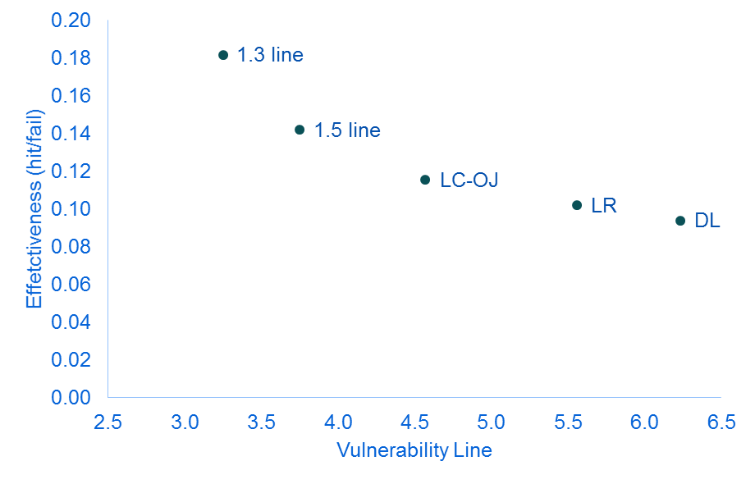
Effectiveness (2)
Effectiveness defined as correctly-predicted / wrongly-predicted as falling (in percentage points).

Slide 19
Outline
1. Vulnerability definitions
2. Empirical results
3. Summary

Slide 20
Summary (1)
Results conditional on distributional shape
All definitions depend on poverty line
Vulnerability rates based on multiples of the poverty line lower than other methods
Effectiveness higher
Lopez-Calva and Ortiz-Juarez (2014) only self-contained
Effectiveness higher than LR and DL
Linear regression methodology can provide estimates comparable to panel data-based methods
Test further assumptions under which holds
Structural change, high mobility

Slide 21
Summary (2)
Most measures are not closed definitions
LC-OJ only exception

Slide 22
Thanks!
References
Lopez-Calva, L. F., & Ortiz-Juarez, E. (2014) A vulnerability approach to the definition of the middle class. The Journal of Economic Inequality, 12(1), 23-47.
Dang, Hai-Anh H. and Lanjouw, Peter F. (2015) Welfare Dynamics Measurement. Two Definitions of a Vulnerability Line and Their Empirical Application. Policy Research Working Paper 6944. The World Bank.

