Slide 1
Euro Area Accounts Household Sector Report
ECB-RESTRICTED
Antonio Matas Mir
Macroeconomic Statistics Division
European Central Bank
UN Economic Commission for Europe
Group of Experts on National Accounts
Geneva, 6-9 May 2014

Slide 2
Background: the IEAA
Euro Area Accounts Household Sector Report
ECB-RESTRICTED
DRAFT
The quarterly integrated economic and financial accounts by institutional sector for the euro area (IEAA) are a joint product of ECB & Eurostat with almost 7 years of production
IEAA allow a quarterly euro-area wide analysis of economic and financial transactions of the institutional sectors within the integrated, internally consistent framework of ESA
However, richness of data available may be underutilised due to somewhat steep learning curve for non-expert users
Financial crisis has increased interest in measures on the economic situation of households as well as individual country data vs. initial focus of IEAA on euro area aggregates

Slide 3
The integrated euro area accounts (IEAA)
Euro Area Accounts Household Sector Report
ESTAT/ ECB
NCBs
NSIs
EAA

Slide 4
The household sector report
Euro Area Accounts Household Sector Report
ECB-RESTRICTED
DRAFT
Combine most relevant indicators on the HH sector from the IEAA in a single electronic publication with a data download facility
Create an appealing package by combining summary of key developments, short statistical commentary, useful graphs and data download facility
Emphasise:
household perspective of economic activity by using relevant measures (e.g. measures in per capita terms and/or percentage of HH disposable income)
cross-country variability with attractive presentational devices, allowing comparison to euro area
both conjunctural and structural information; comparison of current data with recent averages

Slide 5
Development, production and dissemination
Euro Area Accounts Household Sector Report
ECB-RESTRICTED
DRAFT
ECB developed the report in cooperation with WG EAA, a working group of Eurosystem NCBs and some NSIs
WG EAA to participate regular production via contributed country-specific commentary and flagging of institutional features relevant for interpretation
Report has been presented to the ECB/Eurostat Task Force on Quarterly European accounts by institutional sector (TF-QSA) in its two 2013 meetings
Dissemination will remain internal to ESCB institutions during 2014. Relevant ECB committee agreed to consider steps for external publication in a years’ time.

Slide 6
Table of contents
Euro Area Accounts Household Sector Report
ECB-RESTRICTED
DRAFT
KEY DEVELOPMENTS
SECTION 1: EURO AREA INDICATORS
Background
Commentary to the euro area indicators
Chart 1. Household nominal disposable income per capita and its components
Chart 2. Household nominal disposable income per capita and its use
Chart 3. Compensation of employees and components
Chart 4. Employment by age groups
Chart 5. Financing and investment per capita
Chart 6. Financial investment per capita
Chart 7. Household saving, non-financial investment, external financing and debt ratio
Chart 8. Changes to household net worth per capita
Tables
SECTION 2: COUNTRY INDICATORS – SPAIN (example)
Country commentary: Spain
Country indicators
Tables
SECTION 3: EXPLANATORY NOTES

Slide 7
Description of the individual indicators
Euro Area Accounts Household Sector Report
ECB-RESTRICTED
DRAFT
Chart 1: Decomposition of annual growth of nominal disposable income into its components:
major determinant of private consumption and thus internal demand
indicative of households’ debt servicing capacity
by components: show automatic stabilisers at work, effect thereupon of structural reforms, fiscal consolidation, etc.
Chart 2: Decomposition of nominal disposable income growth into consumption, o/w separating price and quantity changes, and savings:
present a three-way decomposition of the uses of disposable income including the effects of inflation as an additional “use”
Chart 3: Decomposition of compensation of employees into changes in nominal wages, employment and real compensation per employee:
show main determinants of change in households’ real incomes related to paid work
Notes:
For Chart 2 the intention is to isolate the “uses” that are welfare enhancing either now (real consumption) or in the future (nominal savings).

Slide 8
Description of the individual indicators
Euro Area Accounts Household Sector Report
ECB-RESTRICTED
DRAFT
Chart 4: Employment by age groups, self-employment, cross-country employment and unemployment rates
overall picture of labour market trends most impacting household welfare
Chart 5: Financing and investment
presentation of the SNA/ESA accumulation and financial accounts in a single chart
flows of internal (savings, capital transfers) and external (borrowing) resources generated in the period against their uses in non-financial and financial investment
Chart 6: decomposition of financial investment and gross financial wealth by asset type
indicative of trends in risk aversion, liquidity preference, expected asset returns
also important role for institutional factors (e.g. tax treatment), financial innovation in explaining cross-country variation and one-off shifts
wealth and income distribution may determine longer-term trends in the aggregate portfolio structure through limited participation phenomena

Slide 9
Description of the individual indicators
Euro Area Accounts Household Sector Report
ECB-RESTRICTED
DRAFT
Chart 7: Savings and debt ratios, non-financial investment & external financing shares
Saving behaviour: forced by real income development? forced by debt service drag? prompted by precautionary motives?
debt ratio development: linked to boom in real assets or in consumption ? driven by deleveraging needs?
Chart 8: Decomposition of changes in net worth:
Main drivers of wealth accumulation (transactions ? other changes?)
Relevance of specific composition for wealth effects and availability of collateral

Slide 10
Charts included in the HSR
Euro Area Accounts Household Sector Report
ECB-RESTRICTED
DRAFT

Slide 11
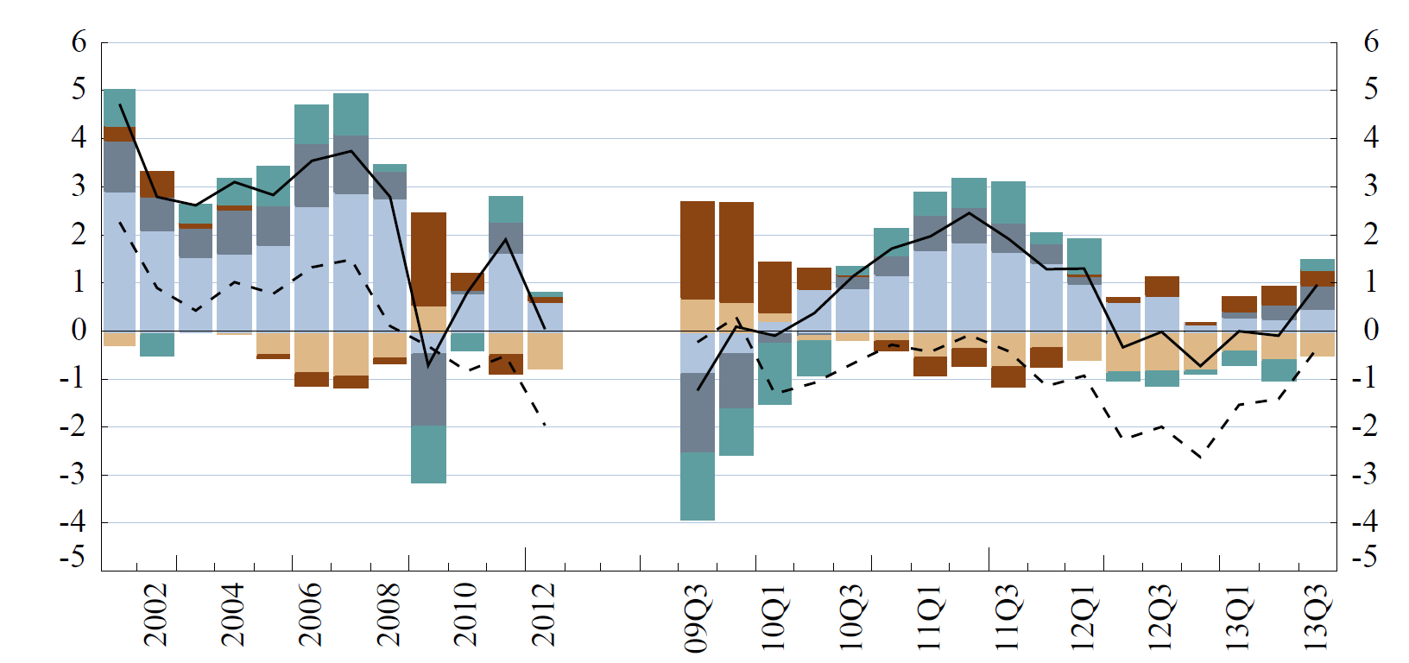
1. Nominal disposable income and components
Euro Area Accounts Household Sector Report
ECB-RESTRICTED
DRAFT
Annual growth rate and contributions
Notes:
Commentary speaking notes to be added before meeting takes place

Slide 12
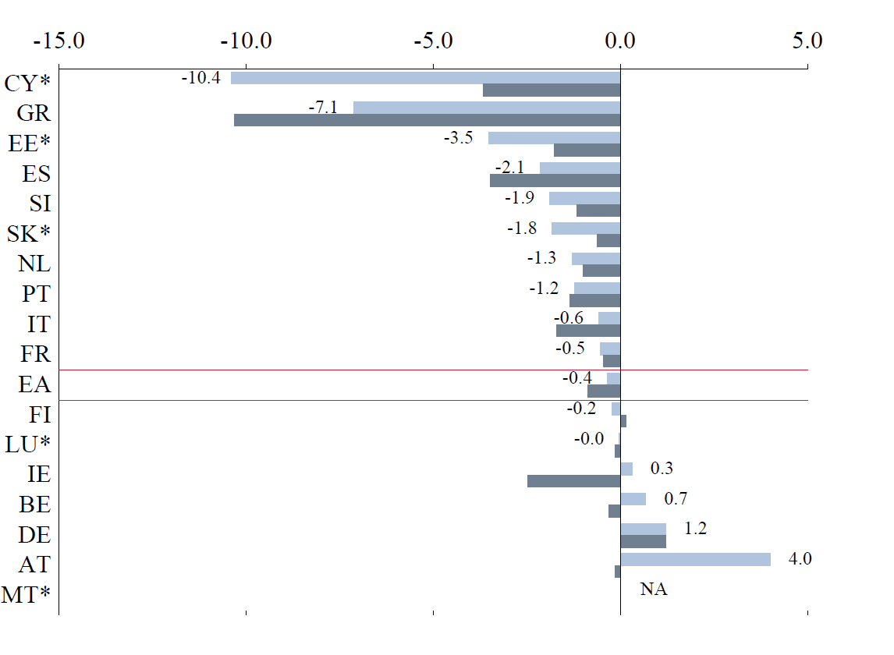
1a. Real disposable income
Euro Area Accounts Household Sector Report
ECB-RESTRICTED
DRAFT
Annual growth rate of per capita values

Slide 13
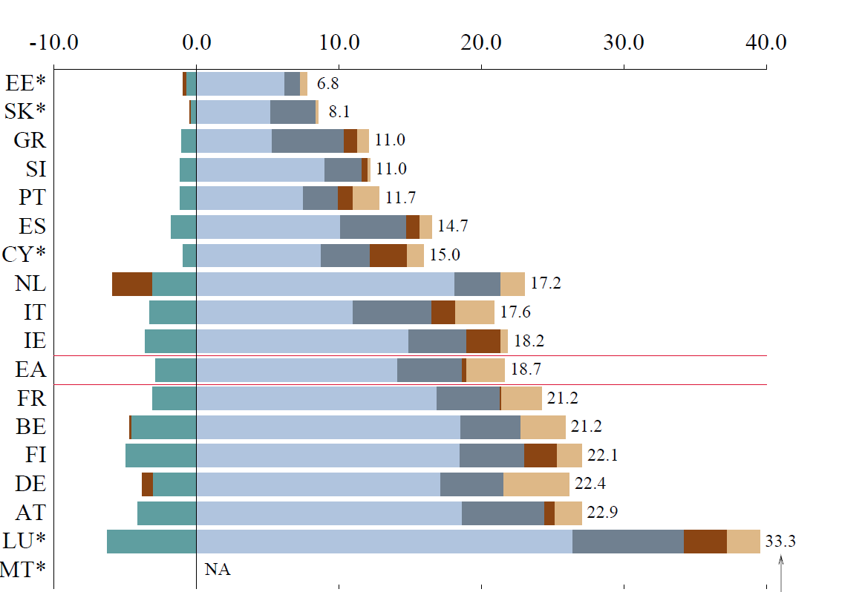
1b. Composition of disposable income
Euro Area Accounts Household Sector Report
ECB-RESTRICTED
DRAFT
Four quarter sum to 2013 Q3, nominal EUR thousand per capita

Slide 14
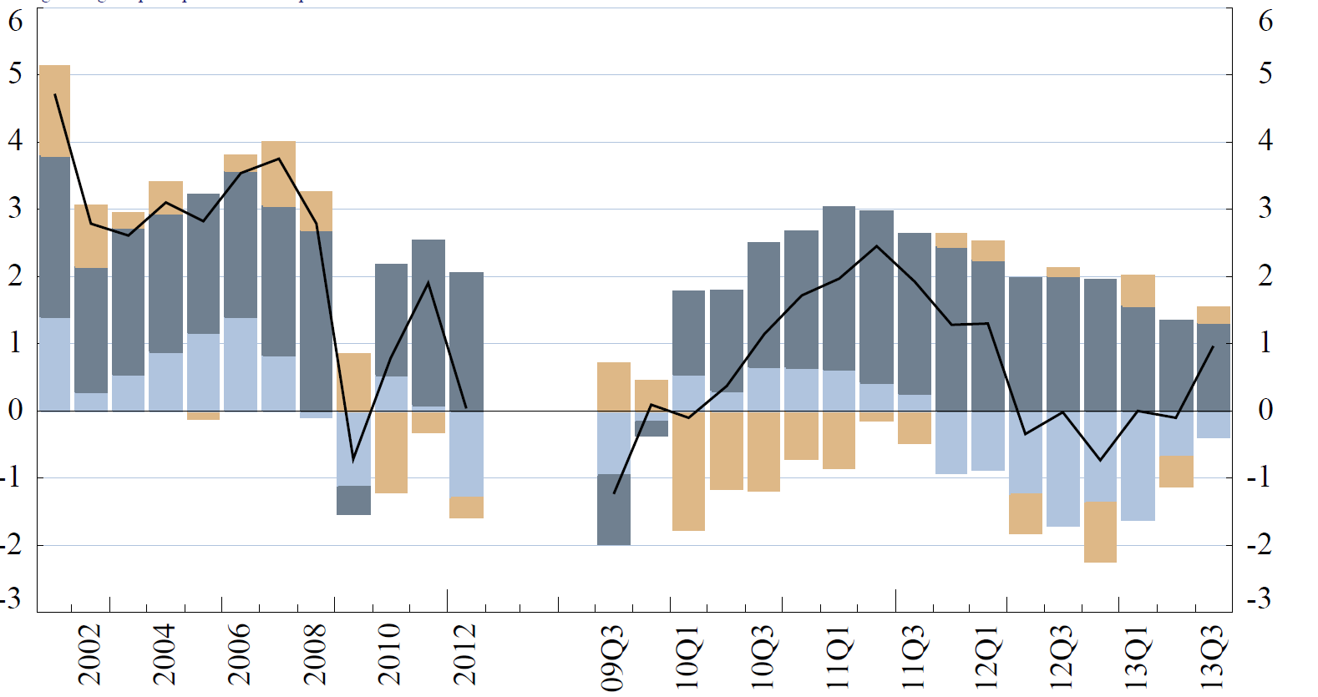
2. Nominal disposable and its use
Euro Area Accounts Household Sector Report
ECB-RESTRICTED
DRAFT
Annual growth rate and breakdown into uses

Slide 15
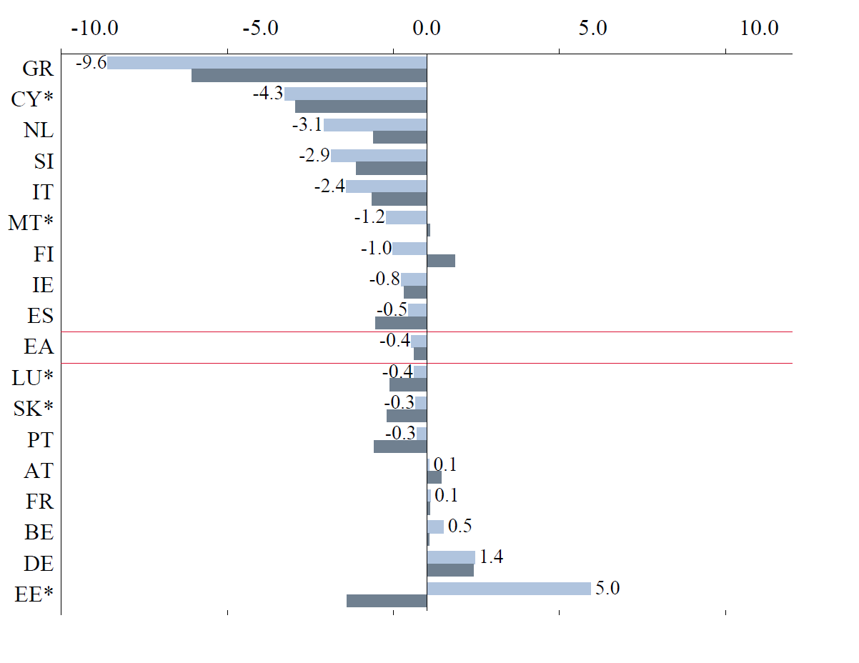
2a. Real consumption expenditure
Euro Area Accounts Household Sector Report
ECB-RESTRICTED
DRAFT
Annual growth rate

Slide 16
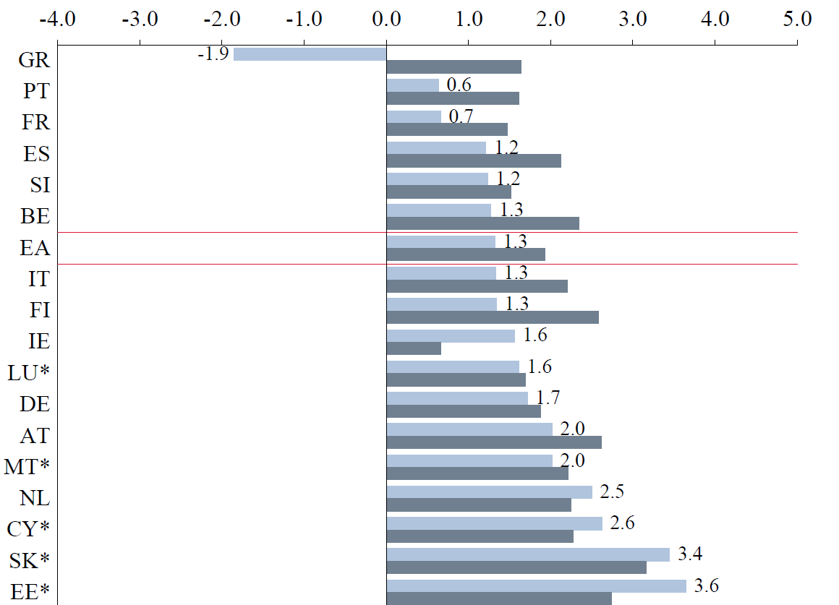
2b. Consumption deflator
Euro Area Accounts Household Sector Report
ECB-RESTRICTED
DRAFT
Annual growth rate

Slide 17
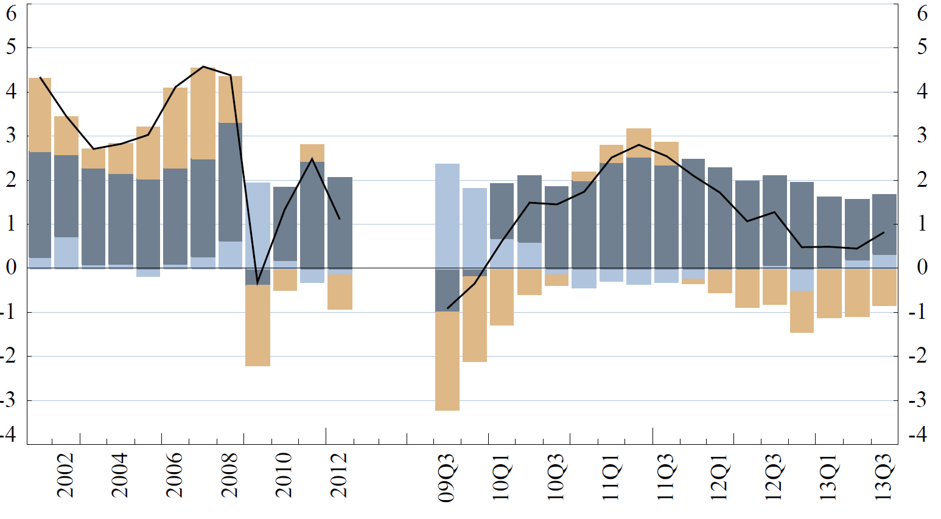
3. Compensation of employees and components
Euro Area Accounts Household Sector Report
ECB-RESTRICTED
DRAFT
Annual growth rate and contributions

Slide 18
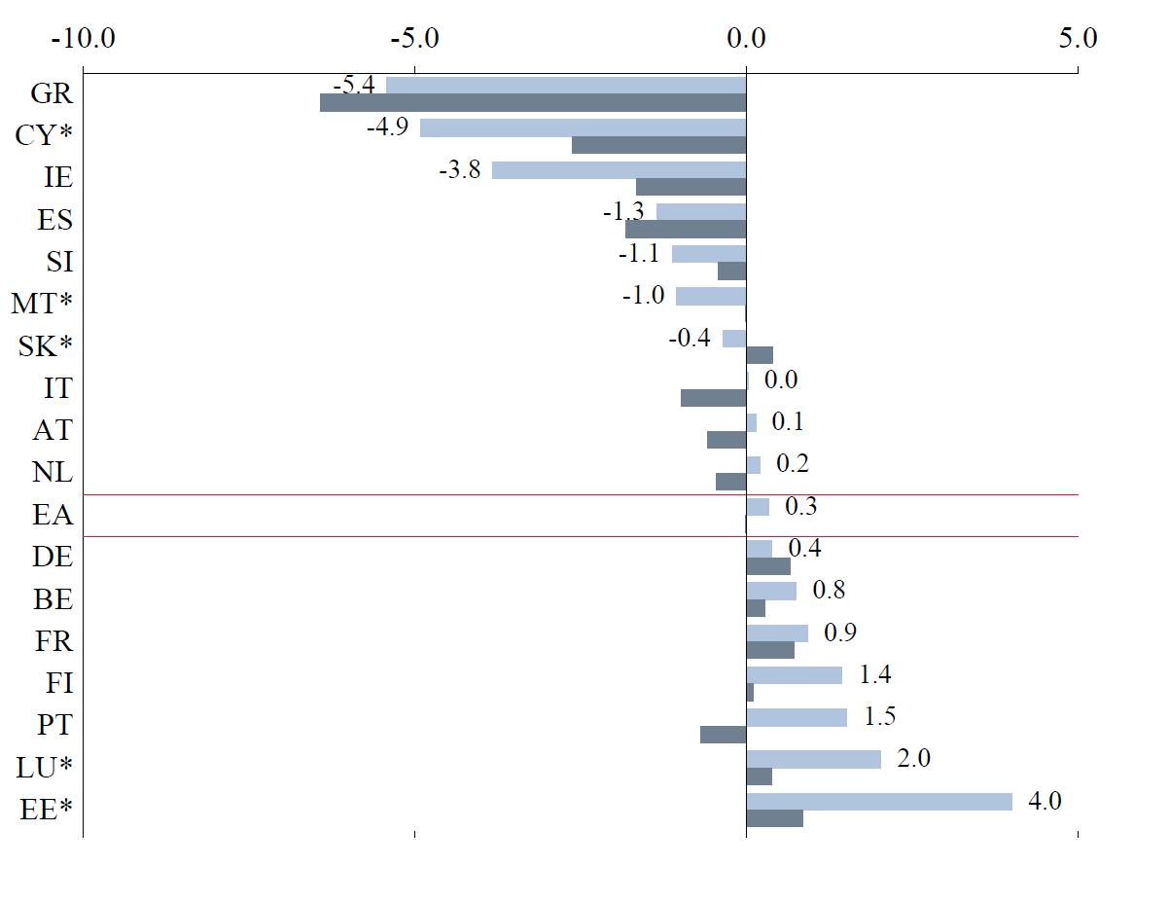
3a. Real compensation per employee
Euro Area Accounts Household Sector Report
ECB-RESTRICTED
DRAFT
Annual growth rate

Slide 19
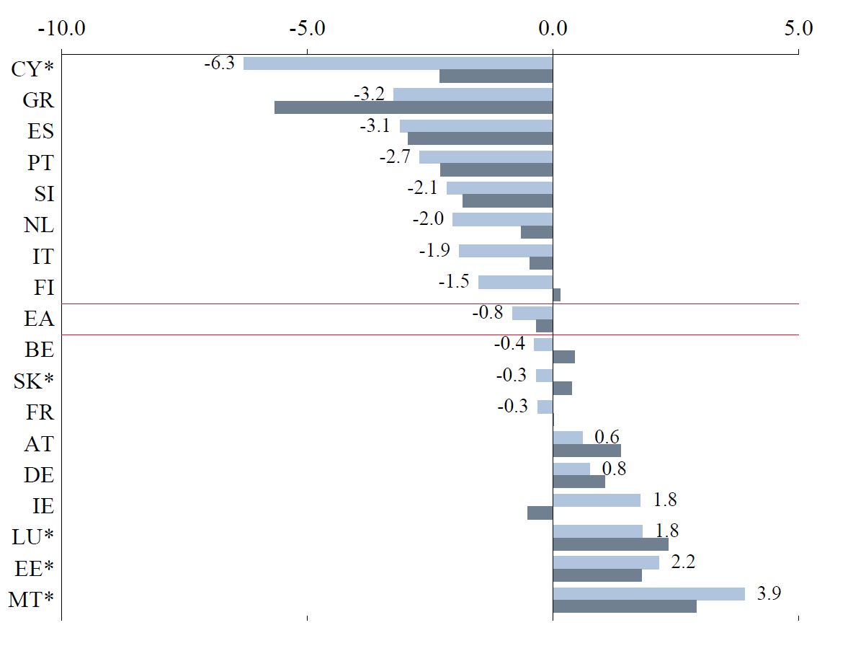
3b. Number of employees
Euro Area Accounts Household Sector Report
ECB-RESTRICTED
DRAFT
Annual growth rate

Slide 20
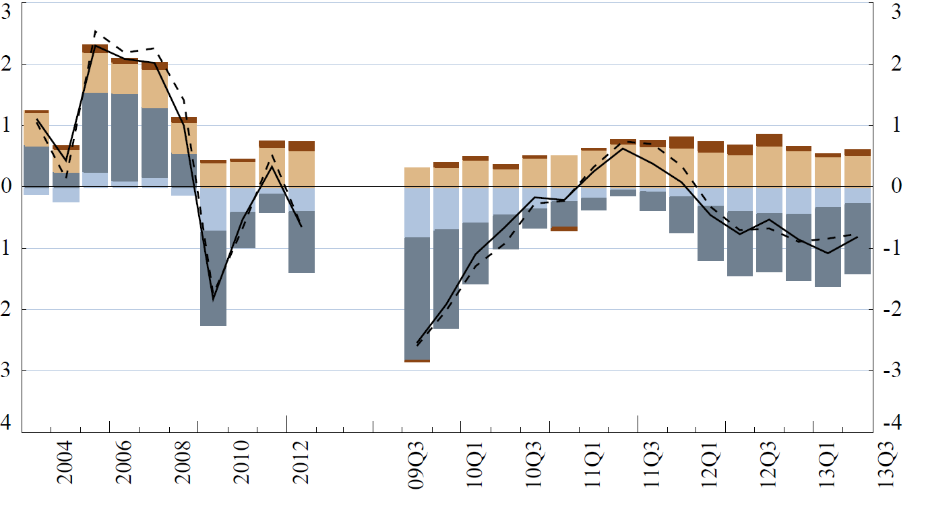
4. Employment by age group
Euro Area Accounts Household Sector Report
ECB-RESTRICTED
DRAFT
Annual growth rate and contributions

Slide 21
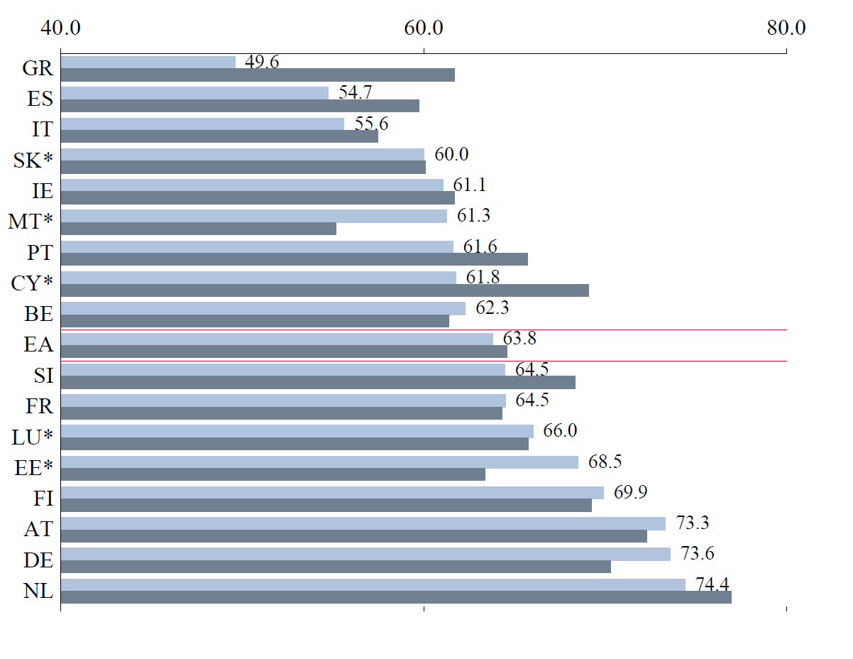
4a. Employment rate
Euro Area Accounts Household Sector Report
ECB-RESTRICTED
DRAFT
% of working age population

Slide 22
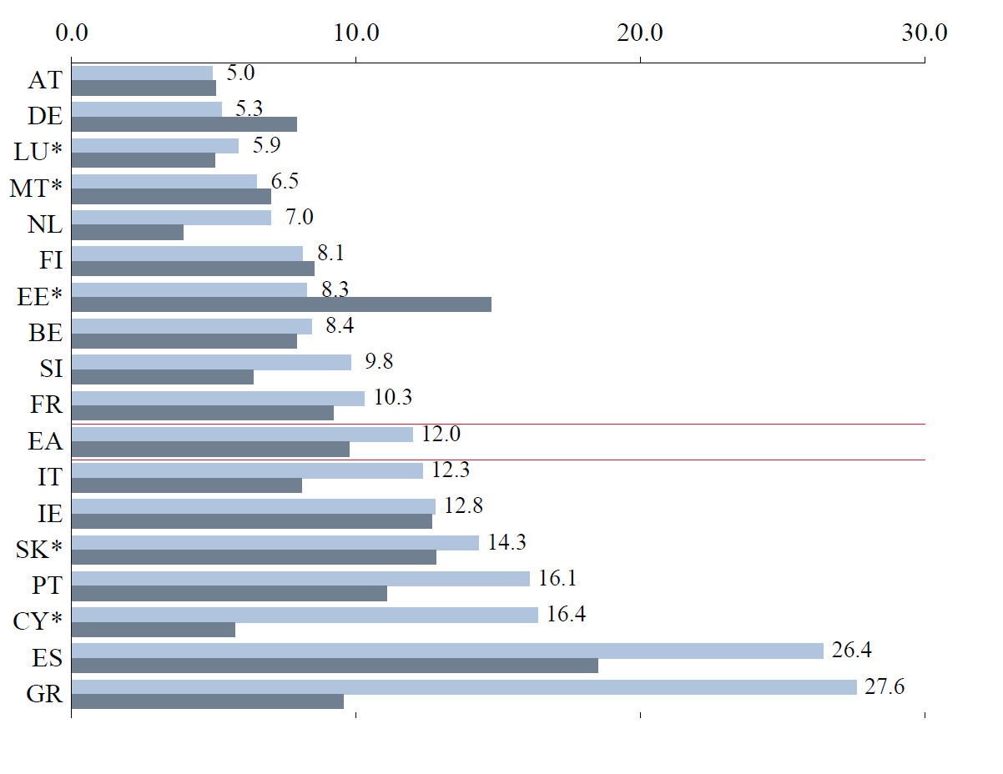
4b. Unemployment rate
Euro Area Accounts Household Sector Report
ECB-RESTRICTED
DRAFT
% of labour force

Slide 23
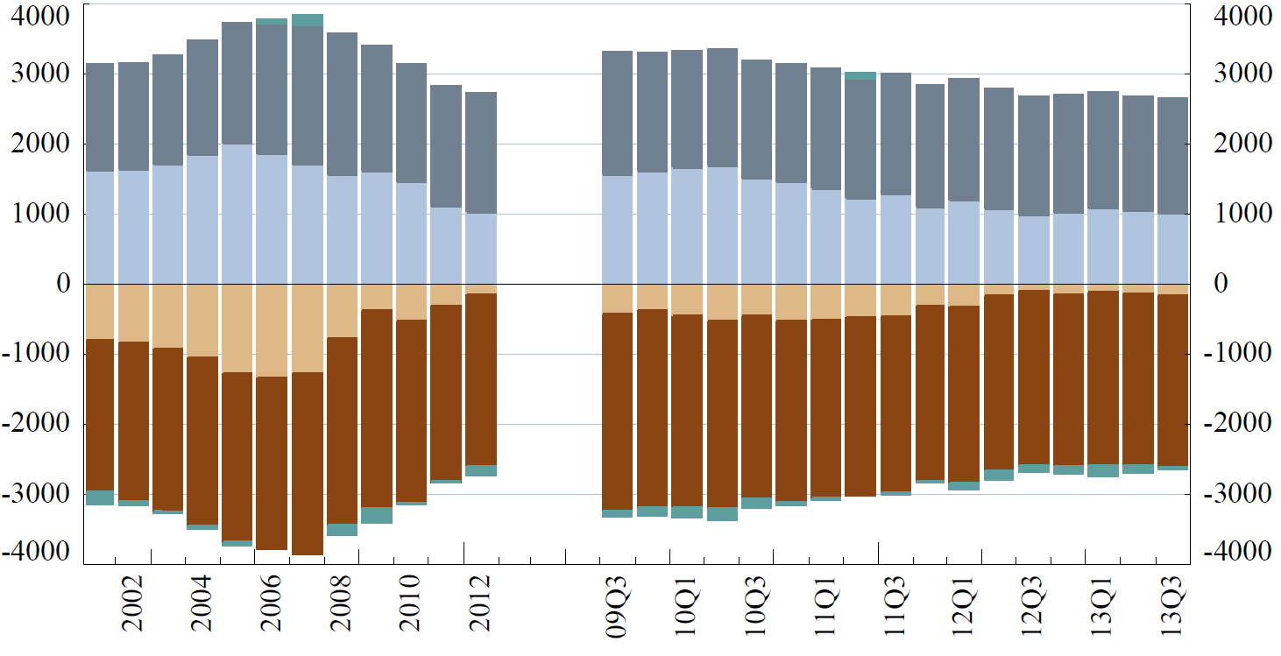
5. Financing and investment
Euro Area Accounts Household Sector Report
ECB-RESTRICTED
DRAFT
EUR per capita annual/four-quarter flows

Slide 24
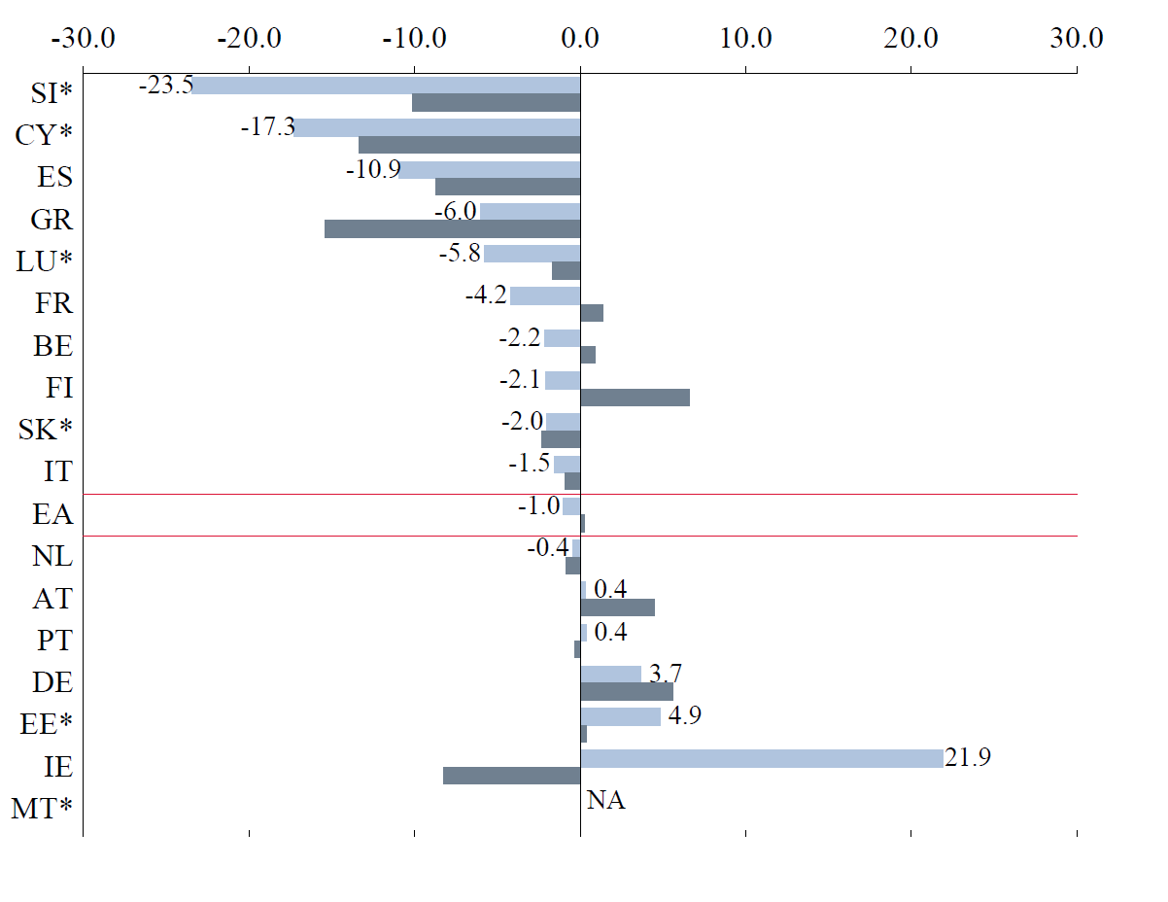
5a. Non-financial investment
Euro Area Accounts Household Sector Report
ECB-RESTRICTED
DRAFT
Annual growth rate

Slide 25
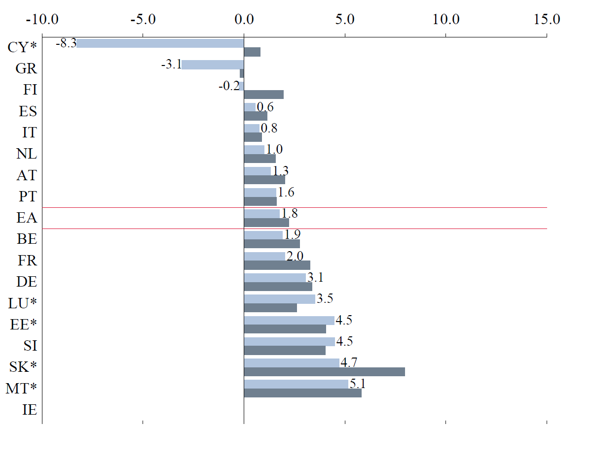
5b. Financial investment
Euro Area Accounts Household Sector Report
ECB-RESTRICTED
DRAFT
Transactions over four quarters as a percentage of gross financial wealth

Slide 26
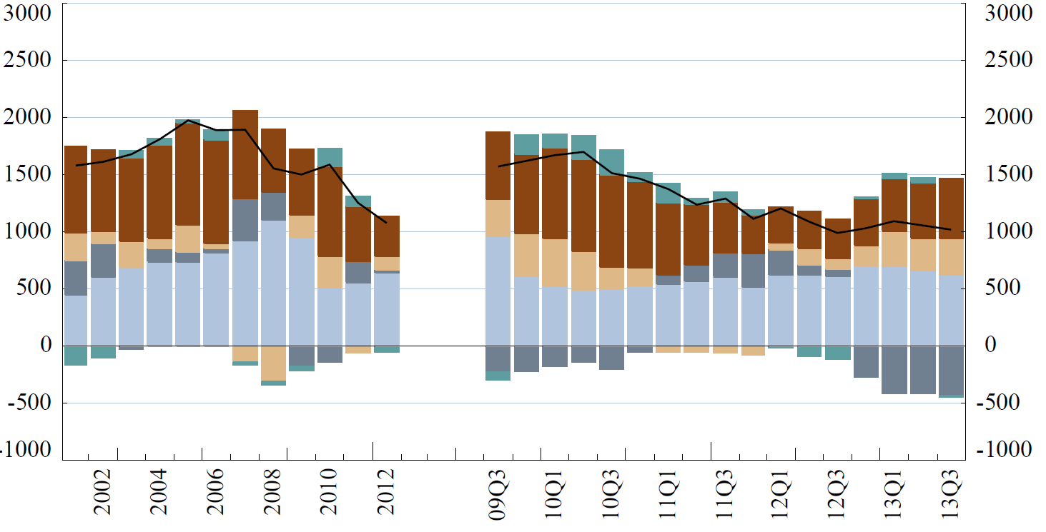
6. Investment in financial assets
Euro Area Accounts Household Sector Report
ECB-RESTRICTED
DRAFT
EUR per capita annual/four-quarter flows

Slide 27
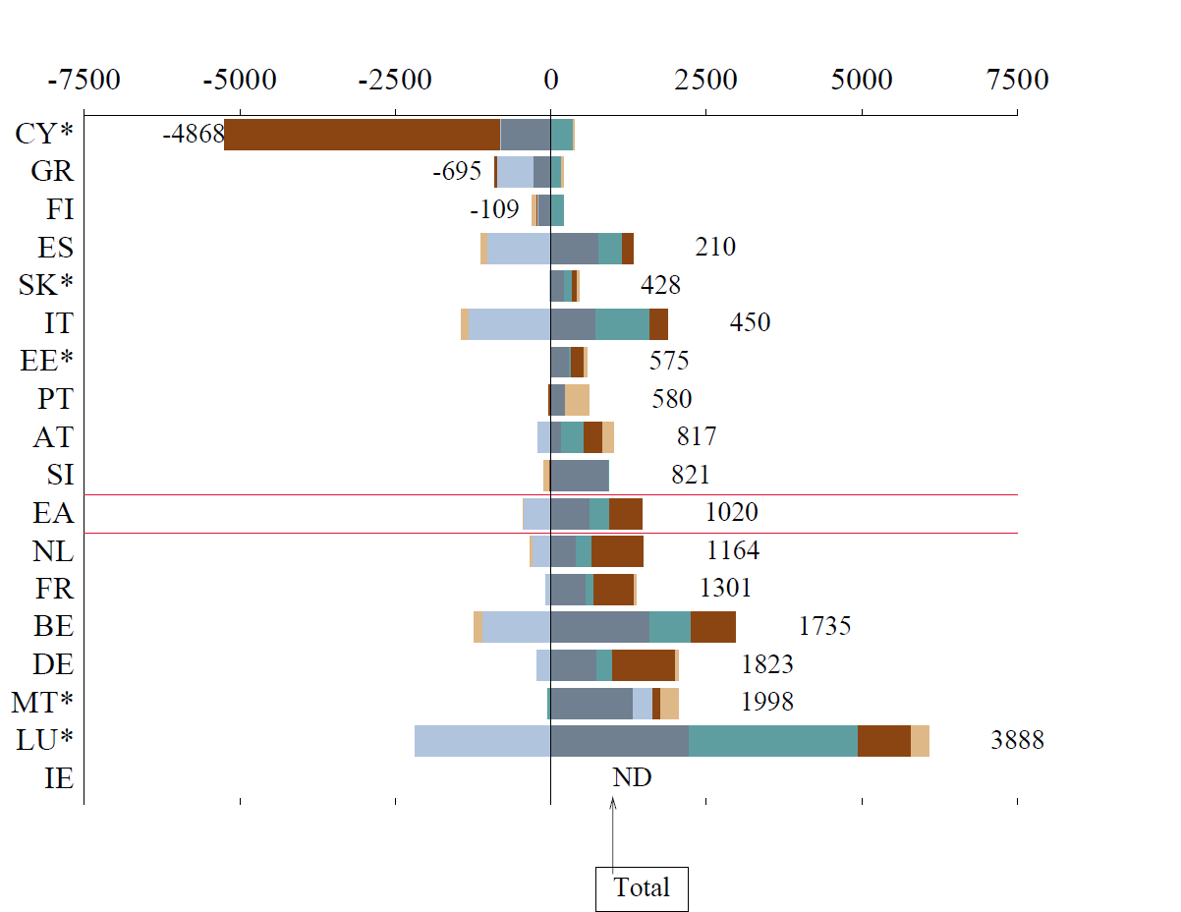
6a. Investment in financial assets
Euro Area Accounts Household Sector Report
ECB-RESTRICTED
DRAFT
EUR per capita four-quarter flow to 2013Q3

Slide 28
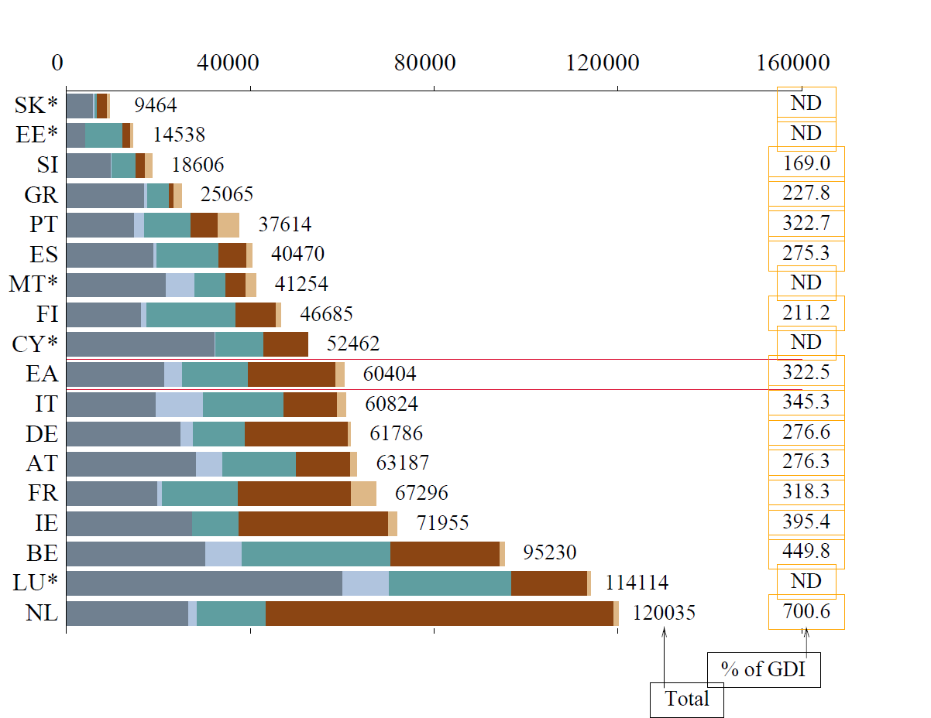
6b. Gross financial wealth
Euro Area Accounts Household Sector Report
ECB-RESTRICTED
DRAFT
EUR per capita, 2013Q3

Slide 29
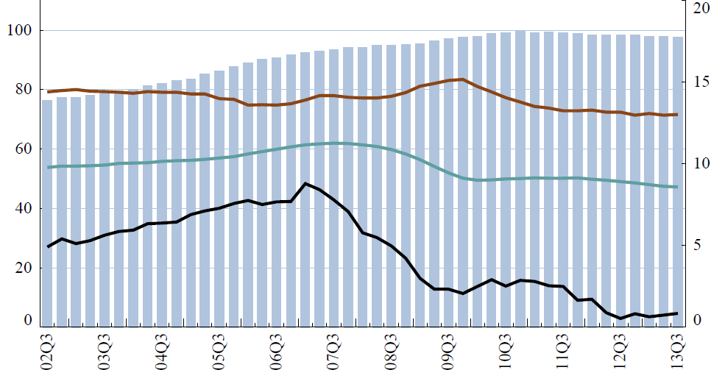
7.Household saving and financial ratios
Euro Area Accounts Household Sector Report
ECB-RESTRICTED
DRAFT
Percentage of disposable income

Slide 30
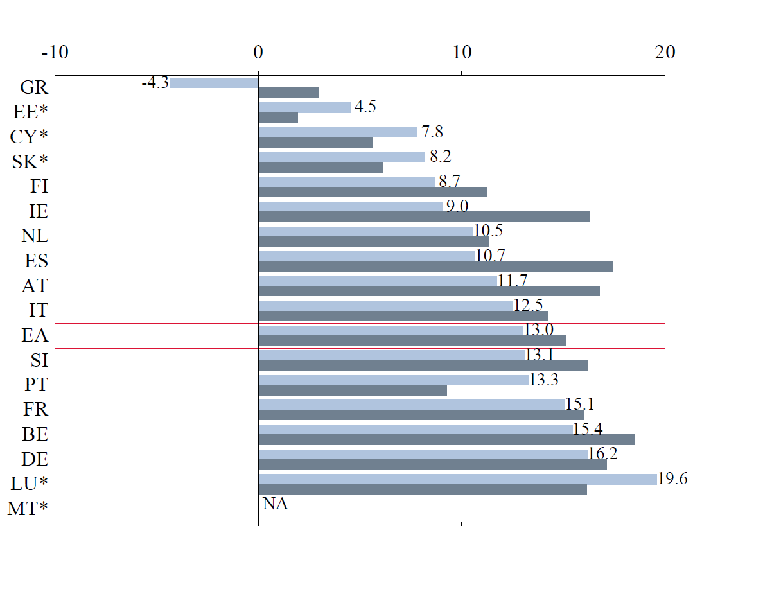
7a. Saving ratio
Euro Area Accounts Household Sector Report
ECB-RESTRICTED
DRAFT
Percentage of gross disposable income

Slide 31
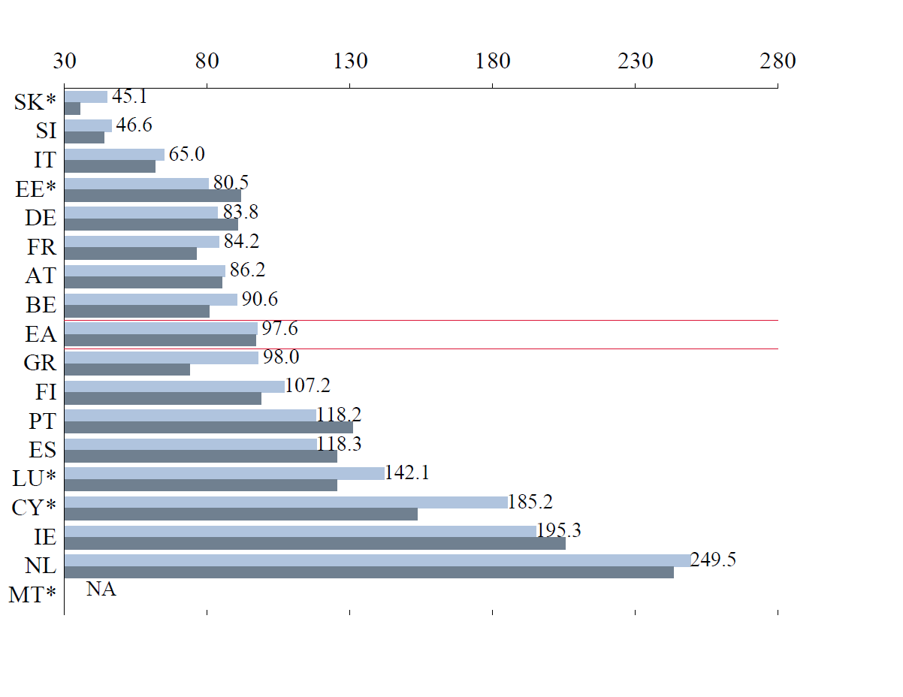
7b. Debt ratio
Euro Area Accounts Household Sector Report
ECB-RESTRICTED
DRAFT
Outstanding debt over gross disposable income

Slide 32
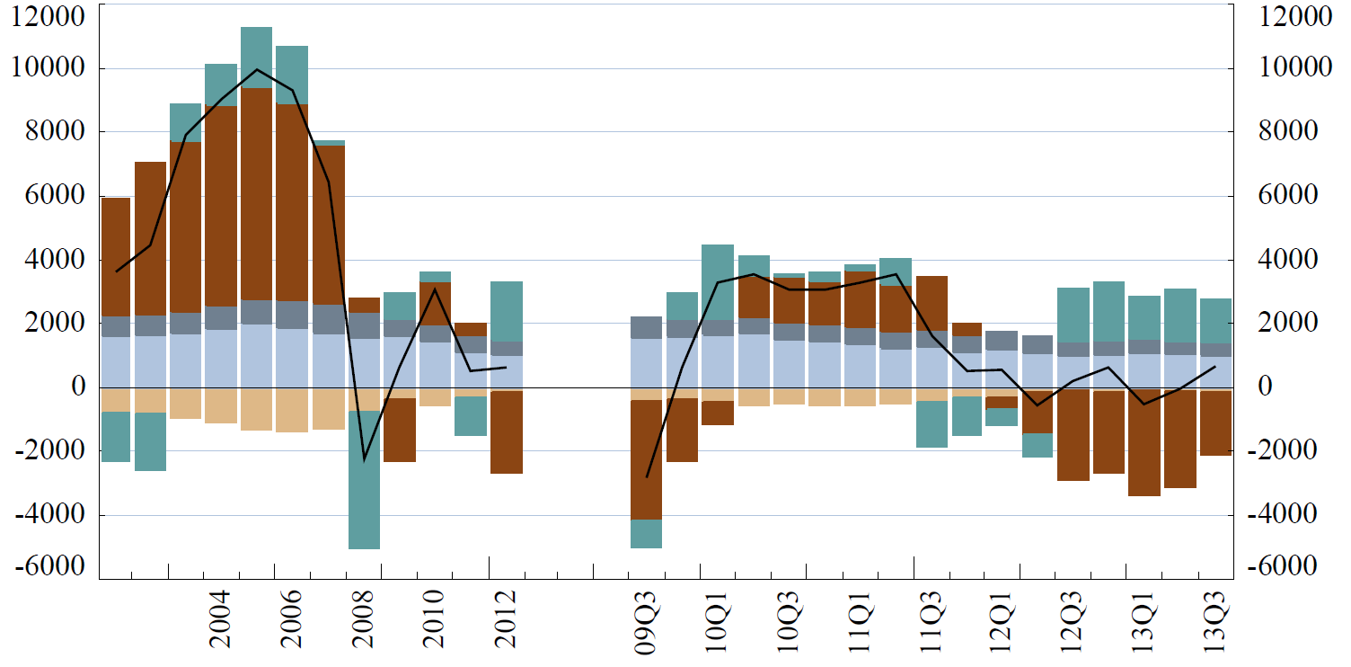
8. Changes to household net worth
Euro Area Accounts Household Sector Report
ECB-RESTRICTED
DRAFT
EUR per capita annual/four-quarter flows

