Slide 1
Turkish Statistical System
Workshop on 2008 SNA and GFSM for EECCA and SEE Countries
20-22 November 2013
İstanbul - Turkey
Alper GÜCÜMENGİL
Head of International Project
Management Group

Slide 2
Content of Presentation
Part I: Features of Turkish Statistical System
Vision and Mission Main Principles Legal basis Statistical Council Official Statistics Programme Protocols National Data Release Calendar
Part II: International Cooperation Activities
Participation in EU financed programmes EU Negotiations – Chapter 18 Statistics Chapter 18: Closing Benchmarks International Cooperation Goals & Activities Projects supported by TurkStat

Slide 3

PART I:
Features of Turkish Statistical System

Slide 4

Turkish Statistical System
A centralized system with specific task distribution to other institutions.
TurkStat is the main actor of Turkish Statistical System and organized under the Ministry of Development.
Other actors are Ministry of Finance, Central Bank, Undersecretariat of Treasury and other Ministries and Institutions having administrative registers or databases serving statistical purposes.

Slide 5
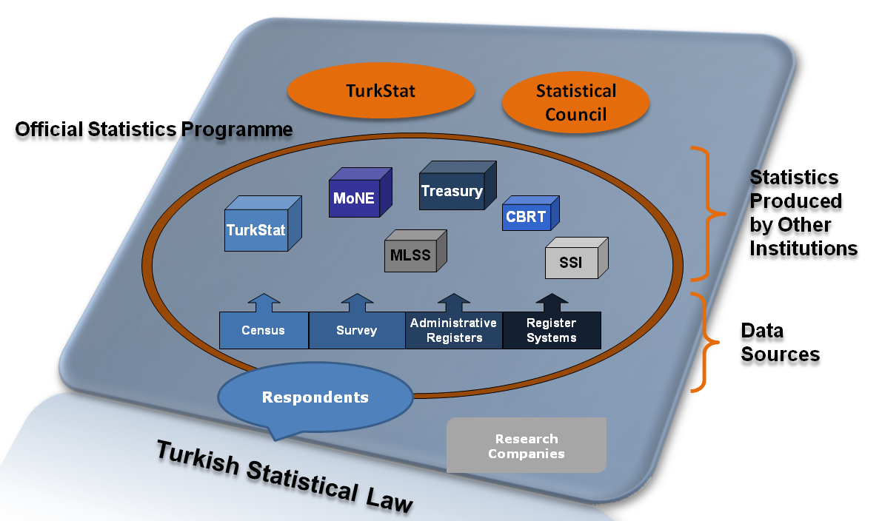
Turkish Statistical System (Cont’d)

Slide 6

Vision and Mission
Our Vision
To establish a user-focused and sustainable
statistical system based on international standards.
Our Mission
To produce and disseminate statistics which are qualified, timely, reliable, objective and consistent with the international standards respond to the requirements and priorities of national and international users, and to provide co-ordination between the public institutions involved in the production process of official statistics.

Slide 7
Strategic Objectives
1
Production of statistics based on international standards.
2
Improvement of institutional capacity and increasing productivity.
3
Improvement of organizational effectiveness by strengthening the role of cooperation and coordination capacity of the institution.

Slide 8

Main Principles
Professional Independence
User-Orientedness
Comparability
Impartiality
Timeliness
Accessibility
Confidentiality of Individual Data
Professional Expertise
Reliability
Coherence
Transparency
Up-to-Dateness
Scientificity

Slide 9

Legal Basis
Statistics Law of Turkey, Articles Specifying Coordination
Article 4: Principles of Official Statistics Programme (OSP)
Article 5: OSP Implementation Principles
Article 6: OSP Implementation Authorities
Article 7: Requesting Information, Verifying the
Accuracy of Information, Controlling and Storing
Article 8: Obligation to Respond and Boundaries
Article 9: Access to Administrative Data
Article 10: National Register Systems
Article 11: Classifications
Article 54: Administrative Fines

Slide 10

Legal Basis (Cont’d)
Regulations
Regulation on Statistical Council
Regulation on Procedure and Principles of Data Confidentiality and Confidential Data Security in Official Statistics
Regulation on Foundation of Data Quality Control
Board and its Working Procedure and Principles
Directives
Directive on the Formation of Official Statistics
Programme Working Groups and Working
Procedures

Slide 11
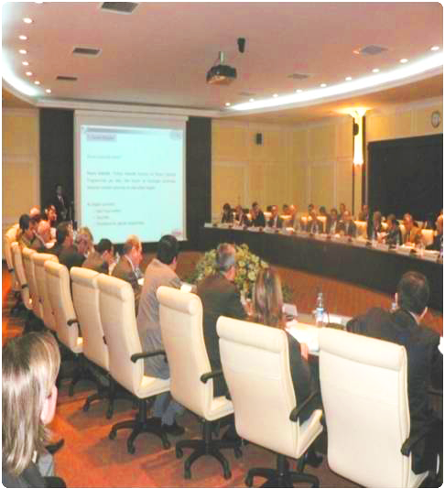
Statistical Council
Article 20 of the Law
  Advises on the preparation, implementation, development and functions of the official statistics.
  Determines and evaluates needs for official statistics and to carry out studies for future works.
Composition of Statistical Council
  Public authorities
  Academicians
  Professional associations
  Non-governmental organizations
Meeting Frequency and Organization
  Statistical Council meets at least once a year.
  It is an advisory body of the Turkish Statistical System.

Slide 12
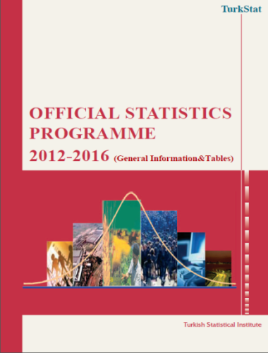
Official Statistics Programme
Establishes a framework for official statistics.
Drafted by TurkStat, adopted by Council of Ministers.
States the objectives, coverage, methods, frequency, work plan and dissemination principles.
Defines the duties and authorities of the institutions and organizations regarding the compilation, evaluation and publication of data.
Second implementation period started in 2012 and covers 2012-2016. First period was in 2007-2011.
Statistical Infrastructure
Social and Demographic Statistics
Macroeconomic Statistics
Business Statistics
Agricultural Statistics
Environmental Statistics

Slide 13
Official Statistics Programme (Cont’d)
Official Statistics Programme Working Groups
Meets throughout the year by the participation of;
  TurkStat staff,
  Producers of official statistics,
  Representatives of non-governmental organizations,
  Academicians, media and private sector representatives.
There are 50 working groups within the OSP.
553 persons participated in the 55 meetings, held in 2012.
Objectives of the working groups are;
  To ensure the completion/validation of missing data of EU/International publications, reports and web sites.
  To make an inventory of administrative records within Turkish Statistical System (through a questionnaire prepared by TurkStat).
  To give advice on methods, classification, etc.

Slide 14
Official Statistics Programme (Cont’d)
Official Statistics Programme Working Group Meetings
TYPE OF INSTITUTION | NUMBER OF UNITS | PARTICIPATED PERSONS
MINISTRIES AND SUBSIDIARIES | 172 | 468
OTHER PUBLIC INSTITUTIONS | 19
NGOs AND PRESS | 67 | 61
UNIVERSITIES | 19 | 24
TOTAL | 277 | 553

Slide 15

Protocols
Article 7-10 ensures a clear and broad legal mandate to TurkStat in terms of data collection and access to administrative registers.
Protocols are also in place with public authorities, universities, professional associations, non-governmental organizations.
For instance,
  Ministry of Food, Agriculture and Livestock
  (Agricultural Holdings Register)
  Central Bank of the Republic of Turkey
  (Consumer Tendency Survey)
  İzmir Development Agency
  (Impact Analysis Research)
  Ministry of Culture and Tourism
  (Household Domestic Tourism Survey)
  Higher Education Council
  (National Education Statistics)

Slide 16
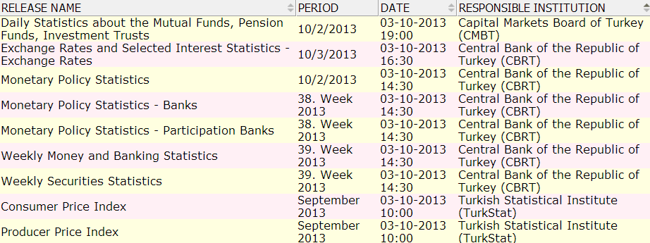
National Data Release Calendar
Prepared by TurkStat in close coordination with stakeholders, and published regularly each year since 2007.
Publication dates and times of official statistics are announced in advance so that decision-makers and users could be informed timely.
Main tool indicating the name of the news release, release date, period and responsible institution.

Slide 17
National Data Release Calendar (Cont’d)
Press Releases/Publications Disseminated in the Context of OSP by Years
Press Release / Publications | 2008 | 2009 | 2010 | 2011 | 2012
Daily | 753 | 759 | 747 | 758 | 787
Weekly | 364 | 416 | 414 | 467 | 467
Monthly | 696 | 756 | 764 | 759 | 801
Quarterly | 120 | 136 | 164 | 152 | 166
Biannually | 4 | 8 | 10 | 4 | 7
Annuallly | 196 | 151 | 152 | 145 | 175
Total | 2133 | 2226 | 2251 | 2285 | 2403

Slide 18
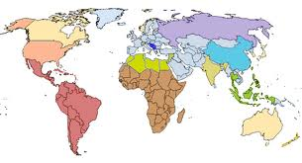
  PART II:
  International Cooperation Activities in TurkStat

Slide 19
Participation in EU Financed Programmes
Turkey’s EU candidacy in 1999 - a breakpoint in TurkStat for Capacity Building efforts
Setting priority to EU membership.
Interaction with Eurostat and Global Assessment Exercise in 2002.
Participation in Eurostat’s workshops, meetings and training courses
Initiation of EU financed programmes
Upgrading the Statistical System of Turkey Programme (started in 2003)

Slide 20
Main Inputs under EU Programmes
The total budget of the completed programmes=25 Million Euro (app.).
Several data collection projects in order to bring selected statistical surveys up to EU standards by field testing their new methodologies
The consultancy service of ~10000 Working Days
Provision of hardware and software
App. 5500 participants attended to 1800 international and local activities such as study visits, training courses, meetings, conferences and traineeships.
Language Training (English): 210 TurkStat staff and the staff of other Ministries within Turkish Statistical System (TSS).
Translation of 8000 pages of EU legislation and methodology
Technical assistance to 12 Ministries within TSS (namely main data providers)

Slide 21

Main Results of EU Programmes
Supported the efforts of EU Compliance Process
  A statistical Law setting the basis of reform of Turkish Statistical System launched in 2005.
  Re-structuring of Regional Offices according NUTS levels.
  Beginning of Strategic Planning
  Official Statistics Programme and Statistics Council
Increased knowledge of TurkStat experts on major areas of official statistics via service contracts and training grants.
Cooperation and coordination between TurkStat and main data providers enhanced.
Provision of tailor-made expertise and consultancy activities through the Programme improved the statistical methodology.

Slide 22

    EU Negotiation Process
Turkey’s Negotiation process started on 20 October 2005 about 33 chapters.
TurkStat has been the responsible institution for Chapter 18 – Statistics.
Chapter 18 opened for Negotiations in June 2007 with two closing criteria: National Accounts & Agricultural Statistics

Slide 23
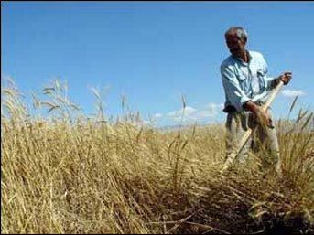

Chapter 18: Closing Benchmarks
Benchmark on agriculture statistics data and methodology addresses three main issues:
  Setting up the farm register
  Submission of statistics
  Detailed description of the methodology and organization for compiling data.
Benchmark on national accounts data and methodology addresses two main issues:
  Submission of national accounts datasets
  Detailed description of the methodologies used to compile these data

Slide 24
International Cooperation Goals
To contribute to the sustainable statistical capacity building of partner countries
To share our experiences and knowledge gained through EU accession process
To strengthen bilateral and multilateral relations within statistical community

Slide 25

International Cooperation Activities
  Completed Programs
  Azerbaijan, Kazakhstan, Kyrgyzstan, Uzbekistan,
  Turkmenistan (1994-2003)
  Bosnia and Herzegovina (1996-1999) ve (2002-2004)
  Mongolia (1998-1999) and (2005-2009)
  Macedonia (1997-2001)
  Georgia(1997-1998) and (2001-2004)
  Kazakhstan (2005-2009)
  Kyrgyzstan (2006-2007)
  Turkmenistan (2008-2010)
  Tajikistan (2007-2010)
  Moldovo (2010-2011)

Slide 26

International Cooperation Activities (cont.)
  On-going activities:
  Azerbaijan
  Turkmenistan
  Palestin
  Tajikistan
  Afghanistan
  Kazakhstan
  Tunusia
  Mongolia
  Turkish Republic of Northern Cyprus
  Iran
  ECO Member Countries
  OIC Countries
  International Organizations

Slide 27
Projects supported by TurkStat
  Strengthening the Statistical System Of Kazakhistan Statistical Office
  Consortium leader: Federal Statistical Office of Germany
  Financed by: World Bank
  Duration: Project started by October 2012’ and will last in 55 months.
  TurkStat provides consultancy and hosts study visits under this project

Slide 28
Projects supported by TurkStat
  Strengthening the Statistical System Of Afghanistan Statistical Office
  Consortium leader: GIZ Gmbh Germany
  Financed by: World Bank
  Duration: Project started by March 2013 and will last in 4 years.
  TurkStat provides concultancy and hosts study visits under this project as a consortium member.

Slide 29
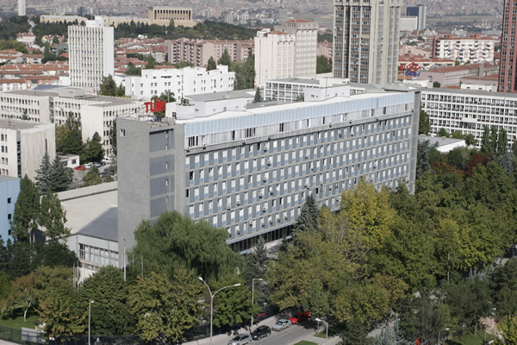
A view from TurkStat -Ankara
Thank You …
Notes:
As I stated before, the participation of main data provider organizations is very important for the effective implementation of USST Programme. TurkStat gives importance the cooperation issue and aims to work with you in close cooperation.
Such kind of meetings will ensure firstly coming together, in later stage keeping together and finally working together and we will reach the success.

