Slide 1
Poverty Measurement in Switzerland
EU-SILC European Statistics on Income and Living Conditions
Stéphane Fleury, Martina Guggisberg, Stephan Häni
December 2013

Slide 2
Structure of the presentation
Introduction
Three approaches to measure poverty in Switzerland
International comparison
Coherence between the different approaches in Switzerland

Slide 3
1. Introduction
Poverty
Multidimensional phenomenon
Cannot be defined independently of the ideal of a particular society, of values
Depend on the social, cultural and political context

Slide 4
1. Introduction
Poverty in Switzerland
Physical survival is generally given (food and housing)
Statistical definition of poverty contains more than the most basic needs and embraces minimal participation in a socially integrated life

Slide 5
2. Three approaches to measure poverty in Switzerland
Absolute poverty concept
Relative poverty concept
Material deprivation

Slide 6
2. Three approaches to measure poverty in Switzerland
Absolute poverty
Threshold based on the guidelines of the Swiss Conference for Social Welfare (SKOS), which serve as a reference for assessing social assistance
Basic needs (food, clothing, personal care, transport, entertainment, education or association fees)
+ effective housing costs (allowed for up to a certain upper limit)
+ CHF 100 per month and person aged 16 or over (for other necessary expenditure such as liability insurance or other insurance premiums)

Slide 7
2. Three approaches to measure poverty in Switzerland
Relative poverty (At Risk of Poverty)
Eurostat Standard, for international comparisons
Threshold: 60% of the total population's median equivalized disposable income
Persons in households with an income that is considerably below the standard income level of the country are considered as poor

Slide 8
2. Three approaches to measure poverty in Switzerland
Material deprivation
Eurostat Standard, for international comparisons
Considers the non-financial aspects of poverty
Deprived, for financial reasons, in elementary living conditions and/or of household consumer durables that are regarded as essential by the majority of the population (for example: one week holiday away from home once a year,
a meal with meat or fish (or vegetarian equivalent) every second day, color TV, telephone, car, etc)

Slide 9
3. International comparison
People cannot afford to eat a proper meal at least every second day
EU-SILC 2011 | Total population | People at risk of poverty
New member States (Bulgaria, Hungary, Romania, etc.) | 20% | 43%
Euro zone population | 8% | 20%
Switzerland | 2% | 5%
Large differences between European countries

Slide 10
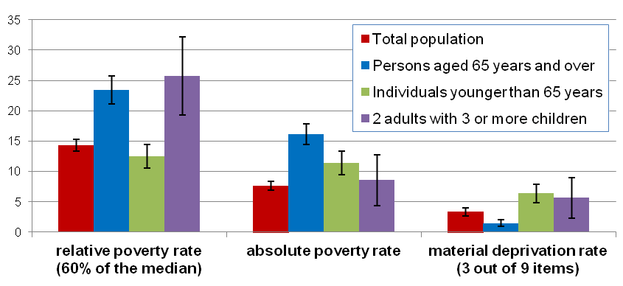
4. Coherence between the different approaches in Switzerland

Slide 11
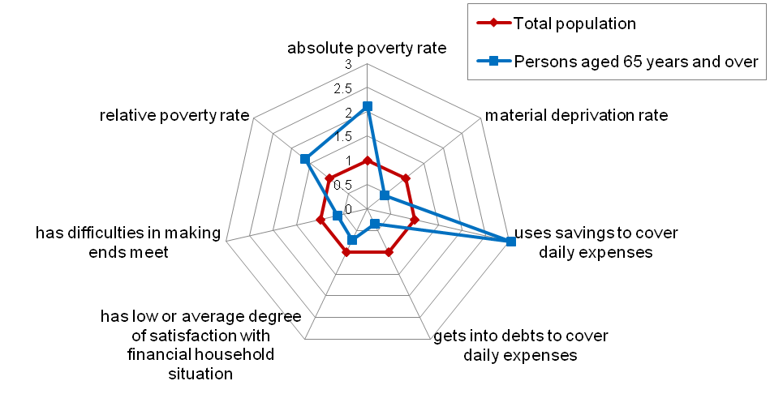
4. Coherence between the different approaches in Switzerland
Various poverty indicators for persons of retirement age, 2011

Slide 12
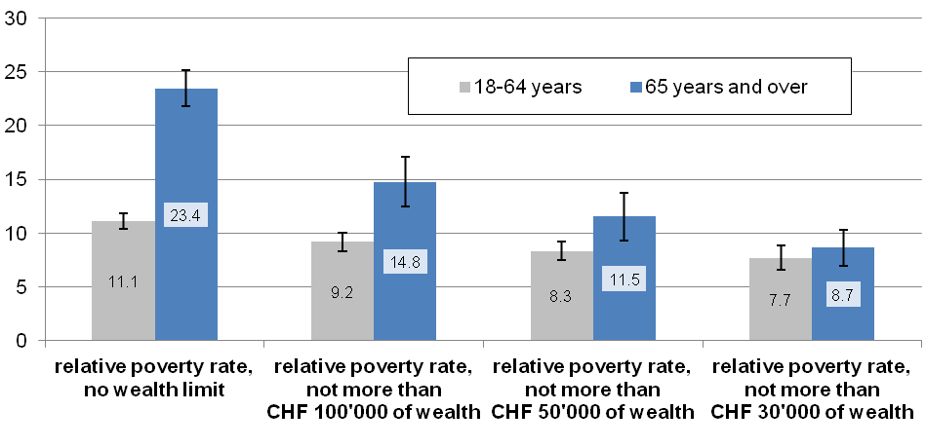
4. Coherence between the different approaches in Switzerland
Influence of wealth on the relative poverty rate, by age group, 2011, in %
1 CHF ≈ 1.09 USD or 0.81 Euro

Slide 13
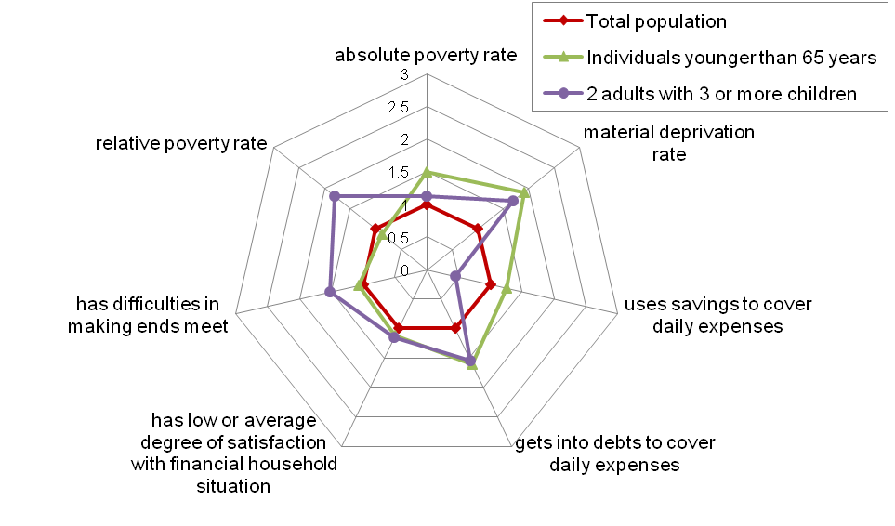
4. Coherence between the different approaches in Switzerland
Various poverty indicators for single persons under 65 and families with 3 or more children, 2011

Slide 14
4. Coherence between the different approaches in Switzerland
Equivalence scales, values for selected household types
Household types¹ | modified OECD equivalence scale | Equivalence scale derived from absolute poverty threshold (incl. housing costs)
Individual | 1.00 | 1.00
2 adults without children | 1.50 | 1.38
2 adults with 1 child | 1.80 | 1.66
2 adults with 2 children | 2.10 | 1.86
2 adults with 3 children | 2.40 | 2.03
¹ In the case of the modified OECD equivalence scale, it is assumed that children are aged under 14. In the case of the other equivalence scale, however, the age of persons in the household is not relevant.

Slide 15
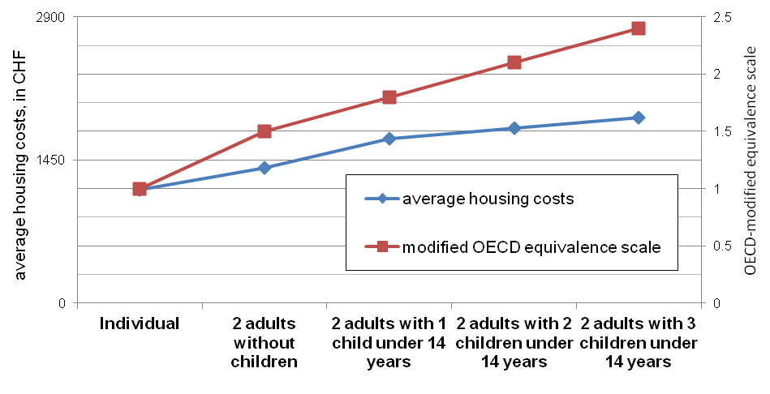
4. Coherence between the different approaches in Switzerland
Average housing costs and modified OECD equivalence scale for selected household types

Slide 16
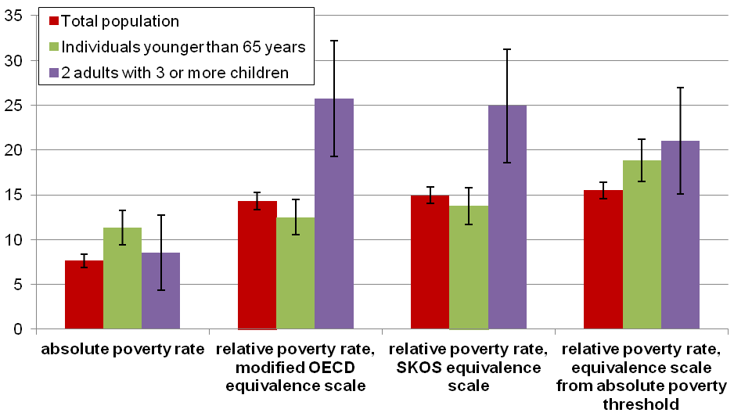
4. Coherence between the different approaches in Switzerland
Poverty rates using different equivalence scales, 2011, in %

Slide 17
Conclusions
Important to dispose of a set of indicators (including subjective evaluations of the household situation) and not to rely just on one indicator
Methodical issues such as the choice of the implicit or explicit underlying equivalence scale and the definition of financial resources (including or excluding assets) may have a crucial effect on the definition of risk groups
Extend actual indicators with consumption-based poverty indicators

Slide 18
Thank you for your attention
?? Questions ??
Discussion
http://www.bfs.admin.ch/
Topics 20 Economic and social situation of the population
Standard of living, social situation and poverty

