Slide 1

Measuring the Multiple
Dimensions of Poverty
The Way Forward in Poverty Measurement Seminar
Geneva, 2-4 December 2013

Slide 2
OPHI – MPI Team
OPHI Research Team: Sabina Alkire (Director), James Foster (Research Fellow), John Hammock (Co-Founder and Research Associate), José Manuel Roche, Adriana Conconi (coordination MPI 2013), Maria Emma Santos (coordination MPI 2010), Suman Seth, Paola Ballon, Gaston Yalonetzky, Diego Zavaleta, Mauricio Apablaza
Data analysts and MPI calculation 2013: Akmal Abdurazakov, Cecilia Calderon, Iván Gonzalez De Alba, Usha
Kanagaratnam, Gisela Robles Aguilar, Juan Pablo Ocampo Sheen, Christian Oldiges and Ana Vaz.
Special contributions: Heidi Fletcher (preparation of the maps), Esther Kwan and Garima Sahai (research assistance and preparation of graphs), Christian Oldiges (research assistance for regional decomposition and standard error), John Hammock (new Ground Reality Check field material), Yadira Diaz (helping in map preparation).
Communication Team: Paddy Coulter (Director of Communications), Emmy Feena (Research Communications Officer), Heidi Fletcher (Web Manager), Moizza B Sarwar (Research Communications Assistant), Cameron Thibos (Design Assistant), Joanne Tomkinson.
Administrative Support: Laura O'Mahony (Project Coordinator)
OPHI prepare the MPI for publication in the UNDP Human Development Report and we are grateful to our colleagues in HDRO for their support.

Slide 3
Outline
Motivations to consider a multidimensional approach for measuring poverty
The Global Multidimensional Poverty Index (MPI)
Alkire Foster methodology
Properties of the Alkire Foster method
Illustrations
MPI 2015+ and the post-2015 development agenda

Slide 4
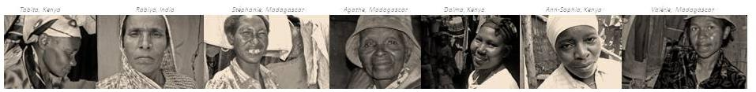
Why Multidimensional
Poverty Measures?

Slide 5
Motivations for moving towards
multidimensional poverty measure
Poor people’s lives can be battered by multiple deprivations that are each of independent importance.
(Amartya Sen, 1992)

Slide 6
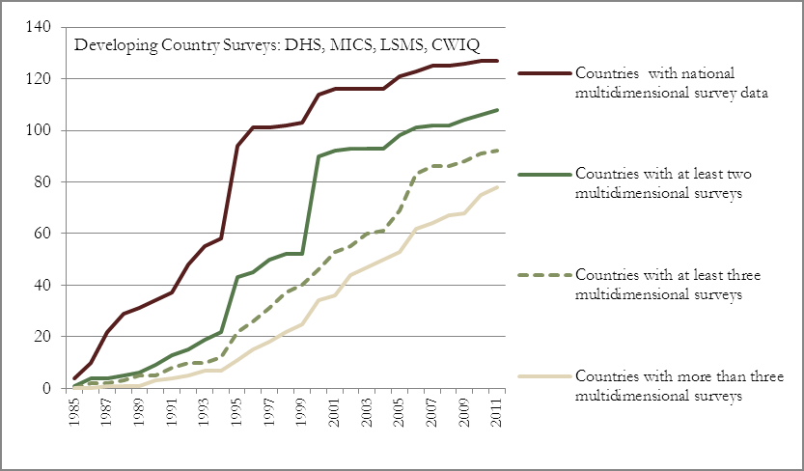
Technical advancement

Slide 7
Policy Implications
Income Poverty is Important, but not Sufficient
(Global Monitoring Report Progress Status, 2013)
Reduction in income poverty does not reduce other MDG
deprivations automatically. Source: World Bank Data

Slide 8
Economic Growth is Important, but Not Always Inclusive
Indicators | Year | India | Bangladesh | Nepal
Gross National Income per Capita (in International $) | 1990 | 860 | 550 | 510
 | 2011 | 3620 | 1940 | 1260
 | Growth (p.a.) | 6.8% | 5.9% | 4.2%
Under-5 Mortality | 1990 | 114.2 | 138.8 | 134.6
 | 2011 | 61.3 | 46.0 | 48.0
 | Change | -52.9 | -92.8 | -86.6
DPT Immunization Rate | 1990 | 70 | 69 | 43
 | 2010 | 72 | 95 | 82
 | Change | 2 | 26 | 39
Adult Pop. with no Education | 1990 | 51.6 | 55.5 | 65.8
 | 2010 | 32.7 | 31.9 | 37.2
 | Change | -18.9 | -23.6 | -28.6
Access to Improved Sanitation (rural pop) | 1990 | 7 | 34 | 7
 | 2010 | 23 | 55 | 27
 | Change | 16 | 21 | 20
Source: Alkire and Seth (2013). The table is inspired by Drèze and Sen (2011), with minor additions.

Slide 9
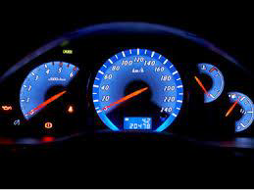
Policy Implications
Dazzlingly dashboards of indicators
Proportion of population
below $1 (PPP)/day
Literacy rate of 15-24 years-old
Prevalence of deaths associated with malaria
Share of women in wage employment in the non-agricultural sector
Proportion of tuberculosis cases detected and cured under DOTS
Net enrolment ratio
in primary education
Maternal mortality ratio
Prevalence of underweight children under 5 years of age
Proportion of seats held by women in national parliament

Slide 10
Identifying Joint Distribution of Deprivations is Important
deprived=1; non-deprived=0
Case 1
 | Illiterate | Undernourished | No safe water | Low income
Abby | 1 | 0 | 0 | 0
Jane | 0 | 1 | 0 | 0
Jon | 0 | 0 | 1 | 0
Tania | 0 | 0 | 0 | 1
Case 2
 | Illiterate | Undernourished | No safe water | Low income
Abby | 0 | 0 | 0 | 0
Jane | 0 | 0 | 0 | 0
Jon | 0 | 0 | 0 | 0
Tania | 1 | 1 | 1 | 1
In both cases, 25% deprived in each MDG indicator
BUT, in Case 2, one person is severely deprived

Slide 11
Political recognition
“MDGs did not focus enough on reaching the very poorest” - High-Level Panel on the Post-2015 Development Agenda (2013)
  Should be able to distinguish poorest from the less poor
  “Acceleration in one goal often speeds up progress in others; to meet MDGs strategically we need to see them together” - What Will It Take to Achieve the Millennium Development Goals? (2010)
  Emphasis on joint distribution and synergies
“While assessing quality-of-life requires a plurality of indicators, there are strong demands to develop a single summary measure” - Stiglitz Sen Fitoussi Commission Report (2009)
  One summary index is more powerful in drawing policy attention

Slide 12
Motivations for moving towards
multidimensional poverty measure
What we have: Technical
  Increasing data
  Improving methodologies
What we need: Policy
Income poverty is important but insufficient
Growth has not been inclusive
  Go beyond dazzlingly complex dashboards of indicators
  Emphasising the joint distribution across deprivations
Path ahead: Ethical and Political
  Political critique of current metrics
  Measures in 2010 HDR sparked interest and debate
  Post-2015 requires re-thinking Data and Measures

Slide 13
Value-added of a Multidimensional Approach
What can a meaningful multidimensional measure do?
  Provide an overview of multiple indicators at-a-glance
  Show progress quickly and directly (Monitoring/Evaluation)
  Inform planning and policy design
  Target poor people and communities
  Reflect people’s own understandings (Flexible)
  High Resolution
  – zoom in for details by regions, groups, or dimensions

Slide 14
The Alkire Foster (AF)
Methodology
&
The Global Multidimensional
Poverty Index (MPI)

Slide 15
Alkire Foster (AF) Method
(Sabina Alkire and James Foster, J. of Public Economics 2011)
Select dimensions, indicators and weights (Flexible)
2. Set deprivation cutoffs for each indicator (Flexible)
3. Apply to indicators for each person from same survey
4. Set a poverty cutoff to identify who is poor (Flexible)
5. Calculate Adjusted Headcount Ratio (M₀) – for ordinal data (such as MDG indicators)

Slide 16
One implementation of the AF Method
Global MPI
Deprived if no household member has completed five years of schooling
Dimensions are equally weighted, and each
indicator within a dimension is equally weighted
Notes:
New labels for Living Standard variables, old picture is behind

Slide 17
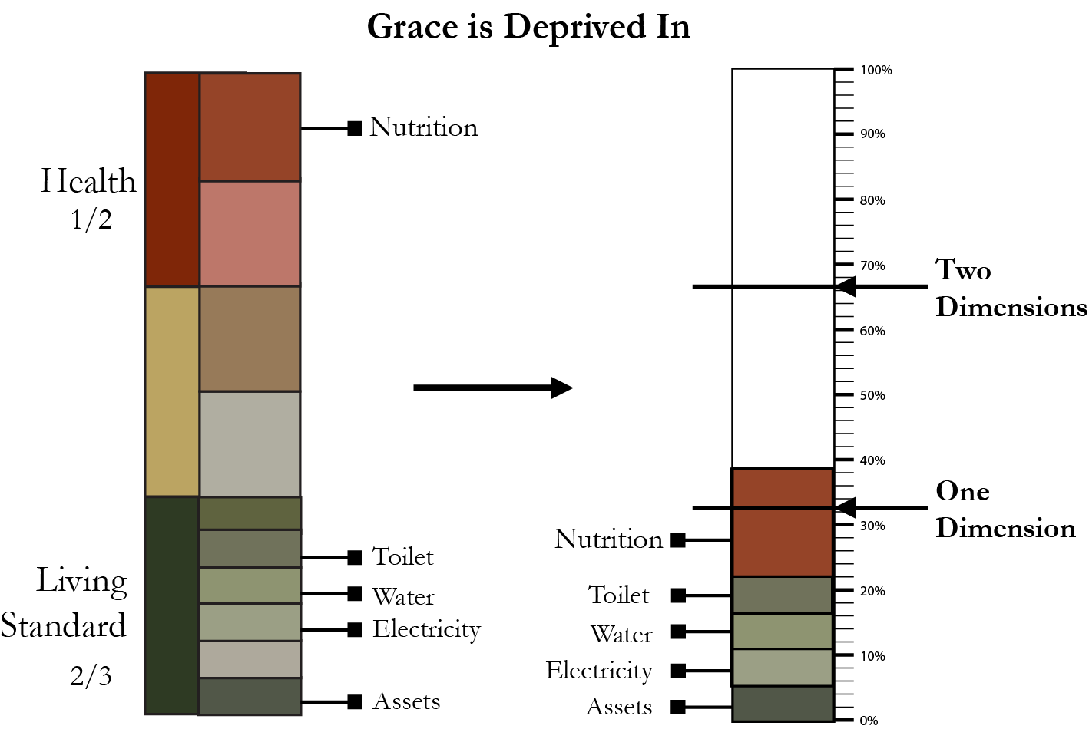
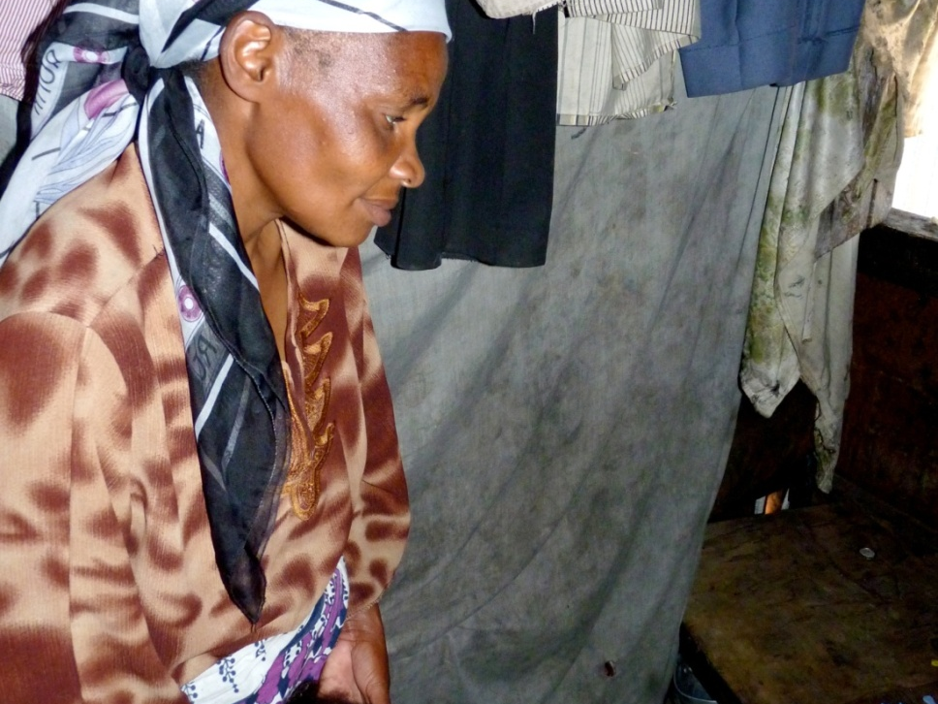
Identify Who is Poor
A person is multidimensionally poor if she is deprived in 1/3 of the weighted indicators.
(censor the deprivations of the non-poor)
39%
33.3%

Slide 18
MPI Computation
The MPI uses the Adjusted Headcount Ratio:
H: The percent of people identified as poor, it shows the incidence of multidimensional poverty
A: The average proportion of deprivations people suffer at the same time; it shows the intensity of people’s poverty
Alkire, Roche, Santos, and Seth (2013)
.
Formula: MPI = H × A

Slide 19
Properties of the
AF method

Slide 20
Properties of the AF method as applied in the Global MPI
Can be broken down into incidence (H) and the intensity (A)
Is decomposable across population subgroups
  Overall poverty is population-share weighted average of subgroup poverty
Overall poverty can be broken down by dimensions to understand their contribution

Slide 21
Policy Relevance: Incidence vs. Intensity
Country A:
Country B:
Poverty reduction policy
(without inequaliy focus)
Policy oriented to the poorest of the poor
Country B reduced the intensity of deprivation among the poor more. The final index reflects this.
Source: Roche (2013)

Slide 22
India (1999-2006): Uneven Reduction in MPI across Population Subgroups
Slower progress for Scheduled Tribes (ST) and Muslims
Religion
Caste
Alkire and Seth (2013)

Slide 23
Dimensional Breakdown Nationally?

Slide 24
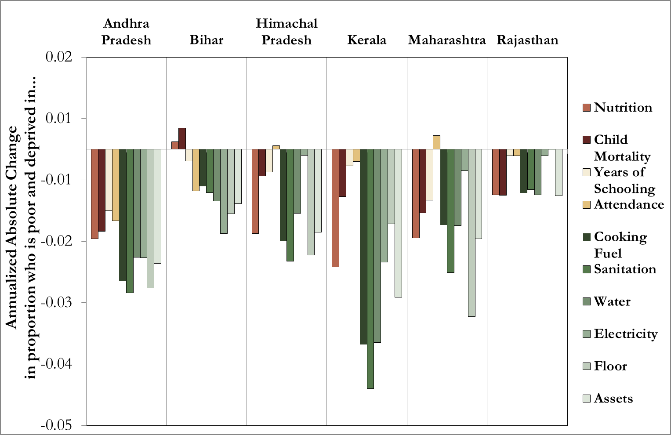
Dimensional Breakdown in Six States?

Slide 25
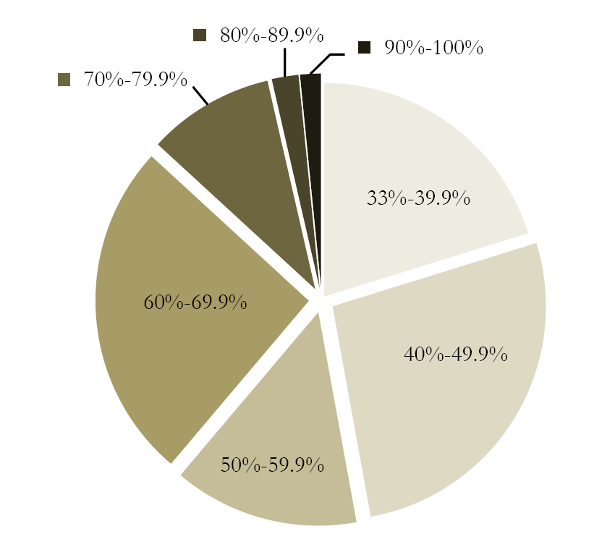
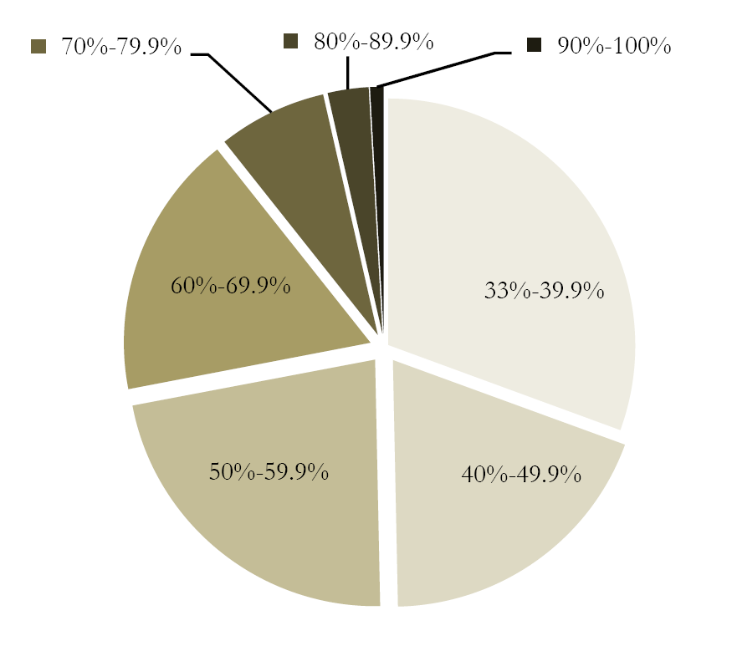
Distribution of Intensities among the Poor
Madagascar (2009)
MPI = 0.357
H = 67%
Rwanda (2010)
MPI = 0.350
H = 69%

Slide 26
The Global MPI 2015+
In the Post 2015 MDG
Development Agenda

Slide 27
Moving towards a MPI 2015+
Findings from Global MPI:
$1.25/poverty and MPI do not move together
MPI reduction is often faster than $1.25/day poverty
Political incentives from MPI are more direct

Slide 28
Height of the bar: MPI Headcount Ratio
Height at ‘•’ : $1.25-a-day Headcount Ratio

Slide 29
Comparison with Change in Income Poverty Headcount Ratio (p.a.)

Slide 30
More on MPI 2015+
(Alkire and Sumner 2013)
To complement $1.25/day poverty
To reflect interconnections between deprivations
To track ‘key’ goals using data from same survey
Emphasis on participatory process

Slide 31
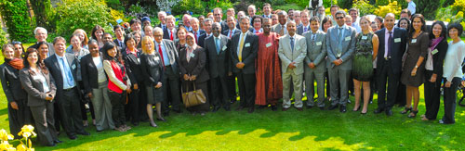
The Global Multidimensionl Poverty
Peer Network (MPPN)
Angola, Bhutan, Brazil, Chile, China, Colombia, Dominican Republic, ECLAC, Ecuador, El Salvador, Germany, India, Iraq, Malaysia, Mexico, Morocco, Mozambique, Nigeria, OECD, the Organization of Caribbean States, OPHI, Peru, Philippines, SADC, Tunisia, Uruguay and Vietnam

Slide 32

Launch of Global MPPN
Presentation by President Santos of Colombia
Roundtable discussion on the MPPN by Ministers
Amartya Sen Lecture on “Discovering Women”

Slide 33
The Network Moving Forward
Expansion of Multidimensional Poverty Index
  Official national poverty measures
  Subnational Pilots (China, Brazil)
An Effective and Informed Voice in the Post 2015 Discussions
  Colombia, Mexico, Germany, OPHI and the MPPN host a side event at the UN General Assembly 2013
The Promotion of Joint Research and Development of Practical Tools

Slide 34
Summary
Shows joint distribution of deprivations (overlaps)
Changes over time: informative
  by region, social group, indicator (inequality)
National MPIs: tailored to context, priorities
MPI 2015+: comparable across countries
National MPI and Global MPI 2015+ can be reported
like national income poverty and $1.25/day
Data needs: feasible – e.g. nested survey.
Published: in annual Human Development Report of UNDP
Method: Alkire and Foster 2011 J Public Economics
Examples: see www.ophi.org.uk
Notes:
New labels for Living Standard variables, old picture is behind

Slide 35
Thank You

