Slide 1
Non-response in household surveys: Selected research on adjustment approaches and implications
Slides prepared for Conference of European Statisticians on “The way forward in poverty measurement” (Geneva, 2-4 December, 2013).
SynthesiS of work from World Bank staff: Johan Mistiaen, Talip Kilic, Gero Carletto, Alberto Zezza,Sara Savastano, Paolo Verme, and Dean Jolliffe.

Slide 2
Nonresponse, overview
Unit Nonresponse
Does not participate in the survey
Item Nonresponse
Participates in survey, but does not respond to all questions
Nonresponse rates are increasing
Historically with LSMS surveys, unit nonresponse was very low (2% common)
Unit nonresponse rates between 10-30% now becoming more common as overall income levels increasing
Implications
Loss of information and precision (relatively easier solution).
Non-response bias when nonrandom. (more challenging)

Slide 3
Anthropometrics Non-compliance/response Living Standards Measurement Study-Integrated Surveys in Agriculture (LSMS-ISA):
 | under-5 sample size | anthro section | non-missing age | non-missing weight | non-missing height
Uganda 2009-2010~ | 2,821 | 2,384 | 2,384 | 2,078 | 2,079
Tanzania 2010-2011 | 3,087 | 2,781 | 2,640 | 2,640 | 2,637
Nigeria 2010-2011 | 4,514 | 3,707 | 2,465 | 2,273 | 2,273
Malawi 2010-2011~ | 9,156 | 8,036 | 7,942 | 7,731 | 7,708
Ethiopia 2011-2012~ | 2,810 | 2,516 | 2,503 | 2,482 | 2,488
~ Sample sizes reflect children under-5 in first column, but 6-59 months in remaining columns

Slide 4
Nonresponse in LSMS-ISA Anthropometrics
 | 1-5 y.0 sample size | Non-missing age, weight, and height | % lost to nonresponse
Uganda 2009-2010 | 2,274 | 1,834 | 19%
Tanzania 2010-2011 | 2,415 | 2,037 | 16%
Nigeria 2010-2011 | 3,642 | 1,816 | 50%
Malawi 2010-2011 | 7,478 | 6,930 | 7%
Ethiopia 2011-2012 | 2,312 | 2,224 | 4%

Slide 5
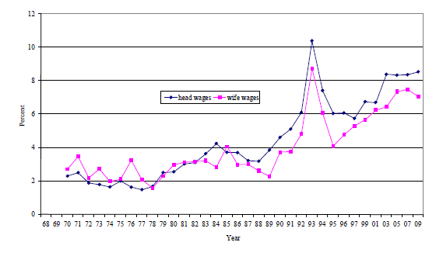
Nonresponse in U.S. surveys
Nonresponse rates for wages, PSID
SOURCE: Killewald, A. & Schoeni, P. 2011, “Trends in Item Nonresponse in the PSID 1968-2009”

Slide 6
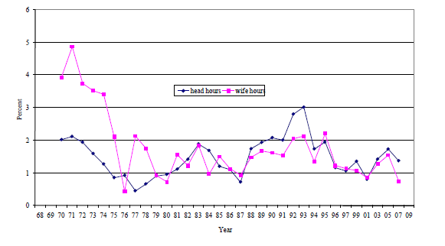
Nonresponse in U.S. surveys
Nonresponse rates for hours at main job (all jobs in 2009), PSID
SOURCE: Killewald, A. & Schoeni, P. 2011, “Trends in Item Nonresponse in the PSID 1968-2009”

Slide 7
Nonresponse in U.S. surveys
Food Stamp Program Dollar Reporting Rates
 | CPS | PSID | CE | SIPP
1980 | 0.747 | 0.770 | 0.591 | ---
1985 | 0.690 | 0.822 | 0.624 | 0.821
1990 | 0.731 | 0.871 | 0.787 | 0.835
1995 | 0.638 | 0.647 | 0.639 | 0.785
2000 | 0.583 | 0.726 | 0.552 | 0.809
2005 | 0.546 | --- | 0.372 | 0.764
SOURCE: Bruce D. Meyer & Wallace K. C. Mok & James X. Sullivan, 2009. "The Under-Reporting of Transfers in Household Surveys: Its Nature and Consequences," NBER Working Papers 15181, National Bureau of Economic Research, Inc.
Notes:
Note: admin total for 2005 was 30 billion dollars

Slide 8
Nonresponse in U.S. surveys
Food Stamp Program Average Monthly Participation Reporting Rates
 | CPS | PSID | SIPP
1980 | 0.661 | 0.729 | ---
1985 | 0.729 | 0.788 | 0.854
1990 | 0.712 | 0.775 | 0.823
1995 | 0.655 | 0.674 | 0.785
2000 | 0.629 | 0.606 | 0.861
2005 | 0.565 | --- | 0.844
SOURCE: Bruce D. Meyer & Wallace K. C. Mok & James X. Sullivan, 2009. "The Under-Reporting of Transfers in Household Surveys: Its Nature and Consequences," NBER Working Papers 15181, National Bureau of Economic Research, Inc.
Notes:
Note: admin average monthly participation for 2005 was 11.5 million households

Slide 9
Nonresponse in U.S. surveys
Social Security Old Aged and Survivors Insurance (OASI) Dollar Reporting Rates
 | CPS | PSID | CE | SIPP
1980 | 0.875 | 0.875 | 0.755 | ---
1985 | 0.917 | 0.917 | 0.799 | 0.950
1990 | 0.875 | 0.971 | 0.909 | 0.967
1995 | 0.903 | 0.902 | 0.898 | 0.904
2000 | 0.918 | 0.960 | 0.740 | 0.902
2005 | 0.910 | --- | 0.903 | 0.997
SOURCE: Bruce D. Meyer & Wallace K. C. Mok & James X. Sullivan, 2009. "The Under-Reporting of Transfers in Household Surveys: Its Nature and Consequences," NBER Working Papers 15181, National Bureau of Economic Research, Inc.
Notes:
Note: admin total for 2005 was 415 billion dollars

Slide 10
Prevention is the best cure

Slide 11
Training
Motivation
Work Load
Qualification
Data collection method
Interviewers
Total Nonresponse
Availability
Type of survey
Respondents
Cross-section, or panel
Burden
Diary or recall
Motivation
Sensitive or invasive
Proxy
Source: “Some factors affecting Non-Response.” by R. Platek. 1977. Survey Methodology. 3. 191-214

Slide 12
Prevention is the best cure, then document the malady
Build-in allowance for non-response in sample design
Afghanistan NRVA example – temporal nature of conflict
American Time Use Survey – 8 attempts to reach respondent spread over 8 weeks, by design
Include replacement households in selection design
Managed by supervisor or headquarters, not the enumerator
Preferably within EA
Time interview based on schedule of respondent, not enumerator
Budget for re-visits (consider incentives where possible)
US Panel Study of Income Dynamics – Informational campaigns, t-shirts, etc.
Questionnaire design, attentive to sensitivities
Unfolding bracket design (eg. PSID)
Record non-response, label replacement households
Consider short form for non-response (basic demographic and SES)
Record reason for unit non-response

Slide 13
Prevention example: Unfolding Brackets*
Wealth, assets, income questions are typically sensitive with high item non-response (eg. PSID hours vs. wage)
In US data, common for 20-25% of observations missing for financial variables in national surveys
Interval-scales can help
Eg. 1992 Health and Retirement Survey (HRS) used “unfolding brackets” for value of IRA and Keogh accounts (personal retirement savings)
If value was not reported, respondent was given a series of increasingly more narrow dichotomous questions to capture true value
Unfolding bracket method can cut the proportion of completely missing data by two-thirds
A significant portion of variance in the desired measure can be recovered with as few as three additional such dichotomous questions
Steven G. Heeringa, Daniel H. Hill, David A. Howell. “Unfolding Brackets for Reducing Item Nonresponse in Economic Surveys” PSID Technical Series Paper #95-01, 1995. http://psidonline.isr.umich.edu/Publications/Papers/tsp/1995-01_Reducing_Item_Nonresponse.pdf

Slide 14
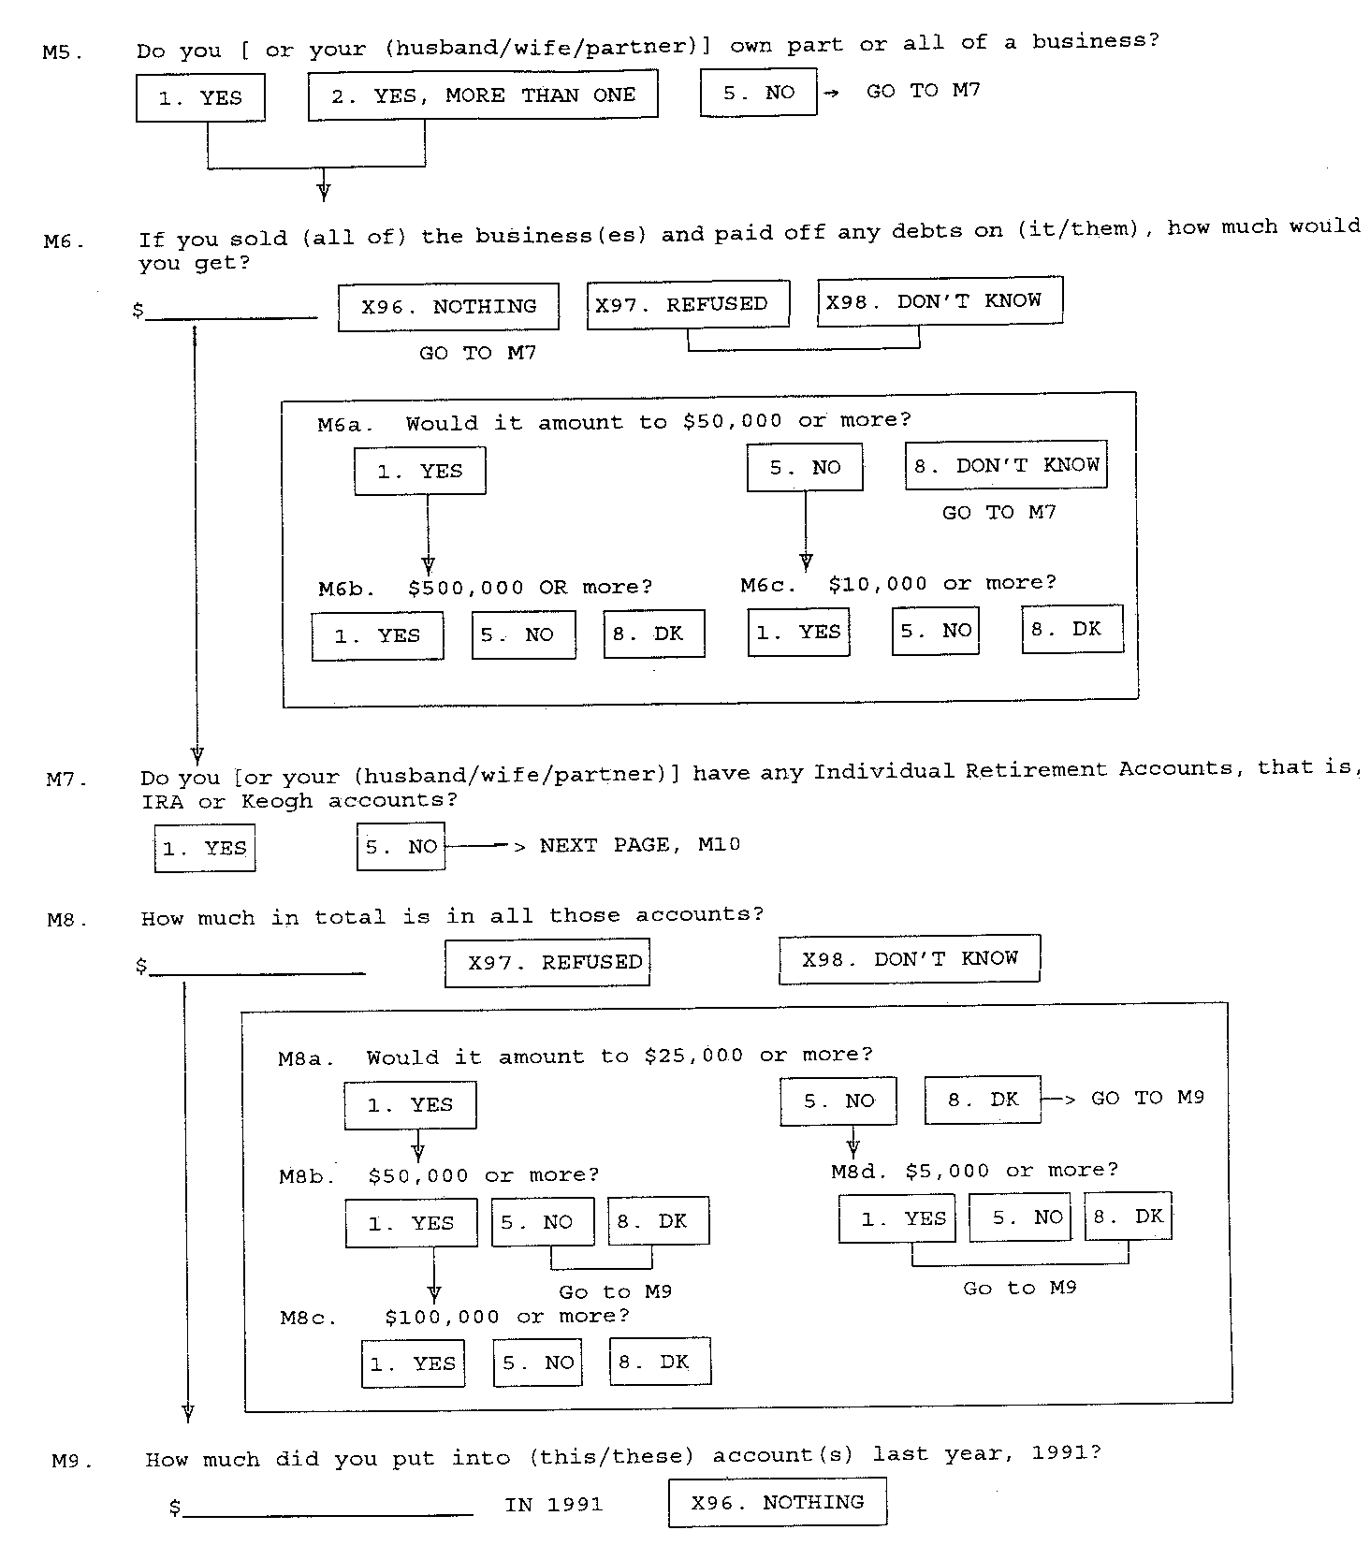
Prevention Example: Unfolding Brackets*
Steven G. Heeringa, Daniel H. Hill, David A. Howell. “Unfolding Brackets for Reducing Item Nonresponse in Economic Surveys” PSID Technical Series Paper #95-01, 1995. http://psidonline.isr.umich.edu/Publications/Papers/tsp/1995-01_Reducing_Item_Nonresponse.pdf

Slide 15
ex-Post treatment examples: Imputation & re-weighting
TERMINOLOGY
Missing Completely at Random (MCAR)
Analysis based on existing sample is consistent
Eg. Random failure of GPS device
Missing at Random (MAR)
Missingness independent of unobservables
May be dependent on observables
Eg. Plot is far away
Missing Not at Random (MNAR)
Missingness dependent on unobservables
Eg. Illicit use of land (assuming activity not obs)
1. IMPUTATION, one approach
Little & Rubin, 1987; Lillard, 1986)
MAR imputation, consistent point estimates, inconsistent SE
Multiple imputation(s) aims to restore stochastic property through series of imputations, consistent point and SE estimates (under MAR)
X
Y
X
Y(imputed)

Slide 16
Multiple imputation (MI) example: land size (and productivity)*
Land areas: Fundamental component of agricultural statistics
Rope and compass assumed to be the gold-standard in land area measurement, but neither time- nor cost-effective
Increasing use of GPS technology in measuring land areas
However...
Collecting GPS-based land areas not always feasible – field work protocols, lack of physical access, refusals
Substantial presence of missing values (up to 30% in LSMS-ISA)
Kilic, T., Zezza, A., Carletto, C., and Savastano, S. (2013). "Missingness in action: selectivity bias in GPS-based land area measurements." World Bank Policy Research Paper No. 6490. http://elibrary.worldbank.org/doi/pdf/10.1596/1813-9450-6490

Slide 17
MI of land size, descriptive statistics Tanzania LSMS-ISA*
 | Entire Sample | W/ GPS | W/o GPS
Observations | 4,333 | 2,814 (65%) | 1,519 (35%)
GPS-Based Plot Area (Acres) | 2.13 | 2.13 | --
Farmer-Reported Plot Area (Acres) | 2.05 | 2.00 | 2.12
Less Than 15 Mins Away from HH † | 0.62 | 0.80 | 0.31 | ***
15-30 Mins Away from HH † | 0.17 | 0.14 | 0.21 | ***
30+ Mins Away from HH † | 0.22 | 0.06 | 0.48 | ***
Rented/Other † | 0.26 | 0.14 | 0.46 | ***
Hilly, Steep or Valley † | 0.20 | 0.17 | 0.25 | ***
# of Plots in Holding | 3.31 | 3.17 | 3.54 | ***
Mover Original HH † | 0.04 | 0.01 | 0.09 | ***
Split-Off HH † | 0.13 | 0.06 | 0.25 | ***
Wealth Index (2005/06) | -0.66 | -0.77 | -0.47 | ***
Note: Results from tests of mean differences reported. *** p<0.01, ** p<0.05, * p<0.1. Statistics weighted through the use of household sampling weights. † denotes a dummy variable.
Kilic, T., Zezza, A., Carletto, C., and Savastano, S. (2013). "Missingness in action: selectivity bias in GPS-based land area measurements." World Bank Policy Research Paper No. 6490. http://elibrary.worldbank.org/doi/pdf/10.1596/1813-9450-6490
Notes:
Mention Hilly difference. Hilly is an observable variable and is also going to be correlated with productivity

Slide 18
MI of land size, conditional mean Examples from Uganda & Tanzania*
Selected OLS Regression Results Underlying Multiple Imputation Dependent Variable = GPS-Based Plot Area (Acres)
 | UNPS 2009/10 | TZNPS 2010/11
Farmer-Reported Plot Area (Acres) | 0.945*** | 0.866***
Log [Value of Plot Output] | 0.023 | 0.056***
Log [Value of Plot Input] | 0.027** | 0.032***
# of Plots in Holding | -0.141*** | -0.094**
District & Enumerator Fixed Effects | YES | YES
Observations | 2,814 | 3,363
R2 | 0.658 | 0.688
Kilic, T., Zezza, A., Carletto, C., and Savastano, S. (2013). "Missingness in action: selectivity bias in GPS-based land area measurements." World Bank Policy Research Paper No. 6490. http://elibrary.worldbank.org/doi/pdf/10.1596/1813-9450-6490

Slide 19
MI of land size, implications for productivity Uganda & Tanzania*
Stronger Inverse Relationship between land size and productivity under MI – Robust to using District, EA, HH Fixed Effects.
Selected OLS Regression Results Dependent Variable = Log Value of Plot Output/Acre
 | UNPS 2009/10 |  | TZNPS 2010/11
 | [1] Observed GPS-Based Parcel Area | [2] Multiple Imputed GPS-Based Parcel Area | [3] Observed GPS-Based Parcel Area | [4] Multiple Imputed GPS-Based Parcel Area
Log Plot Area [Acres] | -0.388*** | -0.515*** | -0.448*** | -0.487***
Observations | 2,814 | 4,333 | 3,383 | 4,121
Note: *** p<0.01, ** p<0.05, * p<0.1. Complex survey regressions underlie the combined MI estimates reported here.
Kilic, T., Zezza, A., Carletto, C., and Savastano, S. (2013). "Missingness in action: selectivity bias in GPS-based land area measurements." World Bank Policy Research Paper No. 6490. http://elibrary.worldbank.org/doi/pdf/10.1596/1813-9450-6490

Slide 20
Post-Stratification / re-weighting, Poverty & Food Assistance in US*
Examine how the design of SNAP influences its antipoverty effect
Benefits reach a broad range of low-income, low-asset households, a “food NIT “
Progressive benefit structure
Estimate the reduction in poverty that results from adding SNAP benefits to family income.
Rate of poverty and deep poverty
Depth and severity indices ( FGT)
Current Population Survey (CPS), source for official poverty estimates in US
Suffers from under-reporting of program participation and benefits
Tiehen, L., Jolliffe, D., Smeeding, T. “The Effect of SNAP on Poverty”, Brookings Institute Conference paper, 2013.
Tiehen, L. Jolliffe, D. Gundersen, C. “Poverty and Food Assistance during the Great Recession” 2013, working paper.

Slide 21
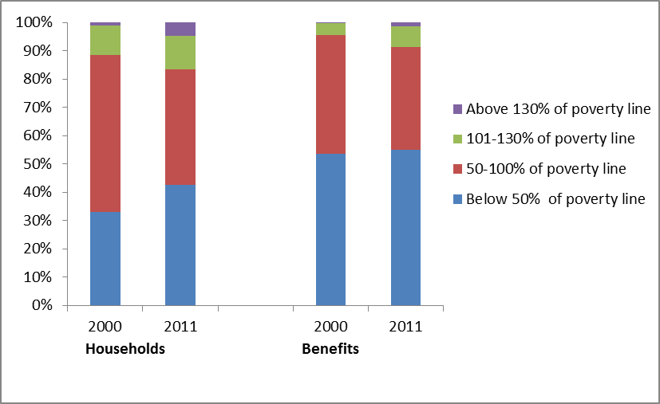
Distribution of Food Assistance benefits in US*
Tiehen, L., Jolliffe, D., Smeeding, T. “The Effect of SNAP on Poverty”, Brookings Institute Conference paper, 2013.
Tiehen, L. Jolliffe, D. Gundersen, C. “Poverty and Food Assistance during the Great Recession” 2013, working paper.

Slide 22
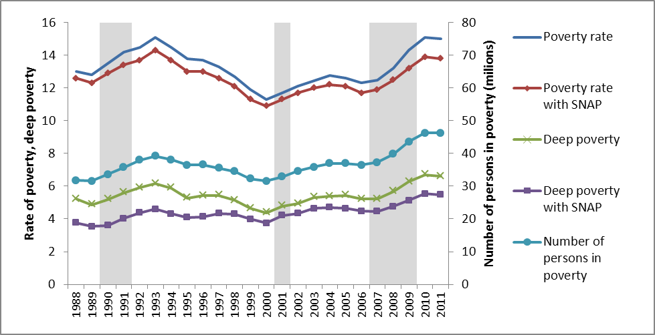
Poverty and Food Assistance in US*
Tiehen, L., Jolliffe, D., Smeeding, T. “The Effect of SNAP on Poverty”, Brookings Institute Conference paper, 2013.
Tiehen, L. Jolliffe, D. Gundersen, C. “Poverty and Food Assistance during the Great Recession” 2013, working paper.

Slide 23
Re-weight based on program data (ie. known population estimates -Poverty and Food Assistance*
Adjusting for item non-response (participation & value)
Use Administrative data on total number of participants and total value of benefit receipt
Separate administrative data into two income categories – income less than 50% of poverty line and income between 50% - 100% of poverty line
Scale up (uniformly within income class) weights of participants to match administrative population counts.
Scale down (uniformly within income class) weights of non-participants to restore official poverty estimates (by income class)
Participation counts, Poverty counts match official data
Value of SNAP benefits increase substantially, but do not match administrative counts. Scale up value within income class to match administrative totals.
Tiehen, L., Jolliffe, D., Smeeding, T. “The Effect of SNAP on Poverty”, Brookings Institute Conference paper, 2013.
Tiehen, L. Jolliffe, D. Gundersen, C. “Poverty and Food Assistance during the Great Recession” 2013, working paper.

Slide 24
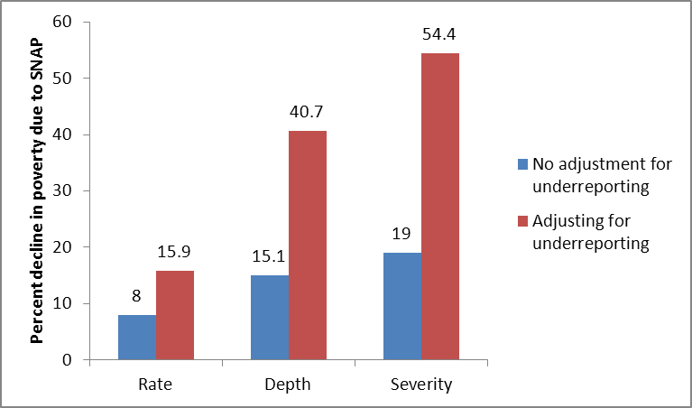
Re-weighting example, Poverty and Food Assistance in the US*
Tiehen, L., Jolliffe, D., Smeeding, T. “The Effect of SNAP on Poverty”, Brookings Institute Conference paper, 2013.
Tiehen, L. Jolliffe, D. Gundersen, C. “Poverty and Food Assistance during the Great Recession” 2013, working paper.

Slide 25
Re-weighting example, Poverty and Food Assistance in the US*
The SNAP program costs 0.5% of GDP. For that amount, after adjusting for nonresponse, we get:
16% reduction in poverty (8 million fewer poor people)
41% cut in the poverty gap, 54% decline in the severity of poverty
David Brooks July 12, 2013 PBS Newshour transcript,
“-- I was going to do a column, because the Republican critics are correct that the number of people on food stamps has exploded. And so I was going to do a column, ‘this is wasteful, … And so, this was going to be a great column, would get my readers really mad at me… But then I did some research and found out who was actually getting the food stamps. And the people who deserve to get it are getting. That was the basic conclusion I came to. So I think it has expanded. That's true. But that's because the structure of poverty has expanded in the country ”
Tiehen, L., Jolliffe, D., Smeeding, T. “The Effect of SNAP on Poverty”, Brookings Institute Conference paper, 2013.
Tiehen, L. Jolliffe, D. Gundersen, C. “Poverty and Food Assistance during the Great Recession” 2013, working paper.

Slide 26
Parametric correction for unit non-response, the missing top and inequality (Egypt)
Egypt HIECS inequality measures – Mismatch between perceptions and data estimates. Could non-response be driving the wedge?
Explore a variety of methods (re-weighting and parametric models) to examine sensitivity of Gini to non-response of “high-income” persons
Main methodology: Atkinson, Piketty and Saez (2011)
Assume top incomes follow the Pareto distribution
The non-response of top-income households is a problem in the HIECS data, causing a downward bias in the measurement of inequality.
The bias is small (about 1.3%pts) and diminishes as we exclude top-income observations, but remains highly significant.
Hlasny, Vladimir and Verme, Paolo. (2013). “Top Incomes and the Measurement of Inequality in Egypt." World Bank Policy Research Paper No. 6557.. http://elibrary.worldbank.org/doi/pdf/10.1596/1813-9450-6557
Notes:
The corrected Ginis are higher than the uncorrected ones (p-values around 0.001, all below 0.022).

Slide 27
Parametric correction for unit non-response, the missing top and inequality (Egypt)
Variable | Sampling correction | Gini (s.e.)
Income per capita | Uncorrected | 0.3289 (0.0023)
 | CAPMAS corrected | 0.3305 (0.0024)
 | Corrected for non-response (Model 4) | 0.3423 (0.0035)
Expenditure per capita | Uncorrected | 0.3054 (0.0017)
 | CAPMAS corrected | 0.3070 (0.0019)
 | Corrected for non-response (Model 4) | 0.3181 (0.0025)
Hlasny, Vladimir and Verme, Paolo. (2013). “Top Incomes and the Measurement of Inequality in Egypt." World Bank Policy Research Paper No. 6557.. http://elibrary.worldbank.org/doi/pdf/10.1596/1813-9450-6557
Notes:
The corrected Ginis are higher than the uncorrected ones (p-values around 0.001, all below 0.022).

Slide 28
References (to be completed)
Juster, F Thomas & Kuester, Kathleen A. “Differences in the Measurement of Wealth,Wealth Inequality and Wealth Composition obtained from alternative US Wealth Surveys,” Review of Income and Wealth, 37(1): 33-62, March 1991.

