Slide 1
Recent Developments in Poverty Measurement
in Turkey
Mehmet Ali KARADAĞ
Seminar
“The way forward in poverty measurement”
Geneva,
2-4 December 2013

Slide 2
OUTLINE
Poverty statistics released by TURKSTAT
from EU-SILC
from HBS
Cost of basic needs approach in Turkey
Food poverty
Complete poverty (food + non-food)
Assumptions and questions
Effects of assumptions on absolute poverty figures of Turkey
Recent studies in TURKSTAT

Slide 3
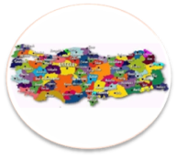
Poverty statistics based EU-SILC
Started at 2006
relative poverty rate
poverty gap,
persistent at-risk-of-poverty rate,
material deprivation
income distribution indicators
Poverty Statistics released by TURKSTAT

Slide 4
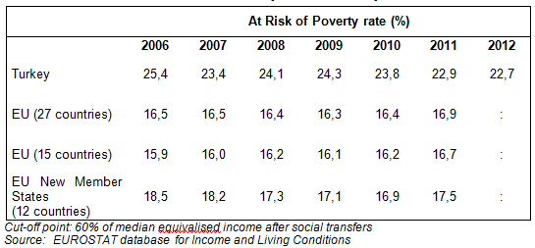
At risk of Poverty Rate in Turkey and EU
Poverty Statistics released by TURKSTAT

Slide 5
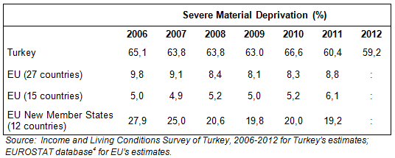
Severe Material Deprivation rates in Turkey and EU
Poverty Statistics released by TURKSTAT

Slide 6
Poverty statistics based on HBS
Started at 2002.
Food poverty rate
Complete poverty rate (food + non-food)
Relative poverty rate (from consumption expenditure)
Poverty Statistics released by TURKSTAT

Slide 7
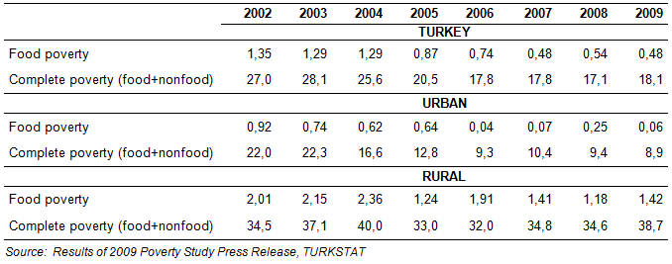
Absolute poverty figures in Turkey
Poverty Statistics released by TURKSTAT

Slide 8
Food Poverty Line
In 2002, the food poverty line was developed using the actual quantities for the most popular 80 products consumed in the third and forth deciles of the population, priced out by using the country average survey prices for 2002.
Minimum colorie requierment is assumed as 2,100 per day per average person, which is a nutritional minimum accepted internationally according to FA0 and World Health Organization [WHO] recommendations.
In order to revise food poverty line in following years, food basket developed in 2002 is priced out by using current year HBS data.
Cost of Basic Needs Approach in Turkey

Slide 9
Complete Poverty Line
In order to derive complete poverty line in 2002, non-food needs of individuals are added to food poverty line.
The share of total consumption that goes to non-food consumption is calculated for reference group. This ‘non-food share’ is the ‘allowance’ for non-food consumption that is added to the value of the food poverty line to get the complete poverty line”
The reference group is households in first income quintile whose total consumption is just above the value of the food poverty line.
For the following years in order to update complete poverty line, non-food share of the same reference group is re-calculated from consequent year’s HBS data instead of using constant non-food share derived in 2002 or using CPI to inflate complete poverty line.
Cost of Basic Needs Approach in Turkey

Slide 10
Discussions about assumptions
Composition of Food Basket:
Should composition of food basket be updated every year regarding items and quantities?
Should composition of food basket vary by regions because of difference in food consumption patterns among regions?
Which reference group should be taken to construct food basket?
Cost of Basic Needs Approach in Turkey

Slide 11
Discussions about assumptions
Updating complete poverty line
Which reference group should be taken to derive non-food share?
Should ‘constant’ or ‘current (changing)’ non-food share be used to update complete poverty line over time?
Should complete poverty line be updated by inflation rate over time, once it has been derived at beginning?
Cost of Basic Needs Approach in Turkey

Slide 12
Discussions about assumptions
How many poverty lines?
In official methodology, there is a single food poverty line and a single complete poverty line, which allow us compare same “standard of living” across the regions/area.
However, consumption pattern of households shows huge differences among regions in terms of food share.
Should food basket and food share be developed separately for each region (or urban/rural) in order to reflect regional differences?
Cost of Basic Needs Approach in Turkey

Slide 13
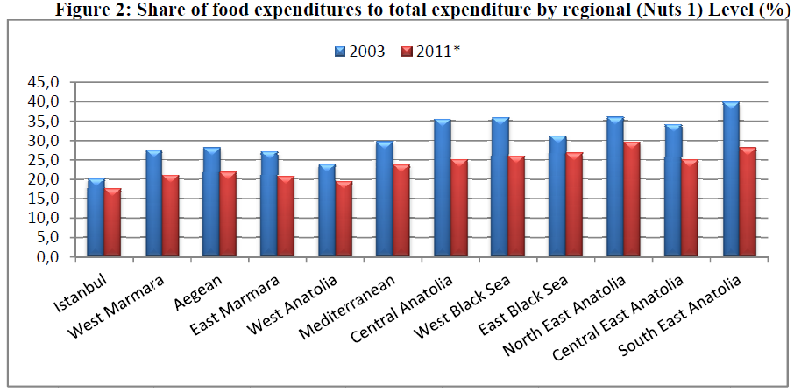
Discussions about assumptions
How many poverty lines?
Cost of Basic Needs Approach in Turkey

Slide 14
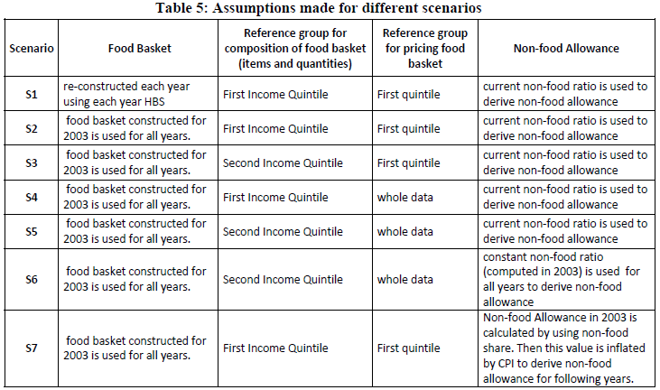
In order to observe effects of these assumptions on absolute poverty figures, 7 different scenarios, created by changing by some assumptions of official methodology, were applied to HBS data over the period of 2003-2009.
Effects of assumptions on absolute poverty...

Slide 15
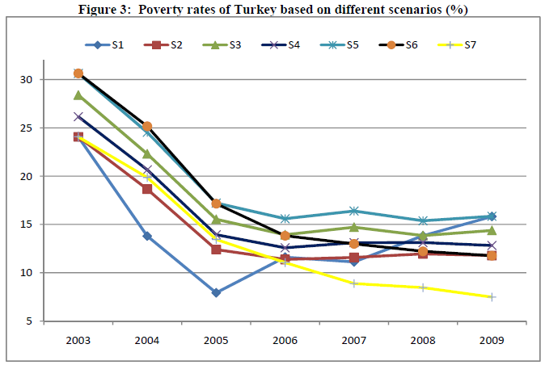
Effects of assumptions on absolute poverty...

Slide 16
Main Results
In S1 where food basket re-constructed each year, poverty rates shows apparent fluctuations over time.
Comparing S2 and S3, where only difference is reference groups for composition of food basket, shows that using second quintile instead of first quintile as a reference group cause 3 points increase in poverty rate in average but trend in poverty rate does not change.
Effects of assumptions on absolute poverty...

Slide 17
Main Results
Comparing S5 and S6 provide us to see effects of using current food-share instead of constant one. Constant food share gives lower poverty rate estimates after 2005 compared to S5 because of ignoring progress in economic development over times in Turkey.
Lastly, S7, which define same welfare level as a poverty line over time because of updating poverty line by inflation, indicates significant decrease in poverty rate from 24.1% in 2003 to 7.5% in 2009.
Effects of assumptions on absolute poverty...

Slide 18
Regarding discussions mentioned, it has been announced in 2012 that TURKSTAT started studies in collaboration of local and international experts and institutions in order to update its absolute poverty methodology based on HBS published for the period 2002-2009.
It is aimed to launch a better way of measuring poverty that reflect social conditions in Turkey, consider all aspects of poverty and enable to compare poverty lines over time and space.
Recent Studies in TURKSTAT

Slide 19
In the scope of improvement studies, a working group has been constructed by TURKSTAT consisting of academicians, representative from different national institutions and ministries, non-governmental organizations and unions:
There are four sub-groups within working group and each one study on different aspects of poverty:
First sub-group focuses on recent methodologies and applications related poverty measurement
Second sub-group makes research on how to improve monetary poverty measures.
Equivalence scales and its effect on poverty figures are under responsibility of third sub-group.
Last sub-group works on non-monetary poverty and factors affecting poverty in Turkey.
Recent Studies in TURKSTAT

Slide 20
Recently, the most remarkable method of measuring multidimensional poverty is belonging to Alkire and Foster (2007) which has been widely applied recently by countries, institutions and researches.
Mexico’s official multidimensional poverty methodology, which is based on Alkire-Foster (2007) method, is one of the best practises of multidimensional methods.
Having aimed to reflect all aspect poverty and being attracted by Mexico case, TURKSTAT has concentrated more on adopting a multidimensional poverty measures.
Recent Studies in TURKSTAT

Slide 21
Thanks...

