Slide 1
Use of Administrative Data for Migration Statistics in Switzerland
Marcel Heiniger, FSO
Workshop on the Use of Administrative Data for the Measurement of Migration in Georgia
Tbilisi, 6 April, 2016

Slide 2
Outline of Presentation
1. Objectives
Migration statistics in Switzerland
Improving migration statistics – two historical phases
Current migration statistics system
Cooperation among different authorities
5. General Findings and Recommendations

Slide 3
Objectives (1)
Developing the Swiss migration statistics system – lessons learned:
using administrative data in a federal system
status of the NSI in the public administration system of the country
role of the NSI in the statistical system, other major players
inter-agency cooperation and coordination

Slide 4
Objectives (2)
objectives of different players: a common goal? or divergent needs?
integrated migration statistics system: possible or utopia?
communicating and reporting conflicting data: risks and challenges

Slide 5
Population Statistics in Switzerland (1)
a long tradition:
data on births and deaths since 1803
first population census in 1850
but:
detailed annual migration data since 1981 only

Slide 6
Population Statistics in Switzerland (2)
1980 – decision by the FSO to establish an annual population statistics system based on various available data sources:
Population Census
vital statistics
administrative data
-> need to capture (international and internal) migration flows

Slide 7
Improving migration statistics
Phase I – early 1980s
Improvements within the then-existing legal framework and on the basis of then available administrative data sources
Phase II – since mid-2000s
Improvements with the aim of better use of administrative data and proactive steps initiated and undertaken by FSO

Slide 8
Improvements – Phase I (1)
focus on administrative data
three levels of government
different legislation for nationals and non-nationals
achievements and shortcomings

Slide 9
Improvements – Phase I (2)
Focus on Administrative Data
well established population registration system: all residents are required to register their place of
residence with the relevant authorities
migration data suitable for generating statistics can be found in practically any administrative system which collects population data
obligation by FSO to use available administrative data whenever possible and not carry out separate surveys (Federal Statistics Act)

Slide 10
Improvements – Phase I (2)
Three levels of government (Swiss Federalism)
state powers are divided between
Confederation (federal government)
cantons (provinces)
communes (municipalities)
The Confederation is responsible wherever it is empowered by the Federal Constitution. The cantons and municipalities have extensive powers.

Slide 11
Improvements – Phase I (3)
Three levels of government (Swiss Federalism)
Municipalities are responsible for maintaining registers of residents.
Issuance of detailed regulations regarding the residence of Swiss citizens falls within the competence of the cantons.
Only with respect to foreigners does the confederation have the power to establish the legal conditions for stay and residence in the country.

Slide 12
Improvements – Phase I (4)
Available Data Sources
one centralized federal register (Central Register of Foreigners) established in 1972 covering the majority of non-national residents
2900 local Residents' Registration Offices
not all registers maintained in electronic form
heterogeneous as to the set of registered data and the degree of detail of recorded information
no established rules of communicating and data sharing

Slide 13
Improvements – Phase I (5)
Achievements
statistical use of a centralized administrative register
relatively detailed annual migration data (stocks and flows) for non-nationals
Shortcomings
important gaps in migration data for nationals
time-consuming collection and harmonization of municipal administrative data
limited amount of individual data
no nationwide personal identification number

Slide 14
Improvements – Phase II (1)
overall objective: better use of administrative data
creating the legal framework to allow a more expansive use of administrative data
services/support provided by FSO
challenges and remaining shortcomings

Slide 15
Improvements – Phase II (2)
Objective
modernizing the census by making increased use of administrative data (switch to a register-based census)
migration statistics as a secondary beneficiary of this process
tailoring the data gathered by administrative authorities to statistical needs
Consequences
establishing the legal framework to make this possible
long-term process

Slide 16
Improvements – Phase II (3)
Federal Constitution
complete revision in 1999
introduction of a new constitutional article that explicitly demands the use of registers for statistics
Art. 65 Statistics
1 The Confederation shall compile the necessary statistical data on the status and trends in the population… in Switzerland.
2 It may issue regulations on the harmonization and maintenance of official registers in order to reduce the cost of compiling data.

Slide 17
Improvements – Phase II (4)
Old Age and Survivors’ Insurance Act
2008: introduction of a new 13-digit personal identification number (OASIN13) for each person who contributes to the federal social insurance system or is entitled to its benefits
2009: establishment of a central register (UPI – Unique Person Identification) for the issuance and management of OASIN13 social security numbers

Slide 18
Improvements – Phase II (5)
Register Harmonization Act
in effect since January 1, 2008
ensures that
the keeping of registers, the content of registers, the definition of variables and the exchange of data when people move are standardized in local population registers
data on foreign nationals are harmonized in federal registers of persons

Slide 19
Improvements – Phase II (6)
Register Harmonization Act
Art. 1 Aim and subject matter
2 The Act determines:
a. the identifiers and attributes that must be recorded in the registers;
b. the responsibility of the Federal Statistical Office (Federal Office) for the harmonization of definitions, attributes and attribute characteristics
(attribute: property of a person that may be objectively recorded and
described / attribute characteristic: specific value that an attribute may acquire)

Slide 20
Improvements – Phase II (7)
Register Harmonization Act
Art. 4 Task of the Federal Office
1 The Federal Office defines the identifiers and attributes …as well as the corresponding attribute characteristics, nomenclatures and coding keys.
Art. 6 Minimum content
…the registers of residents contain the data on the following identifiers
and attributes of each permanently settled or resident person:
a. social insurance number (OASIN13)

Slide 21
Improvements – Phase II (8)
Register Harmonization Act
Art. 14 Provision of data for statistical purposes by the cantons and communes
1 The cantons and communes shall provide the Federal Office with the data defined in Article 6 free of charge. The Federal Council determines the date and the periodicity of the delivery of data.
3 The data are supplied by means of electronic data carriers or in electronic form.

Slide 22
Improvements – Phase II (9)
Services provided by FSO
Regular publication of an official catalogue of attributes that contains the attribute characteristics as well as the nomenclatures and coding keys.
Development of a central IT platform ("sedex"; secure data
exchange) which not only enables cantons and municipalities to transmit their register data to the FSO for statistical purposes, but can also be used for the exchange of data between different administrative authorities.

Slide 23
Improvements – Phase II (10)
Challenges and remaining shortcomings
dealing with different levels of government and about 2800 different data producers/providers
quality of register data (coverage, timeliness, errors)
incoherent data from different registers
different needs and objectives of FSO and other administrative authorities with respect to data collection and dissemination
cooperation/coordination between FSO and federal immigration authority

Slide 24
Preconditions facilitating use of administrative sources
comprehensive and reliable register system
legal framework (also data protection aspects)
unique identification numbers
population registration must provide reliable information that can be used for various, i.e. not exclusively statistical, purposes (“e-government”) -> public approval -> inherent interest of a person to be registered and remain in the register
cooperation among different authorities

Slide 25
Current Migration Statistics System (1)
Utilized Data Sources
Central Migration Information System ( = federal register of foreigners)
managed by the State Secretariat for Migration
covers non-nationals subject to the Foreign Nationals Act
Central Register of Diplomats and International Civil Servants
managed by the Federal Department of Foreign Affairs
covers non-nationals not subject to the Foreign Nationals Act

Slide 26
Current Migration Statistics System (2)
Utilized Data Sources
2,352 local population registers
managed by municipalities (and cantons)
cover nationals and non-nationals
operate independently of central register of foreigners (i.e. no mirror copies)

Slide 27
Current Migration Statistics System (3)
Production of Migration Data
extracts from registers (individual data) are sent at regular intervals to FSO via the IT platform
FSO receives an extract of stocks and all changes in register information (= basis for generating flow data) -> there is no statistical register
at FSO: extracts are subjected to a validation procedure (e.g. compliance with definitions and classifications, correct coding of the characteristics, comparisons with previous data extracts)

Slide 28
Current Migration Statistics System (4)
Production of Migration Data
People, particularly foreign nationals, can appear in several registers. Therefore it is necessary to select the source on which the number of migrants (or migratory flows) to be counted is to be based. Timeliness, completeness, reliability and other factors are critical to prioritize the sources.

Slide 29
Current Migration Statistics System (5)
BEVNAT
Validation et traitements statistiques
RdH
Validation automatique
(Premium)
Micro-traitements
Macro-traitements
Validation_RdH
Recodage RdH
SYMICAsile
Validation SYMICAsile
Recodage SYMICAsile
SYMICLetr
Mouvements
Bilan
Validation SYMICLetr
Recodage SYMICLetr
Constitution
de l’effectif
Macro-
contrôles
ORDIPRO
Validation ORDIPRO
Recodage ORDIPRO
Validation INFOSTAR
Recodage INFOSTAR
Ménages
INFOSTAR
Snapshot
RegBL
GWR
DATAwarehouse

Slide 30
Cooperation among authorities (1)
between
different administrative authorities (register owners or data producers)
NSI and administrative data producers
NSI and regional statistical offices
Special focus on division of responsibilities between NSI and federal agency responsible for immigration control

Slide 31
Cooperation among authorities (2)
Agencies responsible for immigration control and registration of foreigners both provide data to NSI and generate statistics themselves.
An administrative agency may process collected data depending on its own needs and requirements and then publish statistical tables or reports which are pertinent to its particular area of responsibility.

Slide 32
Migration of Non-Nationals (1)
NSI – Federal Statistical Office (FSO) | Immigration authority – State Secretariat for Migration (SEM)
Focus: statistical code of practice, adherence to statistical concepts and definitions of international migration (e.g. place of residence, time criterion) | Focus: statistics as by-product of administrative actions (immigration control and related processes), adherence to national laws on immigration and asylum
Data production: subject to detailed verification processes (quality and process checks) - compliant with Code of Practice for Official Statistics | Data production: subject to less stringent verification processes -> produced for operational management purposes (“management information system”)

Slide 33
Migration of Non-Nationals (2)
NSI – Federal Statistical Office (FSO) | Immigration authority – State Secretariat for Migration (SEM)
Data reflect demographic aspects of migration: socio-demographic characteristics of migrants (gender, age, citizen-ship, place of birth, place of previous/next residence, duration of stay etc.) | Data reflect administrative procedures involved in obtaining permission to reside in the country: admissions, visas, permits (issuance, renewal, cancellation), citizenship, purpose of stay, asylum etc.
Statistics cover all non-national migrants | Statistics cover specific groups of non-national migrants (subject to Foreign Nationals and Asylum Acts)

Slide 34
Migration of Non-Nationals (3)
NSI – Federal Statistical Office (FSO) | Immigration authority – State Secretariat for Migration (SEM)
dissemination of consistent, harmonized data from different administrative register | dissemination of “raw” results drawn from one register
first provisional migration data available 4 months after the end of a calendar year | final migration data available two months after the end of a calendar year

Slide 35
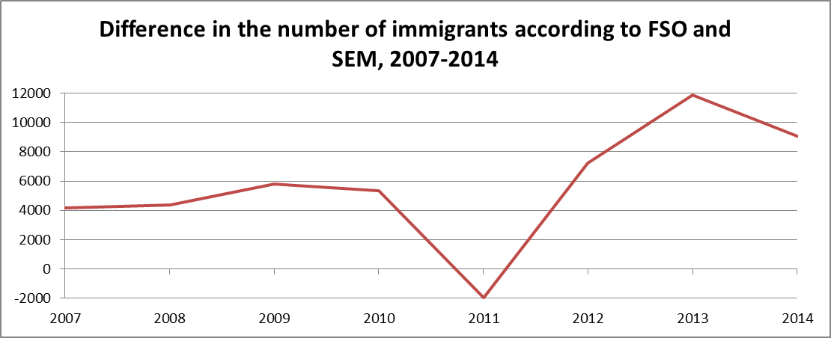
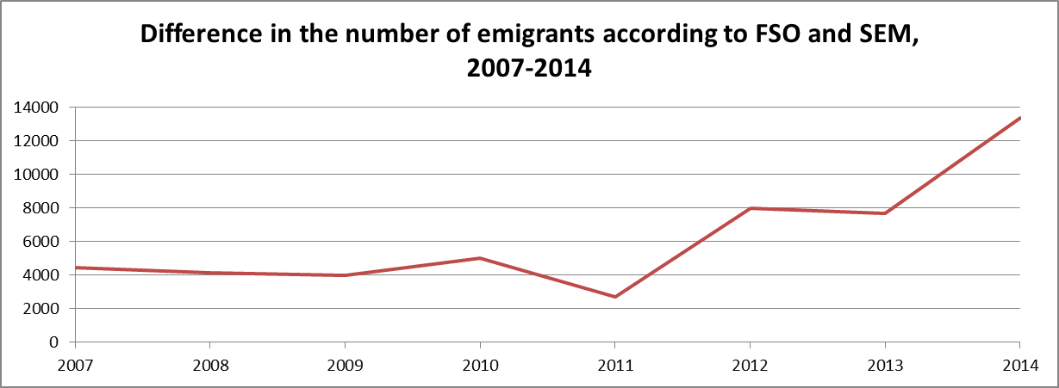
Migration of Non-Nationals (4)
Migration data published by FSO differ from those published by SEM. It is difficult but necessary to explain to policy-makers, stakeholders (and the general public) why such discrepancies exist.

Slide 36
General Findings and Recommendations (1)
major changes in statistics require changes in the legislation concerning the primary data sources
be aware of the procedures used for registration and the information stored in a population register
integrate statistical needs into data collection by administrative authorities (e.g. variables, code lists)
assess periodically the degree of coverage and the quality of data yielded by population registers

Slide 37
General Findings and Recommendations (2)
enable measurement of flows and stocks of international migrants
do not forget national citizens
do not forget emigration (immigration authorities tend to focus on in-migration only…)
international recommendations (concepts, definitions) vs. national information needs

Slide 38
General Findings and Recommendations (3)
choose your principal data source if multiple sources are available
what categories of international migrants have to be identified individually (degree of detail)?
distinguish between permit statistics and migration stock/flow statistics: number of valid permits ≠ number of resident migrants issue of permit ≠ immigration expiry of permit ≠ emigration

Slide 39
Thank you for your attention
Additional information:
Marcel Heiniger
Federal Statistical Office, Demography and Migration Section
email: marcel.heiniger@bfs.admin.ch

