Slide 1
Labour migration: impact on employment and migrant carrier well-being
Why and how EECA region should include labour migration into post-2015 agenda
Marina Manke, Ph.D.
Regional IOM Office in Vienna
Towards better evidence on migration and development in Eastern Europe and Central Asia
Capacity-building workshop on migration statistics
Almaty, 31 October – 1 November 2013

Slide 2








Any place of labour migration in current MDG framework?
NO migration included at goal level
Employment was part of Goal 1 –
“Eradicate extreme poverty and hunger” with
Target 1.B: Achieve full and productive employment and decent work for all, including women and young people
  1.4 Growth rate of GDP per person employed
  1.5 Employment-to-population ratio
  1.6 Proportion of employed people living below $1 (PPP) per day
  1.7 Proportion of own-account and contributing family workers in total employment

Slide 3
Why to include labour migration into post-2015 agenda?
A significant share of migratory processes within EECA are for the purpose of employment
10 % of Moldova and Tajikistan population work abroad
Russia registered 4 times more cases of work-related migration than change of residence-related migration in 2011 (2.1 mln vs. 356 thousand)
Imbalances in labour markets in the region drive and will continue to drive migratory processes
Surplus of labour in Central Asia, Eastern Europe and Caucasus
Shortage of labour in Russia, Kazakhstan and Azerbaijan
Regulation of labour migration has not yet been streamlined to ensure key principles of development:
Right protection
Equality
Sustainability

Slide 4

Illustrative goals for post-2015
Social
Economic
Environmental
End poverty
Gender equality
Quality education
Healthy lives
Food security and good nutrition
Universal access to water, sanitation
Sustainable energy
Jobs, sustainable livelihood and equitable growth
Peace and security
Ensure stable and peaceful societies
Manage natural resources sustainably
Create a global enabling environment and catalyze long-term finance
CROSS-CUTTING
Good governance and effective institutions
Partnership (not among 12 goals, BUT strongly promoted)

Slide 5
How to include labour migration into post-2015 agenda?
Migration
NOT a goal on its own (more migration? Less migration? BETTER MANAGED migration!)
As a significant focus of PARTNERSHIP goal
Within the GOOD GOVERNANCE goal
As a CROSS-CUTTING issue and ENABLER in other thematic goals (e.g. health, education, gender, poverty reduction)

Slide 6
How to include labour migration into post-2015 agenda?
Need to include labour migration at several levels and in several forms of post-2015 agenda

Slide 7
Linking labour migration with sustainable development
MACRO – LEVEL
MICRO-LEVEL
Employment and labour market participation
Via tracking labour market outcomes for migrants as compared to control groups
  Local population?
  Population back at home?
Migrant’s well-being
Objective vs. subjective assessment?
Situation before and after migration?
“Opportunity” cost?

Slide 8
Targets in the making
Regional free movement agreements and labour matching schemes
Reduction of upfront costs for migrants, e.g. recruitment costs, regulation of recruitment industry
Recognition of foreign educational qualifications, skills and portability of social benefits
Ensuring working conditions, wages, occupational safety and health services equal to those among local population
Notes:
Adoption and implementation of regional free movement agreements and/or other trans-border labour matching schemes
Reduction of upfront costs for migrants, especially recruitment costs
Regulation and monitoring of the recruitment industry
Mutual recognition of foreign educational qualifications, skills and the portability of social security benefits, including through the conclusion of bilateral and multilateral agreements
Ensuring working conditions, wages, occupational safety and health services among migrants equal to those among local population

Slide 9
New notions – how to measure and monitor?
Brain circulation (and circular migration)
Social remittances
Portability of social rights
Well-being
Integration

Slide 10
From targets to indicators
SMART
Specific – target a specific area for improvement.
Measurable – quantify or at least suggest an indicator of progress.
Assignable – specify who will do it.
Realistic – state what results can realistically be achieved, given available resources.
Time-related — specify when the result(s) can be achieved

Slide 11
From targets to indicators – “qualitative”?
Advances in global migration and development discourse and action (e.g. GFMD)
Businesses screening their supply chains for forced labour, especially child labour
Recruitment systems that protect human and labour rights of migrants and that facilitate recognition of qualifications and portability of pensions and other social benefits
Existence and effectiveness of frameworks to reduce brain drain within certain professional areas

Slide 12
From targets to indicators – “qualitative” (2)?
Migrants’ freedom to change employers, migrant access to complaint mechanisms
Number of bi- or multi-lateral agreements/ practical mechanisms
  facilitating foreign qualification and skill recognition, facilitating
  social security benefits portability
  labour mobility
Working conditions, wages, occupational safety and health services among migrants as compared to local population

Slide 13
Possible sources: “traditional”
Issued residence permits with the purpose of remunerated activity OR issued work permits
Good for destination countries only
Not disaggregated sufficiently to capture information on migrant characteristics (e.g. economic sector, profession, age etc.)
Labour force surveys
Lack of methodologies for capturing data on migrants
“Ad hoc” module of Eurostat – on labour market integration of migrants
Ad hoc surveys
Irregular
Costly

Slide 14
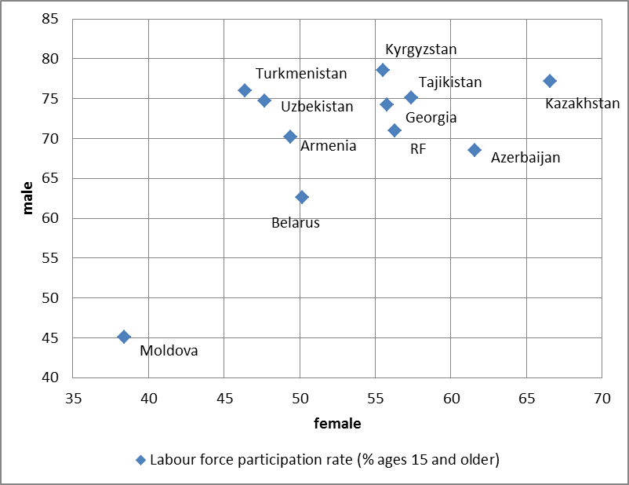
How to include labour migration into post-2015 agenda?
Labour force participation rate (female vs. male) in 2011
Source: UNDP, Human development report, 2013
Is work abroad reflected? Can it be?

Slide 15
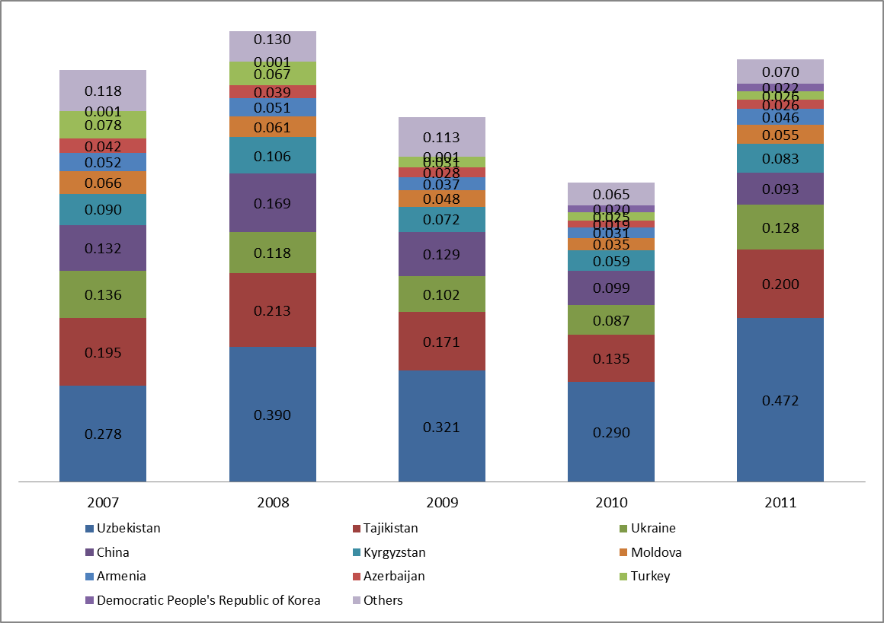
How to include labour migration into post-2015 agenda (2)?
Work permits issued in Russia in 2011
Source: OECD Russia Sopemi report, 2012
Migration data sufficient to track development?

Slide 16

Possible sources: “new”
“Big data” such as social media records, call records, tax records
Opinion polls – e.g. Gallup, World Migration Report

Slide 17
GALLUP WORLD POLL:
A unique source of data on international migration
IV. Key findings: Evidence on migrant well-being
from Gallup World Poll
2009–2011 global database, covering >150 countries
Two methods of comparison:
(a) Migrants (newcomers and long-timers) vs. native-born
(b) Migrants vs. “matched stayers” in origin countries
Some limitations
Migrants |  | Native-born
25,000 |  | >400,000
newcomers <5 years | long-timers >5 years
Notes:
Participants/sample size: Respondents in 150 countries to Gallup’s World Poll survey in 2009, 2010 and 2011 (representing 98% of the world’s total adult population). The typical sample size was 1,000 per country per year. A total of 466,689 responses were included in the analysis, including 441,901 native born residents and 24,788 first generation migrants.
Sample characteristic: Three survey questions were used to determine the migrant category:
i) Were you born in this country, or not? (Respondents who answered “No” were classified as migrants. All other respondents were classified as native born.)
ii) Did you move to this country within the last five years? (Migrants who answered “yes” were classified as Newcomers. Migrants who answered “no” were classified as Long-timers.)
iii) In which country were you born? (Migrants were classified as being born in “North” or “South” using self-reported country of birth.)
Based on responses to these variables and using the World Bank classification for “North” and “South”, the sample was divided up into the 10 comparison groups (= native-born in the South and in the North + newcomers and long-timers for each of the 4 pathways)
2 methods of comparison: Migrant well-being can be analysed in several ways, including their current situation and expectations for the future, differences between newcomers and long-term migrants, and comparisons with the native-born. To obtain the most valuable insights, a twofold approach was adopted when analysing Gallup World data on migrants’ well-being: Comparison between the self-reported well-being of migrants and the native-born in the host country; and a comparison between the self-reported well-being of migrants and native-born in the country of birth. The first analysis examines how migrants fare compared to native-born of the country of destination. To allow a meaning full comparison between native-born, long-timer migrants and newcomers, data had to be adjusted by age, gender, and education. The second comparison allows investigating what migrants have gained and lost by migrating abroad. It sheds light on the extent that migration can be beneficial or disadvantageous for migrants on a personal human development level. This analysis is possible because Gallup World Poll surveys ask the same questions using consistent methodology across the world.
Limitations:
a) Sample does not distinguish irregular migrants, returns, or subcategories of migrants.
b) Sample excludes migrants who may reside in group situations, such as refugee camps.
c) Sample does not include children and adolescents, but only first-generation adults migrants aged 15 years or older.
Data breakdown: Age was measured as a continuous variable (i.e. age in years). However, because of extreme values at the higher end of the distribution, age was collapsed into 8 categories. Sex was measured as male or female as recorded by the interviewer. Educational achievement was measured on different scales for each country, based on the educational system of the country. However, for the global analysis, education was assessed as a 3 category variables – primary school or less, some secondary school through 3 years tertiary, equivalent of 4-year bachelor degree or more.

Slide 18
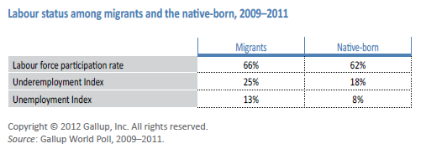
IV. Key findings: Evidence on migrant well-being
from Gallup World Poll
Career well-being
Globally, migrants have a higher rate of labour force participation, underemployment and unemployment, compared to natives.
Notes:
Career well-being refers to well-being in the context of career and employment. To assess levels of career well-being, Gallup examines, inter alia, individuals’ employment status, their views about their own job situation, and their perceptions of opportunities for entrepreneurship, including the potential obstacles to setting up a business.
Among those in the workforce, Gallup’s employment metrics allow for a calculation of the percentage of migrants working full time for an employer, the percentage of unemployed, and the percentage of underemployed:
Unemployment: The Gallup Unemployment Rate is the percentage of unemployed adults who actively looked for work within the preceding four weeks, and could have begun to work in that time frame. Gallup’s unemployment measure is comparable to the Bureau of Labor Statistics (BLS) and the International Labour Organization (ILO) unemployment calculations.
Underemployment: The Gallup Underemployment Index measures the percentage of adults in the workforce who are working at less than the desired capacity. People are classified as ‘underemployed’ if they are employed part time but want to work full time OR if they are unemployed but want to be working.
Labour Participation Rate: Gallup estimates that about 62 per cent of all adults worldwide are in the labour force. For migrants this percentage is slightly higher (66%). These individuals are either currently employed or actively seeking, and able to begin, work. Gallup’s Labour Force Participation Rate measures the percentage of the adult population (aged 15 and older) that is in the labour force.

Slide 19
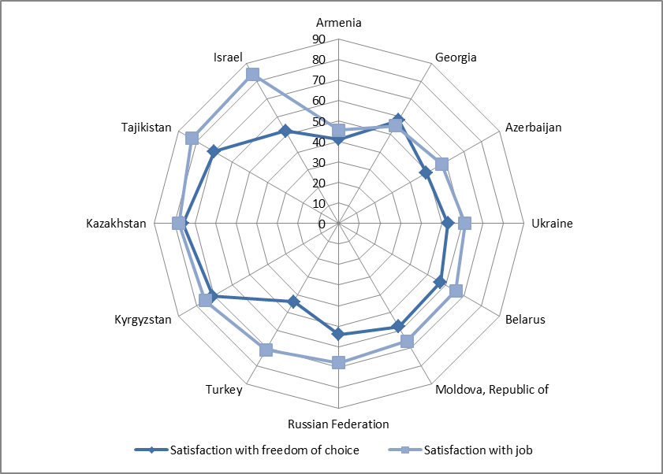
How to include labour migration into post-2015 agenda (3)?
Satisfaction with freedom of choice and job in 2011
Source: UNDP, Human development report, 2013
“Subjective” indicator. Realistic to gather?

Slide 20
Answers – in break-out groups!
THANK YOU! mmanke@iom.int

