Slide 1
Assessing Competitiveness
The use of composite indexes for benchmarking progress
Geneva, 21.10.2014

Slide 2



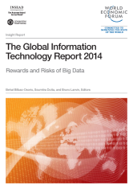

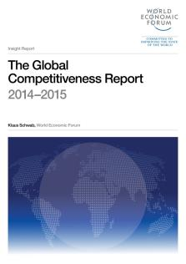
The Global Competitiveness & Benchmarking Network
Flagship product:
The Global Competitiveness Report series
Launched in 1979 covering 16 countries
GCR 2014-2015: 144 economies
Other special topic and regional reports:
The Global Information Technology Report
The Global Enabling Trade Report
The Travel & Tourism Competitiveness Report
The Gender Gap Report
The Europe 2020 Competitiveness Report

Slide 3
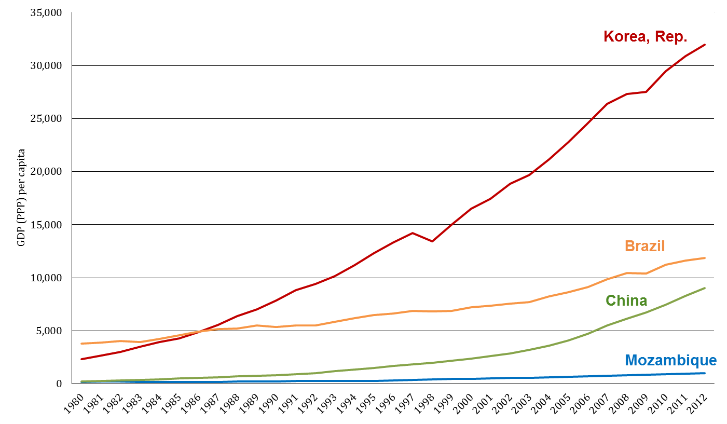
What we aim to measure:
What lies behind different growth paths?
Source: IMF, World Economic Outlook database, April 2014 edition

Slide 4

The Global Competitiveness Index (GCI)
“
The set of institutions, policies, and factors that determine the level of productivity of a country.
The level of productivity,
in turn, sets the level of prosperity that can be
earned by an economy.
”

Slide 5
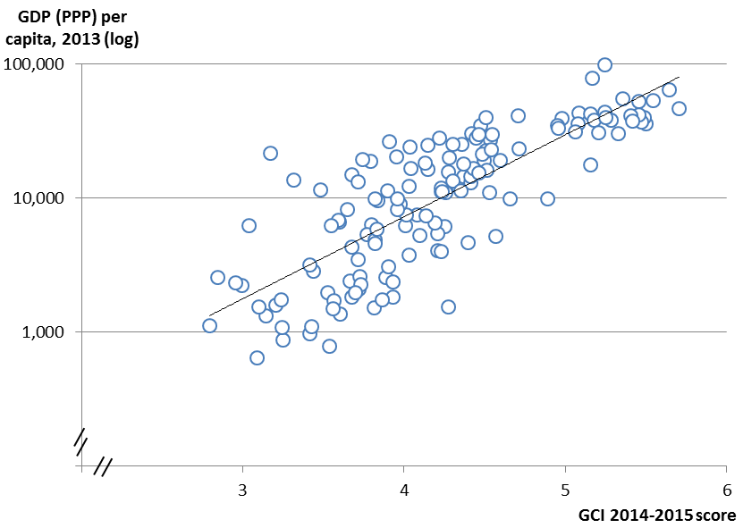
More competitive economies tend to produce higher levels of income
Sources: World Economic Forum; IMF.

Slide 6





The Data
Quantitative data sourced from leading international organizations
Qualitative data sourced from the annual Executive Opinion Survey carried out by the network of the 160+ World Economic Forum’s Partner Institutes.
Survey the perception of 15,000 business leaders Worldwide

Slide 7
Data treatment
Executive Opinion Survey data
  Exclusion of incomplete, duplicate and “straight answers” surveys.
  Exclusion of outliers based on multivariate test (Mahalanobis distance method) to estimates the probability that an individual survey in a specific country “belongs” to the sample of that country.
  Scores are calculated based on a moving average (2 years), taking into account the sample size of each year
Hard data
  No data imputation, we only use indicators that cover over 90% of the countries in our sample.
  Min-max normalization to align hard data with Survey data
Aggregation
  Simple average at all stages (except for the GCI and EAPI)

Slide 8
A Range of Indexes
Index
What does it measure?
Indicators
Global Competitiveness Index
The set of institutions, policies, and factors that determine the level of productivity of a country
144 Economies (Yearly)
14 Pillars
114 Indicators (70%survey / 30%hard)
Network Readiness Index
The ability of economies to leverage ICT to boost competitiveness and well-being
144 Economies / (Yearly)
10 Pillars
54 Indicators (50%survey / 50%hard)
T&T Competitiveness Index
The set of factors and policies that enable the sustainable development of the Travel & Tourism sector, which in turn, contributes to the development and competitiveness of a country
140 Economies (Biennial)
14 Pillars
79 Indicators (40%survey / 60%hard)
The extent to which economies have in place institutions, policies, infrastructures and services facilitating the free flow of goods over borders and to their destination
138 Economies (Biennial)
7 Pillars
61 Indicators (40%survey / 60%hard)
Enabling Trade Index
Smart (knowledge based); Sustainable (resource efficient) and Inclusive (high employment and cohesive) growth
28 Economies (Biennial)
7 Pillars
71 Indicators (60%survey / 40%hard)
Europe2020 Comp. Ind
Gender Gap Index
Benchmarks national gender gaps on economic, political, education, and health-based criteria.
136 Countries (Yearly)
4 Pillars
14 Indicators (10% Survey / 90% hard)
Energy Architecture Performance Index
The ability to provide a secure, affordable and
environmentally sustainable energy supply
124 Countries (Biennial)
3 Pillars
18 Indicators (5% Survey / 95% hard)

Slide 9












The Indexes in details (1/7)
The Global Competitiveness Index
1.Institutions
5.Higher education and training
11. Business sophistication
6. Goods market efficiency
2.Infrastructure
12. Innovation
3.Macroeconomic environment
7. Labor market efficiency
4.Health and primary education
8. Financial market development
9. Technological readiness
10. Market size
Innovation and sophistication factors
Basic requirements
Efficiency enhancers

Slide 10
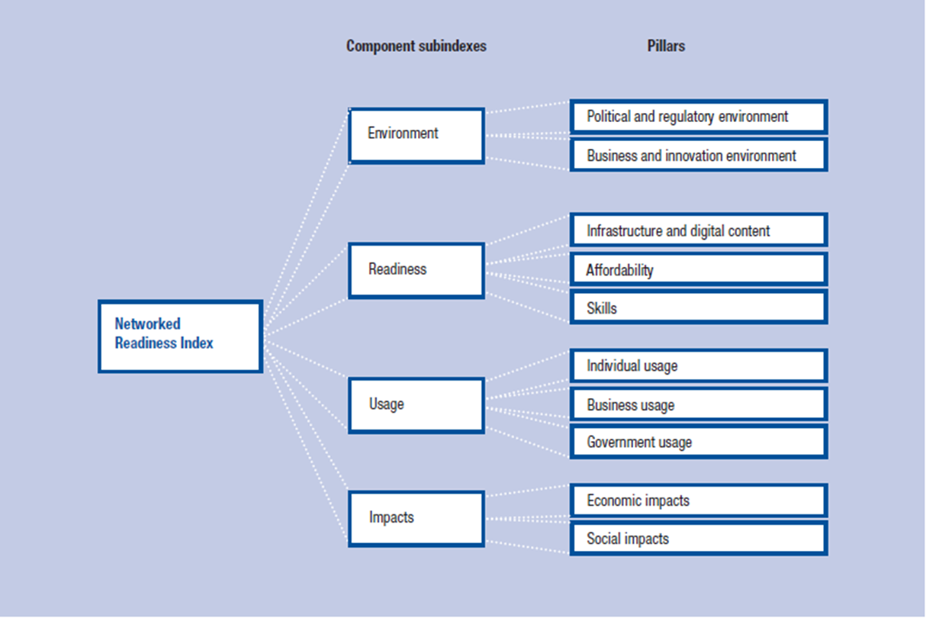
The Indexes in details (2/7)
The Networked Readiness Index

Slide 11
The Indexes in details (3/7)
The T&T Competitiveness Index
T&T Regulatory framework
T&T Business environment and infrastructure
T&T Human, cultural and natural resources
1. Policy rules and regulations
6. Air transport infrastructure
11. Human resources
2. Environmental sustainability
7. Ground transport infrastructure
12. Affinity for T&T
3. Safety and security
8. Tourism infrastructures
13. Natural resources
4. Health & hygiene
9. ICT infrastructure
14. Cultural resources
5. Prioritization of T&T
10. Price competitiveness in the T&T industry

Slide 12






The Indexes in details (4/7)
The Global Enabling Trade Index
A. Market access
B. Border administration
C. Infrastructure
Pillar 2:
Foreign market access
Pillar 1:
Domestic market access
Pillar 3:
Efficiency and transparency of border administration
Pillar 4:
Availability and quality of transport infrastructure
Pillar 5:
Availability and quality of transport services
Pillar 6:
Availability and use of ICTs
6
2
11
7
6
7
D. Operating environment
Pillar 7: Operating environment
17
Foreign market
Domestic market

Slide 13
The Indexes in details (5/7)
The Europe2020 Competitiveness Index
Europe 2020 Flagship Initiatives
The Europe 2020 Competitiveness Index
– Seven pillars
An industrial policy for the Globalization Era
Enterprise environment
A Digital Agenda for Europe
SMART
Digital agenda
Innovation Union
Innovative Europe
Youth on the Move
Education and training
INCLUSIVE
Labour market and
employment
An agenda for New Skills and Jobs
European Platform Against Poverty
Social inclusion
SUSTAINABLE
Environmental sustainability
Resource-Efficient Europe

Slide 14
The Indexes in details (6/7)
The Global Gender Gap Index
Economic participation and opportunity
Political empowerment
Educational attainment
Health and survival
Four critical areas for measuring the gender gap

Slide 15
The Indexes in details (7/7)
The Energy Architecture Performance Index

Slide 16




Our audience
Policymakers and public institutions (e.g. government ministries, investment promotion agencies, etc.): To measure the situation in particular countries in comparison with the performances of other countries.
International organizations, development organizations, etc.: To benchmark policy effectiveness and progress.
Business leaders: To enter into concrete policy discussions with government about improving the environment for doing business; to assess the business environment of selected countries when taking investment decisions.
Academia: To conduct quantitative research and further our understanding about the drivers of national competitiveness.

Slide 17
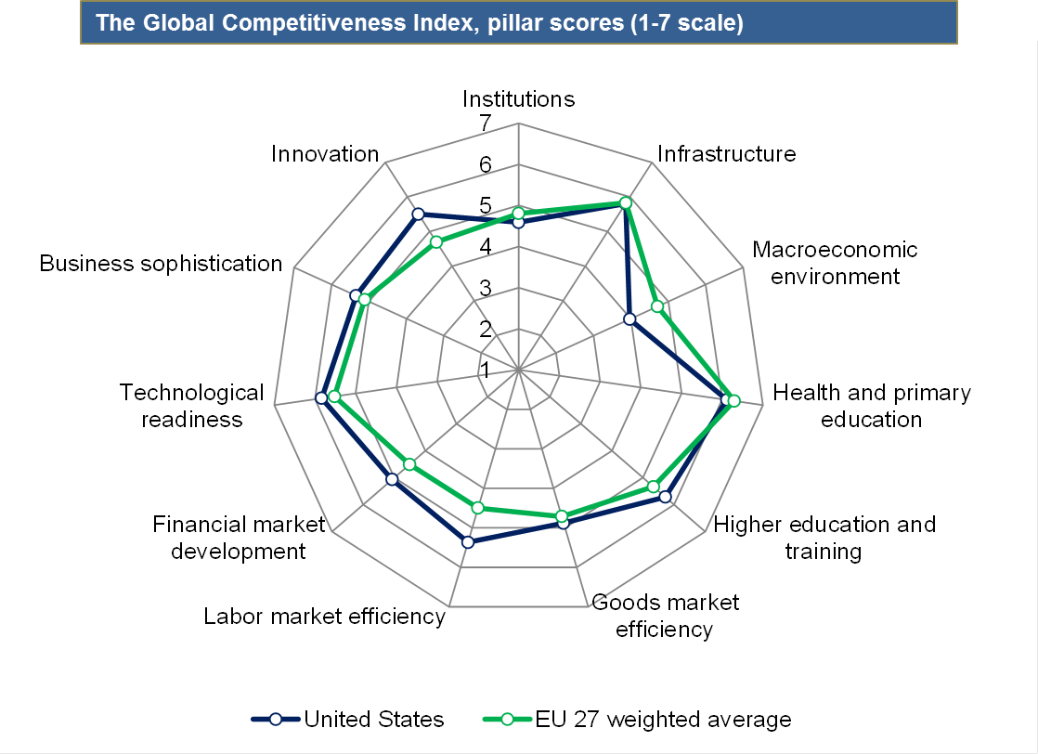
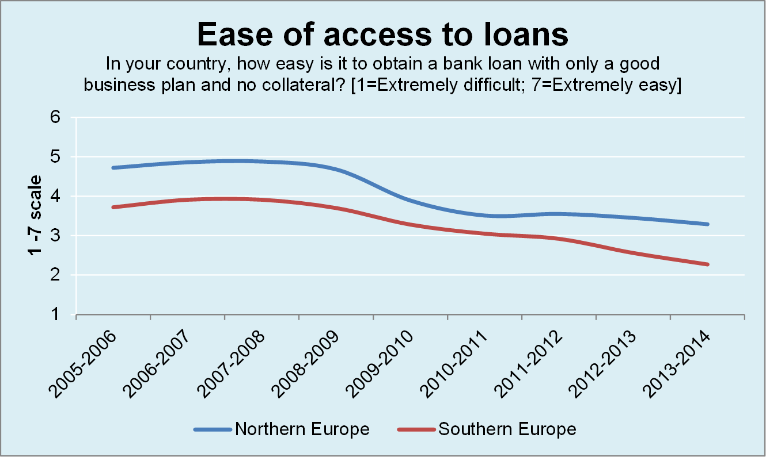
How are the indexes used ?
Compare performances
Track progress

Slide 18
Main learnings and questions in using composite indexes
  Definition and index structure: What are the key dimensions to measure? Thorough literature review consultations with experts are key to build robust indexes.
  Selection of indicators: Select indicators that are widely available, linear, non-binary, updated on a constant basis.
  Distribution of indicators across pillars: PCA analysis can provide an initial guidance, yet, the range of indicator should also allow for storytelling.
  Weighting: Is there a justification for a specific pillar weighting schemes? In absence of theoretical guidance, use equal weighting, keeping in mind that the number of indicators used determines an implicit weighting of factors.
  Normalization: Are there optimal policy targets for each indicator? In absence of clear policy optimum, use statistical rationale.

Slide 19

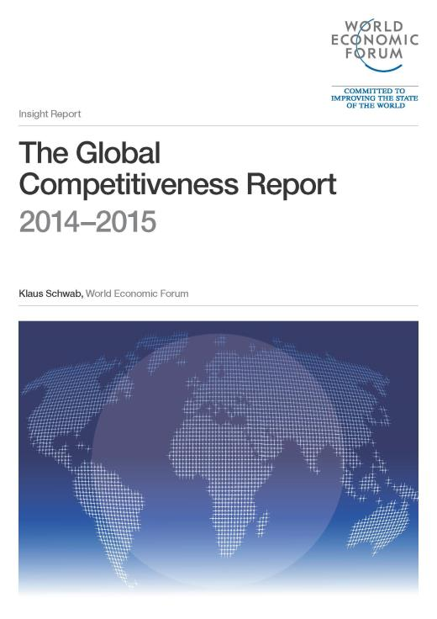
Q&A
Visit our website for further information and to download the Report:
www.weforum.org/gcr

Slide 21
Additional topics for discussion:
2. Sustainability-adjusted GCI
Global Competitiveness Index (GCI)
Social sustainability pillar
Environmental sustainability pillar
Main concepts:
Income inequality
Youth unemployment
Access to basic needs
Vulnerable employment
Main concepts:
Environmental regulation
Environmental degradation
Fish stock depletion
Forest loss
Water use
Social sustainability-adjusted GCI
(GCI) × (social sustainability coefficient)
Environmental sustainability-adjusted GCI
(GCI) × (environmental sustainability coefficient)
Sustainability-adjusted GCI

