Slide 1
Three layer model
ABS Presentation Layer
Other’s Presentation Layers
Our Retail
Wholesale to other parties
Static ABS Web Site
Dynamic ABS Web Site
Mobile Apps
3rd party portals
ABS Applications
Remote Access to Microdata
Content Aggregators
Government or Industry Systems
ABS Delivery Layer (provided by the ABS)
SDMX API/Web service
Other API/Web Service
‘Confidentiality on the Fly’ services
ABS Content Layer (held at the ABS)
Macro data
Micro data
Meta Data
Other Content types

Slide 2
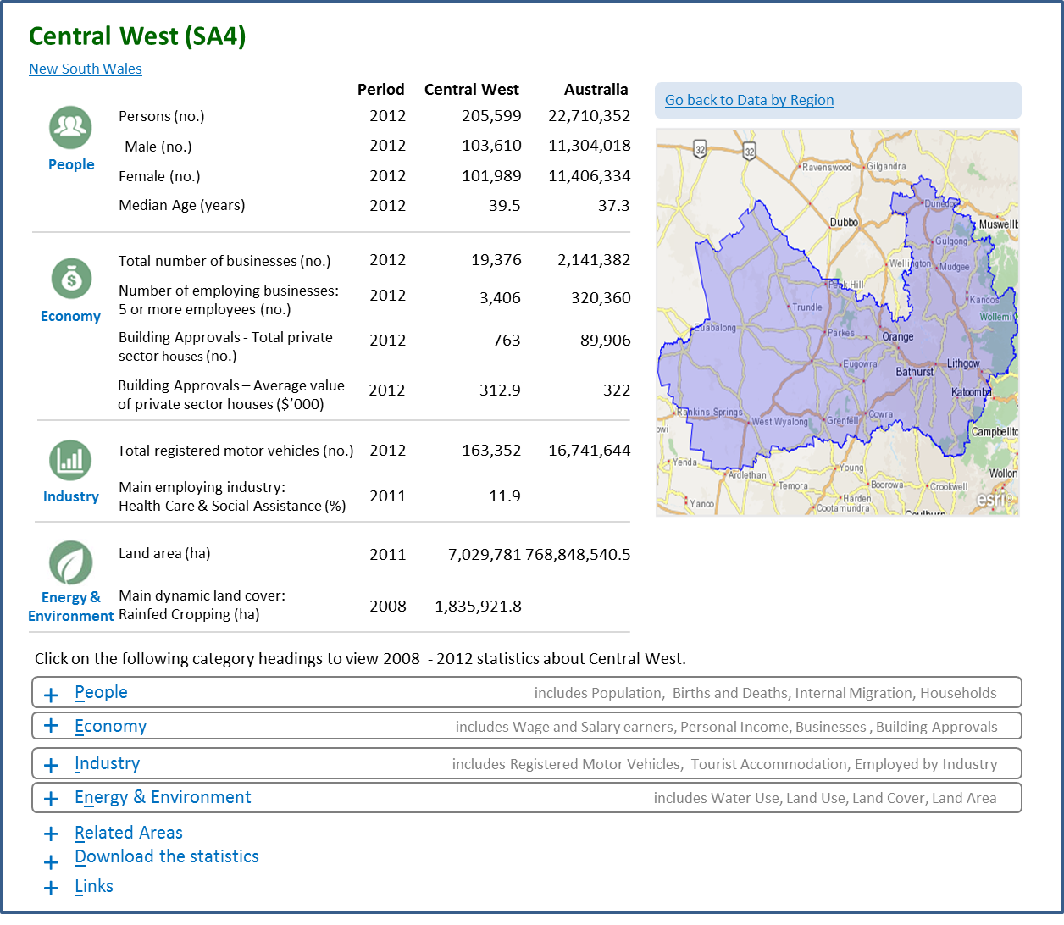
An example – Data by Region

Slide 3
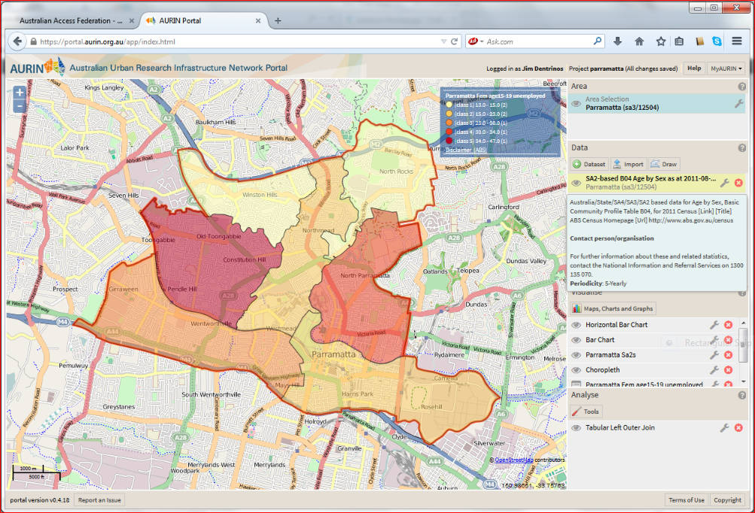
An Example - AURIN

