Slide 1
Generic Statistical Information Model
(GSIM)
Thérèse Lalor
United Nations Economic Commission for Europe (UNECE)

Slide 2

The Challenges
Riding the big data wave
Increasing cost & difficulty of acquiring data
New competitors & changing expectations
Competition for skilled resources
Rapid changes in the environment
Reducing
budget
Notes:
ABS, like other National Statistical Institutions, faces shared constraints and challenges.
External Challenges
rapidly changing external environment
More sophisticated users
Demand for timeliness and responsiveness
increasing demand for more accessible and ‘joined up’ data to solve complex policy questions
Constraints
Reduced funding and volatility in funding
Our costs are increasing significantly – unable to contact many households, response rates dropping, difficult to recruit and retain interviewers
skills shortages – competing for statistical and ICT skills across government
complex work programs
siloed processes
and aging infrastructure
2

Slide 3
These challenges are too big for statistical organisations to tackle on their own.
We need to work together

Slide 4
Response from Official Statistics

Slide 5

Response from Official Statistics

Slide 6
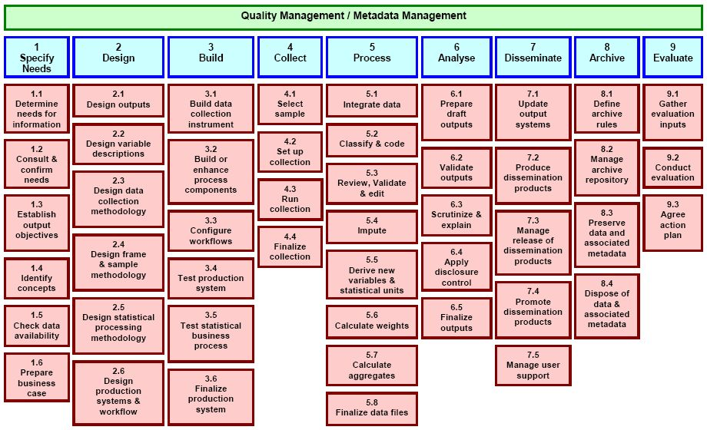
The GSBPM

Slide 7
Information objects
Things that flow between GSBPM sub-processes
Things that drive and integrate sub-processes

Slide 8
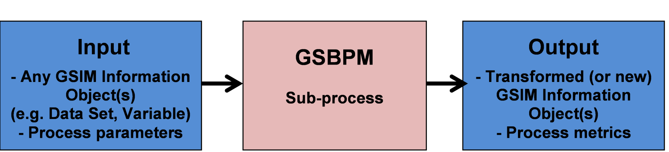
GSIM is complementary to GSBPM
Another model is needed to describe information objects and flows within the statistical business process
Notes:
7. Across the world statistical organizations undertake similar activities albeit with variation in the processes each uses. Each of these activities use and produce similar information (for example all organizations use classifications, create data sets and publish products). Although the information used by statistical organizations is at its core the same, all organizations tend to describe this information slightly differently (and often in different ways within each organization). There has been no common way to describe the information we use.
8. GSIM defines and describes the pieces of information (called information objects) that are important to statistical organizations. It also gives users the relationships between the information objects. By describing statistical information in a consistent way, statistical organizations become able to communicate unequivocally and to collaborate more closely (both at a national and international level).

Slide 9
So what is GSIM?
A reference framework of information objects:
  Definitions
  Attributes
  Relationships
GSIM aligns with relevant standards such as DDI and SDMX
GSIM gives us standard
terminology

Slide 10

Business
Production
Structures
Concepts
Notes:
10

Slide 11
How to use GSIM as a communication tool
Improve communication
Simple, easy to understand views of complex information
Build staff capability by using GSIM as a teaching aid
Notes:
26. A major barrier to effective collaboration within and between statistical organizations has been the lack of common terminology.
27. A 'survey' in Statistics Canada, for example, is a 'survey instance' according to the UNECE, a 'collection cycle' according to Australian Bureau of Statistics, and a 'study' according to the external research community. These examples are just the tip of the iceberg.
28. This has made it difficult to communicate clearly within and between statistical organizations and without a common statistical language, there is no foundation for in-depth collaboration, standardization, or sharing of tools and methods.
29. GSIM, as the unifying 'common language' for official statistics, will enable rationalization, cooperation and collaboration within and between statistical organizations.
30. GSIM provides staff with simple, easy to understand views of complex information. By describing statistical information in a consistent way, statistical organizations become able to communicate unequivocally and collaborate more closely.
31. Information can be a vague concept. Often when staff are asked to describe the information that is the input to and output from a statistical process, this can be a difficult task. It is difficult because most people don't know where to start.
32. GSIM can be used to educate staff. It gives them a framework for thinking about information. It provides a common terminology to describe the processes and their inputs and outputs that are used to generate official statistics. At the simplest level, staff could look at Figure 2 (below) and start to identify whether these information objects are relevant to them.
By providing these simple views on statistical information, GSIM can be used as a way to help staff understand what technical standards such as Data Documentation Initiative (DDI) and Statistical Data and Metadata eXchange (SDMX) describe. If staff can relate these standards to more familiar terms, they become easier to understand and use. For example, knowing that in DDI a 'Universe' is the same as the Population information object in GSIM helps.
35. Using GSIM as a common language will increase the ability to compare within and between statistical organizations. All processes that lead to the production of statistics can be described in this one integrated model. This includes the analysis of business needs, the establishment of statistical programs, the development and management of statistical methods, the design of production processes and their cyclical execution.
36. For example, GSIM can be used by staff (at all levels) to share and compare the concepts used in their work. It is also agnostic of subject matter, so it can be used to compare statistical production across subject matter departments.

Slide 12
Statistical Program
Production Activity
Process Input
Process Method
Statistical Program Design
Process Step
Production
Dissemination Activity
Acquisition Activity
Rule
Process Output
Business
Concepts
Data Set
Data Point
Variable
Population
Data Structure
Structures
Concept
Data Resource
Product
Unit
Classification

Slide 13
GSIM is a conceptual model:
It is a new way of thinking for statistical organizations
Notes:
The conceptual model is explicitly chosen to be independent of design or implementation concerns,
The aim of a conceptual model is to express the meaning of terms and concepts used by domain experts to discuss the problem, and to find the correct relationships between different concepts.
The conceptual model attempts to clarify the meaning of various, usually ambiguous terms, and ensure that problems with different interpretations of the terms and concepts cannot occur.
Such differing interpretations could easily cause confusion amongst stakeholders, especially those responsible for designing and implementing a solution, where the conceptual model provides a key artifact of business understanding and clarity.
Once the domain concepts have been modeled, the model becomes a stable basis for subsequent development of applications in the domain. The concepts of the conceptual model can be mapped into physical design or implementation constructs
13

Slide 14
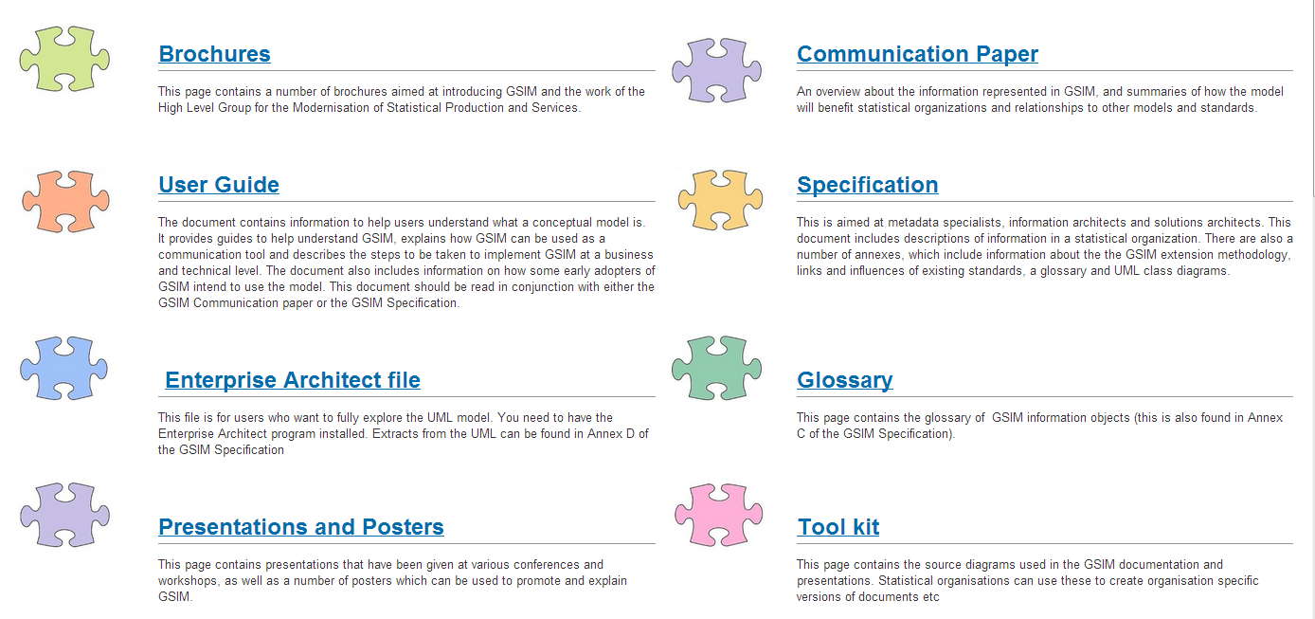
GSIM documentation
Notes:
There are many layers to the GSIM documentation!

Slide 15
Statistical Need
may initiate
Business Case
initiates
Statistical Program
Design
Statistical Program
changes
design of
has
identifies
defines
CONCEPTS
Acquisition Activity
Production Activity
Dissemination Activity
Concept
describes
Population
specifies
comprises
includes
may include
Process Input
defines
measures
comprises
specifies
Classification
Variable
Unit
Process Step
uses
Statistical Activity
is
associated
with
specifies
describes
has
Process output
STRUCTURES
may include
BUSINESS
PRODUCTION
Data Structure
has
Data Set
includes
Data
Resource
uses
Data Channel

Slide 16
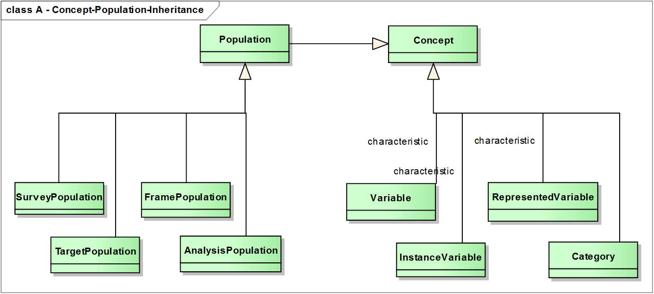

Slide 17

Can I implement GSIM?
Notes:
Yes and no

Slide 18
GSIM: The “sprint’ approach
The HLG decided to accelerate the development of the GSIM using an Agile approach.
Sprints
Collaboration of multi-disciplinary experts
A “time-boxed” period of work, and
A closely defined and agreed output
Notes:
Locked people in rooms
18

Slide 19
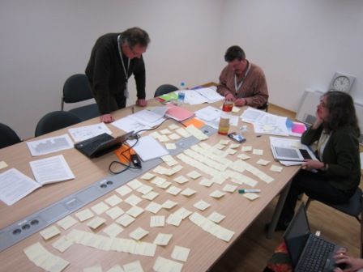
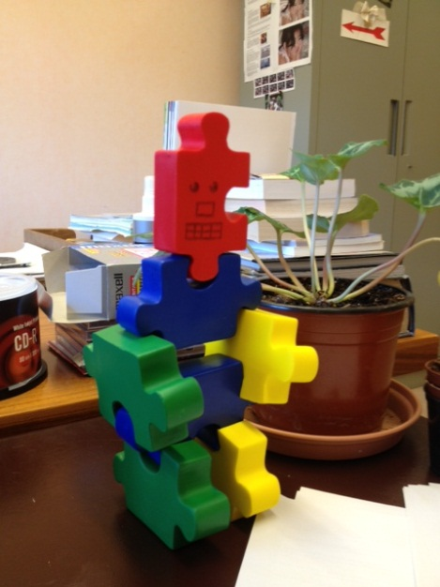
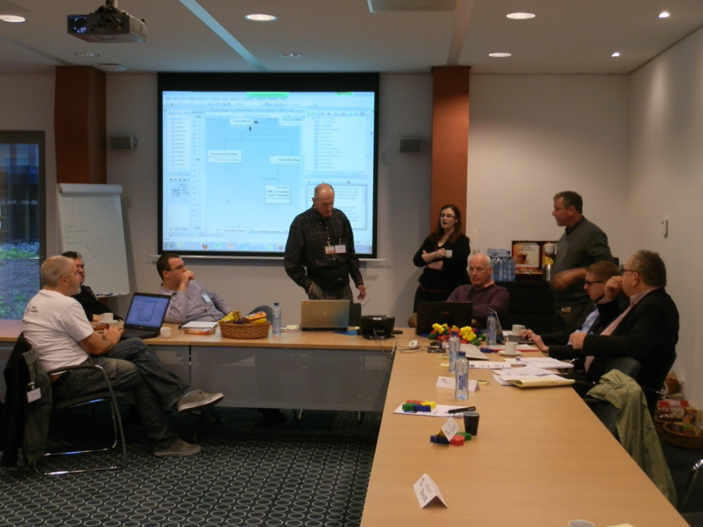
GSIM: The “sprint’ approach
Sprint 1 – Slovenia, February 2012
Sprint 2 – Republic of Korea, April 2012
Integration Workshop, Netherlands, September 2012
Notes:
Locked people in rooms
19

Slide 20
Developing GSIM

Slide 22
Get involved!
Anyone is welcome to contribute to this work.
There are lots of resources on the wiki for you to use:
http://www1.unece.org/stat/platform/pages/viewpage.action?pageId=59703371

