Slide 2
2013 HLG Project
“support the enhancement and implementation of the standards needed for the modernisation of statistical production and services”

Slide 3
Objectives
To ensure access to the standards
To increase coherence between these standards
To provide support mechanisms for the practical implementation
To ensure promotion and maintenance of the GSBPM and the GSIM,

Slide 4
Implementing GSIM
GSIM Implemention Group
providing support for a community of GSIM “early adopters”
forum for the exchange of experiences

Slide 5
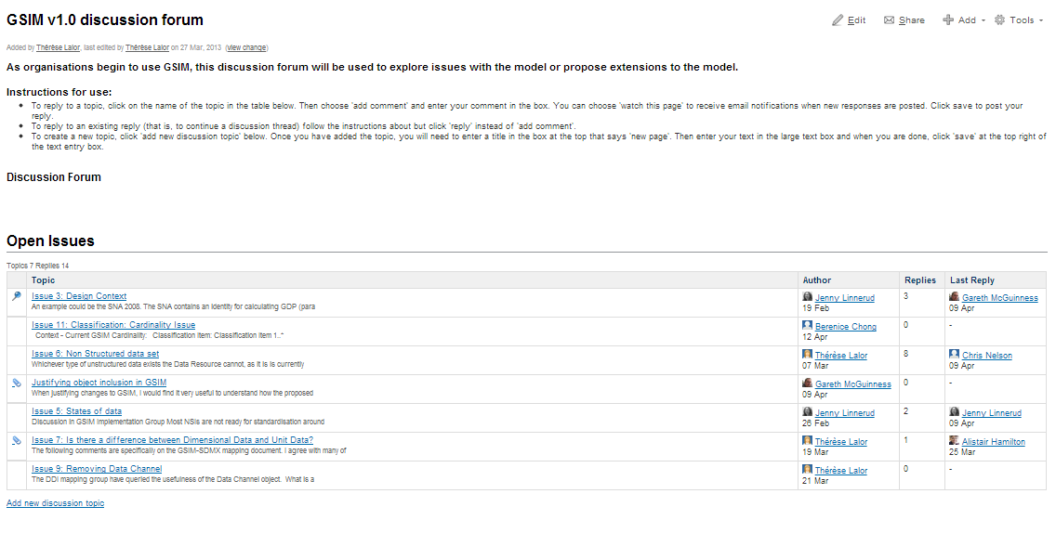
http://www1.unece.org/stat/platform/display/metis/GSIM+v1.0+discussion+forum

Slide 6
Mapping GSIM to DDI and SDMX
Detailed mapping between the information objects in the GSIM, with those in the information models of DDI and SDMX.
Aims to identify any issues affecting the coherence of these standards
Propose solutions where possible

Slide 7
Revising GSBPM
Gather feedback from users on potential changes to the model.
Possible new version of GSBPM
http://www1.unece.org/stat/platform/display/metis/GSBPM+discussion+forum

Slide 8
Links to geo-spatial standards
A task team is being launched to do an initial assessment of the role of geo-spatial standards in the modernisation of official statistics

Slide 9
Training, advocacy and communication
Standards are good!

Slide 10
Get involved!
Anyone is welcome to contribute to this work.

