Slide 1

2013 HLG Project:
Common Statistical Production Architecture

Slide 2
The problem
2 big barriers that hinder modernisation of statistical organisations are:
  Rigid processes and methods; and
  Inflexible and ageing technology environment.

Slide 3
Collect
Process
Analyse
Disseminate
Survey A
NSI 1
Survey B
Historically statistical organisations have produced specialised business processes and IT systems

Slide 4
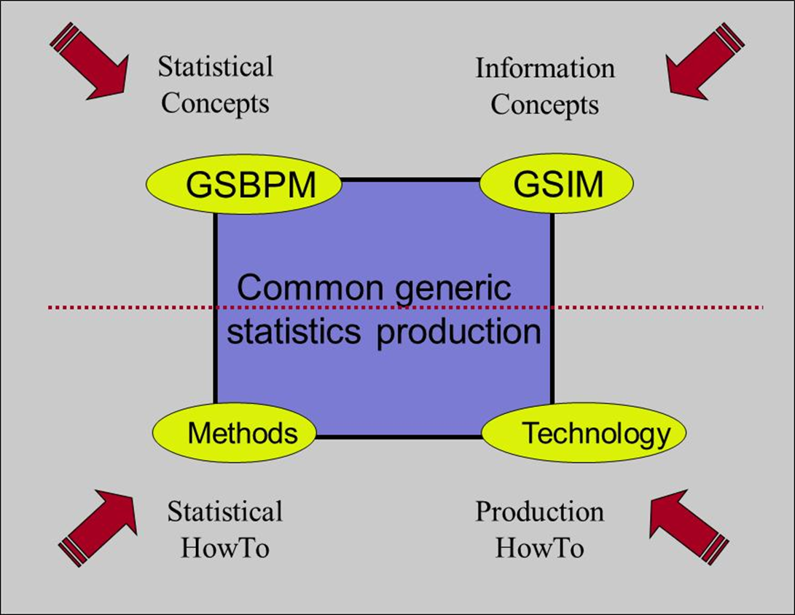

Now we have an agreed conceptual basis to move forward on, we can focus on “How To”

Slide 5

Desired Project Outcomes
Increased:
interoperability in Official Statistics through the sharing of processes and components
ability to find real/genuine collaboration opportunities
ability to make international decisions and investments
sharing of architectural/design
knowledge and practices

Slide 6
How does Architecture help?
Many statistical organisations are modernising and transforming using Enterprise Architecture
Enterprise architecture shows what the business needs are, where the organisation wants to be and aligns the IT strategy to this.
It can help to remove silos and improve collaboration across an organisation.

Slide 7
EA helps you get to this
Survey A
Survey B
NSI 1
Survey C
Collect
Process
Analyse
Disseminate

Slide 8
…but if each statistical organisation works by themselves…..

Slide 9


…we get this….
Collect
Process
Analyse
Disseminate
Canada
Sweden

Slide 10
This makes it hard to share and reuse!
Collect
Process
Analyse
Disseminate
Canada
?
Sweden
?

Slide 11
…but if statistical organisations works together?

Slide 12
Common Statistical
Production Architecture
An industry architecture will make it easier for each organisation to standardise and combine the components of statistical production, regardless of where the statistical services are built

Slide 13
An industry architecture is:
“set of agreed common principles and standards designed to promote interoperability in an industry”
“an architecture template for statistical production”
“common vocabulary to discuss implementations”
“enables the vision and strategy of an industry, showing a clear picture of how to get there”

Slide 14
It has 4 layers
Business Architecture
Information Architecture
Application Architecture
Technology Architecture

Slide 15
Based on Service Oriented Architecture
A Statistical Service:
  is a representation of a business activity with a specified outcome
  is self contained
  performs a task in a business process
  can be reused in a number of business processes

Slide 16
Based on Service Oriented Architecture
Project is sometimes called “plug and play”
  Statistical service is the pluggable bit
  The idea is that installing a new statistical service should be easy

Slide 17


This makes it easier to share and reuse!
Collect
Process
Analyse
Disseminate
Canada
?
Sweden
?

Slide 18


Lego pieces could be:
Wrapped legacy/existing
Brand new

Slide 19
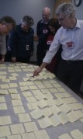
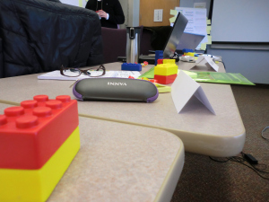
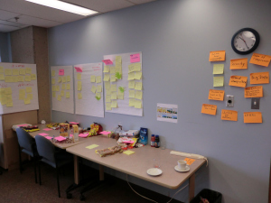
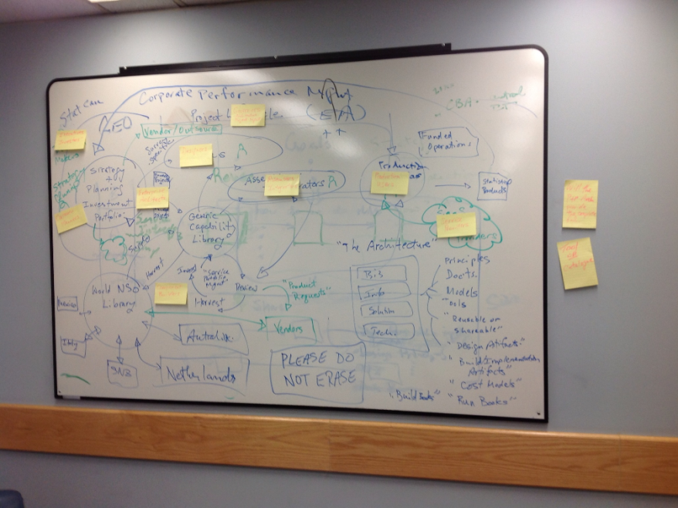
Architecture Sprint!

Slide 20
Design Artefacts

Slide 21


Slide 22

GSIM and GSBPM-processes
GSIM object structures
(formats)
GSBPM -process
GSIM object instances
http://www.illeccio.com/page.php?lang=en&product_id=37

Slide 23
Quality Attributes
GSBPM –
Compliance
GSIM –
Compliance
Statistical Service
Architectural Pattern

Slide 24
User Stories
Architecture gives an industry strategy
  Gives common To Be state for statistical organisations
  Helps statistical organisations to transition
  Aligns roadmaps to achieve future industry vision
  International investment
  Catalogues show what statistical services exists
  Genuine collaboration opportunities
Collaborating
  Adapting an existing statistical service or designing new ones
  Hosting/Deploying services available to all organisations
  Influencing vendors to align to industry requirements

Slide 25

Proof of Concept
Demonstrate the process of working together
  Advantages in cooperation
Demonstrate business viability to senior management
  There are benefits to pursuing this
  Show it is feasible
  Give energy to idea
Prove the value of the Architecture
  Here is something that we could not do before

Slide 26
Get involved!
Anyone is welcome to contribute to this work.
CSPA v0.1 is out for public review until 17 May:
http://www1.unece.org/stat/platform/display/msis/CSPA+v0.1

