Slide 1
Aarhus Convention The role of public interest litigation in environmental matters Csaba Kiss, EMLA, Justice & Environment
Twenty-fourth meeting of the Working Group of the Parties to the Aarhus Convention, on site (28 - 29 October 2020), Tempus 2, Palais des Nations, Geneva, Switzerland

Slide 2
What is Public Interest Litigation?
The PILS Project
https://www.pilsni.org/about-public-interest-litigation
Public interest litigation is the use of the law to advance human rights and equality, or raise issues of broad public concern. It helps advance the cause of minority or disadvantaged groups or individuals.
Public interest cases may arise from both public and private law matters.
Public interest litigation is most commonly used to challenge the decisions of public authorities by judicial review.
Judicial review is concerned with whether the law has been correctly applied, and the right procedures have been followed.

Slide 3
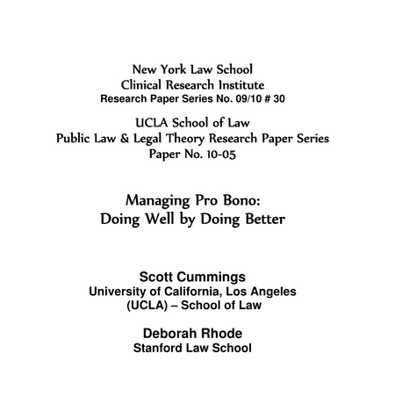
Impacts of Public Interest Litigation
Cummings, Scott L., Rhode, Deborah L.: Public Interest Litigation: Insights from Theory and Practice (2009)
[…] over the past three decades, critics from both the left and right have challenged its capacity to secure systemic change.
The first is that litigation cannot itself reform social institutions.
The second related concern is that over-reliance on courts diverts effort from potentially more productive political strategies and disempowers the groups that lawyers are seeking to assist.
The result is too much law and too little justice.

Slide 4
No systemic change?
Information
Bayer Crop Science (C-442/14)
The definition of information on emissions into the environment “covers information concerning the nature, composition, quantity, date and place of the ‘emissions into the environment’ of plant protection products and biocides and substances contained therein, and data concerning the medium to long-term consequences of those emissions on the environment, in particular information relating to residues in the environment following application of the product in question, and studies on the measurement of the substance’s drift during that application, whether those data come from studies performed entirely or in part in the field or from laboratory or translocation studies.”

Slide 5
No systemic change?
Participation
Trianel (C-115/09)
In the Trianel case, the Court of Justice made it clear that, although the EIA Directive allows Member States to require individuals to demonstrate the impairment of an individual public law right to have standing, this cannot be required of NGOs recognised as the public concerned. It also confirmed that when challenging a decision under the EIA Directive, NGOs may rely on infringements of EU law which protect the general interest.

Slide 6
No systemic change?
Justice
Slovak Brown Bear (C-240/09)
Aarhus Convention Article 9(3) was not sufficiently precise and unconditional to have direct effect. Despite these factors, the EU Court held that national procedural law must be interpreted, so far as possible, in a manner that is consistent with the objectives of Article 9(3) AC that is to provide standing to NGOs.

Slide 7
Acknowledgement of importance
Proposal for a DIRECTIVE OF THE EUROPEAN PARLIAMENT AND OF THE COUNCIL on access to justice in environmental matters (2003)
https://ec.europa.eu/transparency/regdoc/rep/1/2003/EN/1-2003-624-EN-F1-1.Pdf
In addition, the lack of enforcement of environmental law is too frequently due to the fact that legal standing is limited to persons directly affected by the infringement. A way of improving enforcement is hence to ensure that representative associations seeking to protect the environment have access to administrative or judicial procedures in environmental matters. Practical experience gained from granting legal standing to environmental non-governmental organisations indicates that this can enhance the implementation of environmental law.
COMMUNICATION FROM THE COMMISSION TO THE EUROPEAN PARLIAMENT, THE COUNCIL, THE EUROPEAN ECONOMIC AND SOCIAL COMMITTEE AND THE COMMITTEE OF THE REGIONS Improving access to justice in environmental matters in the EU and its Member States (2020)
https://ec.europa.eu/environment/aarhus/pdf/communication_improving_access_to_justice_environmental_matters.pdf
[…] the Commission will support Members States and step up its work to engage actively with civil society and public authorities to achieve full implementation of applicable EU environmental law.

Slide 8
Conditions of PIL
Getting better
Austria: online court hearings, frozen judicial procedural deadlines, small NGO funding for paying rent
Spain: a non-profit environmental organization with recognized legal aid under the Aarhus Law is not required to pay the court costs
Ukraine: Supreme Court’s consistent legal position on wide standing in Article 9.3 cases
Getting worse
Slovenia: stricter conditions for NGO legal standing
Hungary: notification obligation instead of permitting in certain cases
Bulgaria: significant raise of the court fees for cassation appeals (for NGOs almost 15 times higher)
+ SLAPP cases and other attacks!

Slide 9
Need for a change!
Legal
Legislative proposals (e.g. amendment of the Aarhus Regulation)
Strategic cases (e.g. at the ACCC and at the CJEU, as well as at national courts)
Training, education, awareness raising and other capacity building of legal professionals
Non-legal
Campaigns (e.g. anti-SLAPP coalition)
Publications, communication, public pressure

Slide 10
Thank you for your attention!
EMLA
drkiss@emla.hu
www.emla.hu
www.facebook.com/emla.hu
Justice and Environment
info@justiceandenvironment.org
www.justiceandenvironment.org
www.facebook.com/justiceandenvironment
@JustEnviNet

