Slide 1
Fostering public participation - Preliminary views from E.NGO operating at regional level (EU)-
2nd Global Roundtable on PRTRs
Madrid, 25 November 2015

Slide 2
Aims public participation
improve environmental performance of industry / sustainable development
(e.g. SDG 12 on SCP)
improve transparency and (corporate) accountability in environmental management
track (+ improve) progress in pollution reduction
identify “hot spots”, prevention measures and priorities for action

Slide 3
Aims public participation
compliance promotion
active engagement of citizens in decision-making
stakeholder involvement in “subject matters related to environmental protection”
acces to justice

Slide 4
Supporting tools (I)
Easily accessible, comprehensive and timely data / knowledge:
user-friendly portal allowing for multi query search; e.g. http://ampd.epa.gov/ampd/
one-stop-shop solution (streamlining of reporting) and integration of data/knowledge
key phases of decision-making opportunities throughout lifecycle of industrial activity
(EIA, permits, change in operation, inspections, inputs/output policy,...)
Notes:
In order to influence on decisions that impact on future state of environment any key phases of decision making relating to facility need to be clearly marked out in PRTR e.g. date of permit reviews, last inspection, applications for change in operation) etc with links to PP procedures.

Slide 5
Supporting tools (II)
Data of adequate quantity/quality that allows informed decision making to achieve aims:
parameters that enable benchmarking (BAT/BEP uptake, input/output incl. products, substitution chemicals of concern) e.g. U.S. EPA (P2 search tool), ECHA dissemination portal / eChemPortal, SAICM, other improvement actions taken by operator NPRI
parameters that enable (real time) compliance assessment (e.g. CEMs data, real emissions versus permit limits, trends towards quality objectives, track record compliance)
Notes:
Release from products frontrunners: Japan, Korea, Norway / Nordic countries, Netherlands
Harmonisation of expression of performance (concentration / loads and associated reference conditions)
PRTR enables ex post assessment on previous years. NGO need to have “real time” info and reporting format allowing compliance check with permits / environmental quality standards

Slide 6
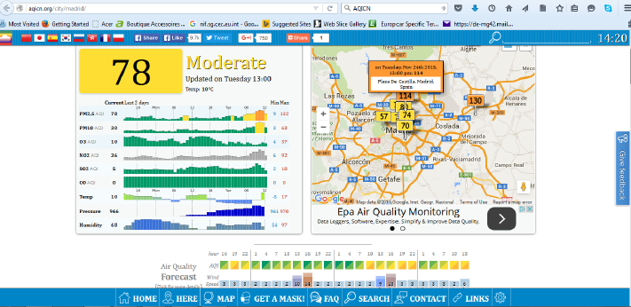
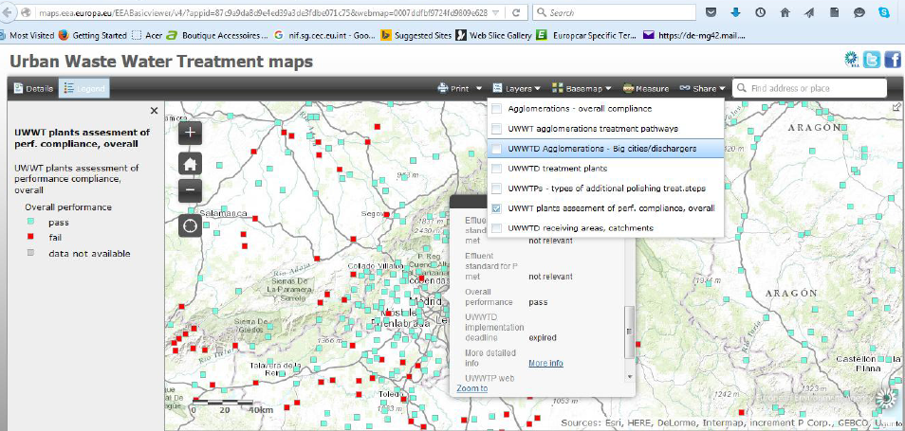
Supporting tools (II)
Contextual information (environmental quality standards and policy aims)
e.g. (air quality ) http://aqicn.org (water quality) WISE/ EEA and FATE
Notes:
Good example Japan concentration map NITE http://www.prtrmap.nite.go.jp.prtr/

Slide 7
Points for consideration
Loads of relevant data / knowledge is generated
How to make operational better participation that impact on present and future?
Fit for purpose IT-Systems (multi-query / real time)
Inclusion of relevant parameters, enable add-ons for benchmark promotion / pollution prevention measures
Integration of related environmental information
(“knowledge on demand”)
Regular exchange with all stakeholders on expectations / follow up
Notes:
Better participation of all: citizens and NGOs, trade unions, industry (technique providers/ operators), research bodies, member states authorities etc to improve status quo. Need to work together to achieve aims + obligations
GIS / google earth

Slide 8
Thank you for your attention !
European Environmental Bureau
Bureau Européen de l’Environnement
Boulevard de Waterloo 34
B-1000 Brussels
Belgium
Tel: + 32 2 289 10 90
Fax: + 32 2 289 10 99
For more information: christian.schaible@eeb.org
aliki.kriekouki@eeb.org
An international non-profit association
Association Internationale sans but lucratif

Slide 9
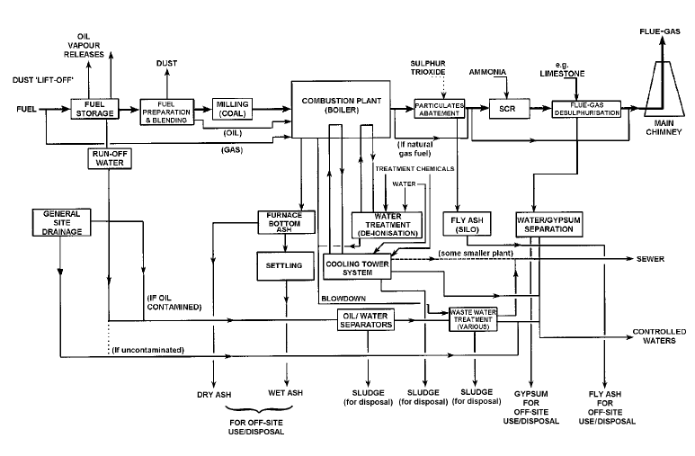
Activity 1c: energy generation
GHG, Heavy metals (hg), SOx, NOx, Dust (incl. PM) organic compounds,HCl, VOC, PAHs, Dioxins, …
Major Accidents
Inputs
Inputs
Anthracene, Benzene, Cd, Hg,Ni, Pb, PAH, …
Appropriate preventive measures against negative impacts
(Air, Water, Soil)
ressource efficiency
Waste hierarchy
Soil protection
Site remediation
substitution HazChems
Major Accidents Hazard
. . .
Waste / Chemicals / Product(s)
Notes:
Performance: outputs (intended = energy and unwanted = pollution/chems) versus inputs
Also look upstream for inputs (mining, nature of fuel etc)

Slide 10
Activity 5: Waste Treatment (integrated LCA approach hazardous chemicals)
E.g. 2: “Sink approach” , EU Hazardous Waste Industry

Slide 11
Activity 5: Waste Treatment (integrated LCA approach hazardous chemicals)
E.g. 2: “Sink approach” , EU Hazardous Waste Industry
Notes:
Good example in CZ PRTR looking in the chems properties of waste / tracking transfers

Slide 12
Supporting tools (II)
Contextual information (environmental quality standards and policy aims) e.g. (air quality ) http://aqicn.org
Notes:
Release from products frontrunners: Japan, Korea, Norway / Nordic countries, Netherlands

Slide 13
Supporting tools (II)
Contextual information (environmental quality standards and policy aims) e.g. ( (water quality) WISE/ EEA and FATE
Notes:
Multi layer map example visualising context (environmental quality standard target value water) and emissions release levels facility

Slide 14
Supporting tools (II)
CEMs direct reporting examples
China: http://nmgepb.gov.cn:8088/enterprisemonitor/webpage!indexPage.action#
http://202.136.217.188:8800/ or http://gk.greenkm.org/upLoad/sort/month_1411/201411210749553998.pdf
(loads *.pdf with overview)
US: http://ampd.epa.gov/ampd/
EU: facility / sector specific on facility website
Notes:
A few non-exhaustive example where CEMs data is made available at regional level

Slide 15
Supporting tools (II)
CEMs direct reporting examples
China (checked) Province Power plant Link
(some links need installation of MobileApp 蔚蓝地图 = Big Blue Map or Blue Sky Map)
http://www.ipe.org.cn/PollutionMapApp_DownLoad.aspx
内蒙古 托克托 http://nmgepb.gov.cn:8088/enterprisemonitor/enterprise-info!getWasteAirLists.action?companyid=10393&yesterday=2014-11-22
上海 外高桥 http://202.136.217.188:8800/enterprise-info!getNewMonitorInfo.action?intpath=&companyid=310000000248&yesterday=2014-11-27+&selectFlag=info&polluteTypeValue=
江苏 利港电力 http://218.94.78.61:8080/newPub/web/publish/homeEnt.htm?3n-3c-36-3e-38-3n=1l-1m-1i-34-1q-1p-1l-1n-1e-1h-1m-1p-35-1e-1l-1q-1l-1l-1e-1p-1n-36-1n-1e-39-36-36-34-39-37-35-1o-37-1p-37-1h&38-3h-3n-38-3l-3j-3l-3c-3m-38-25-3i-37-38=1k-1j-1h-1j-1h-1h-1h-1h-1h-1h-1m-1i&38-3h-3n-38-3l-3j-3l-3c-3m-38-2g-34-3g-38=sqt-13q7-lrf-tas-106s-m05-rdr-1919-llc-mbd&36-34-3h-3n-3i-3h-25-3i-37-38=
浙江 北仑 http://app.zjepb.gov.cn:8089/nbjcsj/
山东 邹县电厂 http://58.56.98.78:8405/Enterprise.htm?entCode=37088301839&cityCode=370800
辽宁 华能大连 http://218.60.25.88/Main/History?enterpriseId=bb162398-dcdf-47ce-b70d-16ae05222cb2
Notes:
A few non-exhaustive examples where CEMs data is made available at regional level in China and available through Mobile App « Big Blue Map » source: Greenpeace China/international

Slide 16
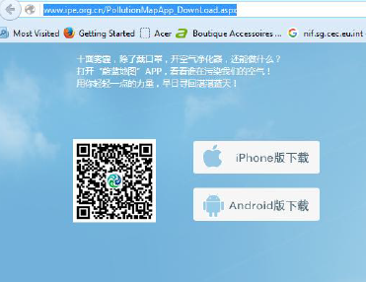
Supporting tools (II)
Big Blue Map / Blue Sky MAP
MobileApp 蔚蓝地图 = Big Blue Map or Blue Sky Map)
http://www.ipe.org.cn/PollutionMapApp_DownLoad.aspx
- Displays facilities in non-compliance (Nox/Sox/Dust), mg/Nm³ (hourly average CEMs) depending on parameter against permit limit for air/water release

