Slide 1
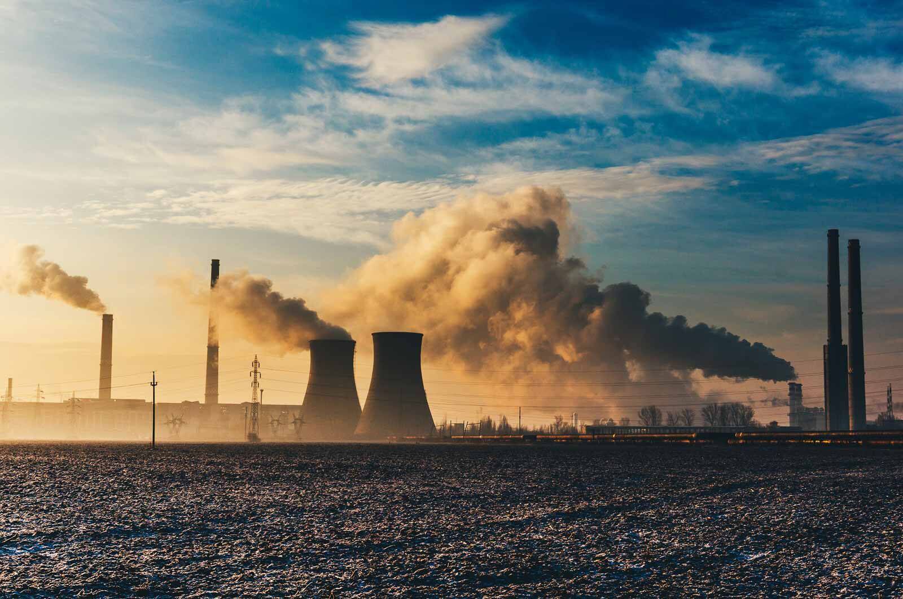
EEB 2017 report ‘BURNING: THE EVIDENCE’
How European Countries Share Industrial Pollution Permit Information Online
A case Study on Large Combustion Plants

Slide 2
Aim of the project
Examine how effectively European countries are making information about industrial pollution available to the public online
identify best practice examples that could serve as guidance for policy makers and authorities;
inform competent authorities / encourage remediation actions,
contribute to ongoing improvements in the environmental performance of industrial activities in Europe by increased transparency and public participation in decision-making processes;
promote better use of available information and enhance synergies with other relevant work on industrial policy, such as the review of Best Available Techniques Reference Documents

Slide 3
Aim and Methodology of the project
Examine how effectively European countries are making information about industrial pollution available to the public online
An online survey was completed by researchers in 26 of the EU’s 28 Member States and Norway
Research was carried out between October and December 2016 (results latest check: February 2017)
Results, methodology, websites checked, interactive map:
https://eeb.org/most-eu-countries-failing-to-ensure-effective-access-to-industrial-pollution-information/
Notes:
For each of the above points a score out of 10 was awarded creating a total score out of 50 for each country. Where required permit information was found to be missing, a penalty of -10 points was applied to reflect the inadequacy of systems failing to meet minimum requirements.

Slide 4
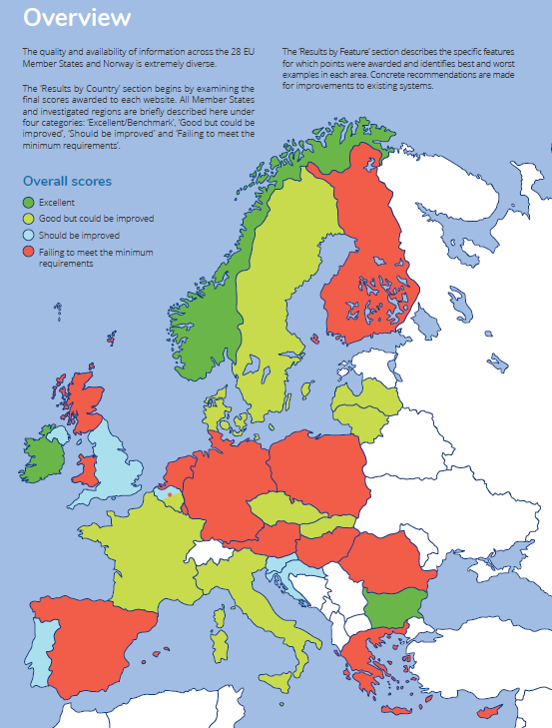
Websites assessment based on 5 key criteria:
ease of use (presence and functionality of a search function);
permit-related information (completeness, quality);
inspection and compliance reports (availability, quality);
any additional (plant) information (plants inputs/outputs);
an overall score for the website as a whole (user-friendliness)
Note: Based on research Oct- Dec 2016
Ranking could change due to improved PRTR infrastructure but documents missing for sampled plants e.g. Spain
Notes:
3 countries: Norway, Ireland and Bulgaria have created systems for sharing information that rank as the best in Europe.
However, more than half of the EU countries are failing to meet even the minimum requirements.

Slide 5
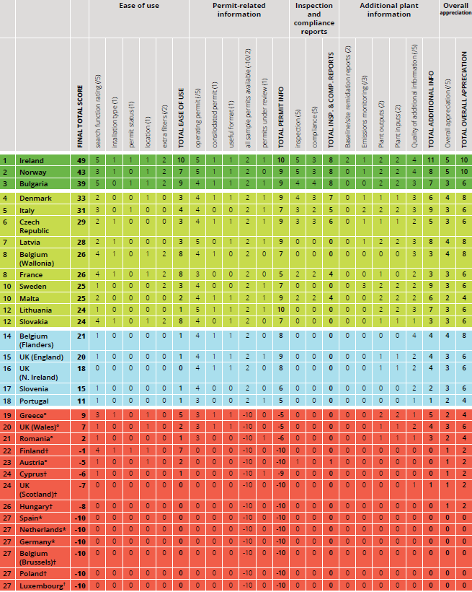
Check Interactive map and report for details
Note:
Based on research Oct- Dec 2016.
Ranking could change due to improved PRTR infrastructure but documents missing for sampled plants e.g. Spain

Slide 6
Best practice examples (1/2)
IRELAND www.epa.ie/terminalfour/ippc/index.jsp?
User-friendly website, useful search function
Each IED plant has a “homepage” where various kinds of
information can be located, including: consolidated permits, correspondence regarding the permit application procedure and inspection and other reports
Option to subscribe to RSS feeds linked to permit numbers
Option to ask to be contacted by email should any new applications or updates be made to particular installation permits

Slide 7
Best practice examples (2/2)
NORWAY www.miljodirektoratet.no/en/Useful-Sites1/The-Norwegian-PRTR/
Combines permitting and inspection information with emissions monitoring data as part of the Norwegian Pollution Release and Transfer Register (PRTR), includes diffuse emissions (products)
essential plant-specific information such as production outputs (energy generated, production volumes specified by types) and flow rates to air and water for releases, displayed next to the permit limit in a single graph and downloadable as electronic files
Plant-specific pages also publish the latest consolidated permits, annual compliance reports and the full inspection report

Slide 8
RECOMMENDATIONS
Europe level “quick fix” PRTR improvements
Align to the Norwegian PRTR model (considered more helpful for benchmarking / compliance promotion )
The following information should be available as a minimum within the E-PRTR installation-level pages:
a .pdf or (working) weblink to currently in force consolidated permit;
a .pdf or (working) weblink to latest inspection report(s);
a .pdf or (working) weblink to latest compliance report(s);
release data combined with information on flow rates (to air/water);
production outputs data;
the Emission Limit Values (ELV) set in plant permits should be integrated in the data reporting, next to releases, based on common reporting IED Electronic Permit Template (EPT);
Permit review status (RSS feeds, email notifications)
Derogation from Best Available Techniques standards applied/approved/pending? If such a derogation has been granted, the required justification;
upload option raw continuous monitoring data (air) or other measurements data

Slide 9




Thank you!
Christian.schaible@eeb.org
www.eeb.org
@Green_Europe
@EuropeanEnvironmentalBureau
eeb@eeb.org
META news: https://metamag.org
The EEB gratefully acknowledges the financial support from the LIFE Programme of the European Union. This communication reflects the organizers’ views and does not commit the donors.

