Slide 1
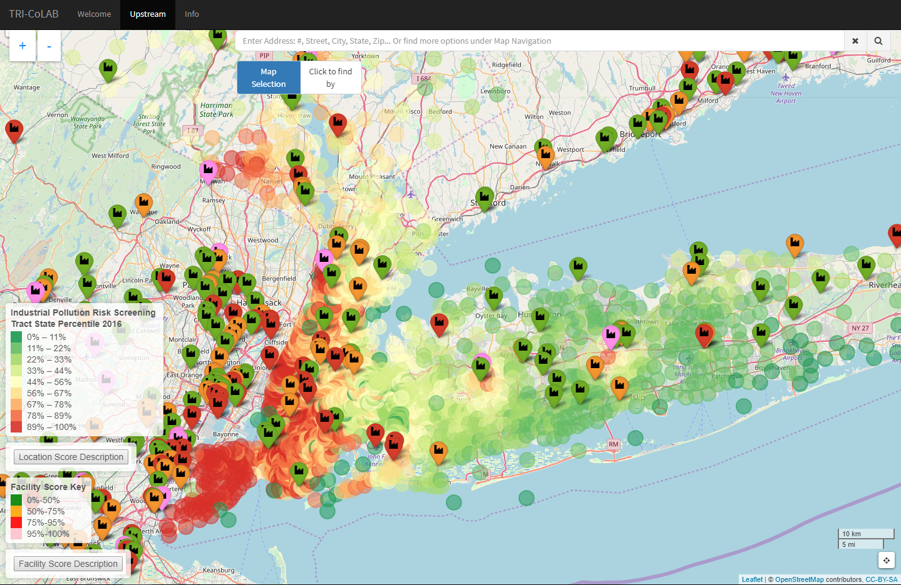
TRI-CoLAB Demonstration
A PRTR tool for identifying potential impacts and pollution prevention using risk screening scores and facility commonality matching
Mike Petroni, Dustin Hill & Dr. Mary Collins | SUNY College of Environmental Science and Forestry, Syracuse, NY, USA

Slide 2
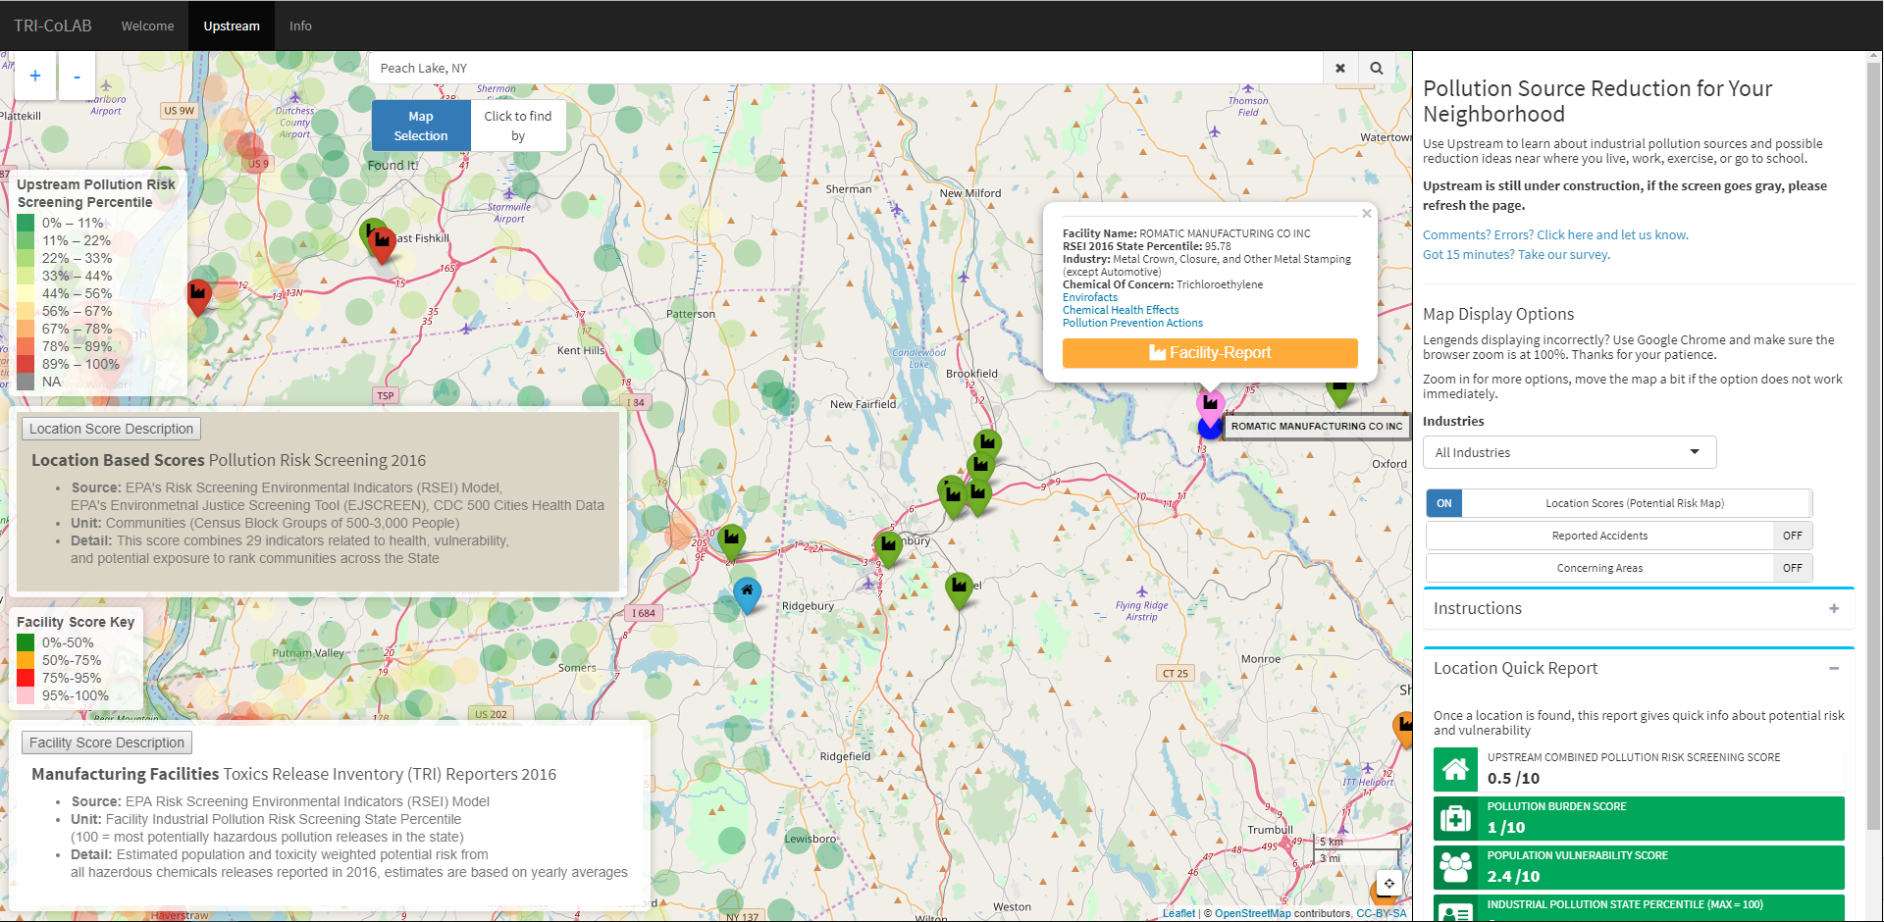
Use Case Example: Cross-Border Potential Impact Identification

Slide 3
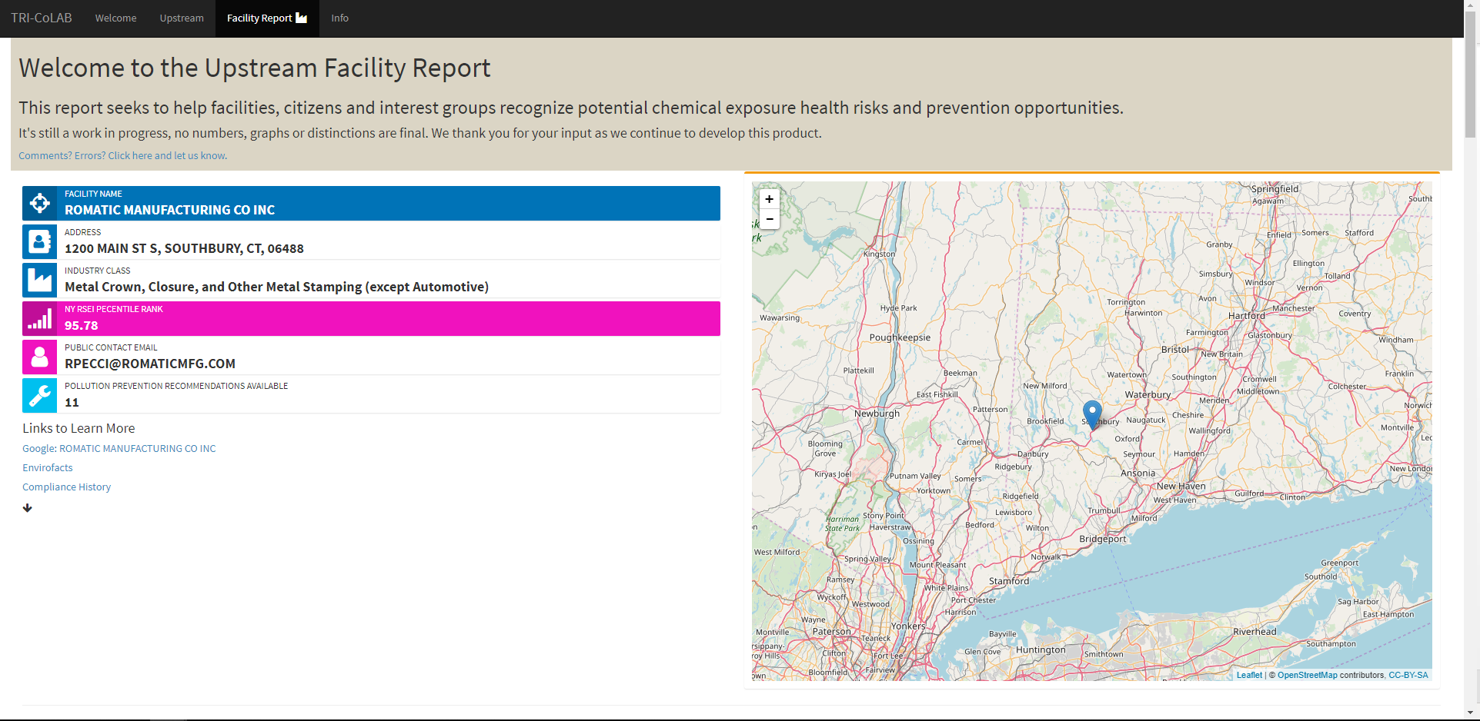
Facility Report Example

Slide 4
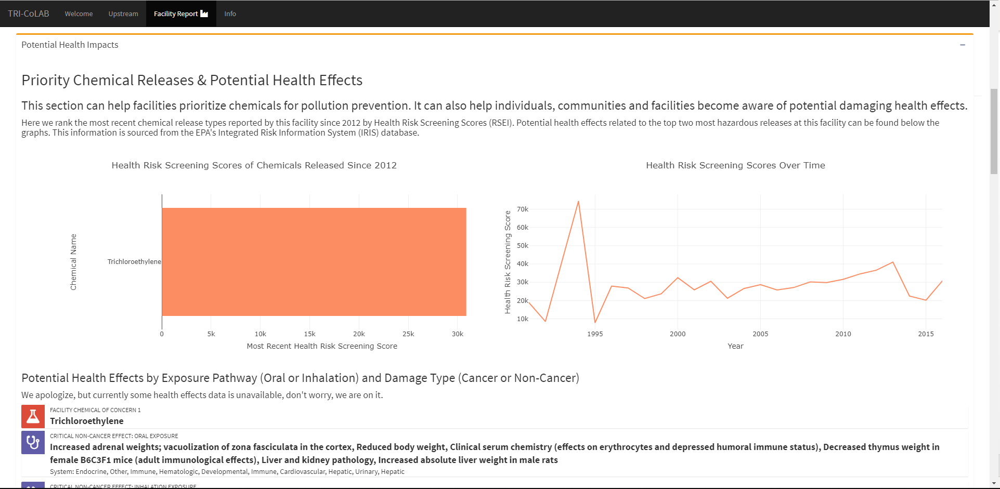

Slide 5
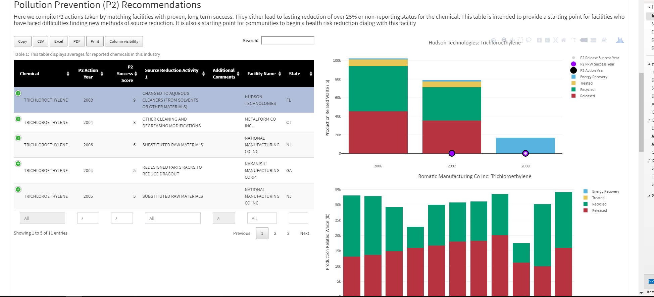

Slide 6
