Slide 1
Role of equivalency in comparability of PRTR data
Item 4.- Emerging PRTRs
Iñigo de Vicente-Mingarro
Chair of the International PRTR Coordinating Group
(with the support of PRTR-España, Ministry for the Ecological Transition of Spain)

Slide 2
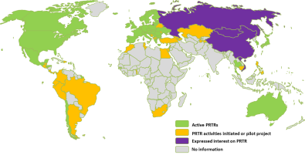
Background
1
Even being minimum requirements…
Legal acts in PRTR
UNECE Protocol (Kiev/PRTR Protocol)
Regional registers (EU, CEC…)
2
National / Regional PRTR registers ≈ same goals and public information
International organizations Recomendations
OECD (Recomendation for its MS)
UNITAR Iniciatives
Different scopes, criteria depending on country needs
dissimilar level of available information
3
Country experiences
National legal acts implemeting PRTRs or similar
How could we get a
good understanding?

Slide 3
identifying the problem…
why dealing with the same topic, the information provided is so different ?
Harmonization – Comparability .
OECD, UNITAR works,…
Good practices at national/regional level
Are PRTRs consistent and comparable across them ?
need for…
are they comprehensive and understandable for everyone?
industrial activity categories
pollutants /subtances
something missing?
good practices
room for improvements?

Slide 4
…is it enough?
identifying “activitiy” … some questions:
do the “activity descriptions” have the same meaning in every where, even using the same codelists?.
“main activity”: economic or industrial capacity codes
How are these codes designated?; is it the same procedure in all countries?...
identifying “pollutants” … some questions:
when using “Hg” or “Hg and compounds, are we taking about the same “pollutant”?
what about “group of substances” like HAPs, VOCs, POPs…?...
what´s more?
coherence across MEAs..?
“thresholds” vs “ELV”?
“methodologies” M,C, E and ISO, EN etc.. ?
“units used vs IS”?

Slide 5
why not “equivalence” instead of just “equality”?
… providing with additional information about the meaning of definitions, criteria, codes, list, standards and methods, etc…used in each PRTR…
and
when appropriate, establishing/developing its correspondence with the “others” codelist, standards and methods, criteria… used in other PRTR systems/registers/ reporting requirements/MEAs…

Slide 6
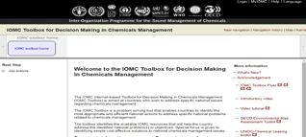
where?
national/regional PRTRs
PRTR Global portals
OCDE PRTR
UNITAR PRTR PLATFORM
IOMC toolbox
PRTR.net
Making it more understandable/accessible to everyone, mainly when PRTR data are used for communication and dissemination purposes;
Also facilitating clues for a better comparison across PRTRs themselves and other MEAs

Slide 7
…some examples as starting point for discussion:
ACTIVITY:
ISIC/NACE codes vs industrial capacity thresholds
PRTR vs SNAP/CLRTAP vs IPCC vs IED…
DATA:
units correspondence when other than IS is used
total mass load vs [concentrations]
thresholds vs ELV, are they the same?
POLLUTANTS/SUBSTANCES:
“Hg and compounds” includes: …and equate to “Hg” in…
VOCs are/include:…
HAPs
PST vs PM10 vs PM2.5
METHODS
M,C,E when descriptions are differents
ISO/EN…matches DIN..UNE…EPA…etc.
when “this” method is used…equate to…
what else could be useful/needed?

Slide 8
Thank you very much for your attention!
Íñigo de Vicente-Mingarro
PRTR-España, Ministry for the Ecological Transition (T.A.)
Calle Téllez nº 24, 1ª planta; 28007 Madrid. Spain.
Telephone: +34 917499121; Fax: +34 917499140
e-mail: info@prtr-es.es / ivicente@consulnima.com

