Slide 1
Republic of Moldova:
Single window approach / International reporting
Mrs. Tatiana Țugui, manager
Environmental Pollution Prevention Office

Slide 2
Ratified global Chemical MEAs:
- Basel Convention (1998)
- Stockholm and Rotterdam Conventions (2004)
- Montreal Protocol (1996)
- Minamata Convention on Mercury (2017)
Other ratified MEAs
- UNECE Protocols on Persistent Organic Pollutants and Heavy Metals to the Convention LRTAP (2002)
- UNECE PRTR Protocol to the Aarhus Convention (2013)
- UNECE Industrial Accidents Convention (1993)

Slide 3
Legal background
Waste Law, No. 209 of 29 of July 2016
Article 53. Persistent Organic Pollutants Stocks Waste
Draft Chemicals Law
Article 17. Prohibitions and restrictions for certain substances and chemical mixtures (incl. Hg)
Article 58. Mercury Waste
Article 64. Waste Transport and Export
Article 19. The prior import consent
Article 18. Export and import of hazardous chemicals
Law No 99 of 26.04.2013 on PRTR ratification
Government Decision for approval the PRTR IT software and PRTR Regulation

Slide 4
Institutional arrangements
Ministry of Agriculture, Regional Development and Environment
Environment Protection Agency
Pollutants Release and Transfer Register Information System (www.retp.gov.md)

Slide 5
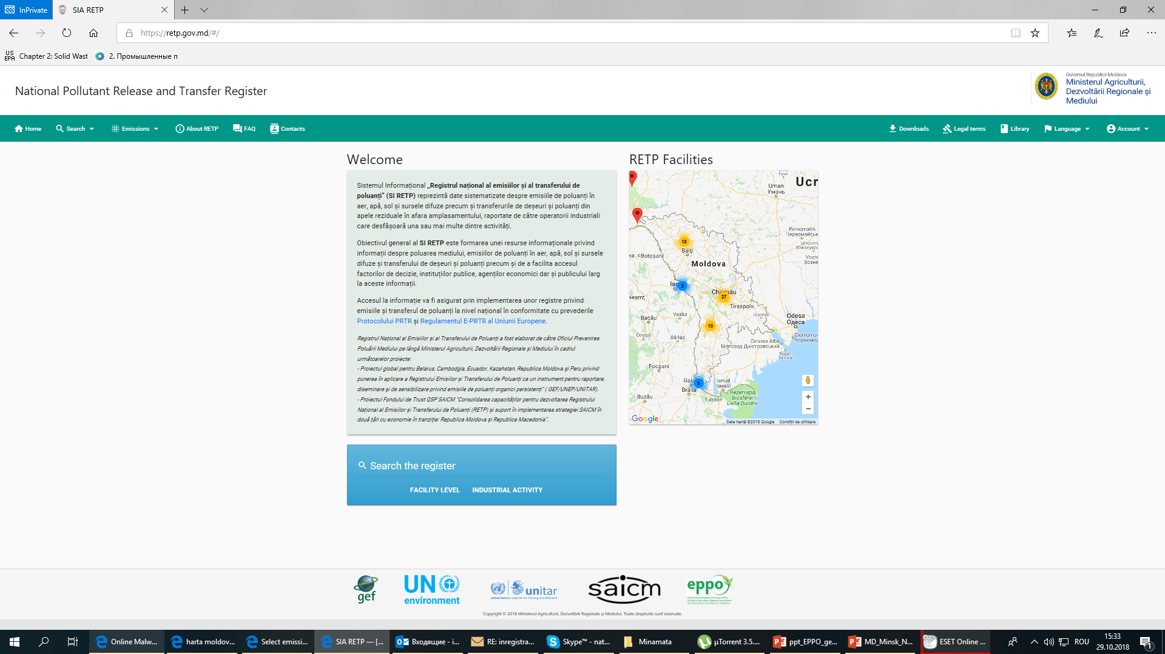
Pollutants Release and Transfer Register Information System

Slide 6
PRTR system – start with bigger companies
Expected to become the emissions and transfer reporting tool at national level – single window for:
Reporting release of polutants to air
Regulation on PRTR (GD 373 of 28 April, 2018)
Law on air quality (draft, to be adopted)
Reporting release of pollutants to water
Regulation on requirements for the collection, treatment and discharge of wastewater into the sewage system and / or in water bodies in urban and rural areas (GD No. 950 of 25.11.2013)
At a later stage linked to polluter payment and used for decision making and planning process

Slide 7
LRTAPC
Montreal Protocol on Substances that Deplete the Ozone Layer
Minamata Convention
Stockholm Convention on POPs
UNFCCC
Single window for releases into air of substances reported under MEAs

Slide 8
POPs to reported under the PRTR
Aldrin
Heptachlor
Hexachlorobenzene (HCB)
1,2,3,4,5, 6 hexachlorocyclohexane (HCH)
Lindane
PCDD +PCDF (dioxins +furans) (as Teq)
Pentachlorobenzene
Brominated diphenylethers (PBDE)
Hexabromobiphenyl
Hexachlorobutadiene
Pentachlorophenol (PCP)
Endosulfan
DDT
Chlordane
Toxaphene
Dieldrin
Endrin
Chlordecone
Mirex
Polychlorinated biphenyls (PCBs)
Decabromodiphenyl ether,
Dicofol,
Short-chained chlorinated paraffins
Pentadecafluorooctanoic acid

Slide 9
It is expected to cover POPs emissions from:
(1) Energy sector – thermal power stations and other combustion installations
(2)Production and processing of metals
(4)Chemical industry (basic plastic materials; surface-active agents and surfactants; basic pharmaceutical products)
(5) Waste and waste water management (open burning of landfills)
(3) Mineral industry (Cement clinker and lime production, glass production)

Slide 10
emissions from transport means
agricultural activities (use of pesticides and fertilizers)
unauthorized landfills (open burning)
Diffuse sources under PRTR (additional source of POPs)

Slide 11
Methane (CH4)
Carbon monoxide (CO)
Carbon dioxide (CO2)
Hydro-fluorocarbons (HFCs)
Nitrous oxide (N2O)
Non-methane volatile organic compounds (NMVOC)
Nitrogen oxides (NOx/NO2)
Perfluorocarbons (PFCs)
Sulphur hexafluoride (SF6)
Sulphur oxides (SOx/SO2)
UNFCCC – GHG and precursors
All the PRTR sectors

Slide 12
Ammonia (NH3)
Non-methane volatile organic compounds (NMVOC)
Nitrogen oxides (NOx/NO2)
Sulphur oxides (SOx/SO2)
Arsenic and compounds (as As)
Cadmium and compounds (as Cd)
Chromium and compounds (as Cr)
Copper and compounds (as Cu)
Mercury and compounds (as Hg)
Nickel and compounds (as Ni)
Lead and compounds (as Pb)
Zinc and compounds (as Zn)
Aldrin
Chlordane
Chlordecone
DDT
Dieldrin
Endrin
Heptachlor
Hexachlorobenzene (HCB)
1,2,3,4,5, 6 –hexachlorocyclohexane (HCH)
Lindane
Mirex
PCDD +PCDF (dioxins +furans) (as Teq)
Toxaphene
Hexabromobiphenyl
Pentachlorophenol (PCP)
Polychlorinated biphenyls (PCBs)
Long-Range Transboundary Air Pollution Convention
All the PRTR sectors

Slide 13
Hydrochlorofluorocarbons (HCFCs)
Chlorofluorocarbons (CFCs)
Halons
Tetrachloromethane (TCM)
Trichloromethane
Montreal Protocol on Substances that Deplete the Ozone Layer
The mechanism to be established

Slide 14
Minamata Convention
Mercury releases
Mercury containing waste
All the sectors

Slide 15
Methodological guidelines for calculation the releases to air from stationary sources:
Detalied methodological guidelines and dedicated excel files for 8 sectors:
Energy
Metalurgy
Minerals
Chemical
Waste and wastewater
Food process
Animal rearing
Other activities
Based on the IPCC, EMEP/EEA and UNEP Guidelines

Slide 16
Report submitted by a installation – heat production sector

Slide 17
Thank you for your kind attention !
Tatiana Țugui
Environmental Pollution Prevention Office
Tel: +373 22 222 542
Email: tatiana.tugui@eppo.md
www.eppo.md

