Slide 1

HOW TO APPLY PRTRs TO ACHIEVING THE
UN SUSTAINABLE DEVELOPMENT GOALS
The potential of PRTR systems
“designed from scratch”
Nebojša Redžić, MSc
Environmental Protection Agency
Republic of Serbia
Global Round Table on PRTRs (7-8 November 2018, Geneva)

Slide 2
Serbian National PRTR register
Serbian National PRTR register is a set of systematic information and data on environmental pollution sources. This is a register of all human activities that may have a negative impact on the quality of the environment in Serbia.
National PRTR register is an information subsystem of the Environmen-tal Information System of the Republic of Serbia, which is managed by the Environmental Protection Agency in accordance with the Law on Ministries and the Law on Environmental Protection.
The main function of this register is to collect and process data and to manage and update a number of databases related to industrial and communal pollution.

Slide 3
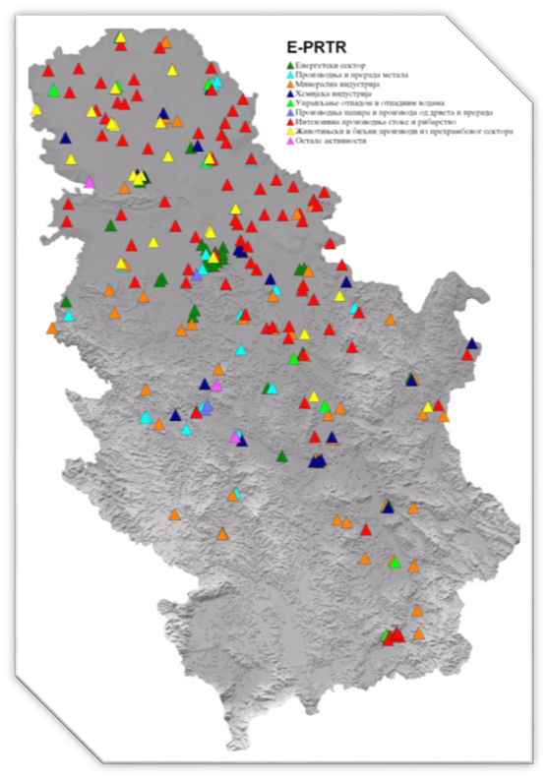
Serbian National PRTR register
HISTORY
SEPA started with implementation of PRTR protocol and E-PRTR directive in 2008.
During 2009 and 2010, complete legal framework for implementation of PRTR protocol and E-PRTR directive was adopted.
PRTR protocol ratified in 2011.
Information system has been developed in 2012. and extended with GIS component in 2016.

Slide 4
Serbian National PRTR register
Capacity thresholds (Annex I) are implemented.
Thresholds for releases (Annex II) are not implemented. All amounts of released pollutants must be reported.
All data in Format for the reporting of release and transfer (Annex III) are obligatory.
Additional data in forms:
Raw materials consumption, fuel consumption, amount of products;
Technical data about stacks, wastewater outlets, waste managements.
There is no confidentiality toward SEPA – All data must be reported. SEPA take care about confidentiality.
Data are collected once a year.

Slide 5
Serbian National PRTR register
THE REPORTING FORMS
There are 5 different forms:
General data,
Emissions to air,
Emissions to water,
Emissions to land,
Waste management.
The forms are not developed in line with PRTR protocol. We asked for more data than PRTR protocol.
We want to avoid the possibility of mistakes, cheating and fake emission data using different methods (drop down lists, mandatory fields etc.)
We asked for data which give us opportunity to use emission models to calculate their emissions as validation tools.

Slide 6
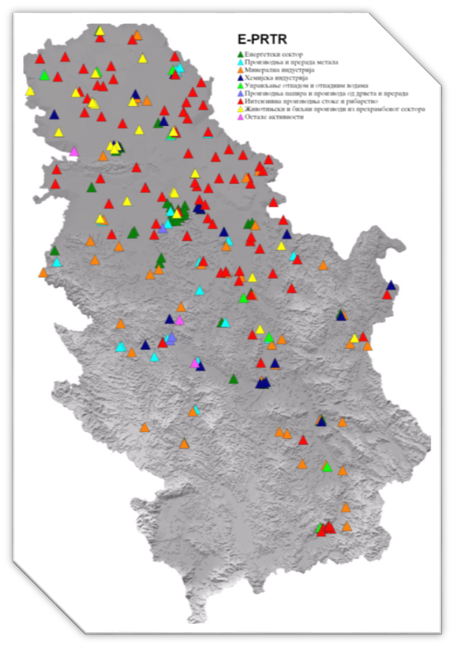
Serbian National PRTR register
In 2017. PRTR register in Serbia according PRTR protocol covers 292 facilities.
Number of reports
Emissions to air | 278
Emissions to water | 170
Emissions to soil | 0
Waste management | 250

Slide 7
Serbian National PRTR register
Serbian PRTR register encompasses a series of thematic units:
  PRTR - Pollution Release and Transfer Register;
  Emissions to air according ELV;
  Emissions to water other than PRTR;
  Emissions to soil,
  Waste management,
  Hazardous waste movement,
  Waste tracking,
  Products that become special waste streams after use,
  Packaging and packaging waste,
  Greenhouse gas inventory (UNFCCC),
  Main air pollutants inventory (LRTAP),
  Unintentionally released POPs substances (Stockholm convention),
  LPS, LCP, etc.

Slide 8
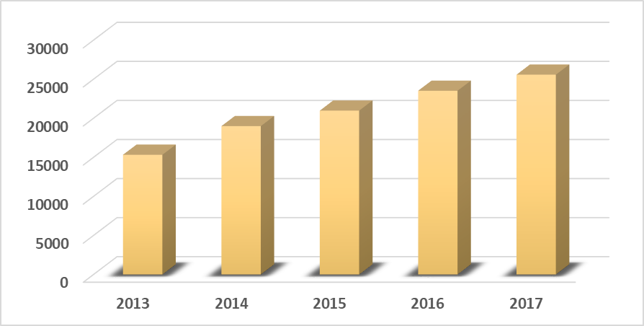
Serbian National PRTR register
The number of reports for the period 2013 – 2017
For 2017. reports delivered by 03.11.2018.
Hazardous waste movement documents – 50435 docs. in 2018
Waste tracking documents – 44226 docs. in 2018

Slide 9
Serbian National PRTR register
GUIDELINES
Different kind of Guidelines in SEPA
Guidelines for using SEPA IT system
Guidelines for form filling
Guidelines for emission estimation
These Guidelines have the purpose of reducing the possibility of errors.

Slide 10
Serbian National PRTR register
GUIDELINES
Guidelines for emission estimation
These guidelines are part of bylaw and their use is obligatory.
The basis for guidelines developing are:
2016 EMEP/EEA air pollutant emission inventory guidebook
2006 IPCC Guidelines for National GHG Inventories
Livestock
  Broilers
  Laying hens
  Pigs and sows
Mining - ongoing
Household appliances
Landfills - ?

Slide 11
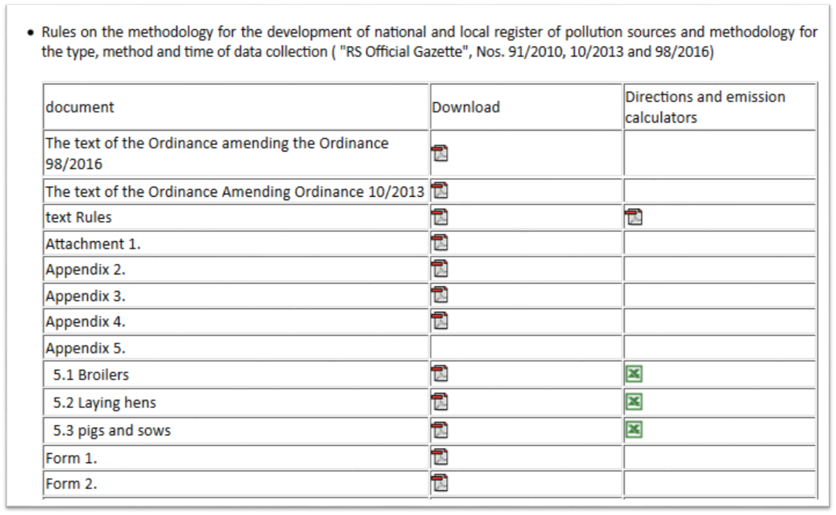
Serbian National PRTR register
Guidelines for emission estimation

Slide 12
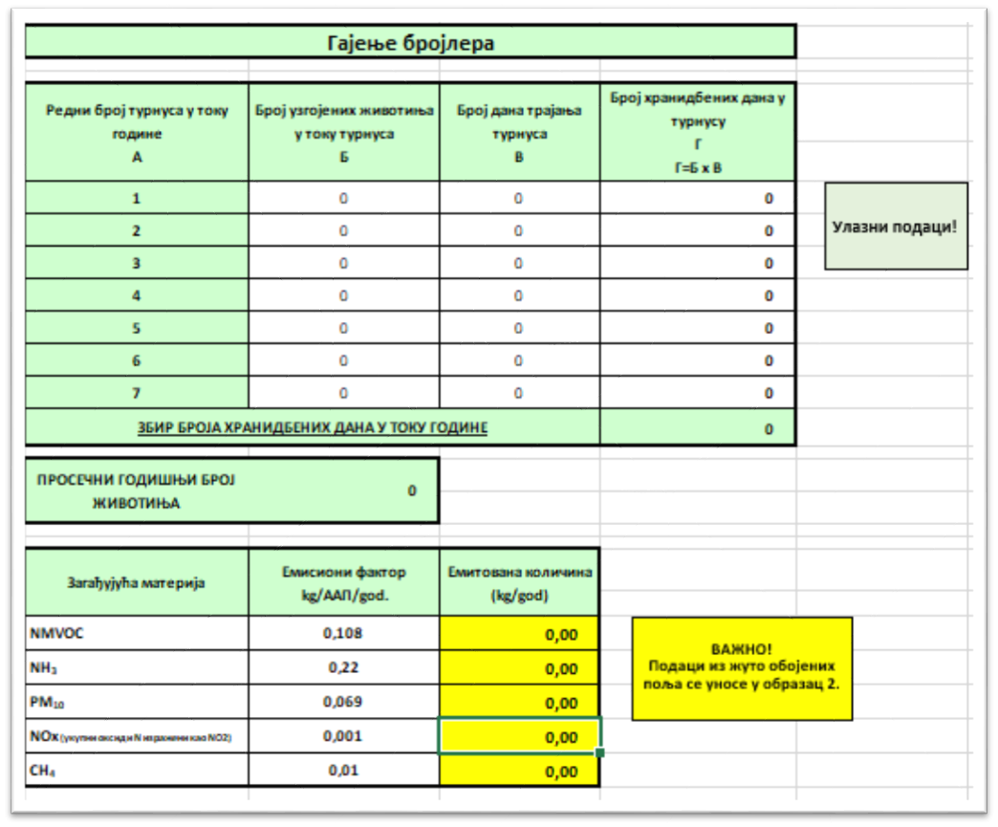
Serbian National PRTR register
GUIDELINES
Guidelines for emission estimation
Emission calculator
Easy to use tool
Simple Excel file
The values from yellow cells must be typed into air emission PRTR forms

Slide 13
Serbian National PRTR register
FINANCING OF ENVIRONMENTAL PROTECTION
Financing of environmental protection in Republic of Serbia relies on data from National PRTR register.
Two very important principles for collecting funds for financing of environmental activities are included in it:
polluters pay principle and
extended producer responsibility.
In 2017. SEPA collect more than 80 million of Euros using these principles.

Slide 14
Serbian National PRTR register
INFORMATION SYSTEM OF NATIONAL PRTR REGISTER
Information system of National PRTR register is one of the most important subsystems of the environmental information system in the Republic of Serbia, which is lead by Environmental Protection Agency.
This information system is completely developed in the Environmental Protection Agency.
By using the software tools of this information system, data has being collected and processed, verified and analyzed, and after all, delivered to interested parties.
Whole system is bilingual – Serbian and English.

Slide 15
Serbian National PRTR register
INFORMATION SYSTEM OF NATIONAL PRTR REGISTER
For all these activities it is necessary to establish strong IT support:
Modular IT system.
GIS component.
IT system is continually expanded with the goal that all implemented segments merged into a single system in accordance with national and international legislation.
Operators have obligation to report using IT system only. No paper or Excel reporting for PRTR.
IT system needs to help operators to deliver their reports on the easiest way and as quickly as possible, but also help administrators to more easily verify data and prepare the necessary reports.

Slide 16
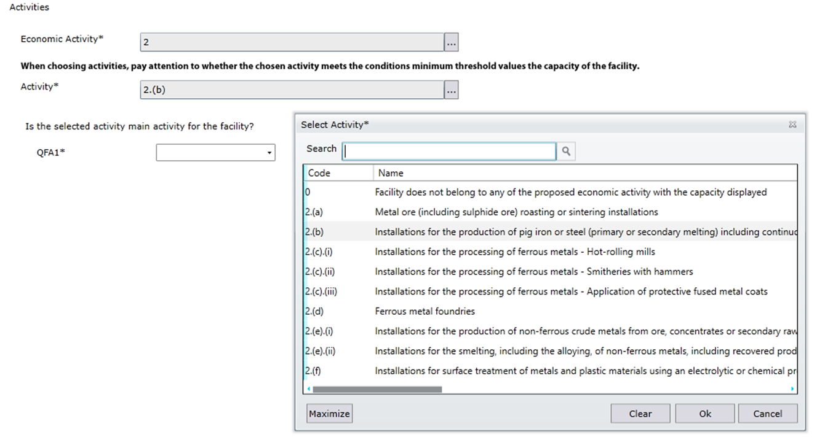
Serbian National PRTR register
SELECTION OF FORMS
Automatic system for selection of forms using a set of questions.
Company select forms alone during input of master data.

Slide 17
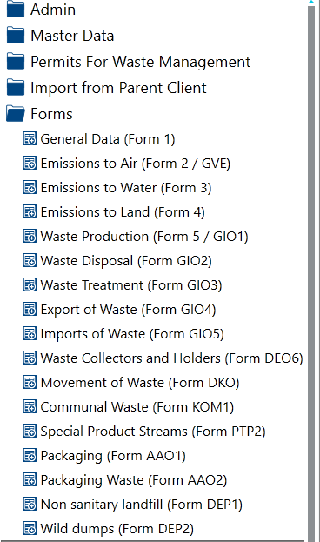
Serbian National PRTR register
IMPLEMENTED FORMS IN IT SYSTEM
PRTR – 5 forms
Waste generation,
Waste disposal,
Waste treatment
Export of waste
Import of waste
Waste collectors and holders
Movement of waste
Communal waste
Special waste streams
Packaging put on market
Packaging waste
Non sanitary landfills
Wild dumps

Slide 18
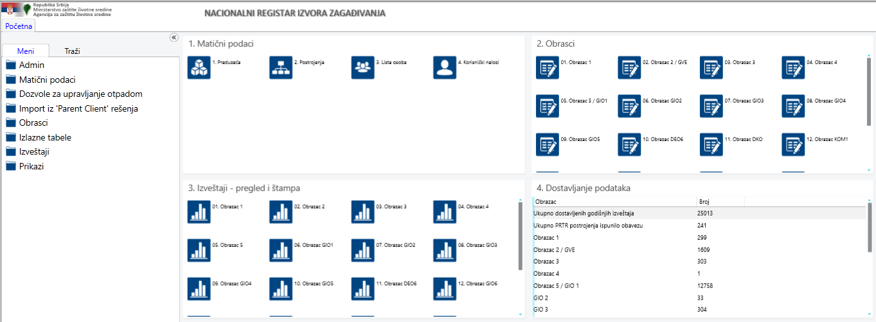
Serbian National PRTR register
SEPA AUTHORITY PORTAL (CA)

Slide 19

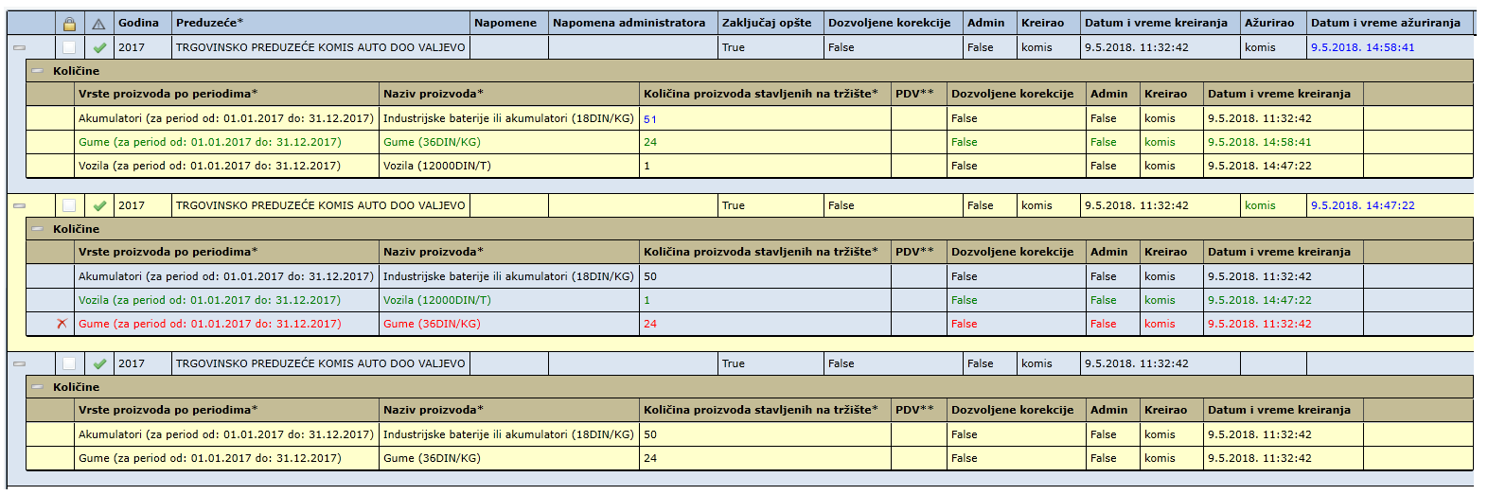
Изазови – Производи
SEPA AUTHORITY PORTAL (CA) – Tracking changes

Slide 20
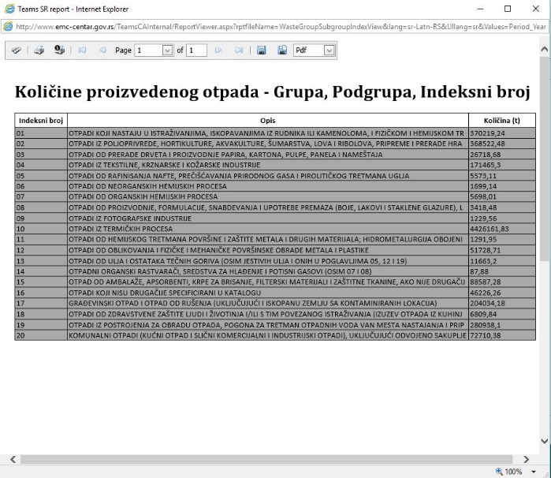
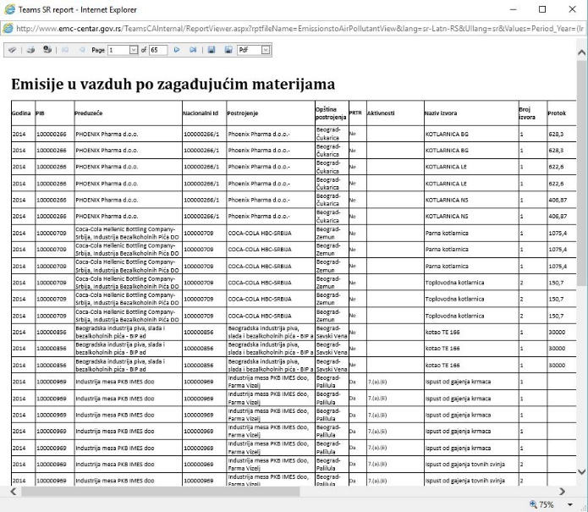
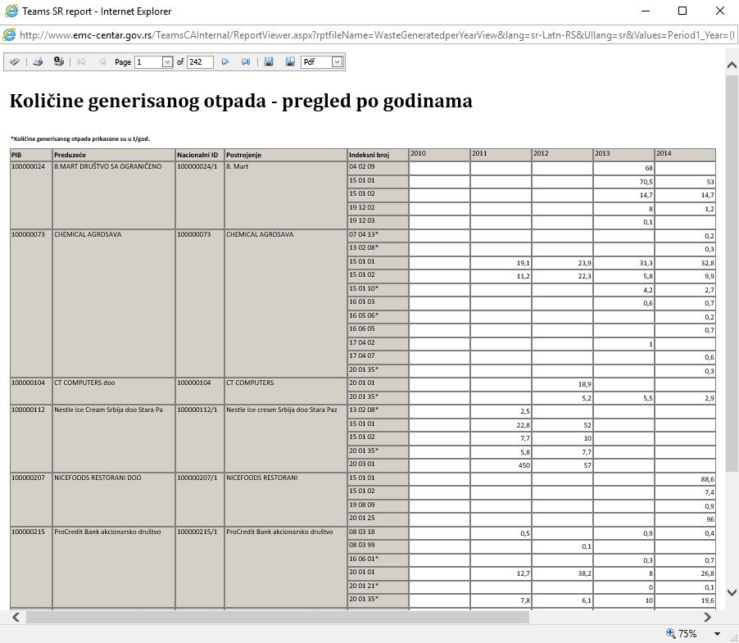
Serbian National PRTR register
SEPA AUTHORITY REPORTS
Based on collected data, IT system created dozens of analytical reports.

Slide 21
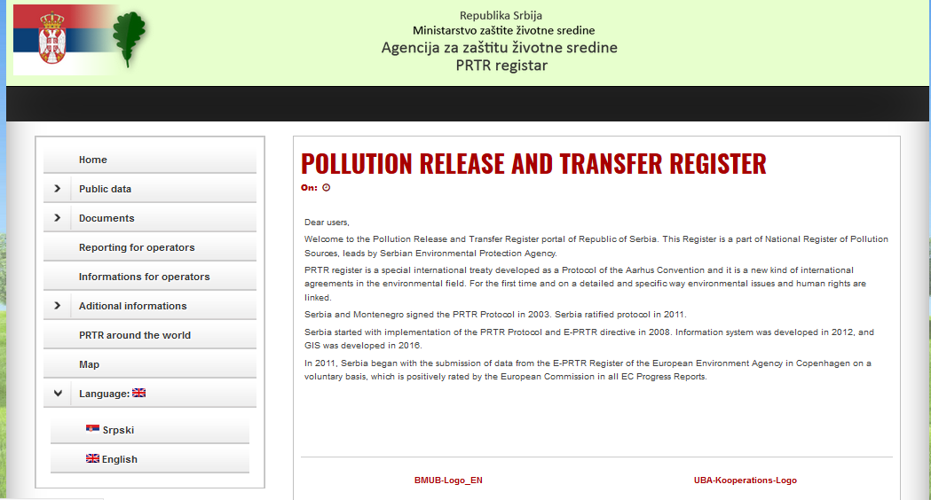
Serbian National PRTR register
PUBLIC ACCESS TO DATA – PRTR register

Slide 22
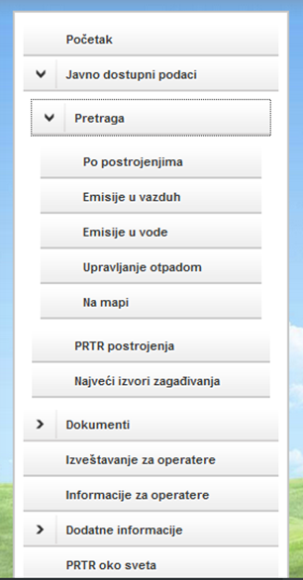
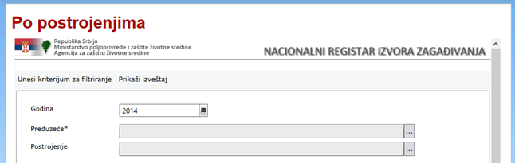
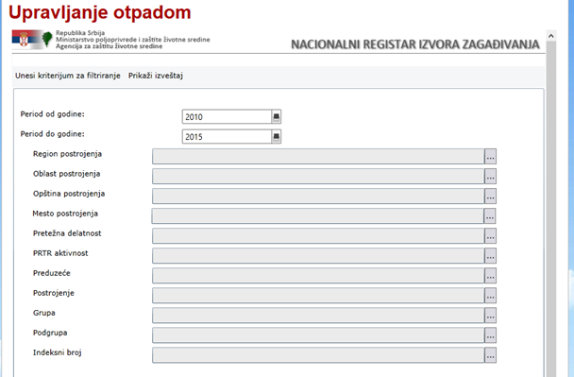
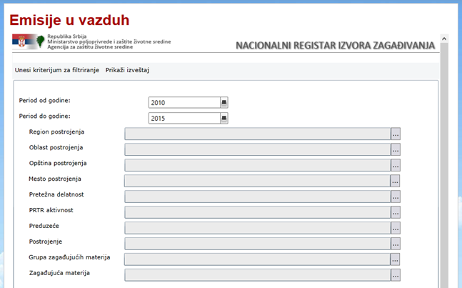
Serbian National PRTR register
PUBLIC ACCESS TO DATA – PRTR register

Slide 23
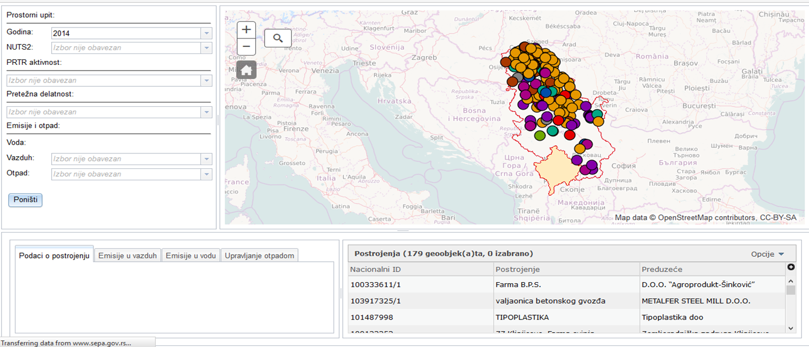
Serbian National PRTR register
PUBLIC ACCESS TO DATA – Search on maps

Slide 24
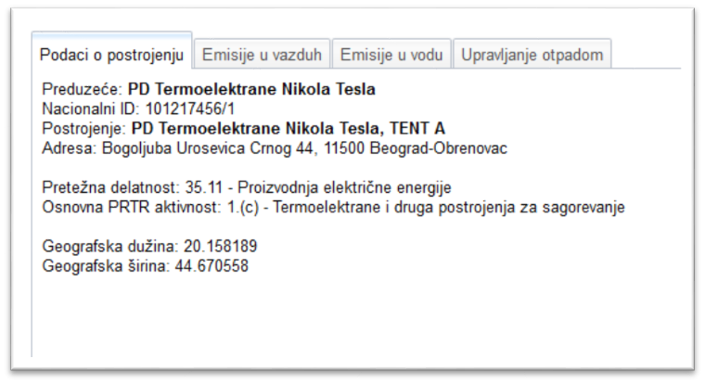
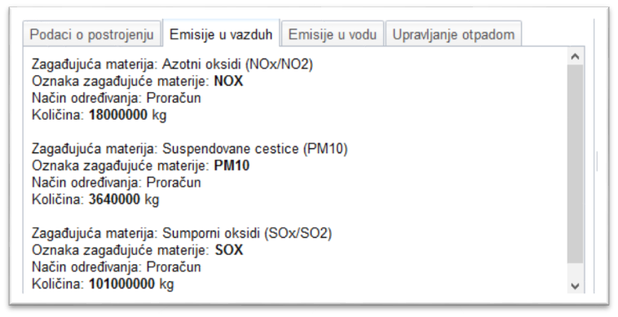
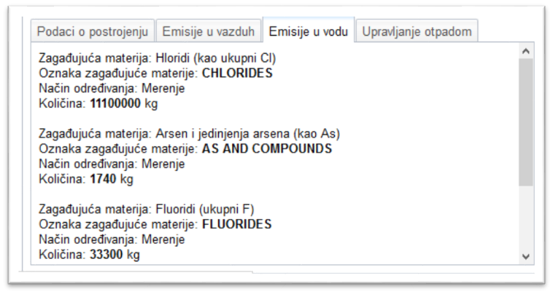
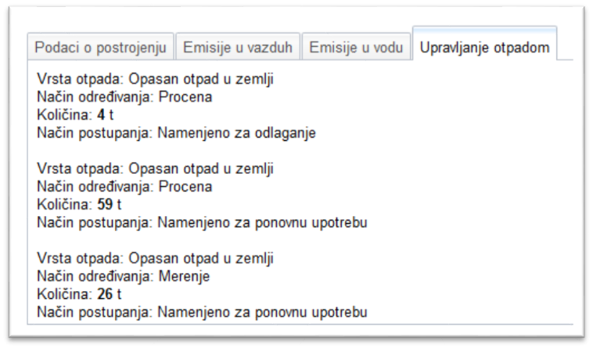
Serbian National PRTR register
PUBLIC ACCESS TO DATA – Search on maps

Slide 25
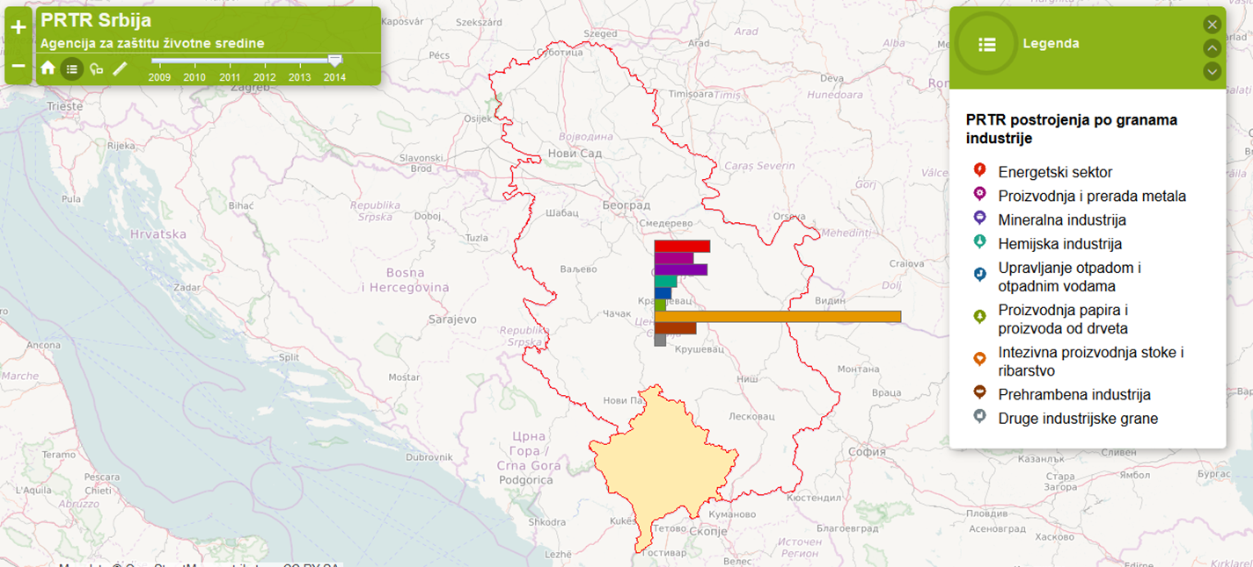
Serbian National PRTR register
PUBLIC ACCESS TO DATA – Navigation

Slide 26
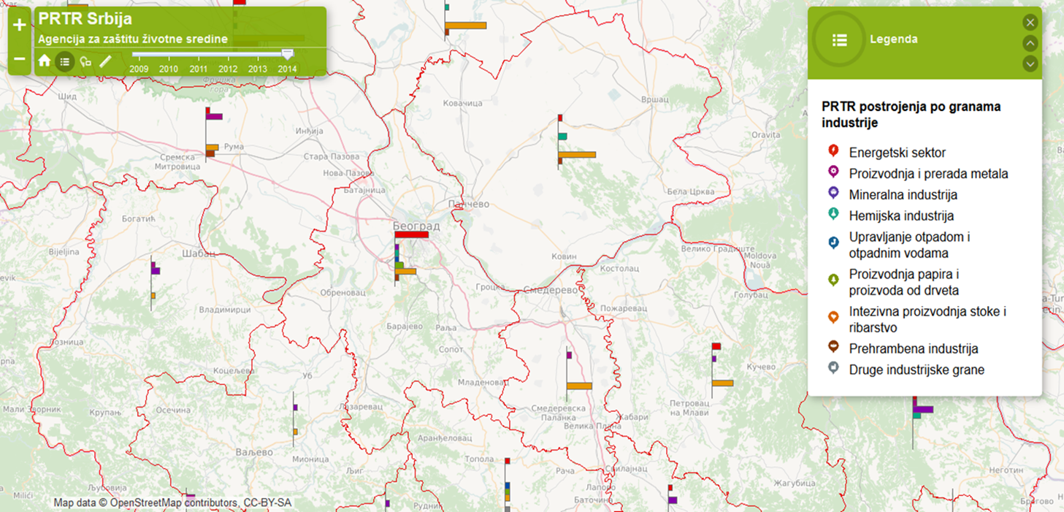
Serbian National PRTR register
PUBLIC ACCESS TO DATA – Navigation

Slide 27
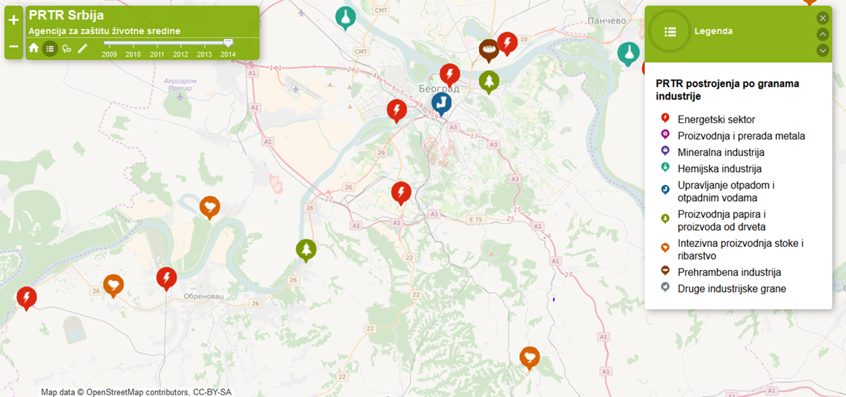
Serbian National PRTR register
PUBLIC ACCESS TO DATA – Navigation

Slide 28
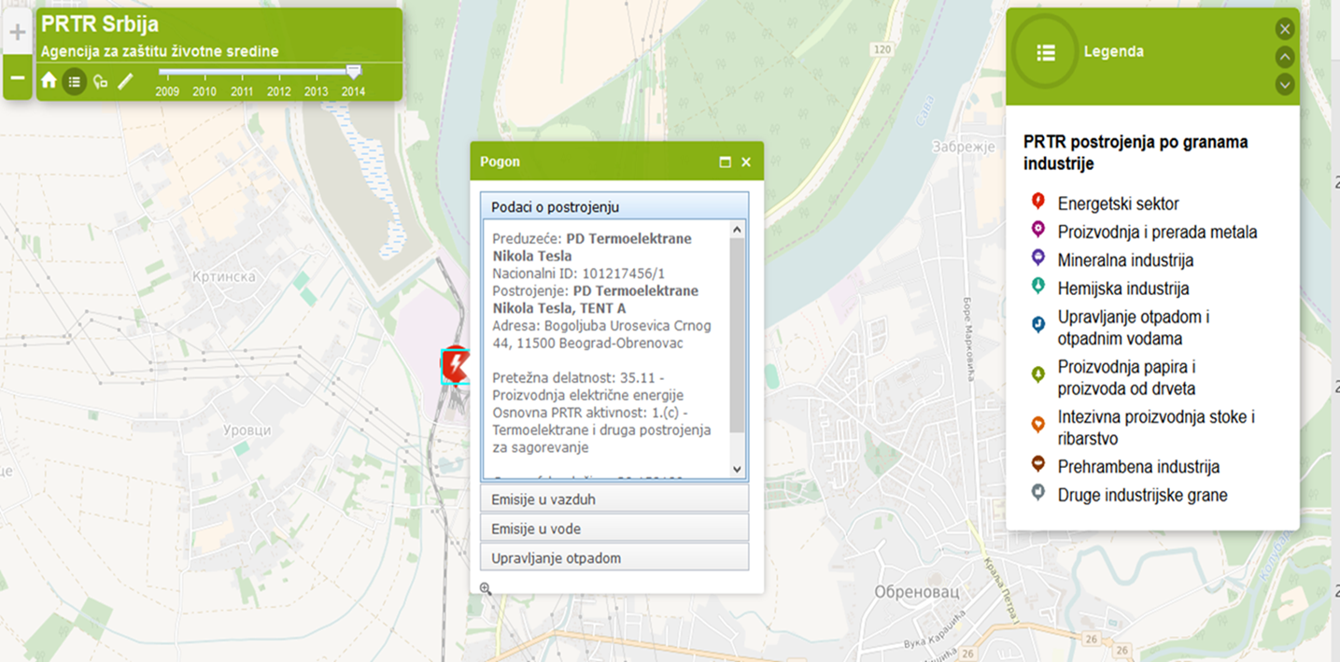
Serbian National PRTR register
PUBLIC ACCESS TO DATA – Navigation

Slide 29
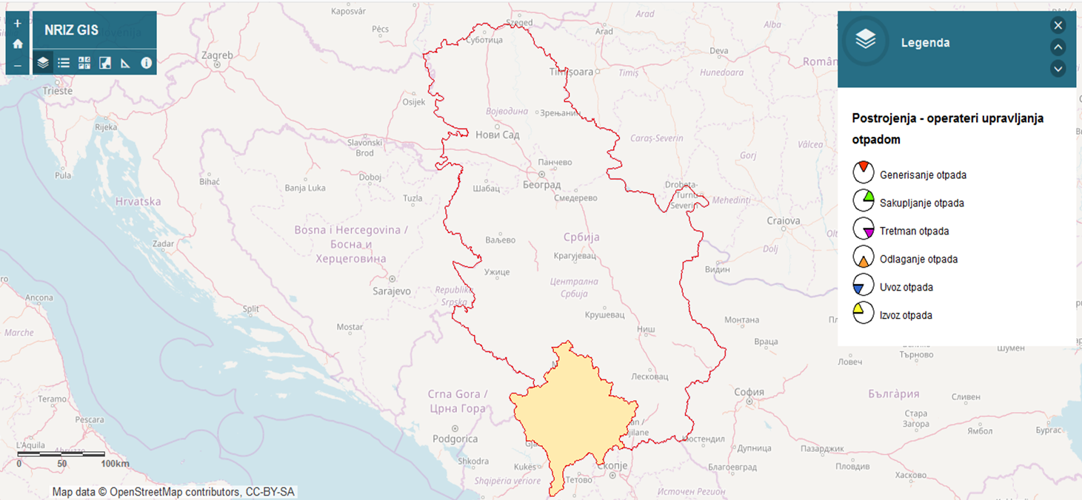
Serbian National PRTR register
PUBLIC ACCESS TO DATA – Waste management portal

Slide 30
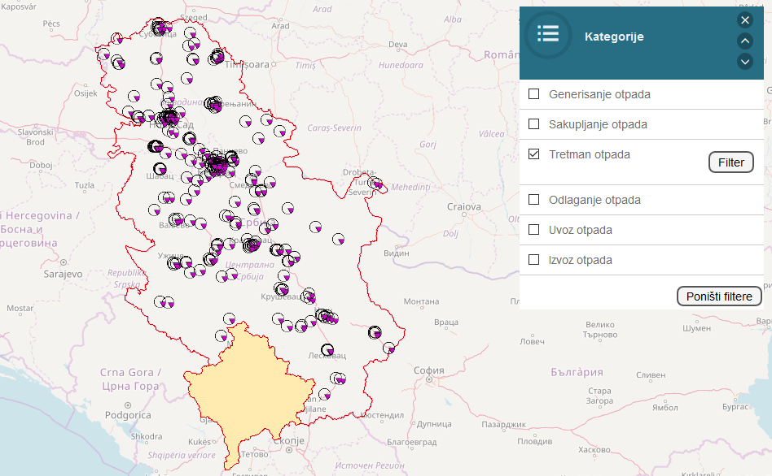
Serbian National PRTR register
PUBLIC ACCESS TO DATA – Waste management portal
Waste
treatment facilities

Slide 31
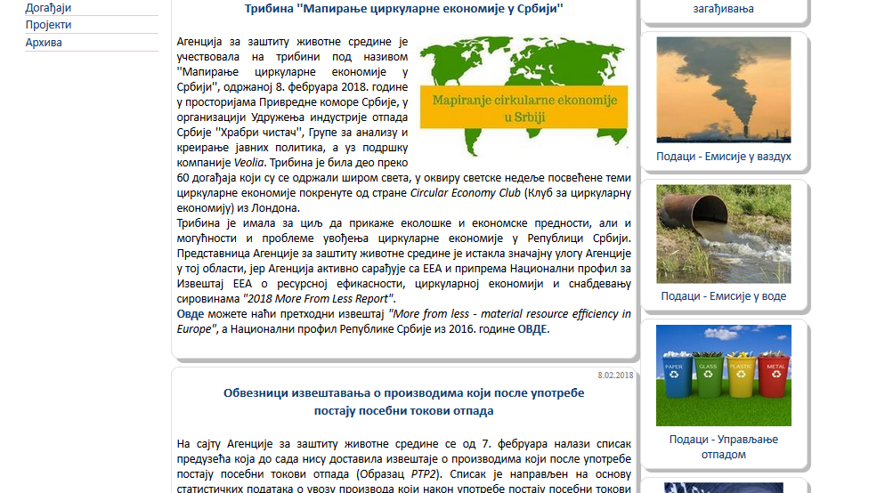
Serbian National PRTR register
PUBLIC ACCESS TO DATA – Open data portal

Slide 32
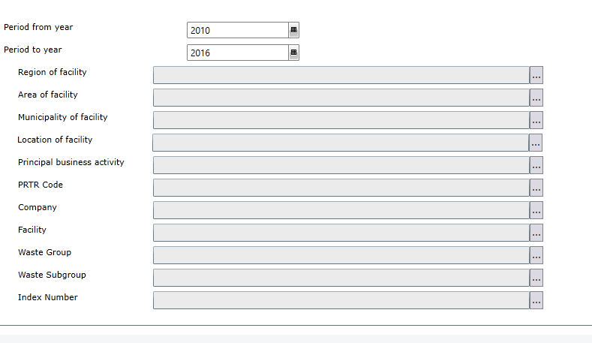
Serbian National PRTR register
PUBLIC ACCESS TO DATA – Open data portal

Slide 33
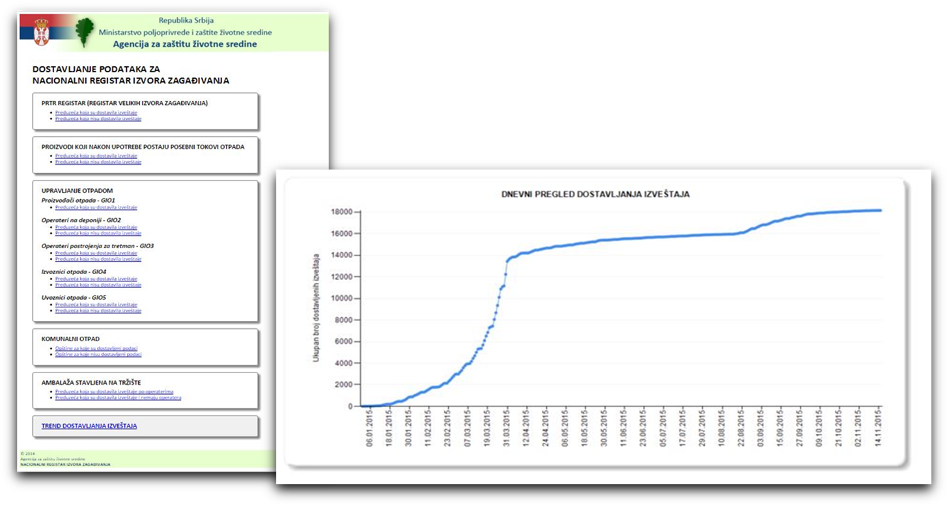
Serbian National PRTR register
PUBLIC ACCESS TO DATA – Data submission monitoring portal

Slide 34
Serbian National PRTR register
PUBLIC ACCESS TO DATA – Reports
GENERAL
Environmental state reports
THEMATIC
Waste management in Serbia
Special waste streams
Packaging and packaging waste
Plastic bags
Air quality report
LRTAP IIR

Slide 35
Serbian National PRTR register
INTERNATIONAL COOPERATION
Serbia gives great importance to strengthening of the cooperation on the implementation of PRTR protocol within the UN organization, UNECE, UNITAR, UNEP etc.
Sharing experiences and best practices is an indispensable step on the road to success. In the context of knowledge dissemination, the Republic of Serbia actively participates in the activities of the above-mentioned UN organizations.
Only this year, experts from Serbian EPA transferred their knowledge and experience in implementing the PRTR protocol to our colleagues in Turkey, Mongolia, Russia, and also participated in numerous meetings where PRTR protocol was important issue.

Slide 36
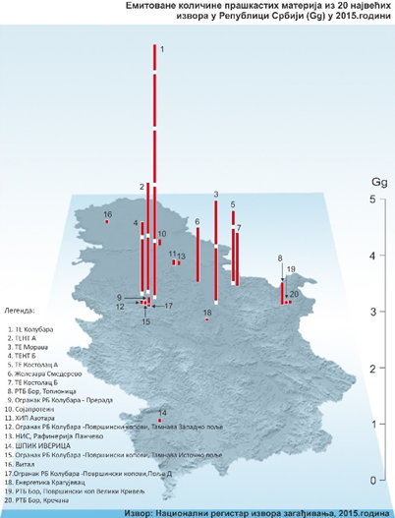
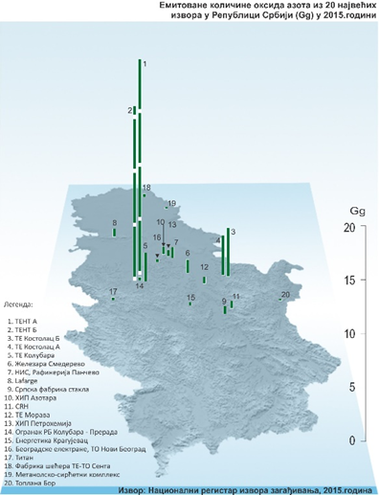
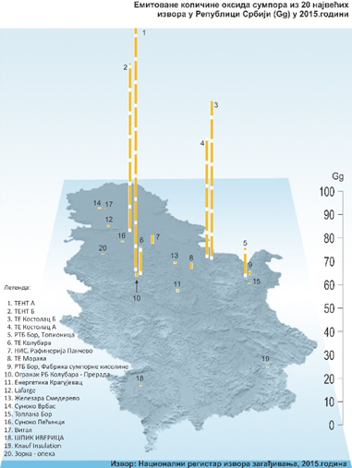
Serbian National PRTR register
Particles
NOx
SOx

Slide 37

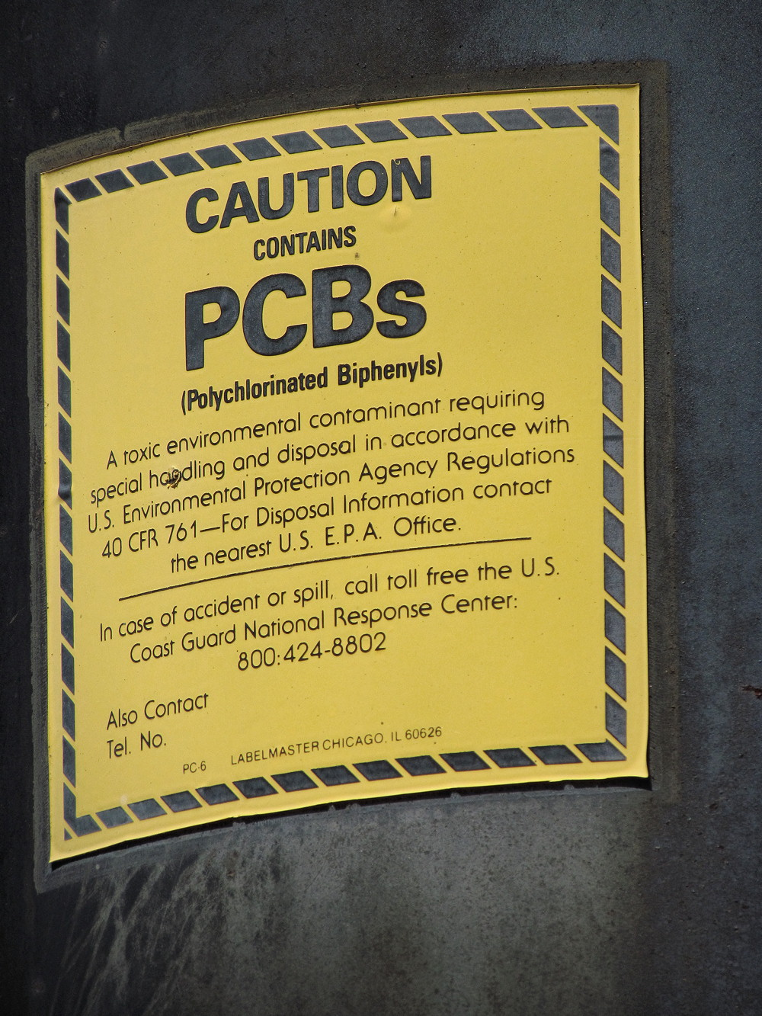
Serbian National PRTR register
ONGOING ACTIVITIES
VOC
F-gases
PCB and PCB waste
Online waste management permitting
Implementation of facility unique ID
NEAR FUTURE ACTIVITIES
Transboundary movement of waste
IED reporting
End of life vehicles
Development of GIS portal for air emissions and water emissions
Development of portals for UNFCCC and CLRTAP convention reports

Slide 38


Serbian National PRTR register
FUTURE ACTIVITIES
Implementation of SDGs and evaluation of the implementation of SDGs
Emissions data from facilities in real time
GPS waste tracking system
EU Emissions Trading System (EU ETS)

Slide 39
Serbian National PRTR register
THANK YOU FOR YOUR ATTENTION!
Nebojša Redžić, MSc
Head of Department of National PRTR register
Environmental Protection Agency
nebojsa.redzic@sepa.gov.rs
www.sepa.gov.rs
Phone: +381-64-6406348

