Slide 1
Tracking Pollutant Releases and Transfers in North America: North American PRTR Initiative
Orlando Cabrera-Rivera
Commission for Environmental Cooperation
Global Round Table on PRTRs
7 November 2018
Notes:
Taking Stock: Tracking Pollutant Releases and Transfers in North America to Support Sustainability

Slide 2
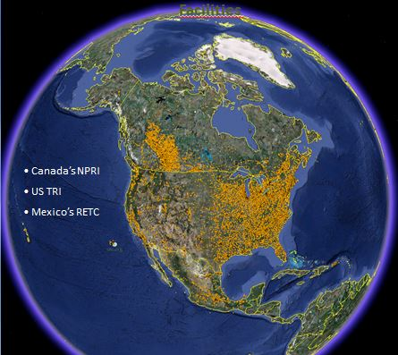
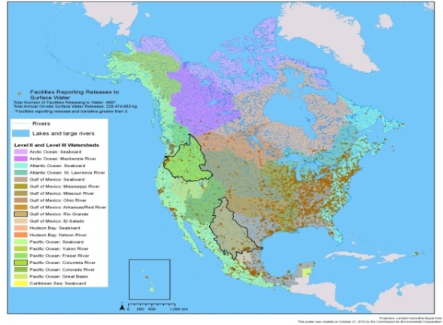
North American Pollutant Releases and Transfers
Increase access to information
Improved data comparability and consistency
Stakeholder Participation
Support decision-making relative to pollution prevention and reduction.
Notes:
The North American North American Pollutant Release and Transfer Register (PRTR) Initiative.
This is a cross-program initiative, and part of the core functions of the Secretariat.
The image on the slide shows more than 30,000 industrial facilities that report to the national PRTRs in North America. As you know, pollution does not stop at the border, and as you can see, we have pollution sources that cut across our shared ecosystems and population centers along border areas.
In order to address any cross-border environmental issue, whether national or international, you need data that are comparable.
This project aims to increase access to information about the sources and nature of industrial releases, in order to support decision making relative to pollution prevention and reductions.

Slide 3
NAPRTR Initiative and Sustainable Development Goals (SDG)
SDG 3 (good health and well-being), reducing/preventing deaths and illnesses from exposure to hazardous chemicals and pollution;
SDG 6 (clean water and sanitation), improving water quality by reducing pollution, and minimizing release of hazardous chemicals and materials;
SDG 9 & 12 (industry innovation/sustainable production and consumption), providing tools to assess the adoption of environmentally sound technologies and industrial processes.
Notes:
Access to PRTR data is an important tool to achieve and evaluate many of the SDGs associated with reducing environmental contamination and improving human health.

Slide 4
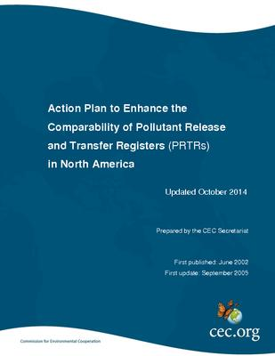
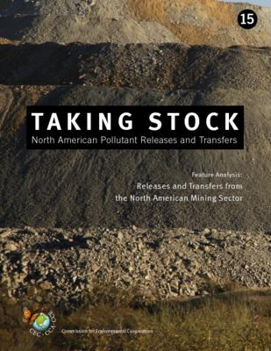
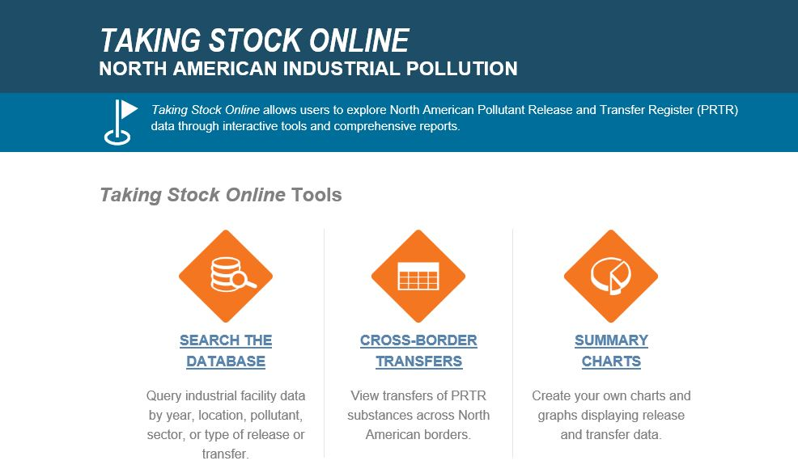
North American PRTR Initiative:
Access to Information and Enhanced Comparability
www.cec.org/takingstock
Notes:
Under this Initiative we integrate data reported to the PRTR systems of North America (TRI, NPRI and RETC), and provide value-added information on industrial pollution trough the Taking Stock Report, and the Taking Stock Online website. We also work with the national PRTR programs in addressing issues of data comparability, quality and completeness.
The third update of the Action Plan to Enhance the Comparability of PRTRs in North America was published in late 2014. It was drafted in colaboration with stakeholders from government, academia, industry and civil society.
The most recent version of the Taking Stock report was published in April 2017, and focused on the comparability in reporting of the mining sector, and we had a chance to present some of the reults to you at last years meetgin in new York (June 2017).

Slide 5
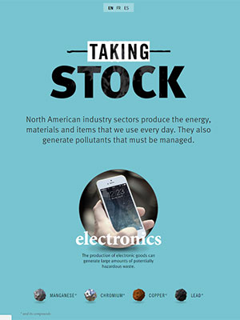
Taking Stock Online – Interactive Infographics
http://www.cec.org/sites/default/tsinteractive/index-en.html
Notes:
Along with the Taking Stock report, we also published an interactive Infographic about our analysis on North American PRTR data, to provide context and assist the reader in understanding the multiple factors to be considered is assessing the risk posed by a specific pollutant to human health and the environment.

Slide 6
Taking Stock Online – Update
Update of trilateral 2006-2015 data
City Search
Added context on pollutant reporting requirements
Improved Summary Graphics
www.cec.org/takingstock
Notes:
Our trilateral North American PRTR database has been recently updated. We are currently working on the integration of 2016-17 data, and working with our prtners in addressing reporting inconsistencies in cross border transfers data (As an example, a facility in one country reports sending a reportable pollutant (about reporting threshold) to a facility in another country, but the receiving facility does not report to the PRTR program.

Slide 7
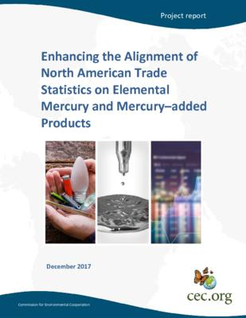
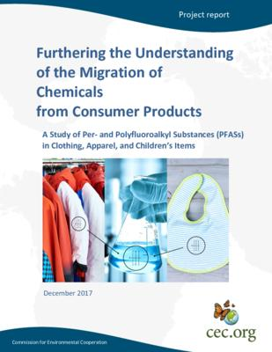
Greening of Chemicals Management in North America
http://www3.cec.org/islandora/en
Notes:
Late last year we published two reports under the Greening of Chemicals Management in North America project, one on mercury; the other on chemicals in consumer products. The mercury report presents an assessment of mercury trade statistics amongst the North American countries, with the aim of improving reporting under the Minamata Convention. For this report, the North American PRTR databases were consulted to obtain informatino on quantities of mercury transferred to off-site recycling, as well as to assess mercury uses in several industrial processes.
The chemicals in products work involved testing the presence and migration of chemicals of concern from manufactured goods (PFAS). Some of these chemicals include flame retardants, water repellants and other substances linked to health effects that are often contained in fabrics. Some of the substances assessed are reported under the North American PRTR programs, and have the potential to enter the environment though laundry water.

Slide 8
Orlando Cabrera-Rivera Head of Unit CEC Environmental Quality
Thank You!
Telephone: (514) 350-4323
Fax: (514) 350-4314
Email: ocabrera@cec.org
www.cec.org
www.cec.org/takingstock
THREE COUNTRIES WORKING TOGETHER TO PROTECT OUR SHARED ENVIRONMENT
Notes:
8

