Slide 1
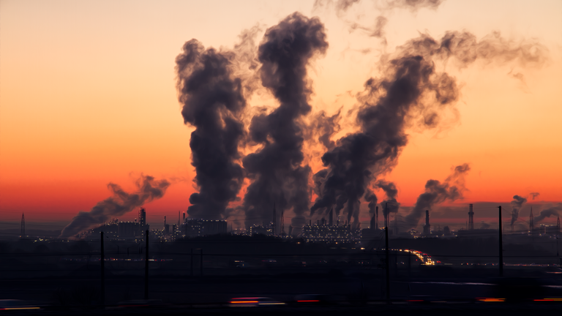
European Union progress towards SDGs
UNECE Global Round Table on PRTRs, 7-8 November 2018, Geneva

Slide 2
SDGs and the European Union
Alex RADWAY (European Commission, Brussels)
2. Indicators to monitor EU industrial emissions policy and track SDG progress
Bastian ZEIGER (European Environment Agency, Copenhagen)

Slide 3
1.1 Overview
EU is committed to maximising progress toward SDGs – see COM(2016)739
Regular monitoring by Eurostat
Indicator set – 100 metrics spread over the 17 goals
Two main interfaces – report and a webpage

Slide 4
1.2 ‘SDGs and me’ website

Slide 5
1.3 For example; SDG 12

Slide 6
Overall progress in the European Union
Alex RADWAY (European Commission, Brussels)
2. Indicators to monitor EU industrial emissions policy and track SDG progress
Bastian ZEIGER (European Environment Agency, Copenhagen)

Slide 7
2.1 Aims of the project
Primary:
Track effects of Industrial Emissions Directive (IED) on emission trends
Support OECD work on indicator(s) to track progress towards SDG targets 12.4 and/or 9.4
Secondary:
Explore normalisation of European-PRTR data including via activity, toxicity and damage costs
Identify gaps in regulatory framework
Explore applicability of pollutant thresholds for reporting in E-PRTR Regulation

Slide 8
2.2 Indicators developed
Contribution of industry to total air emissions
Air and water emission trends
Emission intensity - per unit GVA (Gross Value Added), energy
Sector-level emission trends (IED and conclusions on Best Available Techniques - BATc)
Number of installations covered per sector (IED and BATc)

Slide 9
2.3 Limitations
Regulatory scope (IED, BREFs, BATc) different from E-PRTR in terms of activities and pollutants
E-PRTR data limitations (scope, thresholds, Measured/Estimated/Calculated)
CLRTAP* data limited to few pollutants
Heterogeneous PRTRs in different parts of World
Normalising factors such as activity data, toxicity factors or damage costs not always available
(* Convention on Long-range Transboundary Air Pollution)

Slide 10
2.4 Example – Application to SDGs
SDG 9.4: “By 2030, upgrade infrastructure and retrofit industries to make them sustainable, with increased resource use efficiency and greater adoption of clean and environmentally sound technologies and industrial processes, with all countries taking action in accordance with their respective capabilities”
EU: E-PRTR pollutants (excl. GHGs) per GVA (2010 values in €)

Slide 11
2.4 Example – Application to SDGs
SDG 9.4: “By 2030, upgrade infrastructure and retrofit industries to make them sustainable, with increased resource use efficiency and greater adoption of clean and environmentally sound technologies and industrial processes, with all countries taking action in accordance with their respective capabilities”
US: TRI chemicals per RVA (2009 values in €)

Slide 12
Thank you
Further information:
Sustainable development in the European Union — Monitoring report on progress towards the SDGs in an EU context (2018 edition) https://ec.europa.eu/eurostat/en/web/products-statistical-books/-/KS-01-18-656
Study on ‘Indicators for industrial emissions‘
https://circabc.europa.eu/w/browse/523fc5ff-fb45-4ff3-a513-9ee7268e967b
Contact details:
Alex RADWAY alex.radway@ec.europa.eu
Bastian ZEIGER bastian.zeiger@eea.europa.eu

