Slide 1
Application of Pollutant Release and Transfer Register Data to Track United Nations Sustainable Development Goals
Caitlin S. Briere
United States Environmental Protection Agency
Toxics Release Inventory Program
3rd Meeting of the Global Round Table on PRTR
7 November 2018
Notes:
drive home the point that there is a role for PRTRs in assessing progress towards achieving the SDGs.

Slide 2
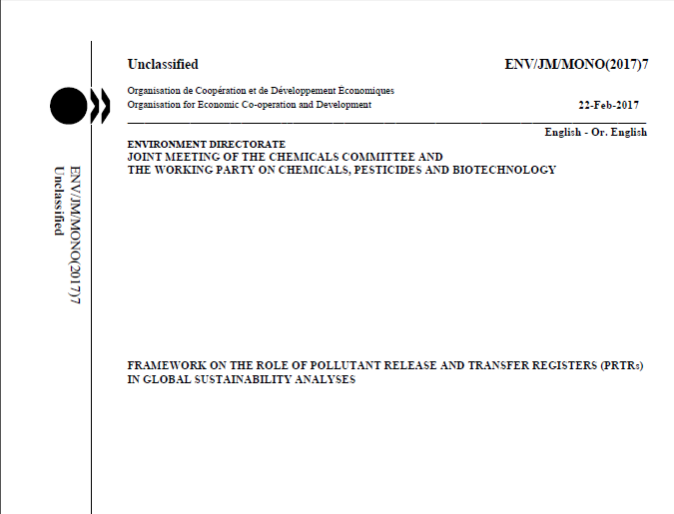
OECD’s Framework on the Role of PRTR in Global Sustainability Analyses
Presents strategies for harmonizing PRTR data for use in global-scale analyses
Provides guidance on how PRTR data from multiple PRTR systems can be used to track progress towards global sustainability
Illustrates how data from PRTRs can be integrated
Framework document published Feb. 2017 (developed from 2011 to 2017)
Notes:
2011: The United States proposed developing a Framework that defines the role of PRTRs in global sustainability
2012 – 2014: Outline and drafts presented to the PRTR Task Force. Draft document prepared.
2015: Draft presented for PRTR Task Force for review
2016: Comments incorporated
2017: Published Feb. 2017

Slide 3
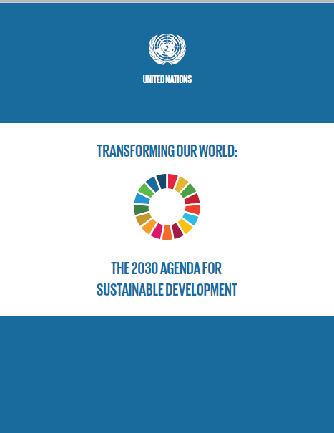
UN Sustainable Development Goals
In Sept. 2015, countries adopted a set of goals to end poverty, protect the planet, and ensure prosperity for all.
Published as Transforming Our World: The 2030 Agenda for Sustainable Development
Sets forth a plan to “shift the world on to a sustainable and resilient path”
Defines 17 SDGs that encompass the economic, environmental, and social dimensions of sustainability

Slide 4
Framework document is Aligned with UN SDGs
Section 2.4 of the Framework document:
“Using PRTR Data to Assess Progress toward Sustainable Development Goals”
The Framework identifies the goals and specific targets most directly relevant to PRTRs
Notes:
Section 2.4 of the Framework describes using PRTR data to assess progress toward SDGs

Slide 5
Implementing the Framework: How to use PRTR data to assess progress towards achieving the Sustainable Development Goals
PRTRs: Select PRTRs that represent geographical diversity and can provide sufficient trend data on common chemicals
Chemicals: Select a manageable but diverse group of priority chemicals to demonstrate application of PRTR data to track SDGs
Rationale for selections: Develop a construct for the pilot application of PRTR data to evaluate SDGs most relevant to PRTR
Notes:
Project being conducted under the purview of the OECD WG-PRTR

Slide 6
Implementing the Framework: Selecting PRTR systems from which to collect data
PRTR systems included in the project:
Australia
Canada
Chile
European Union (may include additional data from individual countries not stored in the E-PRTR)
Japan
Mexico
United States (in addition to TRI chemical data, the National Emissions Inventory [NEI] will serve as a source of data for PM and SO₂)

Slide 7
Implementing the Framework: Selecting pollutants to include
Pollutants included in the project:
Benzene | Nickel & nickel compounds
Tetrachloroethylene | 1,2-dichloroethane
Di-(2-ethylhexyl)phthalate | Dichloromethane
Ethylbenzene | Trichloroethylene
Styrene | Cadmium & cadmium compounds
Sulfur dioxide | Chromium & chromium compounds
Particulate matter | Mercury & mercury compounds
Notes:
Are included in at least 4 of the 6 PRTRs
Are included on international chemical priority lists
Are used in a variety of applications and sectors
Are carcinogens or cause other serious health effects
The rationales for including these additional pollutants in the project are that the above metals and metal compounds are major water pollutants in many parts of the world, and sulfur dioxide and particulate matter are major air pollutants that cause significant impacts on human health. The metals (cadmium and chromium and their compounds) are covered by all seven of the proposed PRTR systems, although for chromium, reporting in Australia and Japan is limited to trivalent chromium (Cr⁺³) and hexavalent chromium (Cr⁺⁶) and their respective compounds.

Slide 8
Implementing the Framework: Selecting an SDG Target most suitable for application of PRTR data
Target 12.4 is most directly relevant to readily-available, comparable PRTR data
Tracking Target 12.4 by media (air, water, soil/land) will simultaneously provide information to track Targets 3.9 and 6.3
Further exploration of other Targets may come in later stages of this project as additional data is compiled
Target 12.4: By 2020, achieve the environmentally sound management of chemicals… and significantly reduce their release to air, water and soil to minimize their adverse impacts on human health and the environment.
Notes:
Target 3.9: By 2030,substantially reduce the number of deaths and illnesses from hazardous chemicals and air, water, and soil pollution and contamination.
Target 6.3: By 2030, improve water quality by reducing pollution, eliminating dumping, and minimizing release of hazardous chemicals and materials, halving the proportion of untreated waste water and substantially increasing recycling and safe reuse globally.
Newly proposed indicators:
12.4.1 Number of parties to international multilateral environmental agreements on hazardous waste, and other chemicals that meet their commitments and obligations in transmitting information as required by each relevant agreement
12.4.2 Hazardous waste generated per capita and proportion of hazardous waste treated, by type of treatment
(this indicator makes me think that we’d want to encourage the inclusion of off-site releases (transfers for release/disposal))
PRTR data can help inform agreed upon indicator 12.4.2, tiered documentation notes this indicator as Tier III “with no established methodology for the indicator”
Target 3.9 – Substantially reduce the number of deaths and illnesses from hazardous chemicals and air, water, and soil pollution and contamination
Target 6.3 – Improve water quality by reducing pollution, eliminating dumping and minimizing release of hazardous chemicals and materials, halving the proportion of untreated wastewater and substantially increasing recycling and safe reuse globally

Slide 9
Implementing the Framework: Conducting data analysis
Determine scope of analysis:
Focus on manufacturing sectors
Focus on on-site pollutant releases to air, water, and soil/land (applicable to Target 12.4)
Analyses to investigate:
Snapshot analyses – most recent year of data
Trend analyses – 2008 to 2016
Comparative analyses between PRTR systems
Toxicity-weighted release quantities
Economic information as an indicator (e.g. kg released/$ value added)
Other potential variables (e.g. regulatory activity)
Notes:
Industry sector scope: This would allow the project to examine pollutant releases from facilities involved in a wide variety of industrial operations (e.g. food & beverage manufacturing, chemical manufacturing, textile manufacturing, and fabricated metal product manufacturing), but would limit the scope of analysis to sectors represented in a majority of the PRTR systems included in the project. It is also important to concentrate on those manufacturing sectors where the pollutants listed previously are most likely to be manufactured, processed, or used in order to maximize the utility and meaning of the project results. Focusing on the manufacturing sectors will achieve a balance between examining a sufficient number of different types of industrial operations and limiting the analysis to a feasible and useful subset of data that is consistent across PRTR systems. Depending upon the results of the sector-based analyses, more specific sub-sector based analyses may be warranted and, if so, will be performed.
Release data scope - Release data of the chosen pollutants are readily available, and focusing on their releases will maximize the comparability of data sourced from multiple PRTR systems. Moreover, among all of the quantities of a given pollutant managed as waste by a facility (e.g., quantities recycled, burned for energy recovery, released into the environment or treated), it is the release quantities that are most expected to lead to any adverse effects to human health or the environment and therefore are the most relevant to the application of PRTR data for global-scale sustainability analyses. Additionally, as fewer PRTR systems collect data on non-release waste management quantities (e.g., quantities recycled, burned for energy recovery or treated), it seems most reasonable to concentrate on the most relevant and widely available information first. Examining other waste management and pollution reduction data will be explored in a later stage of this project.
Other factors - When interpreting results of trend analyses, it will also be necessary to consider factors that may be responsible for an observed trend. Thus, the impact of production and economic status over the timeframe of the analysis and specific to each country or region of analysis must be considered, as these factors can greatly influence the extent of manufacturing output and therefore emissions. Another contributing variable that may need to be considered is the implementation of regulations that could potentially impact release quantities of the study chemicals and/or activities of the study sectors. Such information may be needed to provide additional context to changes in pollutant release quantities.
Analytic Descriptors
Pollutant release quantities (kg)
Toxicity-weighted release quantities
Pollutant release quantities per unit of production
Toxicity-weighted release quantities per unit of production

Slide 10
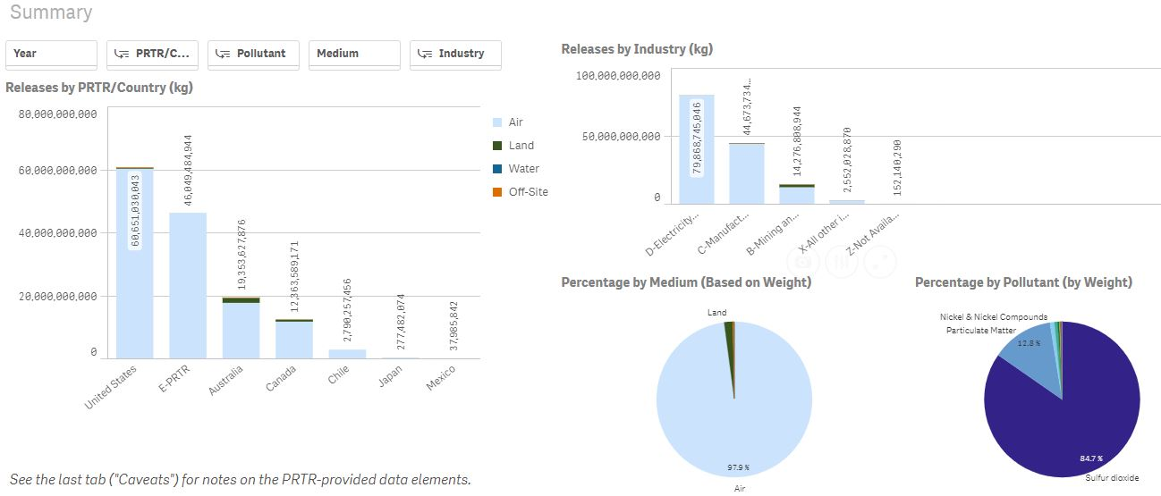
Implementation
Qliksense Data Visualization Application
Notes:
Plug Cheryl’s presentation in next segment of session

Slide 11
Next Steps
Continued analysis using data visualization application
Compilation of analytical results in various formats
Dissemination to stakeholders through various outlets
Further out…
Potential to apply methodology to additional SDG Targets
Adding data on additional chemicals and/or sectors to data visualization application
Expanding scope to include other PRTR systems
Using this methodology as the foundation for more extensive global-scale PRTR analytical projects

Slide 12
Contact Information
Caitlin S. Briere, MPP
Senior PRTR Analyst
Director, TRI National Analysis
United States Environmental Protection Agency (EPA)
Toxics Release Inventory (TRI) Program
briere.caitlin@epa.gov

