Slide 1
PRTRs: PROMOTING INFORMED DECIONS FOR A SUSTAINABLE FUTURE
3rd Global round table on PRTRs
Implementation of the Peruvian PRTR

Slide 2
2005-2007
2005 - Ratification of Stockholm Convention (SC)
2010
2012
2015
2018
2007 - National Implementation Plan of SC. Includes a strategy for the design of PRTR
Evaluation of institutional capacities for a PRTR platform, and the definitions of key features.
Development of a pilot to validate the electronic procedure of report.
Implementation of a PRTR voluntarily
Trainings and Technical Assistance, offered to companies.
Adaptation of PRTR to OECD standards.
Development of mechanism to give data Access to public.
Milestones of PRTR Implementation in Peru

Slide 3
Legal instruments of reference
2001: The Stockholm and Basel Convention
2005: General Law on Environment
Articles 78 and 80 establish that companies must provide information on their environmental performance.
2016: Evaluation of Environmental Performance(CEPAL –OECD)
Recommendation 26: sets out the need to continue the implementation of a PRTR.
It was ratified by Peru in 2005.
2018: Escazú Agreement
A binding instrument that recognizes PRTRs and requires countries to implement it

Slide 4
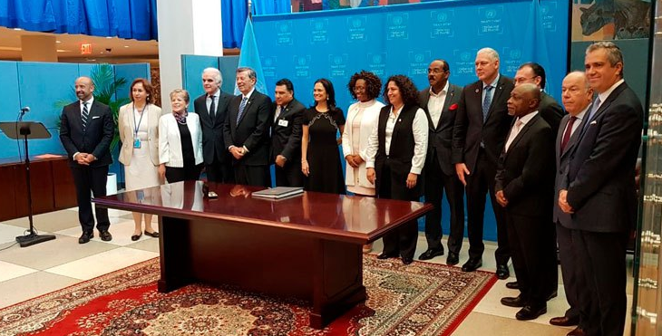
Escazu Agreement:
Regional Agreement on Access to Information, Public Participation and Justice in Environmental Matters in Latin America and the Caribbean
Signed by Peru on September 27
General Assembly of the United Nations - New York (USA).
16 Latin American countries have signed the agreement (47%)
Article 6: Generation and dissemination of environmental information
3. “Each Party shall have in place one or more up-to-date environmental information systems, which may include, inter alia: An estimated list of waste by type and, when possible, by volume, location and year”.
4. "Each Party shall take steps to establish a pollutant release and transfer register covering air, water, soil and subsoil pollutants, as well as materials and waste in its jurisdiction. This register will be established progressively and updated periodically”.
Texto disponible en:
http://sinia.minam.gob.pe/documentos/acuerdo-regional-acceso-informacion-participacion-publica-acceso

Slide 5
Features of the PRTR

Slide 6
What is reported to the PRTR?
Section | Description
Information of sources (establishments) | Location of the establishment, processes performed, responsible for reporting, annual fuel consumption, annual energy consumption.
Emissions to air, water and land | Amount of pollutants emitted outside the establishment in kilograms.
Effluents | Total amounts of wastewater that were generated and treated.
Hazardous waste | Amount of hazardous waste generated, imported and exported according to the Basel Convention classification.

Slide 7
What is reported to the PRTR?
EMISSIONS
Organics
POPs
Metals and non-metals
Ozone Depleting Substances
HAPs
Inorganics
Greenhouse Gases
Oxides
Cyanides
Regulations | Nº of substances
Basel Convention | 1
Stockholm Convention | 23
Rotterdam Convention | 29
DS 003-2002-PRODUCE | 3
DS 015-2006-EM | 3
DS 021-2009-VIVIENDA | 14
DS 029-94-EM | 2
DS 037-2008-EM | 8
DS 047-2001-MTC | 2
ECA water | 73
ECA air | 7
ECA land | 17
Kyoto Protocol | 5
Montreal Protocol | 9
RM 011-96-EM/VMM | 3
RM 026-2000-ITINCI/DM | 3
RM 315-96-EM/VMM | 2
Without regulation | 10
144
Substances

Slide 8
Sectors that currently report
Industrial sector
Chemical industry, tannery, foundry, manufacture of non-metallic products, production of fish products, other manufacturing activities.
Energy and mines sectors
Electric power generation, metallic and non-metallic mining, petroleum extraction and refining.
Agricultural sector
Agribusiness

Slide 9
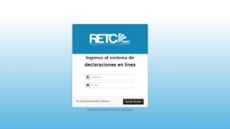
Virtual Report
3
Internet
Reception
Authentication
Evaluation
4
Database storage
1
Calculating the pollutants release and transfer
6
Dissemination and outreach
5
Sending a printable certificate
2
Sending the PRTR report
Jan | Feb | Mar | Apr | May | Jun | Jul | Aug | Sep | Oct | Nov | Dec
DECLARATION SUBMISSION |  |  | DECLARATION ASSESSSMENT |  |  |  | STADISTICAL REPORT PREPARATION |  |  | PREPARATION FOR NEXT YEAR REORTING CYCLE
1
2
3
4
5
6

Slide 10
Progress in National implementation

Slide 11
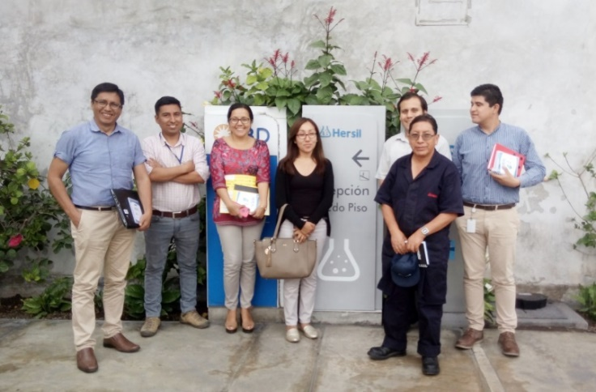
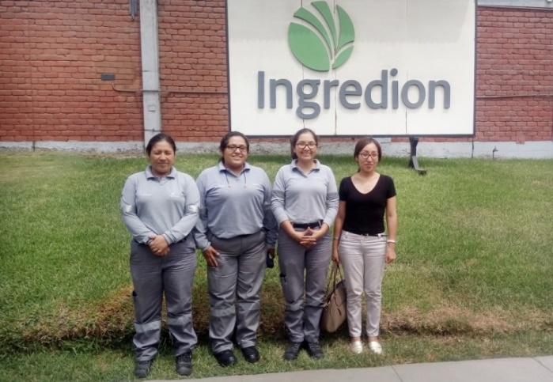
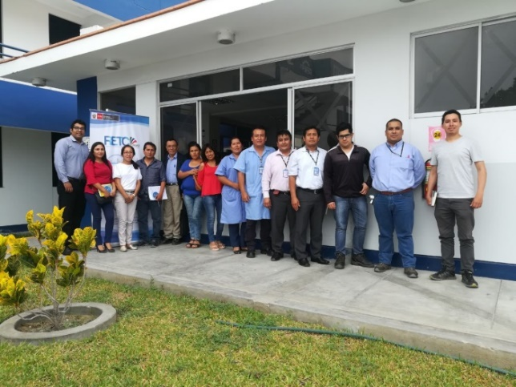
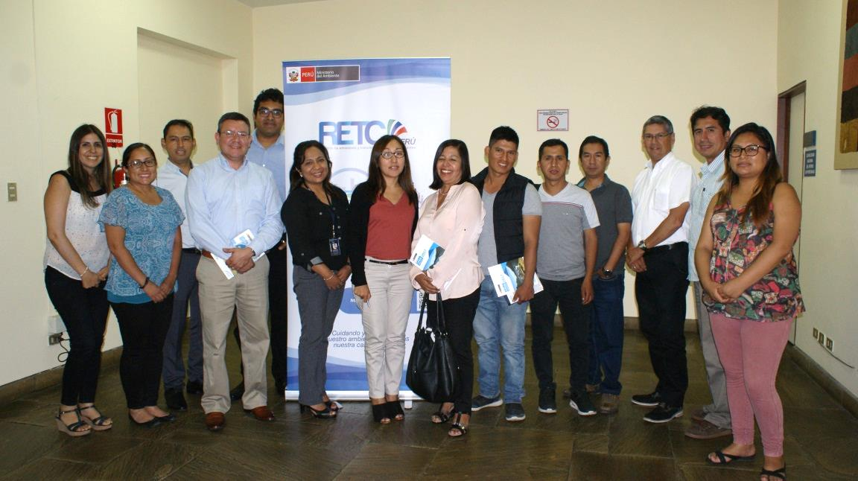
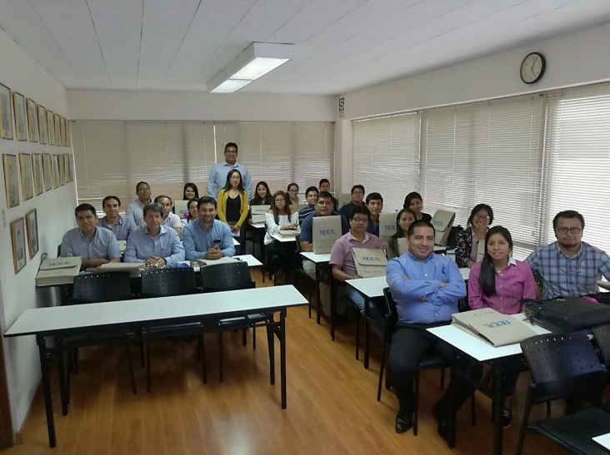
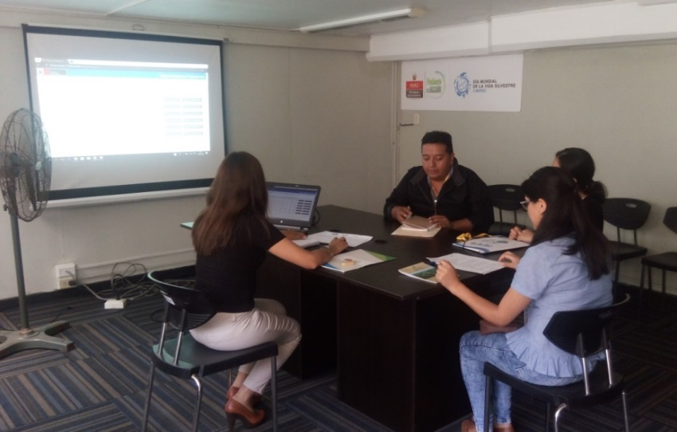
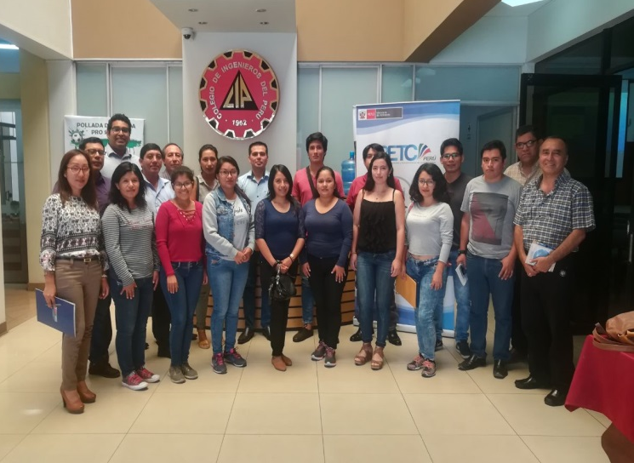
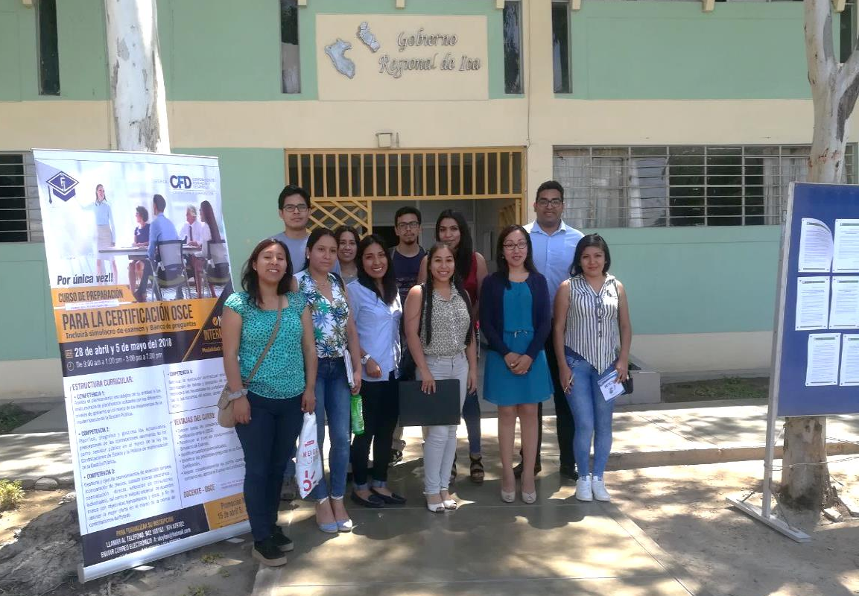
Training actions for companies in the Pollutant Release and Transfer Registers
and emission estimation methods; in 2018, 100 companies were trained

Slide 12
COMPANIES REACHED BY SECTOR ($\sim 150$)
Notes:
Foundry: the sector with the main source of emissions; representing 75% of the total emissions registered in the PRTR.

Slide 13
PARTICIPATION OF COMPANIES 2012 - 2018
VOLUNTARY PROCESS OUTCOMES
Outcomes | Description
Reporting cycles completed | 2016, 2017 y 2018
Reported substances | 50 substances
People sensitized | 4500 people
Government staff trained | 150 people
Pilot test
Voluntary Process

Slide 14
Challenges
Consolidate a registry mechanism that integrates other notification systems under a single window platform, allowing to reduce costs (of the government and the industries) and to improve the quality of the information.
Positioning the PRTR as a tool that contributes to national environmental management, providing useful information for various governmental and non-governmental interest groups.
Develop incentive mechanisms
Strong communication strategy to reach public
Achieve national regulations that allow the government to have a mandatory PRTR that works sustainably; implemented gradually.

Slide 15
Thanks For more info: http://retc.minam.gob.pe

