Slide 1
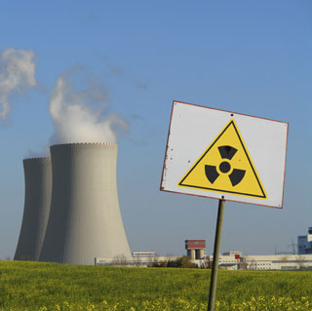
Decision–making on construction of new nuclear facilities
O.Melen-Zabramna
Head of legal unit, EPL, Ukraine
www.epl.org.ua

Slide 2
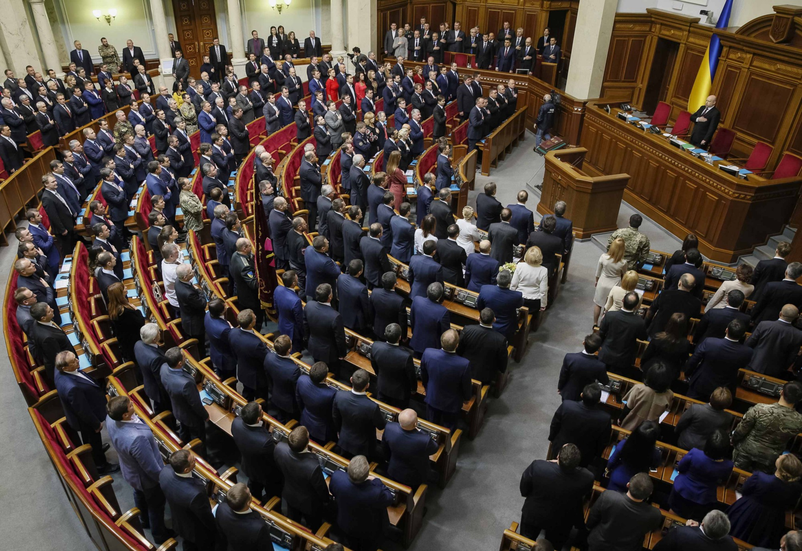
Final decision permitting project development, construction (Law of the Parliament)
Lack of public participation
No access to court
No environmental
integration

Slide 3
The Parliament has to make final decision on the basis of:
feasibility study of the proposed nuclear facility,
the conclusion of the state ecological expertise
the results of the consultative referendum (when conducted)
the report on the notification of the affected countries on possible transboundary impact from the construction.

Slide 4
State ecological expertise
Abolished in 2011 for construction project
Now – expertisa done by private of state organization
Main task – check if construction project adheres to ….. ecological safety requirements
No public participation provisions and transparency of process
Result – report of expertise, no approval of state authority is needed
Team of experts can include experts in ecology

Slide 5
Public opinion
Since 2012 local (consultative) referendum could not be held
Parliament has to check positive decisions of the local executive bodies or bodies of local self-government on location of facility
Such bodies have to take into account the results of public hearings
Numerous settlements in 30km control area

Slide 6
Access to court
No access to court for the final decision (Law of Parliament)
No access to court for the report of expertise (not decision of public authority)

Slide 7
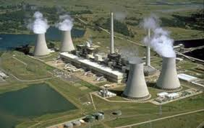
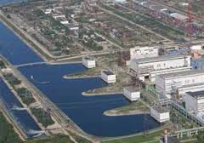
Case study: Construction of new blocks 3 and 4 at Khmelnytsky NPP

Slide 9
Decision-making on construction of new blocks
On January 12, 2011, the parliament of Ukraine ratified the Agreement between Ukraine and Russian Federation on cooperation in construction of blocks № 3 and № 4 of KhNPP
In July 2012, the governmental decision № 498 on approval of the feasibility study of construction of blocks № 3 and № 4 of KhNPP.
On September 6, 2012, the Law “On location, engineering and construction of nuclear power blocks 3 and 4 of Khmelnytska nuclear power plant”

Slide 10
Violations
Aarhus convention
Espoo convention
Disapproval of construction by local councils
Public hearings held in 14 settlements out of 207
Nuclear safety violations
Water shortage, negative impact on water resources

Slide 11
EPL actions: litigation
EPL v. parliament of Ukraine
On March 27, 2013, EPL submitted a suit to the High Administrative Court of Ukraine challenging the illegal actions of the Parliament of Ukraine during the adoption of the Law “ On location…”
The court rejected EPL’s suit and suggested applying to the Constitutional Court of Ukraine. (no standing for EPL or citizens)
EPL v. The Ministry of Energy of Ukraine
In May 2013, EPL challenged the illegal actions of the Ministry of Energy during preparation of the draft Law “ On location,..” Court rejected the claims due to the expiry of limitation period for such suit.

Slide 12
State ecological expertise
September 2015 – cooperation agreement denounced, the legal force of the law terminated

Slide 13
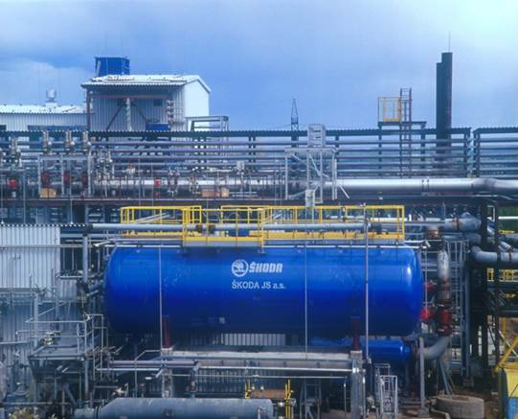
Who’s next?
Skoda? In 2004, United Heavy Machinery Plants became the owner of the company, and now guarantees ŠKODA JS long-term development of its key activity – nuclear power.

