Slide 1
Shared Environmental Information System (SEIS) state of play, outlook into the future
Lukasz Wyrowski
UNECE, EMA programme manager
Task Force on Access to Information, 3td session
Geneva, 3-5 December 2014

Slide 2
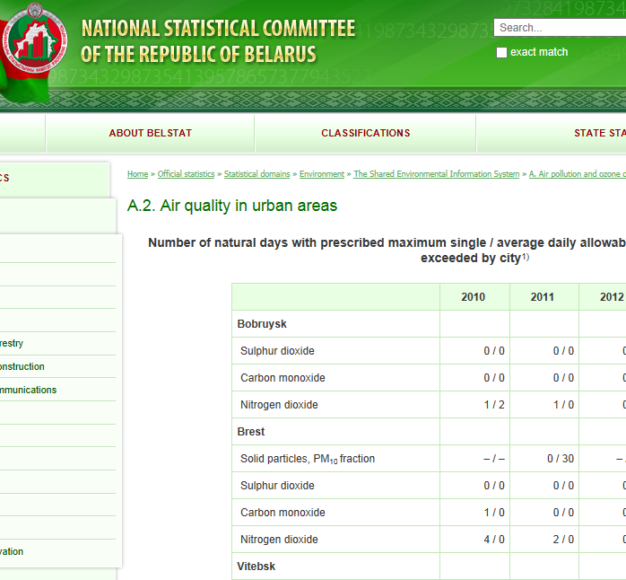
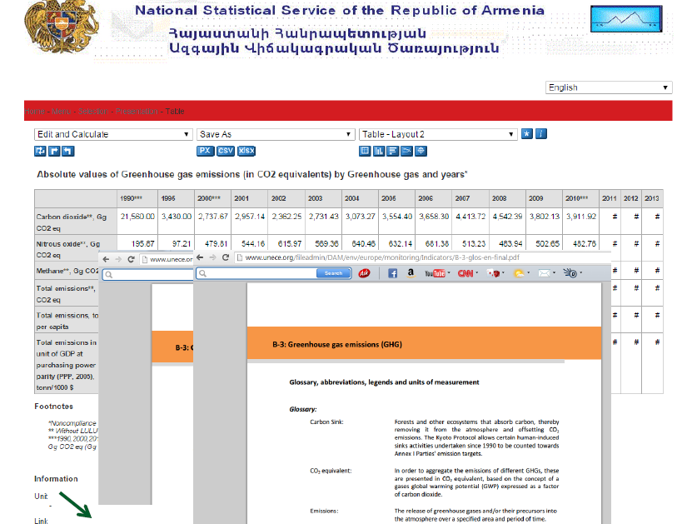
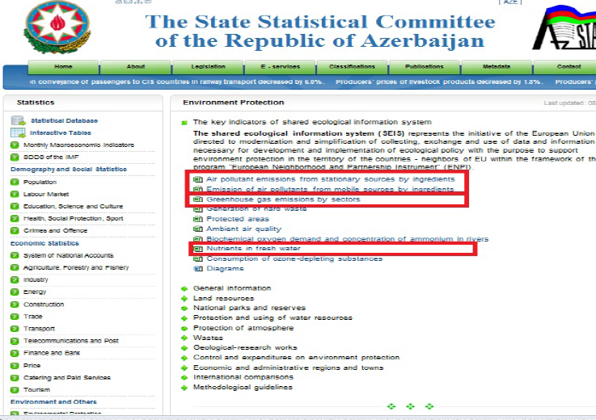
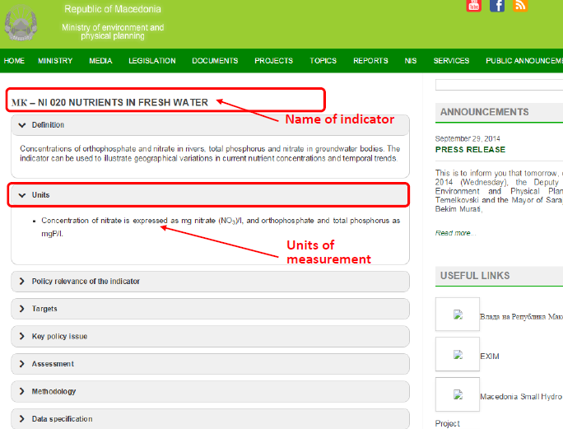
What is SEIS?
An approach to be followed for facilitating regular environmental assessments and reporting
Data and information flows

Slide 3
What is SEIS?
To support national
and international
policy development
Content
National SoE
Institutional cooperation
To meet SEIS principles
MEAs
Regional, global assessments
Infrastructure
SDGs
Post 2015 agenda

Slide 4
What is SEIS?
To support national
and international
policy development
Content
National SoE
Institutional cooperation
To meet SEIS principles
MEAs
Regional, global assessments
Infrastructure
SDGs
Post 2015 agenda

Slide 5
What is SEIS?
To support national
and international
policy development
Content
National SoE
Institutional cooperation
To meet SEIS principles
MEAs
Regional, global assessments
Infrastructure
SDGs
Post 2015 agenda

Slide 6
SEIS in Pan-Europe
Today
Future
assessments
MEAs
Common components under national SEIS to
constitute pan-European SEIS
SDGs
Post 2015
indicators

Slide 7
SEIS in Pan-Europe
Despite availability of:
Good practices
Support material (SEIS cookbook)
Support projects (e.g. ENPI-SEIS, FLERMONECA, ECE JTF)
Challenges faced:
Lack of common agreed SEIS component for pan-Europe
Unequal progress (initial, medium or advanced) on national SEIS development

Slide 8
Targets and performance indicators
Solution to the challenges:
Targets and performance indicators to guide a development of SEIS in time (developed by Friends of SEIS, adopted by CEP-20, implementation starts now)
now
2021

Slide 9
How to measure implementation?
Have we identified gaps vis-à-vis the targets?
Have we defined all the tasks required to eliminate the gaps - roadmap?
Have we carried out all the tasks – implemented the roadmap?
Do we operate SEIS sustainably?
Phase III
Phase II
Phase I

Slide 10
How to measure implementation?
Phase I
Phase II
Phase III
2015
mid-2016 EfE Conference
2021

Slide 11
SEIS management
National
Responsibility for assuring performance:
National coordination mechanism
Pan-European
Responsibility for assuring performance:
Working Group on Environmental Monitoring and Assessment (WGEMA)
REPORTING FORMS (under development)

Slide 12
SEIS management 2015
WGEMA activities:
Agree the priority data flows for pan-European SEIS (pan-European component) – WGEMA session in April 2015
Finalize the reporting forms to enable countries reporting – WGEMA session in April 2015
Review the SEIS establishment for 2015-bound priority data flows - WGEMA session in second half of 2015

Slide 13
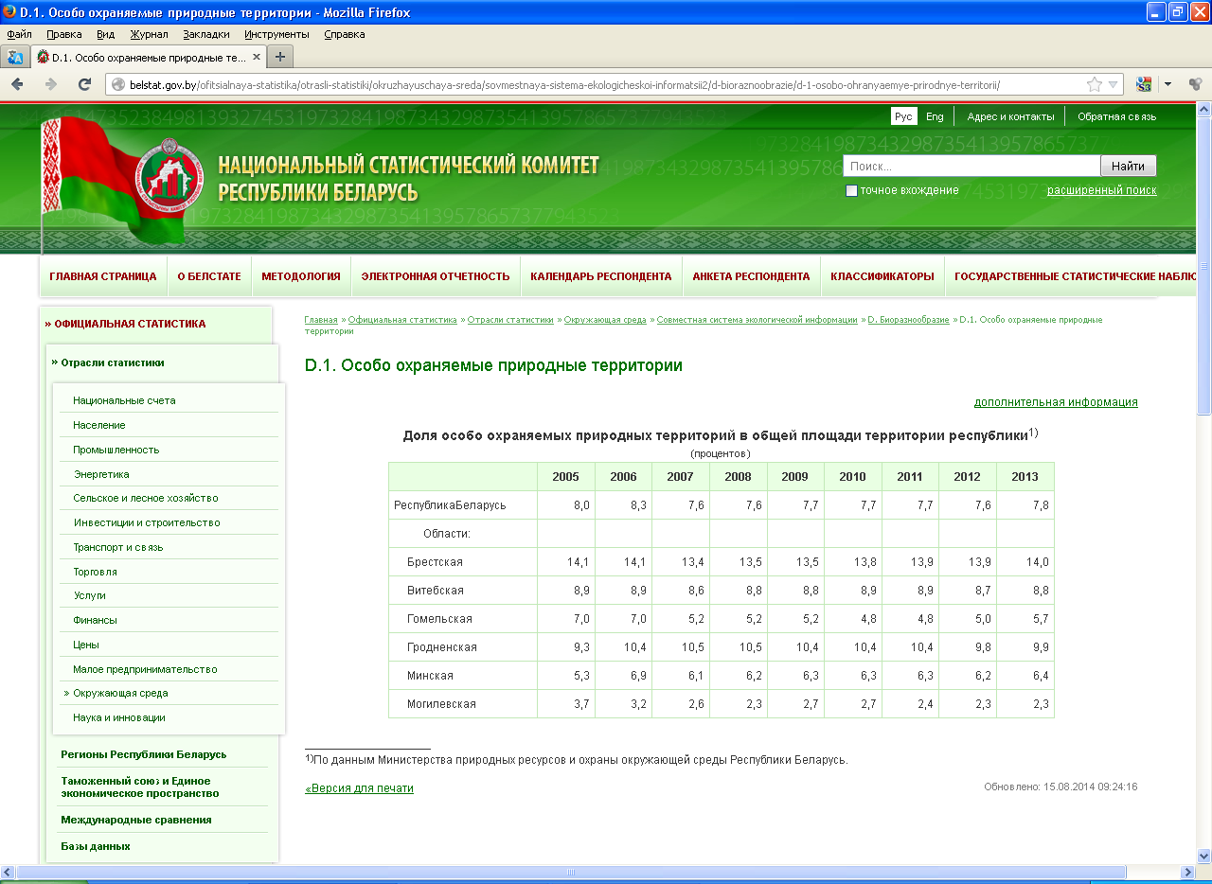
SEIS outlook into the future
2015
2018
2020
2015 - SEIS established with priority data flows 2015-bound
2018 - SEIS established with priority data flows 2015+2018-bound
2020 - SEIS established for all pan-European priority data flows

Slide 14
Friends of SEIS - 2nd task
2015
2018
2020
Taken into account that pan-European SEIS is established, which should be the regular assessment process
Friends of SEIS proposal (May meeting) CEP-21 for decision

