Slide 1
Quality System in Air Quality Monitoring
Maja Gramatikova, IT Division
Ministry of Environment and Physical Planning
Republic of Macedonia
Geneva, 03-05 December 2014
Third meeting of the Task Force on Access to Information

Slide 2
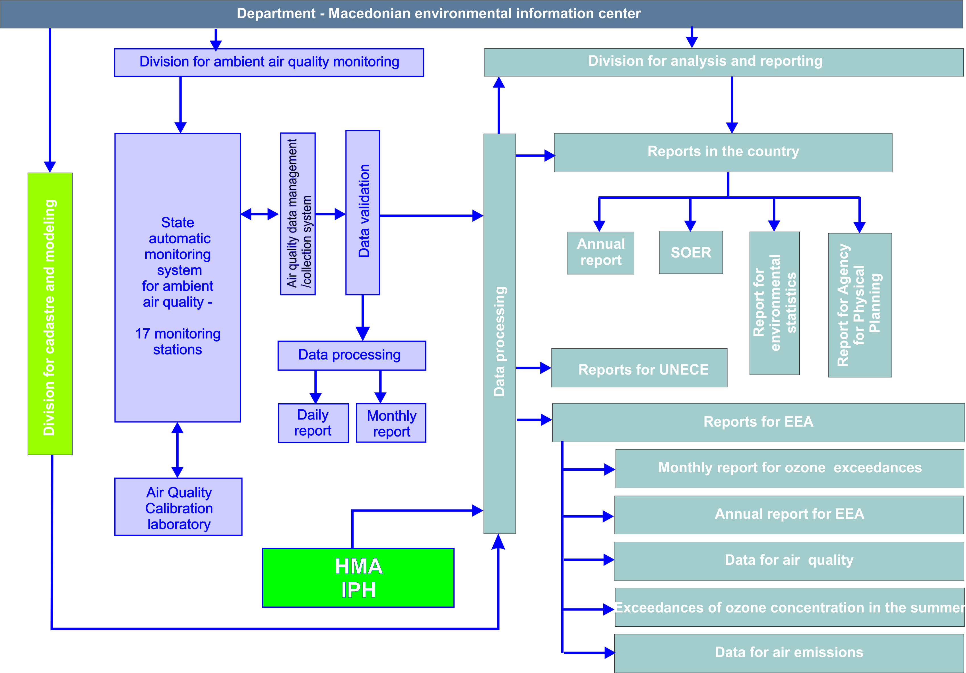
MACEDONIAN ENVIRONMENTAL INFORMATION CENTER
Installations
Institute for Public Health

Slide 3
Legislation
Degree on limit values of the levels and types of pollutants in ambient air and alert thresholds, terms for limit values achievement, limit value margins of tolerance, target values and long-term targets | Limit values, target values, thresholds | 2005/2013
Rulebook on criteria, methods and procedures for evaluating the ambient air quality | Criteria for assessment | 2006/2013
Rulebook of methodology for monitoring of ambient air quality | Criteria for measurement locations | 2009
Rulebook on the contents and the manner of transmission of data and information on the status of the ambient air quality management | Reporting and public information | 2009
Rulebook on the equipment, devices, instruments and appropriate facilities requirements for entities performing professional matters for ambient air quality monitoring | Methods for measurement | 2011

Slide 4
Air quality measurements data from installations
According to article 47 of the Law on Ambient Air Quality, installations are obliged to measure air quality in the nearest populated area;
Data from the air quality measurements are coming to the MOEPP;
Sampling time is checked (must be in accordance with the sublaw, for example, 24 hours for PM10);
Methods are checked if they are in accordance with the EN standards defined in the Annex of a certain rulebook;
Measuring devices must have performance characteristics in accordance with the EN standards;
If this is not a case, equivalence test report must be given in addition and in this case data must be corrected with correction factor.

Slide 5
State Automatic Monitoring System
for Ambient Air Quality (SAMSAAQ)
Structure of the SAMSAAQ
Air Quality Calibration Laboratory
State Air Quality Monitoring Network
Air Quality Data Management System

Slide 6
Quality System
All policies, programs, procedures and instructions are documented and constitute the QUALITY SYSTEM.
Established, implemented and maintained by the Air Quality Monitoring Division.
Assures the quality of the results generated by the SAMSAAQ.
Includes the following documents:
  Quality manual,
  SOPs,
  Registers,
  Forms,
  Reports,
  QA/QC procedures,
  Plans,
  Lists,
  Data base,
  Reporting,
  Records.
Quality manual
SOPs
Registers
Forms
Report
QA/QC procedures
Plans
Lists
Data base
Reporting
Records

Slide 7
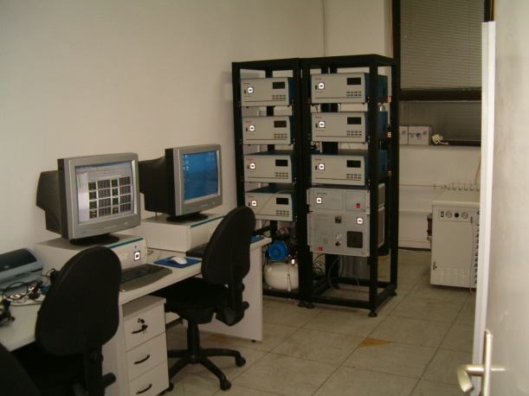
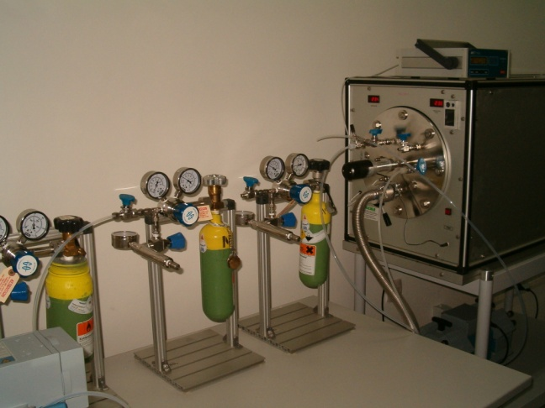
AIR QUALITY CALIBRATION LABORATORY
TASKS OF THE AQCL
Maintains the traceability of the reference gas standards towards conducted measurements
through calibration of the measuring instruments;
Participates in interlaboratory comparison exercises organized by EC/Joint Research Center and the WHO;
Approves measurement systems (methods, equipment, networks and laboratories);
Ensures the accuracy of measurements;
Maintains accreditation according to ISO/IEC 17025
for the reference methods;
Keeps good contacts and passes the information from the EC, AQUILA, EC-working groups to the personnel at the local networks.

Slide 8
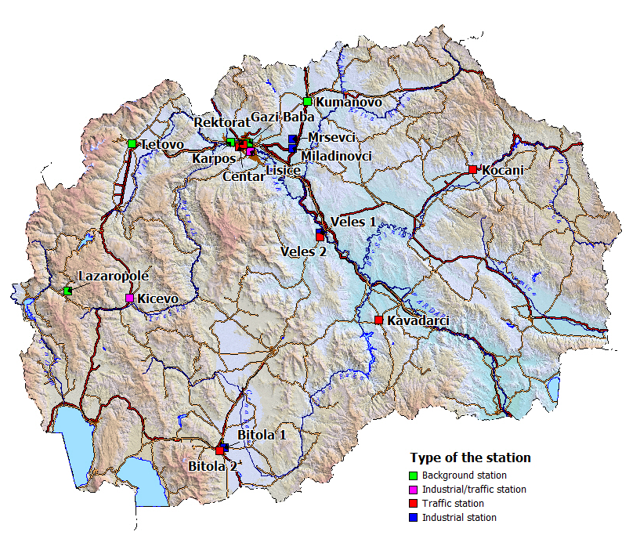
State Air Quality monitoring NETWORK
MEIC
Skopje Karpos
Tetovo
Veles 2
Veles 1
Bitola 2
Bitola 1
Kicevo
Kocani
Skopje Gazi Baba
Skopje Centar
Skopje Lisice
Skopje Rektorat
Kavadarci
Lazaropole
Kumanovo
Mrsevci
Miladinovci
Main segments of the SAQMN:
17 automatic monitoring stations, 6 Low Volume and 4 High Volume samplers
Basic environmental and meteorological parameters are measured
Data Acquisition software in each station
Central location – MEIC server, Airviro

Slide 9
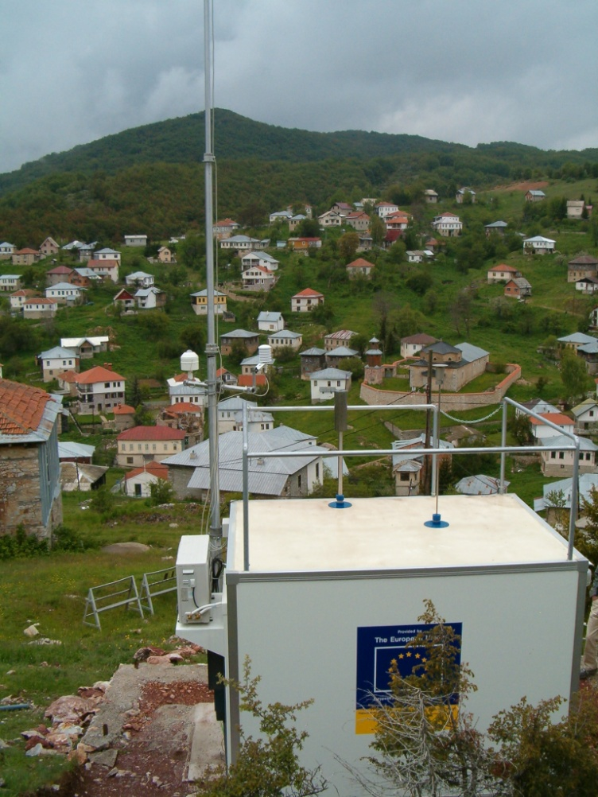
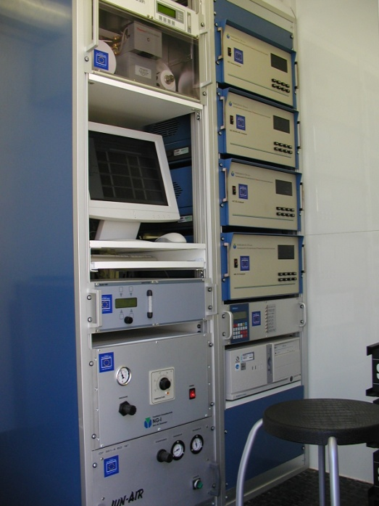
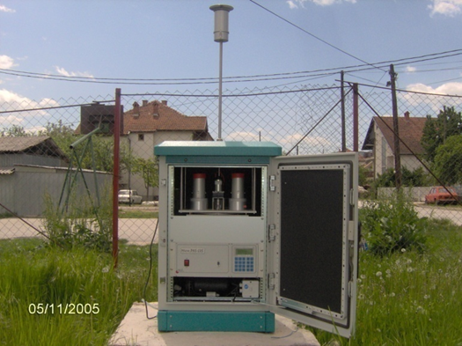
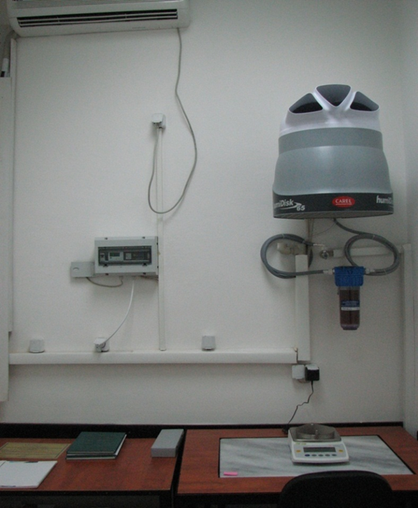
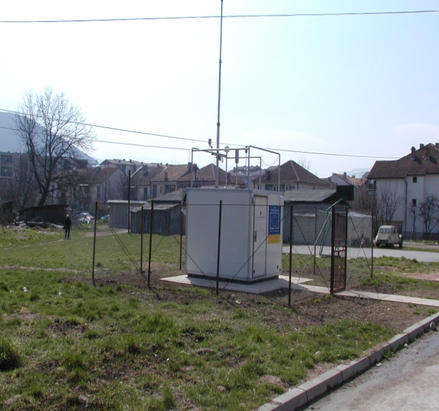
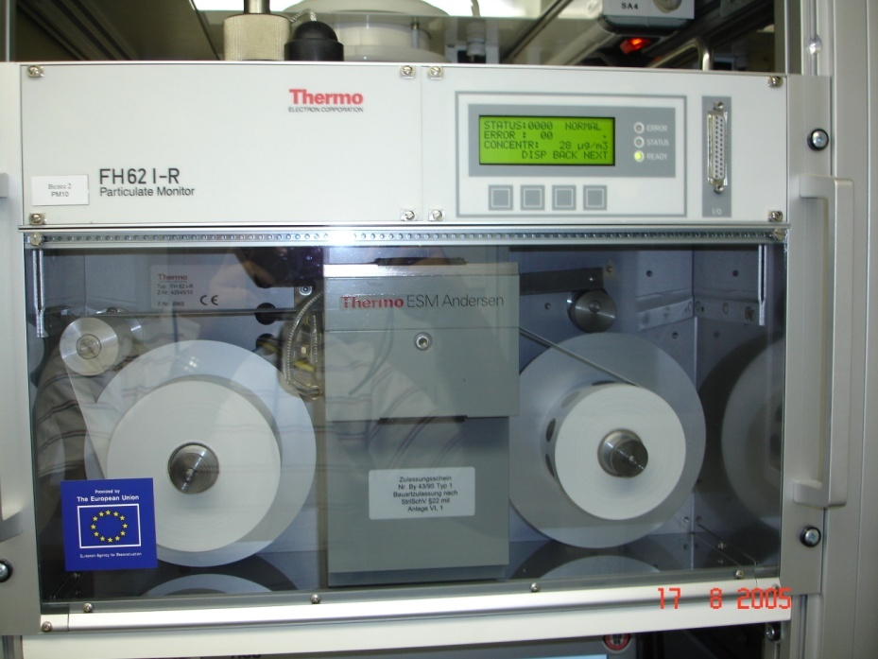
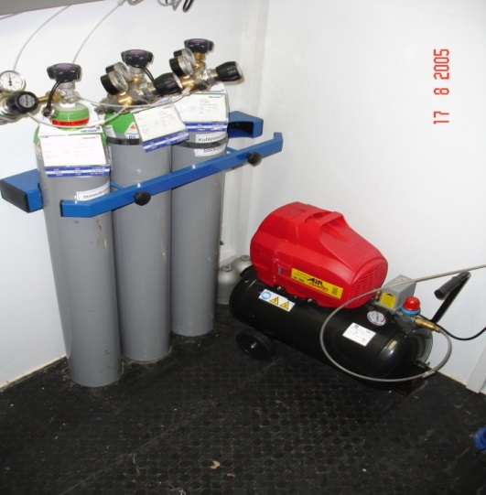

Slide 10
Automatic Monitoring stations
CO – carbon monoxide
SO₂ – sulphur dioxide
Nitrogen oxides (NO, NO₂, NO_{x})
O₃ – ozone
Meteorological parameters
Wind velocity
Wind direction
Temperature
Humidity
Pressure
Global radiation
PM10, PM2.5 – suspended particulate matters with size below 10 and 2.5 μm
Environmental parameters
BTX – benzene, ethyl benzene, toluene...

Slide 11
Air Quality Data Management System
1. Gathering hourly data from each station through GPRS connection
4. Web portal for publishing
near-to-real time data from the SAQMN
2. Storing data in the air quality data base
3. Management of different time interval data through web based system

Slide 12
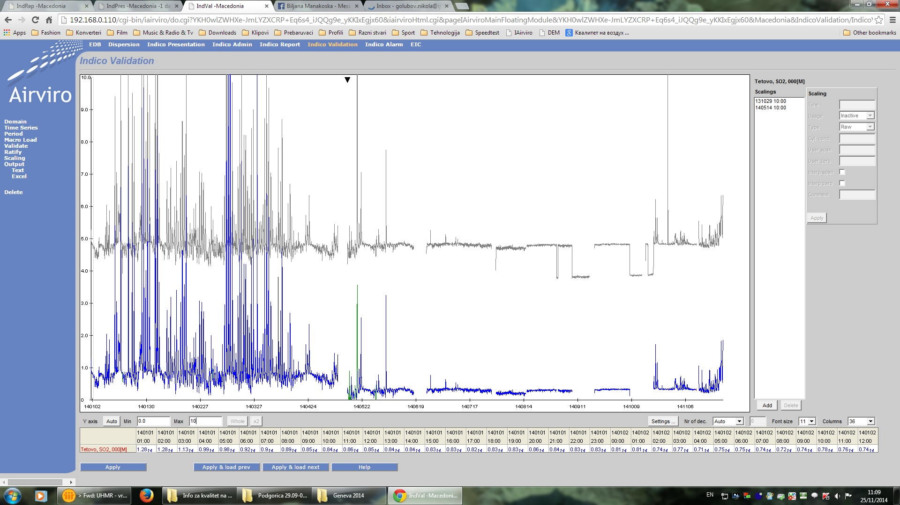
Data processing
Preliminary automated, followed by manual data validation on daily, monthly and yearly basis

Slide 13
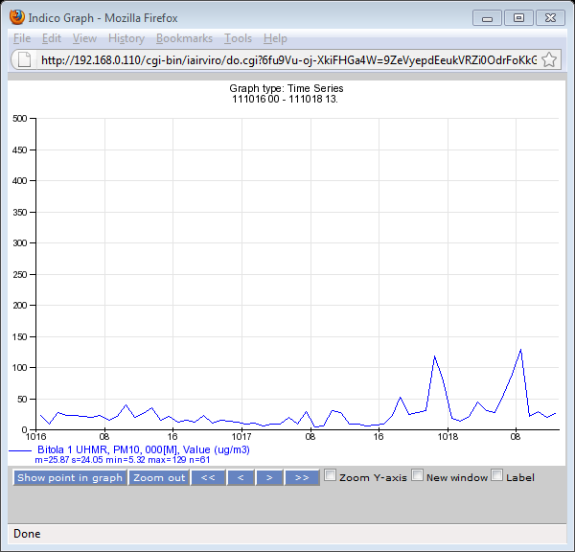
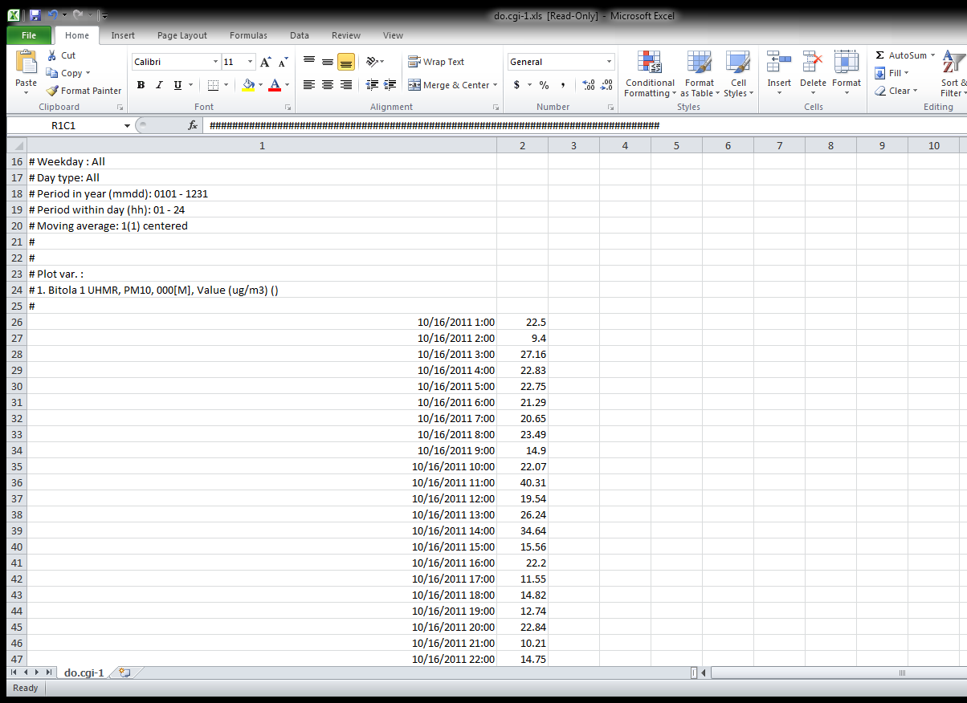
Data processing
Possibility to extract data in graphic (PDF and GIF)
and tabular format (EXCEL)

Slide 14
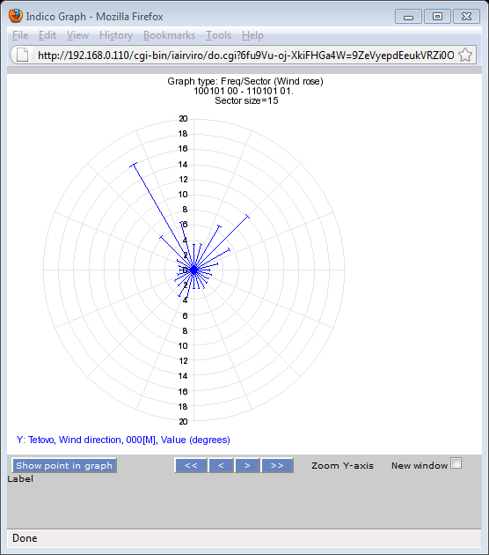
Data processing
By collecting, processing and utilising meteorological data, AIRVIRO has ppossibility to display wind rose needed for dispersion modeling

Slide 15
PUBLIC INFORMATION
Daily information
    State Inspectorate of Environment
    City of Skopje
    Crisis Management Centre
Monthly report
    Hydro Meteorological Administration
    Institute of Public Health of RM
    Public Health Centers
    Municipalities
    Annual report

Slide 16

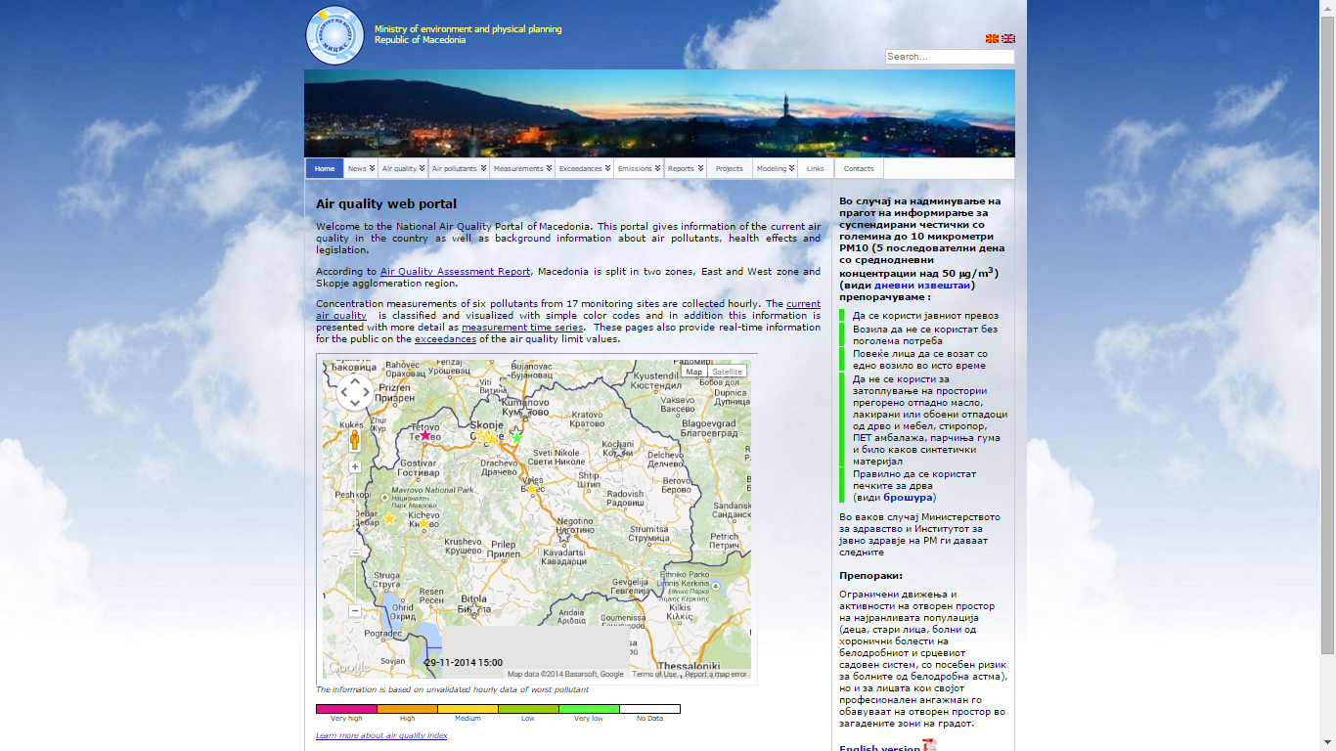

Slide 17
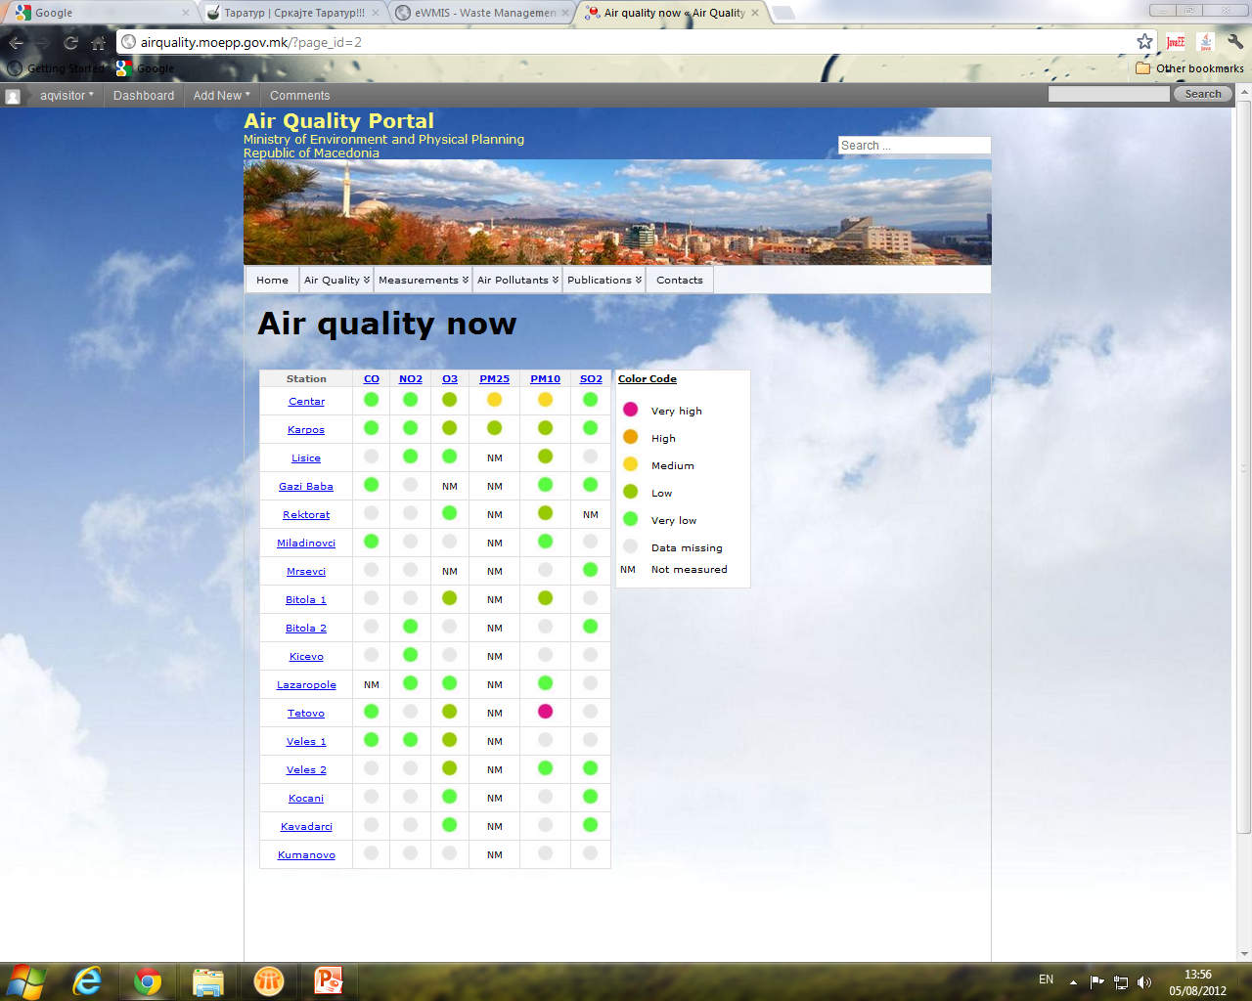

Slide 18
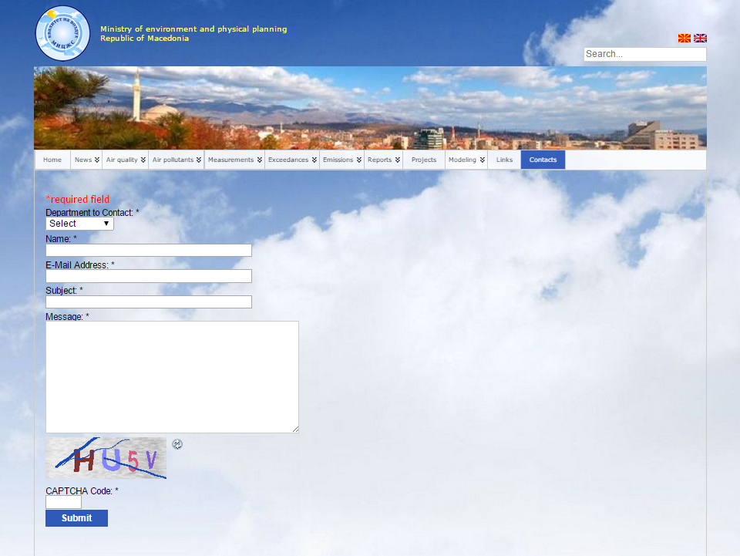

Slide 19
Future Steps
Accreditation of the Calibration Laboratory – Internal and external auditing
Training for implementation of QA/QC procedures within the new Twining project “Further strengthening the capacities for effective implementation of the Acquis in the field of air quality” that will begin in March 2015
Mandatory results
Air quality web portal data management functionality improved
Introduction of additional methods for data analysis and processing in respect to established QA/QC procedures
Documents for accreditation of the calibration laboratory revised and updated

Slide 20

Thank you
Hand made from Macedonia

