Slide 1
Environment Statistics
Objective, Conceptual Foundation, Scope
Access to Environment Statistics
Michael Nagy
Environment and Multi-Domain Statistics Section
UNECE Statistical Division

Slide 2
Objective of Environment Statistics
Provide information about the environment:
Most important changes over time and across locations
Main factors that influence them
Purposes:
Improve knowledge of the environment
Support evidence-based policy and decision making
Inform the general public and specific user groups

Slide 3
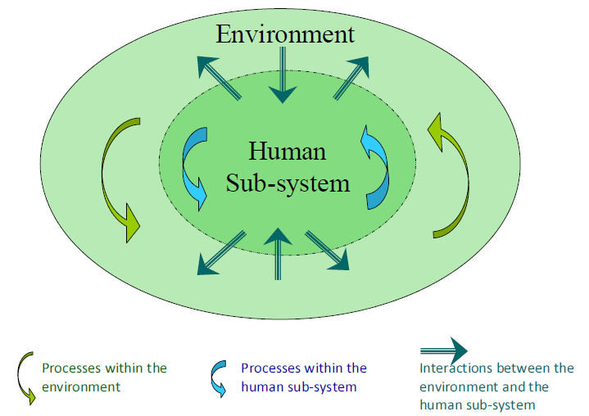
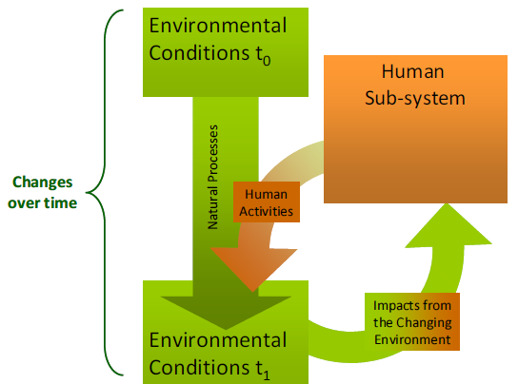
FRAMEWORK FOR THE DEVELOPMENT OF ENVIRONMENT STATISTICS (FDES 2013) Conceptual Foundation
Environment, Human Sub-system and Interactions
Environmental conditions and their changes

Slide 4
Scope of FDES
Biophysical aspects of the environment, those aspects of the human sub-system that directly influence the state and quality of the environment, and the impacts of the changing environment on the human sub-system.
Includes interactions with the environment, and among the environment, human activities, and natural events.

Slide 5
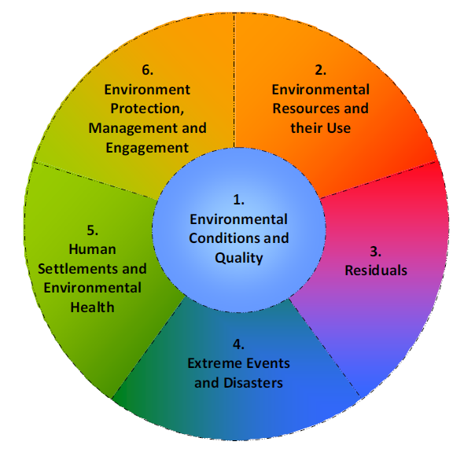
Components of the FDES

Slide 6
Data, Statistics, Indicators
Environmental DATA:
Unprocessed observations and measurements about the environment and related processes
Sources: Surveys, Administrative, Research,…
Environment STATISTICS:
Statistical methods, standards, procedures applied
Role of environment statistics to process environmental data into meaningful statistics
Environmental INDICATORS:
Synthesize and present complex statistics
Define objectives, assessing present and future directions etc.
Frameworks are e.g. DPSIR, MDGs, SDIs, Climate Change

Slide 7
Environmental-Economic Indicators
(e.g. CO₂ emissions/value added)
Environmental Indicators
(e.g. CO₂ emissions/capita/year)
Economic Indicators
(e.g. GDP, value added etc.)
Integration
(e.g. Environmental- Economic Accounts)
Environment Statistics
(Water, Air Emissions, Waste, Soil, Air Quality,…)
Economic Statistics
(National Accounts, Trade Statistics, etc.)
Municipal Survey
MoE administrative records
Etc.
Enterprise surveys
MoF administrative records
Etc.

Slide 8
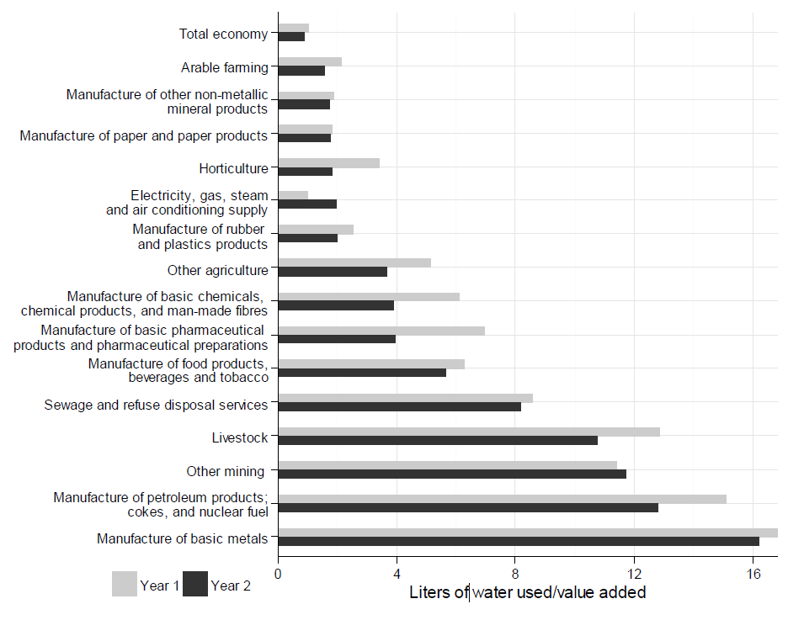
EXAMPLE: Industry level water use intensity indicators (liters/$ value added)
Requires integration
Water statistics. Data sources:
Industry Surveys
Municipal Surveys
Records of Ministry of Environment
Records of Ministry of Agriculture
…
Economic Statistics. Data sources:
Industry surveys
Agriculture survey
…
Use of unified industry classification (ISIC/NACE) essential

Slide 9
The Beauty and the Power of Environment Statistics
Environment Statistics provides a single set of trusted environmental information which can be used for multiple purposes:
Simple and complex policy questions
International comparisons and cross-boundary issues
Sub-national, national, regional and global indicators
Information of the general public
Research
What makes ES so special?
Official Statistics (fundamental principles applied)
International framework (FDES) that tries to cover the complexity of the environment and its interactions as a whole
Statistical quality standards
Statistical classifications
Can be integrated with other statistics (e.g. economic and social statistics)
Accounting frameworks can be applied

Slide 10
Fundamental Principles of Official Statistics – Principle 6: Statistical Confidentiality
Fundamental Principles of Official Statistics developed by UNECE in 1991
UN General Assembly adopted the Fundamental Principles of Official Statistics in January 2014
Principle 6: “Individual data collected by statistical agencies for statistical compilation, whether they refer to natural or legal persons, are to be strictly confidential and used exclusively for statistical purposes.” (From the disseminated information it should not be possible to identify the individual who it refers to.)

Slide 11
Confidentiality of Environment Statistics
Objective of ES is to provide information
No contradiction with Aarhus convention:
Data for statistical and administrative purposes should be kept separately
Duplication in data collection avoided by use of administrative data for statistical purposes (most of Environment Statistics is from administrative sources)
Different solutions used by NSOs to serve specific information requests (but always protecting the privacy of respondents)
Example: Information about emissions covered by PRTRs

Slide 12
Environment Statistics are disseminated by NSOs and international organisations
Eurostat: http://epp.eurostat.ec.europa.eu/portal/page/portal/environment/introduction
UNSD (UN data): http://data.un.org/
Austria: http://www.statistik.at/web_de/statistiken/energie_und_umwelt/index.html
Netherlands: http://www.cbs.nl/en-GB/menu/themas/natuur-milieu/nieuws/default.htm
Qatar: http://www.qix.gov.qa/portal/page/portal/qix/subject_area?subject_area=356
Mexico: http://www3.inegi.org.mx/sistemas/temas/default.aspx?s=est&c=21385
Etc.

Slide 13
Conclusion
ES provides high quality information which can be use by multiple purposes
ES is powerful, because it follows principles of official statistics
Main purpose of ES is to provide information
Privacy of individual respondents is to be protected. Fundamental Principles of Official Statistics adopted by UN General Assembly
Administrative records are important data sources
NSOs can often provide individual solutions in case of data confidentiality issues

Slide 14
Environment Statistics
Objective, Conceptual Foundation, Scope
Access to Environment Statistics
Thank you for your attention!
michael.nagy@unece.org

