Slide 1
Tools for Providing Information on Access to Justice – Latvia’s Perspective
Gustavs Gailis National Focal Point to the Aarhus Convention, Latvia
Geneva, 25 February 2014

Slide 2
Provision of Information on Access to Justice
Why?
Required by the Aarhus Convention and
Latvian law (the Constitution, the law
“On Judicial Power”, procedural law)
How?
Upon direct request to the respective authority;
2) Printed material;
3) Via online tools.

Slide 3
WHERE TO FIND WHAT THE LAW IS?
The official publisher of the Republic of Latvia
“Latvijas Vēstnesis” provides official publications
and systemizes legal acts. Website: lv.lv
Main directions of activity:
1) Official publication (i.e., function of the
Official Journal; electronic only; free of charge);
2) vortal of legal acts –
consolidated and systemized legal acts;
free of charge;

Slide 4
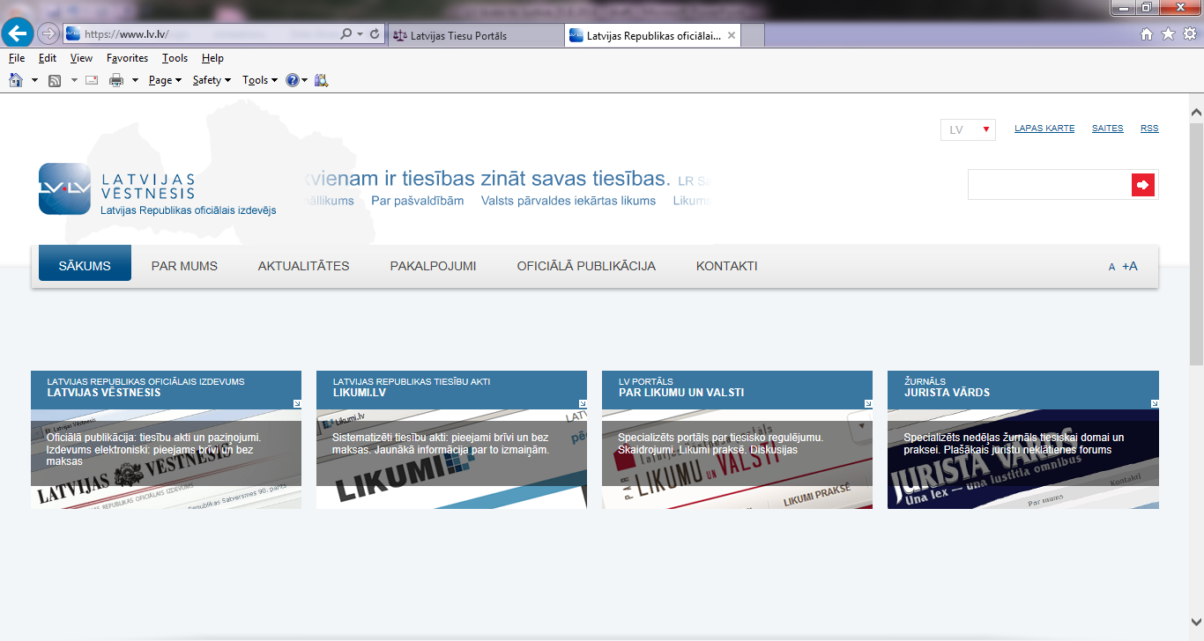
3) a specialized portal for dialogue between
the public and the state. Informative aid
in state information and legal acts; free of charge;
4) journal “Jurista Vārds" - specialized weekly
journal for judicial thought and practice;
5) book publisher – high quality legal literature.

Slide 5
ACCESS TO COURT ADJUDICATIONS
The Latvian court portal www.tiesas.lv allows
searching anonymous court adjudications
according to several criteria at the searcher’s choice:
case number;
name of the court;
type of the case – civil, criminal or administrative,
including administrative violations;
text fragment.

Slide 6
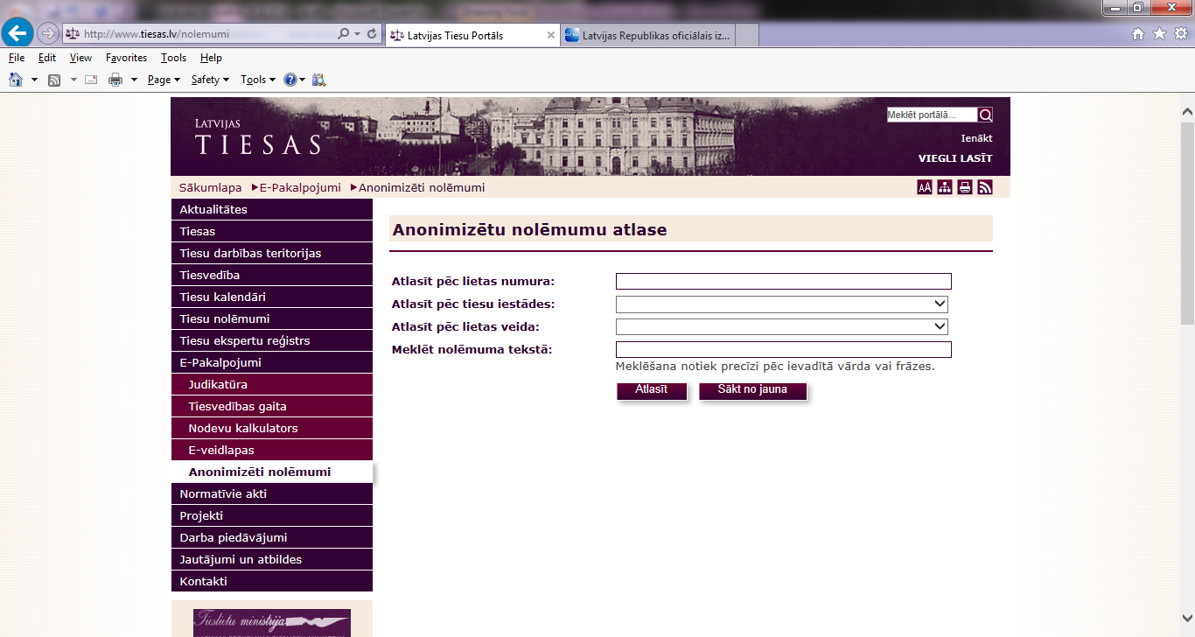

Slide 7
ACCESS TO CASE-LAW
The Supreme Court contributes
by making available at its website www.at.gov.lv
court adjudications constituting case-law.
Detailed search options available:
case chronology;
case classification depending on issue;
regulatory enactments;
court thesis.

Slide 8
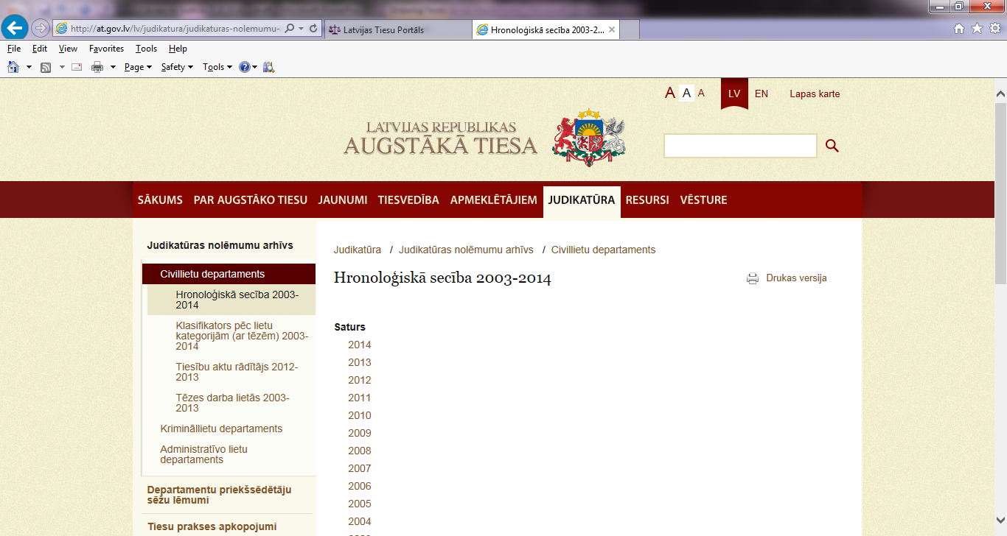

Slide 9
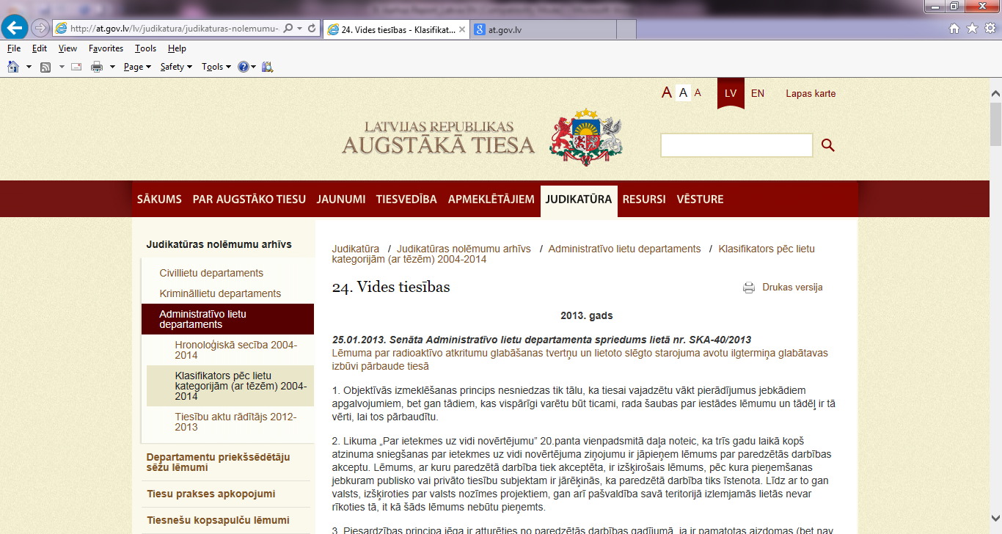

Slide 10
CASE-LAW OF THE CONSTITUTIONAL COURT
Judgments and other material available online
free of charge at: www.satv.tiesa.gov.lv.
The website operates in Latvian, English
and Russian languages.
Detailed search options in Latvian.

Slide 11
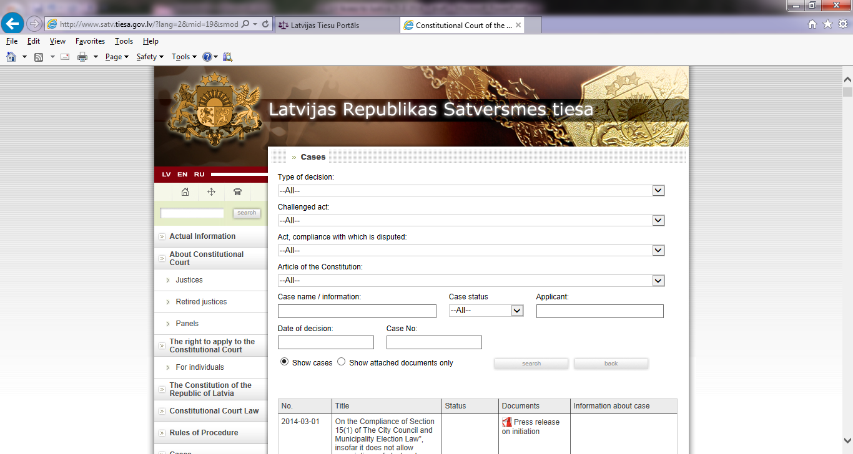

Slide 12
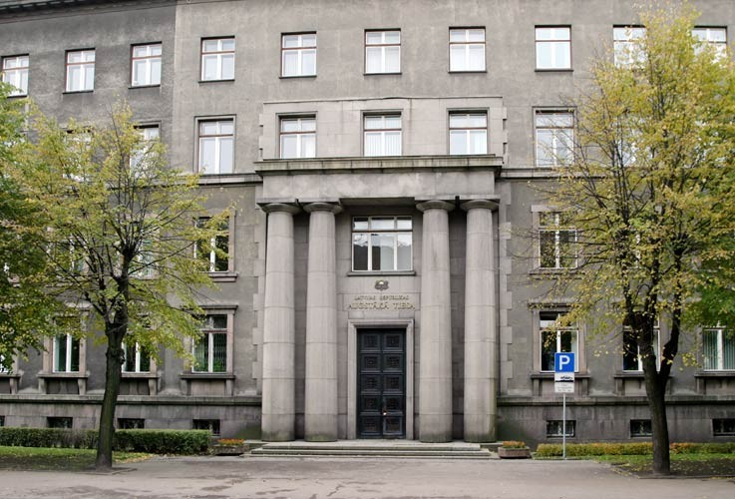
PRACTICAL INFORMATION ON
ACCESS TO JUSTICE
The Latvian court portal and the Constitutional Court website
provide practical information on access to justice
for potential applicants. For example, information on
state fees, communication with judges outside the
courtroom, etc.
Mandatory requirement
that decisions must
contain an indication of
the right to appeal.

Slide 13
ACCESS TO DECISIONS OF NON-JUDICIAL BODIES
Available in accordance with the
Information Transparency Law.
Certain categories of decisions
have to be published without request of the public.

Slide 14
For further information, please contact:
Gustavs Gailis National Focal Point to the Aarhus Convention, Latvia Ministry of Environmental Protection and Regional Development
of the Republic of Latvia Phone: + 371 67026544 Fax: + 371 67820442 E-mail: Gustavs.Gailis@varam.gov.lv
www.varam.gov.lv

Slide 15
Thank you!

