Slide 1
Standing of Individuals and Groups in the EECCA region
5th meeting of the Task Force on Access to Justice
Gor Movsisyan
Geneva/ 2012

Slide 2
The scope of the issues to be addressed
Standing in the EECCA subregion under the
Study “Access to justice in environmental matters: available remedies, timeliness and costs”
Aarhus Convention National Implementation Reports (2011)
Comparison of data provided by the Study and NIRs
Case Law Developments in Armenia
Conclusions
Suggestions for further developments
The emphasize will be made on non-governmental organizations and individuals standing under the article 9, paragraph 2.

Slide 3
The issue of standing within the framework of the Study
The objective of the study - identification of impediments with regard to costs, remedies and timeliness
Part VI. Dedicated to the Judicial Review- Legal Standing
The qualifications of standing identified by the Study:
infringement of the rights and interests of individuals, organizations and/or its members,
on behalf of indefinite number of persons
violation of law

Slide 4
The issue of standing within the framework of the Study
Judicial Review
Standing | Azerbaijan | Armenia | Belarus | Georgia | Kazakhstan | Kyrgyzstan | Moldova | Russia | Tajikistan | Turkmenistan | Uzbekistan | Ukraine
Infringement of the rights and interests of organizations and/or its members | + | + | + | + | + | + | + | + | + | + | + _ | +
Infringement of the rights and interests of individuals | + | + | + | + | + | + | + | + | + | + | + - | +
Violation of Law (NGOs /Individuals) | - | - | (+) | - | - | - | - | + | (+) | - | -
*(+)/Not fully, or requires a further study

Slide 5
The issue of standing within the framework of the Study
Standing (on behalf of indefinite number of persons-actio popularis) | Azerbaijan | Armenia | Belarus | Georgia | Kazakhstan | Kyrgyzstan | Moldova | Russia | Tajikistan | Turkmenistan | Uzbekistan | Ukraine
Organizations | (+) | - | - | - | + | + | + | + | + | - | - | (+)
Individuals | - | - | - | - | - | + | + | + | + | - | - | -
*(+)/Not fully, or requires a further study

Slide 6
Comparison of data provided by the Study and NIRs
Data of NIR
Data of Study
Tajikistan
Question 29- Obstacles; absence of lawsuits initiated by NGOs
Challenging of dec. by org. is a common practice/ 200 cases per year. Certain jurisdictional impediments exist
Ind./org. have the right to apply to the court for Public Interest Protection
Ind./org. have the right to apply to the court for PIP and protection of their rights
Kyrgyzstan

Slide 7
Comparison of data provided by the Study and NIRs
Data of NIR
Data of Study
Ukraine
Wrong interpretation of the Aarhus Convention provisions by the Courts. (paragraph 230, no details provided).
No obstacles were encoun-tered in the implemen-tation of article 9 of the Convention (paragraph 56).
The public has the right to challenge actions and omissions by private persons and public authorities violating the environmental law, if members of the public allege violation of their right to safe environment.
Environmental Protection Act, article 7 (right to bring lawsuits for PIP) v. Code of Civil Procedure, article 4.1 (any natural or legal person for their rights, freedoms and legitimate interests.)
Azerbaijan

Slide 8
Case Law Developments in Armenia
The international treaties as a consistent part of RA legal system and the Aarhus Convention
Decisions of RA Administrative Court on legal standing of NGOs from 28 July, 2009
The criteria set by the judgment of RA Cassation Court from 30 October, 2009
A Cassation Court reviewing the appeal brought against the Decision of the RA Administrative Court from 24 March, 2010 denied it upholding Court's decision of lower instance

Slide 9
Case Law Developments in Armenia
The Position of the Constitutional Court on the issue: “RA Constitutional Court finds that the RA CAP may encompass the occasions of bringing cases before the court by concerned NGOs (on the basis of the Charter) for the purpose of public interests protection. For this reason the current developments of the institute of "actio popularis" in Europe should be taken into consideration”.
Decision N 127 "On the practice of implementation of the article 79 of RA Code of Administrative Procedure" issued by Council of Courts' Chairmen of Armenia: “The natural and legal entities are not deemed to have the right to challenge any administration just for the reason of their interest in the lawfulness of the activities of administrative bodies".
Ongoing developments - 22 residents V. "Armenian Water Sewerage" CJSC obliging the Company "1. to operate in compliance with obligations assumed by the contract, that is, to provide the wastewater treatment and discharge, 2. to exclude the risk for environment promoting the health and well-being of human beings.

Slide 10
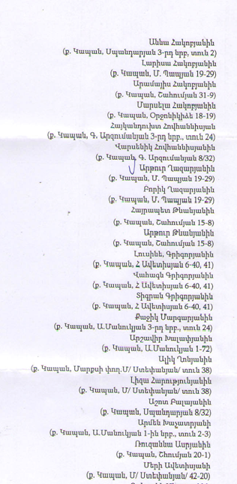
22 resiedents v. "Armenian Water Sewerage" CJSC
List of applicants (abbreviation from the Decsion of the Cassation Court)
Some of the 22 residents were former employees of the Company and had the information helping them to substantiate the action.
The actions of the applicants were coordinated by the legal advisor of the NGO “For Ensuring Ecological Safety and Developing Democracy” operating in Kapan city.
The Cassation Court of RA dismissed the appeal as the Company hadn’t provided the Court with any substantiation that the issue raised would contribute to the unified application of the law.

Slide 11
Conclusion
The study was conducted mainly on available remedies, timeliness and costs, therefore the standing issues are not fully reflected in it.
Though the questions are enough precise in National Reports the data provided in national reports on the particular issue are ambiguous and vague
Defining Locus Standi ( particularly NGOs for public interest protection) in the national legislation does not always mean the existence of the right in reality...
The existence of the legitimate interest (e.g. the charter goals of environmental protection) as a precondition to apply to the court.
Absence of the information on case law in the Aarhus clearinghouse and the web-pages of the Convention from the EECCA countries , except the case of Moldova Republic.
The aforementioned requires further steps toward, e.g. research, support for NGOs, facilitating participation of judges in different Aarhus related activities etc.

Slide 12
Possible scope of the research on standing in the EECCA countries
The research may be based on the following principles:
Comparison with EU member state’s best-practice
Encompass answers to the question -why NGO’s?
Contain positive law requirements, but the emphasize should be made on the case-law and/or the reasons of its absence
Experts and national focal points are encouraged to ensure the translation of the main findings of relevant research into national languages
Aarhus Convention’s provisions as a consistent part of the legal systems of the EECCA countries by virtue of Constitutions….
Minimum descriptive information + Maximum analysis+ Maximum availability for national judicial systems

Slide 13
5th meeting of the Task Force on Access to Justice
THANKS FOR YOUR ATTENTION !!!

