Slide 1
PRTR-online survey

Slide 2
Questions – Items

Slide 3
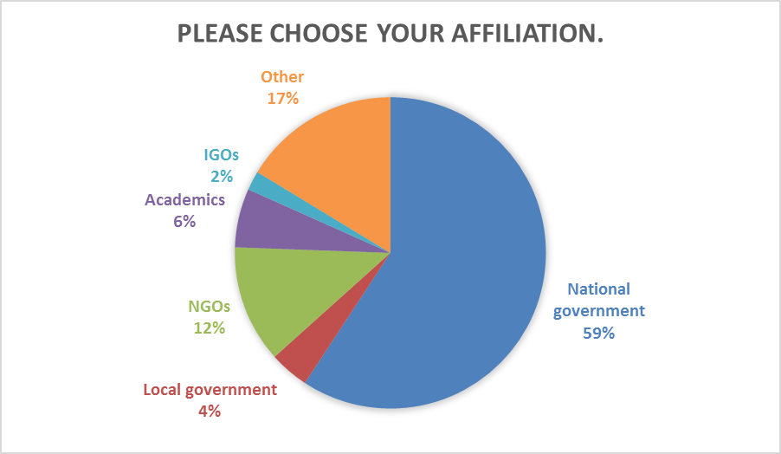
Question 3 – Item 2

Slide 4
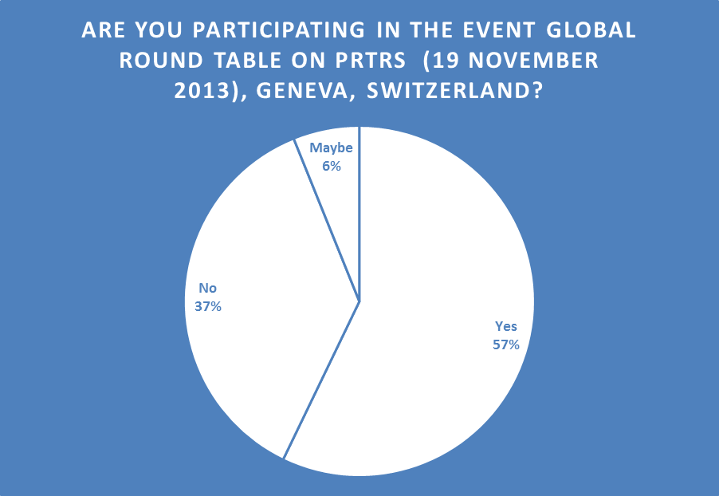
Question 4 – Item 2

Slide 5
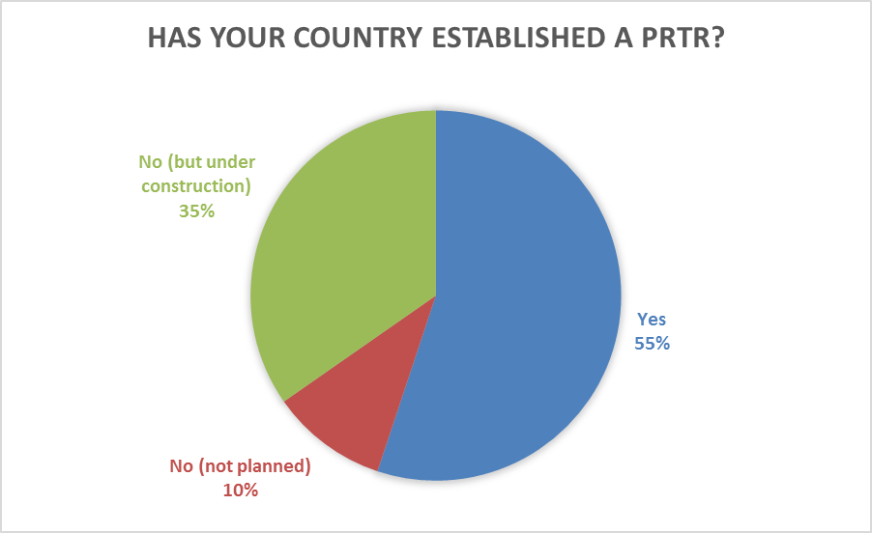
Question 5 – Item 2

Slide 6
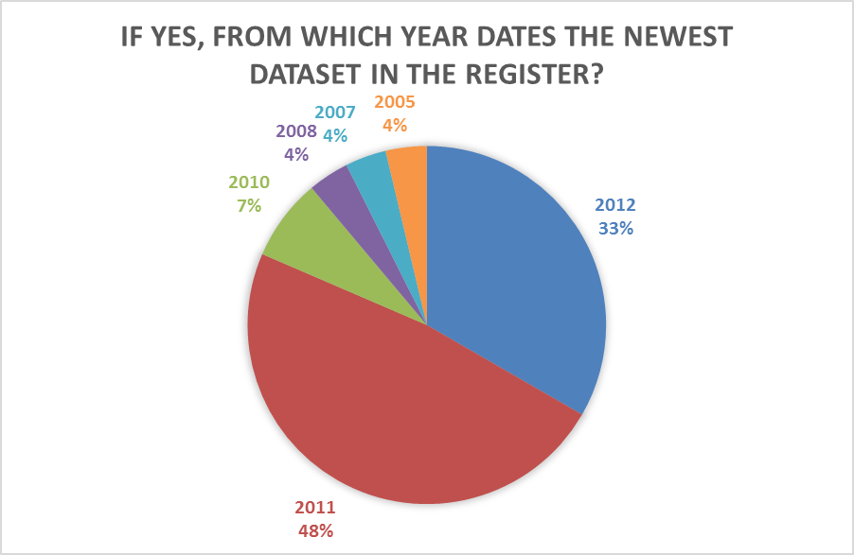
Question 6 – Item 2

Slide 7
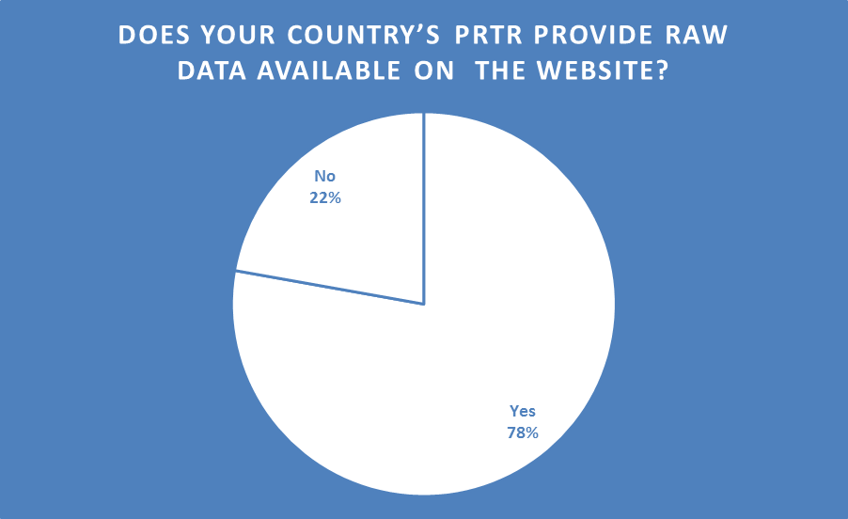
Question 7 – Item 2

Slide 8
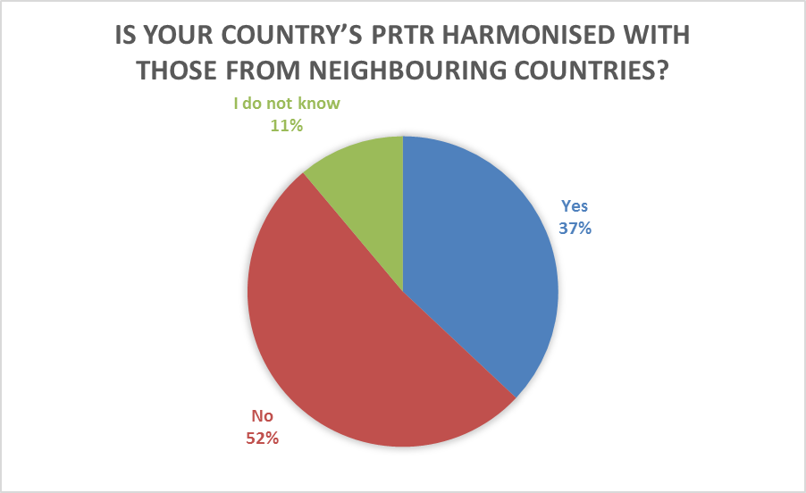
Question 8 – Item 2

Slide 9
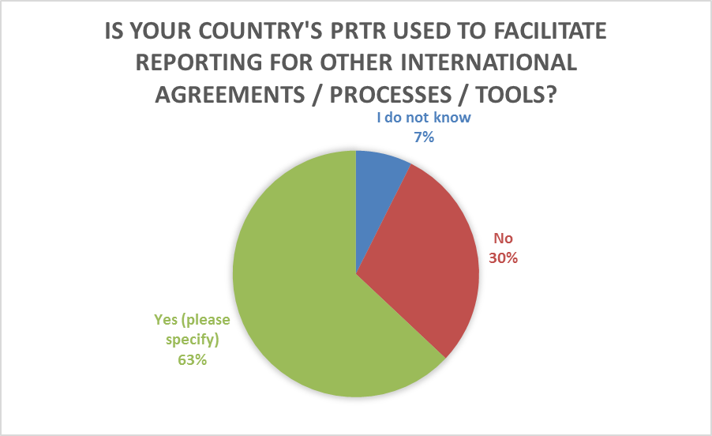
Question 9 – Item 2
CLRTAP, UNFCCC
Immission Control Act
Climate Change, PoPs, CLRTAP, Basel
UNFCCC,CLRTAP,EEA(RO-EIONET),UWWTD,ICPDR, BASEL&DUNAV CONVENTION ETC.
E-PRTR
submit data for SEQE - emission trading system "ETS" / directive 2001/80/CE / directive 2001/81/CE
E-PRTR
PRTR is used also for fulfilling reporting obligations within European Directive on Industrial Emissions.
Barclone Convention, Stockholm Convention, IPCC
The E-PRTR-data
Reporting til E-PRTR. PRTR-data serves as input to the emission inventories on CLRTAP and UNFCCC and Stockholm. Data are reported to those conventions.
In the Austria Air Emission Inventory E-PRTR data are used for verification purposes.
CLRTAP, GHG, LCP
EPRTR
The USA PRTR data is used in the Commision for Environmental Cooperation's Taking Stock Online tool

Slide 10
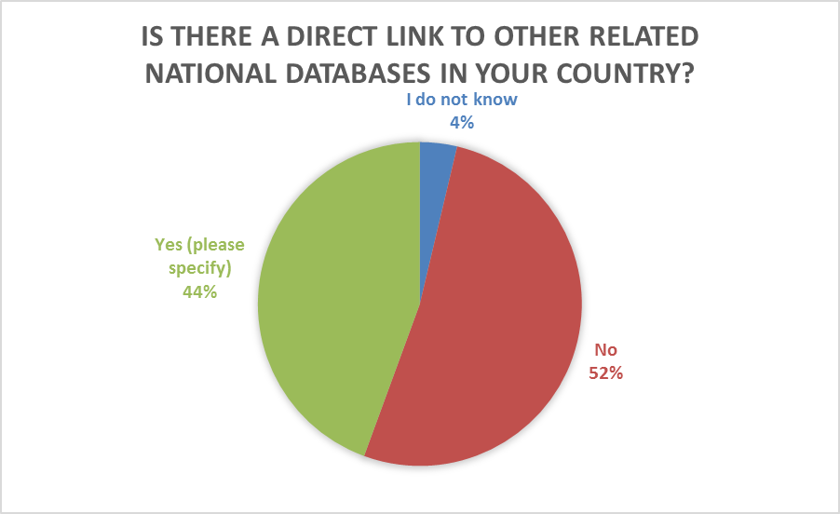
Question 10 – Item 2

Slide 11
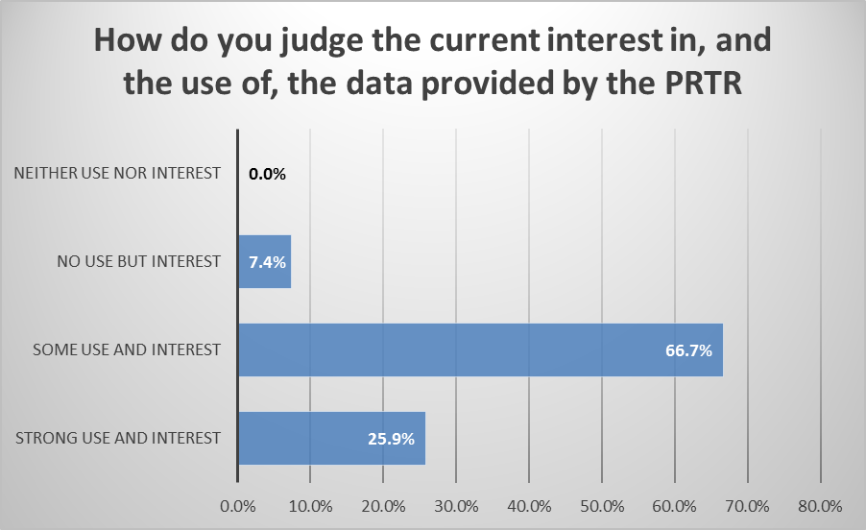
Question 11 – Item 3

Slide 12
Question 12 – Item 3

Slide 13
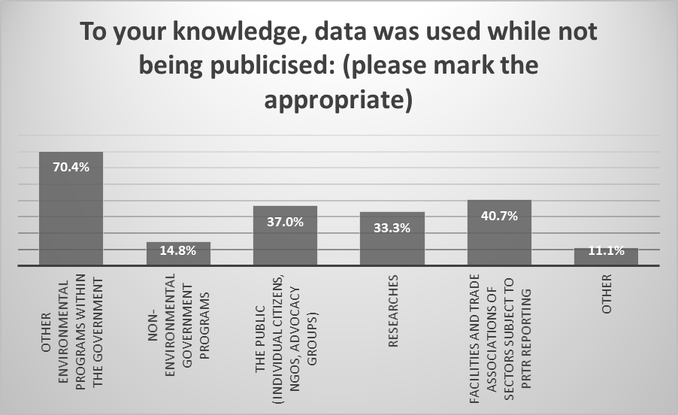
Question 13 – Item 3

Slide 14
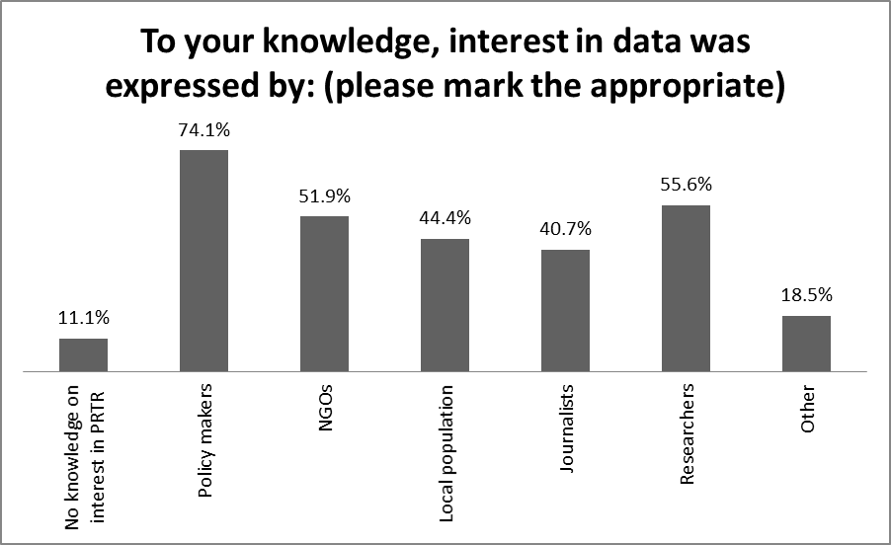
Question 14 – Item 3

Slide 15
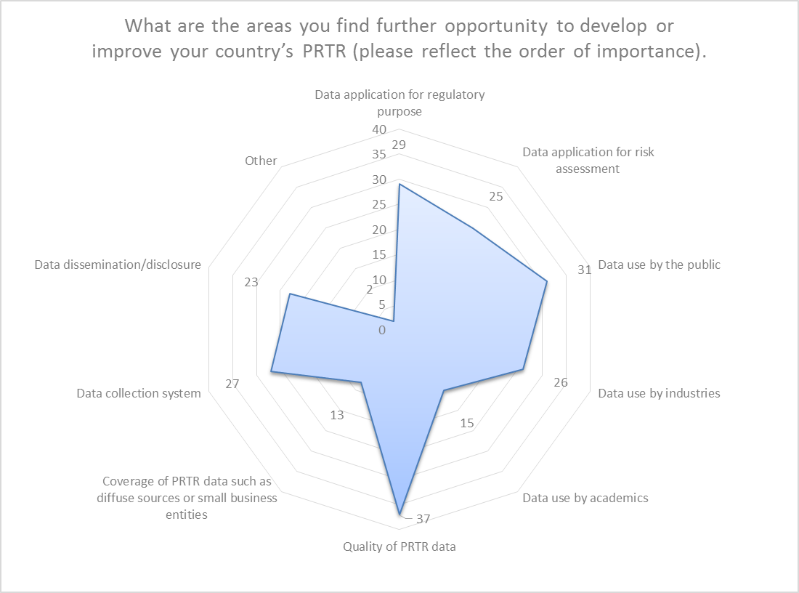
Question 15 – Item 3

Slide 16
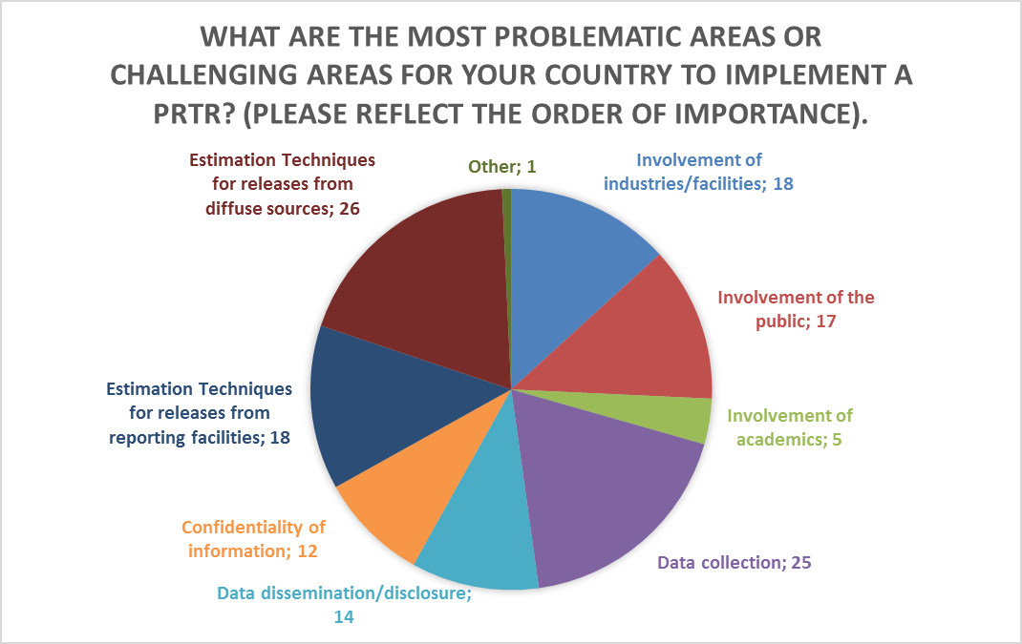
Question 16 – Item 3

Slide 17
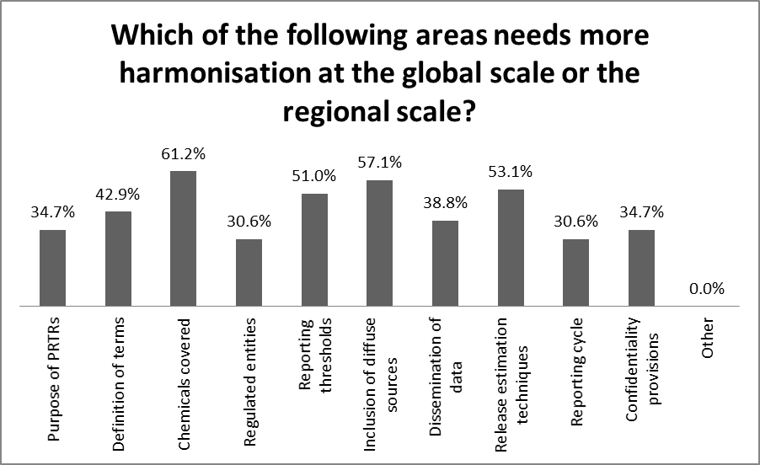
Question 17 – Item 4

Slide 18
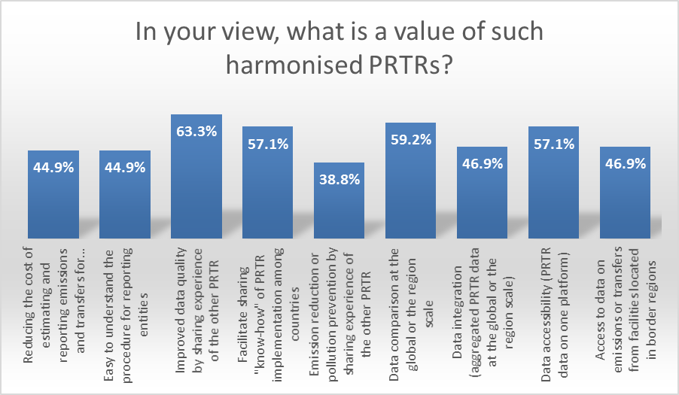
Question 18 – Item 4

Slide 19
Question 19 – Item 5

Slide 20
Question 20
In addition to what has been mentioned in the survey: How would you want to use a PRTR, or what kind of specific use should a PRTR allow?
All issues have been covered by the questions above.
"To reduce consumption of natural resources
To sensitize other authorities about the environmental impacts of production activities"
to track the stages with the highest level of waste and pollution generation in the life cycle of chemicals in order to reduce or eliminate waste production
The PRTR would be a control and monitoring tool very useful in regard to emissions and discharges which are issued to different environmental components.
PRTR may enhance the contribution to the prevention and reduction of pollution of the environment
Emission reduction, pollution prevention
In some kind, the use of PRTR is "random". We should consider to use quantities t/year of emissions as a treshold in stead of kind of installations. Many in installations not mentioned in the annex do have bigger emissions than those installations mentioned in the annex!
Improve public information about ecological problems
for public environmental control over the activities of enterprises
Nothing different of what have been already mentioned
PRTR should provide its users with high quality and precise data on emissions with focus on what is really the point of PRTR: about releases and transfers of emissions. We use PRTR as additional data source to fill missing data in other systems, and we also use PRTR as data source for cross-checking with other data sources. We take PRTR as one of many information systems we use in the area of environment protection.
"EU Integration Issues
Voluntary reporting"
The PRTR should more be used in spatial planning process.
"I would like to have quality assurance of data, including: Completeness, consistency, credibility"

Slide 21
Question 20
In addition to what has been mentioned in the survey: How would you want to use a PRTR, or what kind of specific use should a PRTR allow?
Free accessibility to environmental data.
To minimize reporting burdens for industry, data submitted should be used to satisfy as many reporting obligations as possible.
Raw data in life cycle analysis
measuring compliance with permits
A PRTR should ensure easy and convenient handling. Information on pollutants should be provided to the public in a transparent way.
Our country needs in free computer program for the establishment national PRTRs
To assess implementation of green chemistry practices by facilities. To track progress towards achieving global sustainability.
"PRTR should enable the use of data for the purpose of implementation of the Strategy of Environmental Protection, scientific research activities, action plans for sustainable development in a given period of data analysis :
Monitoring the gradual reduction of discharges of pollutants into the environment ( water, air, soil )
Monitoring the formation and disposal of non-hazardous waste
Monitoring of hazardous waste disposal
Reducing the use of energy (electricity, oil, gas, coal) .
PRTR should be publicly available for all citizens. It is necessary to raise the public awareness of nature conservation for a healthier life and protect the Earth . PRTR is a useful set of data - "" laboratory test "" nature of the annual amount of emitted pollutants . Based on these data must make decisions in order to prevent further pollution of the appointment of environmental conditions and measures prescribed BAT and BREF documents. PRTR should be a powerful tool for environmental protection. Valid data in the PRTR database must be based on the information which will be used to create environmental policy and make important decisions ."
Use it as a basis for a dialog between stakeholders (industry, NGOs, authorities).
As we have data only for air and water pollution, which doesn't cover all substances provided in the Annex of PRTRs Protocol, we would like to use a PRTR for all substances and in all media.

