Slide 1
Structure and Content of SoE Report in the Czech Republic
Tereza Ponocná
CENIA,
Czech Environmental Information Agency

Slide 2
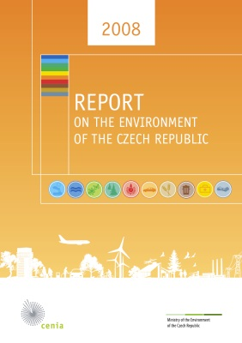
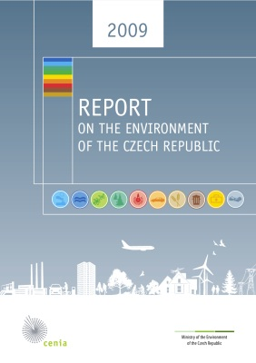
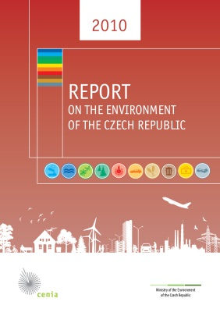
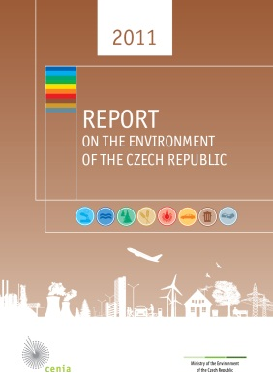
General notes
A basic environmental reporting document
Published since 1998
1998-2007: analytical environmental yearbook, without changes, no reflections to the State Environmental Policy
Since 2008: based on a set of indicators creating in EEA, providing conclusions relevant to policy-making, based on authorized data obtained from monitoring systems both from within and outside the environmental sector

Slide 3
Structure and Content of SoE Report in CZ
Air and Climate
Water management and Water quality
Forests
Soil and Landscape
Industry and Energy sector
Transportation
Waste and Material Flows
Financing
8 topics, 36 key indicators (2011)
Table of contents:
Methodology
Key messages
Main positive findings
Main negative findings
Development of the main driving forces
Indicator-based assessment
Global and European context (GMT) of driving forces affecting the state of the environment
Availability of data in the Report
List of abbreviations
Glossary of Terms

Slide 4
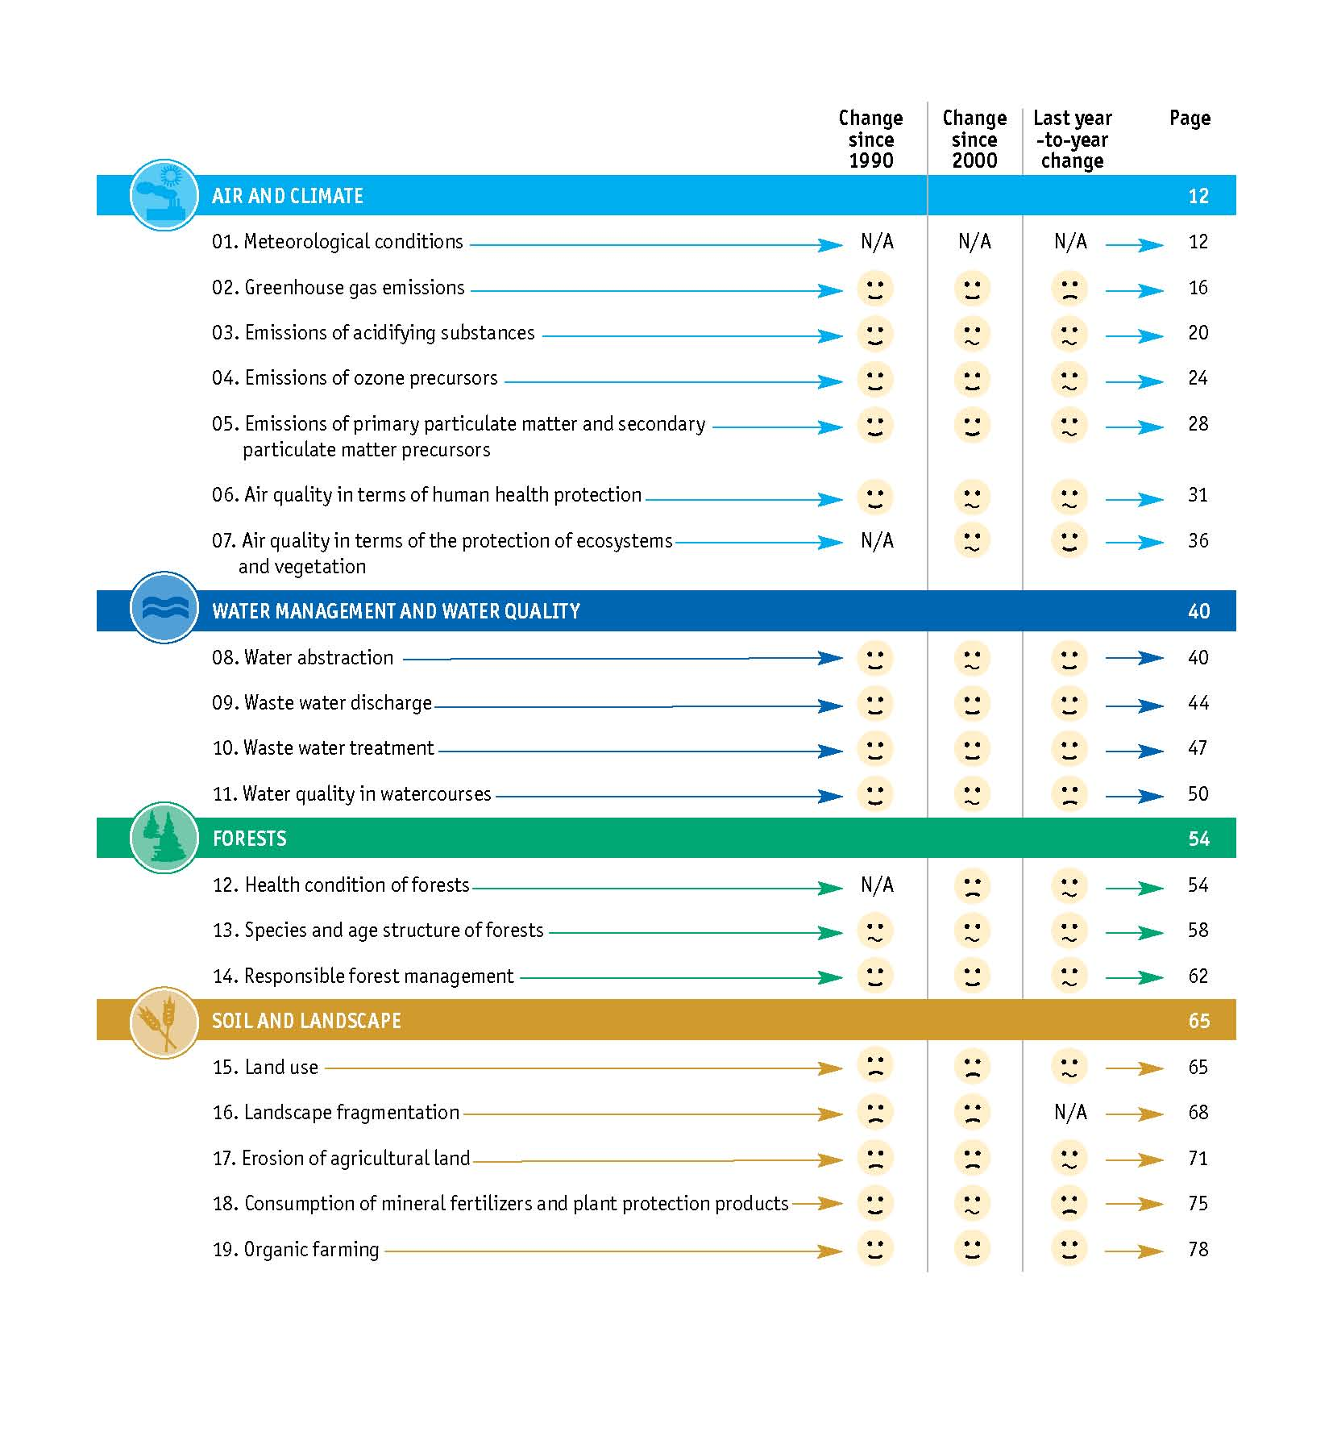
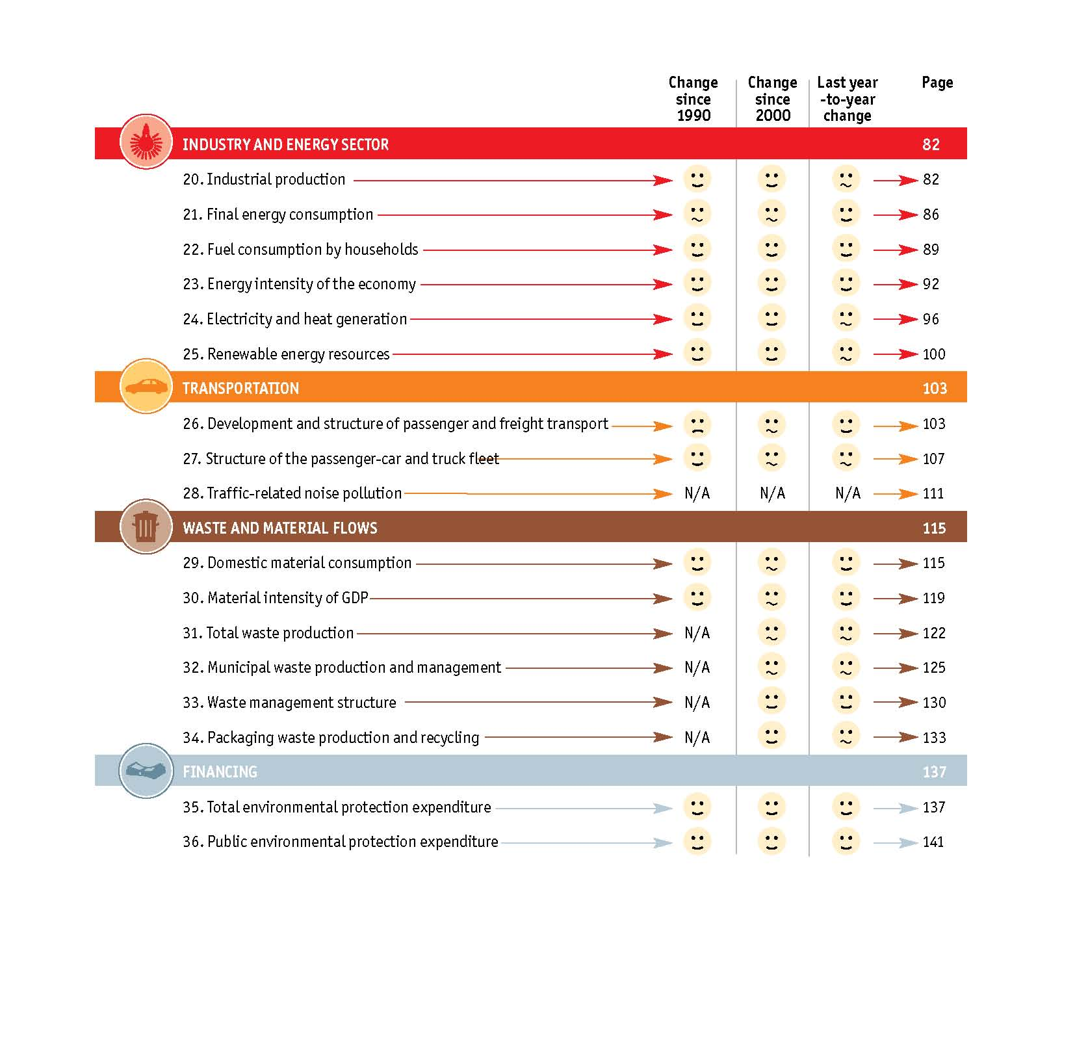
Key Indicators in SoE Report in CZ

Slide 5
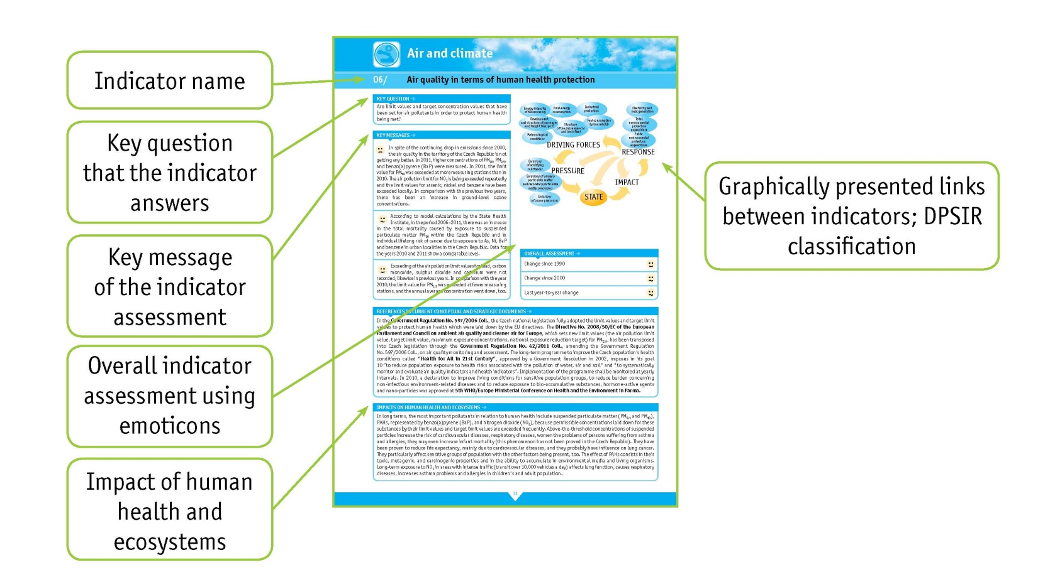
Indicator Assessment Structure
Key question
Key message
Overall indicator assessment
DPSIR chain
References to current conceptual and strategic documents
Impacts on human health and ecosystems
Graphic assessment
Textual assessment
International comparison: Eurostat, EEA, OECD
References

Slide 6
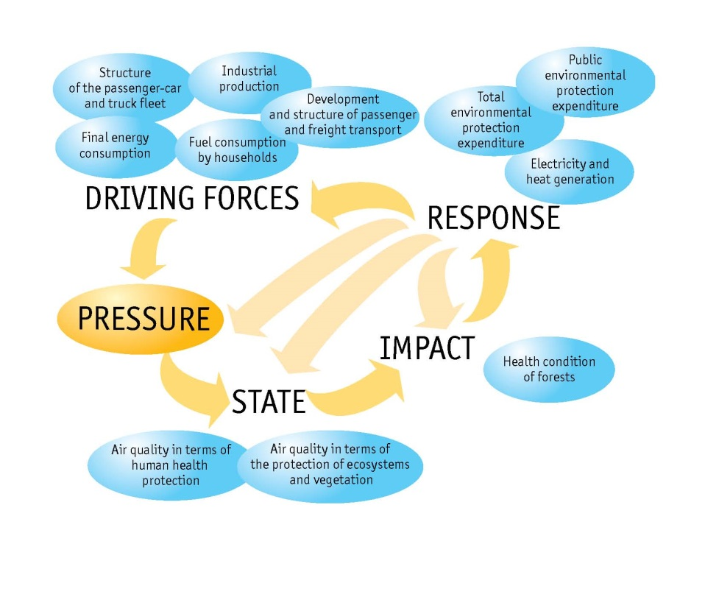
Indicator Assessment Structure
Set of key indicators
related to main environmental topics
should reflect State environmental policy and fulfilment of its objectives
this methodology follows the trend applied in EU
indicators comparable with CSI
DPSIR model
Air and Climate structure

Slide 7
Reflections
Set of key indicators
Clear
User friendly
Comparable with CSI

Slide 8
Data assurance and control system
Editorial team relies on the qualities of obtained data from collaborating institutions X data are based on specific methodologies X recounted and verified
Availability of quality and reliable data over a long period of time
Data in relationship to sectoral concepts and its environmental aspects
“Cross-section“ nature of the indicators – the indicators cover as many causal links as possible

Slide 9
Use of modern technologies for data presentation
Information System of Statistics and Reporting (ISSaR): http://issar.cenia.cz/issar/page.php?id=1760
Source of actual, verified environmental data
Publication interface with possibility of on-line data processing
Tool for sharing environmental data
It is built for collecting generalized not primary data
Collected data and its metadata are officially authorized
Spatial representation of data
Data are collected in complete time series

Slide 10
Information System of Statistics and Reporting (ISSaR)
http://issar.cenia.cz/issar/page.php?id=87

Slide 11
Information System of Statistics and Reporting (ISSaR)
Reflect and complement the Report
Key question
Key message
Overall indicator assessment
References to current conceptual and strategic documents
Indicator assessment - Graphic part
Indicator assessment - Textual part
Data sources
Links to additional information
http://issar.cenia.cz/issar/page.php?id=1831

Slide 12
Thank you for your attention!
tereza.ponocna@cenia.cz
www.cenia.cz

