Slide 1
ENVIRONMENT
Twenty-fifth session
Geneva, 13-15 November 2019
Palais des Nations
Meeting room XI
Committee on Environmental Policy
Agenda Item 5: Environmental monitoring, assessment and reporting.
Working Group on Environmental Monitoring and Assessment

Slide 2
Working Group on Environmental Monitoring and Assessment
ENVIRONMENT
21st session
6-7 May 2019
20 member States represented
Session report available (ECE/CEP/AC.10/2019/2)
Annual workplan for 2020 (ECE/CEP/AC.10/2019/4, amended as Information paper 23)
Revised assessment framework of the Shared Environmental Information System (ECE/CEP/AC.10/2019/5)
Pan-European environmental assessment (ECE/CEP/AC.10/2019/6)
Sharing and integration of economic, social and environmental data
Guidance and information on environmental statistics and indicators
Progress in environmental monitoring and assessment

Slide 3
Working Group on Environmental Monitoring and Assessment
ENVIRONMENT
Annual workplan 2020
Item B.1 reclassified as high priority
Bring together experts involved in the UNEP Global Environment Outlook process and the EEA European Environment Information and Observation Network to discuss and oversee the regular pan-European environmental assessment
Adopted

Slide 4
Working Group on Environmental Monitoring and Assessment
ENVIRONMENT
Annual workplan 2020 foresees
Annual sessions of the Working Group and the Joint Task Force on Environmental Statistics and Indicators
Development of SEIS e-learning platform, with UNEP (UNDA project)
Initiation of final reporting on the establishment of SEIS
Support to the preparation of a pan-European environmental assessment
Capacity-building and advisory missions to assist in streamlining of regular state-of-the-environment reports (UNDA project)
Regional capacity-building workshop or conference on environmental data (UNDA project)
Publication of guidelines, as appropriate

Slide 5
Working Group on Environmental Monitoring and Assessment
ENVIRONMENT
Shared Environmental Information System
Assessment framework revised for final review. Minimize workload on countries, with questions at different levels and more guidance
Agreement on scope: 18 indicators from across the 10 themes covered by the UNECE set of environmental indicators
Agreement to use online reporting tool as primary means of data collection. Tool to be finalized for 16th session of Joint Task Force
Pillar-based performance score option to be included in assessment framework
Draft outline of final review to be considered by Joint Task Force
Data collection for the final review might begin in December 2019
Approval of the outline of a publication
Notes:
Fewer questions posed for every data flow, by asking some at thematic level and some even at macro level, i.e. only once
18 indicators and 21 data flows in support of those indicators. Up from 3 and 7 respectively, but offset by fewer questions
Can look at performance by country, theme, indicator or by SEIS pillar (content, infrastructure, cooperation)

Slide 6
Working Group on Environmental Monitoring and Assessment
ENVIRONMENT
Pan-European environmental assessment
Recommendation of option 2 of the draft concept for the next pan-European environmental assessment, an indicator-based and thematic assessment, be used as a basis for preparing a detailed proposal on the pan-European assessment
Proposal to include annotated table of contents, timeline, costs for elements and foreseen outputs
Proposal to be presented to make clear how the assessment would be affected if inadequate financial resources were to be made available
Request that secretariat inform the Committee at its 25th session of the outcome of this agenda item and the recommendation
Request that secretariat share the detailed proposal with potential donors leading up to 25th session of the Committee

Slide 7
Working Group on Environmental Monitoring and Assessment
ENVIRONMENT
Sharing and integration of economic, social and environmental data with regard to implementation of 2030 Agenda
Report on progress in the implementation of a UNDA project on improving environmental monitoring and assessment in support of the 2030 Agenda in South-Eastern Europe, Central Asia and the Caucasus.
Next project steps for 2019:
Finalization of seven gap analysis reviews
Development of national workplans or roadmaps
National training sessions based on the review recommendations X
Regional Conference on Environmental Data under UNDA project
Notes:
National training sessions are on hold because of the current United Nations secretariat cash-flow crisis.

Slide 8
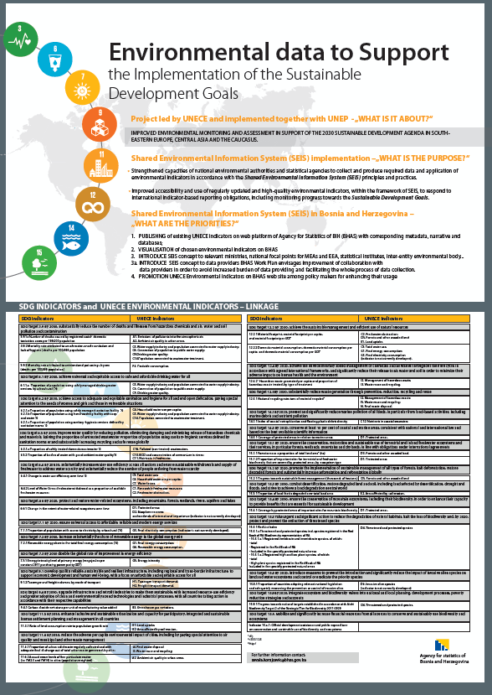
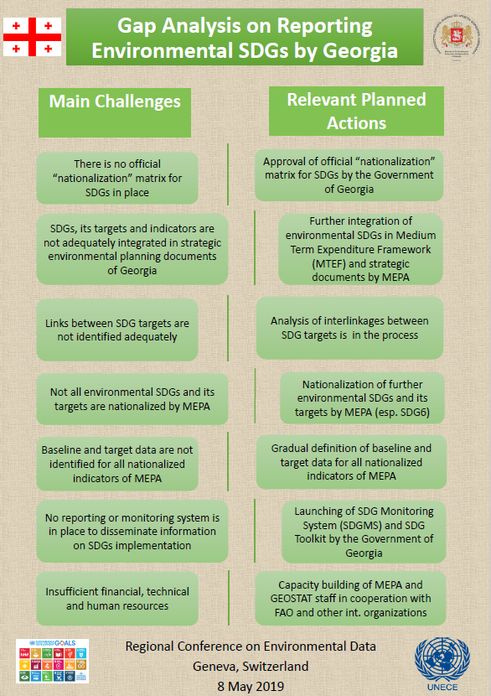
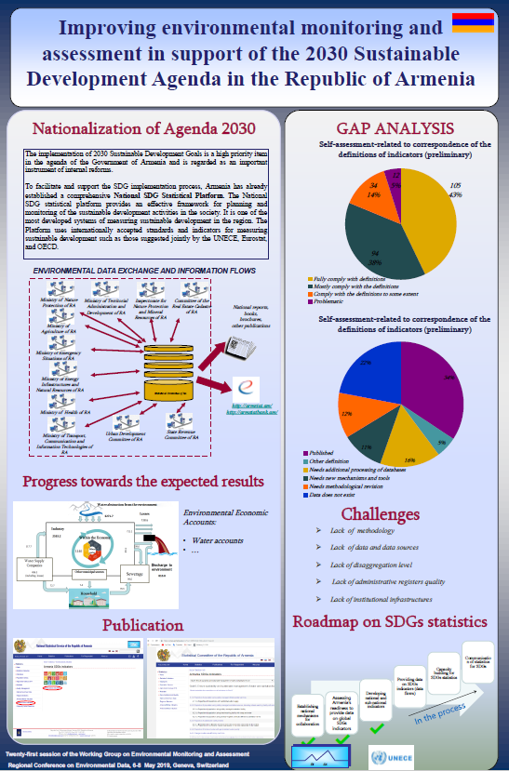
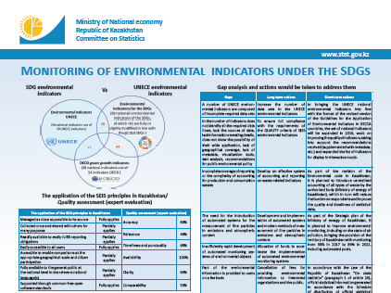
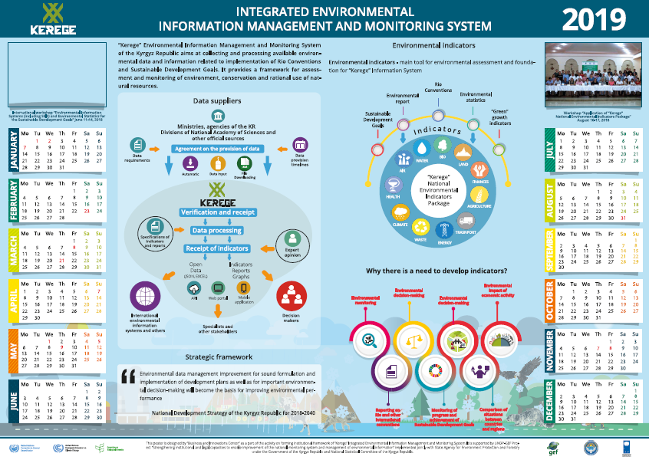
Notes:
Impressive presentation of activities at national level presented during the Regional Conference on Environmental Data under UNDA project

Slide 9
Working Group on Environmental Monitoring and Assessment
ENVIRONMENT
Guidance and information on environmental statistics and indicators
Decision that no further action would be taken for establishment of a web-based portal. Existing resources would be utilized to update relevant content on UNECE website when possible
Noting of progress made in revising the UNECE Guidelines for the Application of Environmental Indicators and approved suggested changes to the metadata sheet
Agreement to use presented database to produce metadata sheets
Agreement to stop using environmental indicator production templates once the revision of the guidelines had been completed
Proposal that Joint Task Force discuss phasing out the production templates during its next session

Slide 10
Working Group on Environmental Monitoring and Assessment
ENVIRONMENT
Progress in environmental monitoring and assessment
Representatives of Albania, Armenia, Austria, Azerbaijan, Belarus, Bosnia and Herzegovina, Finland, Georgia, Kazakhstan, Kyrgyzstan, North Macedonia, Republic of Moldova, Russian Federation, Serbia, Switzerland, Tajikistan, Turkmenistan, Ukraine and Uzbekistan shared information
Information on major actions carried out since previous session
production of environmental reports
improvements in data policy
institutional and regulatory mechanisms
data quality assurance and technical solutions for data exchange between various ministries
modernization of national monitoring networks
implementation of EPR recommendations on environmental monitoring and assessment
Notes:
Progress in environmental monitoring and assessment, including institutional and regulatory mechanisms and infrastructure at the national level
Impressive range of actions, efficiently reported upon by 19 countries.

Slide 11
Working Group on Environmental Monitoring and Assessment
ENVIRONMENT
Report on progress and results of the European Neighbourhood Instrument Shared Environmental Information System East II project on the implementation of the principles and practices of the Shared Environmental Information System in the Eastern Partnership countries, implemented by the European Environment Agency
Thanks to Austria, Norway, the Russian Federation, Switzerland and the European Union through the European Environment Agency for their financial support
Next meeting: 4-5 May 2020 ?

Slide 12
Working Group on Environmental Monitoring and Assessment
ENVIRONMENT
The Committee on Environmental Policy is invited to consider
Taking note of the annual timetable of activities for 2020

