Slide 1
Human health effects - bioaccumulation and toxicity
Joint thematic session – Heavy metals with focus on mercury
Dr Dorota Jarosinska
WHO European Centre for Environment and Health
Fourth Joint session of the Working Group on Effects
and the Steering Body to EMEP
Geneva, Switzerland, 10-14 September, 2018

Slide 2
Presentation outline
Health effects of mercury – an overview
Mercury human biomonitoring (HBM)
Mercury in WHO air quality guidelines and related documents

Slide 3
Health impacts of mercury
Mercury is one of the top priority chemicals of major public health concern globally:
environmental ubiquity and persistence
adverse developmental effects observed at relatively low levels of exposure
Exposure to all forms of mercury can contribute to the burden of disease
Different forms of mercury are toxic to people
elemental mercury
inorganic mercury
organic mercury, mainly methylmercury
Notes:
Widespread use of methylmercury for seed dressing or as a fungicide was known to cause local pollution of waterways and coastal waters.
Then, it turned out that any release of mercury could be converted into methylmercury
Studies in North America verified that bio-accumulation took place, with the highest concentrations at the top of the food chains (Fimreite, 1974).
Many rivers and lakes were already so polluted with mercury that fish advisories against eating sports fish were issued, especially in countries like Canada, Sweden and the US Advisories against eating locally caught fish now affect over 16 million lake acres and 1.3 million river miles in the US (US EPA, 2007).

Slide 4
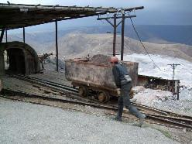
Health impacts of mercury
Mercury affects many systems and organs: nervous, immune, digestive systems; lungs, kidneys, skin and eyes
Major threat is an impact on child’s neurodevelopment following exposure to methylmercury in utero and early in life
Currently, of major concern are adverse effects associated with low level exposure to (methyl)mercury
Any release of mercury could be converted into methylmercury
Mercury methylation in the aquatic environment
Bio-accumulation of mercury with the highest concentrations at the top of the food chains
Notes:
In subsistence fishing populations, between 1.5/1000 and 17/1000 children showed cognitive impacts
Of particular concern is the developmental toxicity of mercury, with well-documented neurodevelopmental effects of exposure to (methyl) mercury (MeHg) in utero and early in life.
Methylation of mercury in the aquatic environment became a world‑wide problem in 1970-ties.
Widespread use of methylmercury for seed dressing or as a fungicide was known to cause local pollution of waterways and coastal waters.
Then, it turned out that any release of mercury could be converted into methylmercury
Studies in North America verified that bio-accumulation took place, with the highest concentrations at the top of the food chains (Fimreite, 1974).

Slide 5
Neurotoxic effects of mercury
(prenatal exposure)
Neurodevelopment is the most sensitive health effect of exposure to low doses of mercury
Neurodevelopmental and neuropsychological dysfunctions:
cognitive development
behaviour
memory
language
visual-spatial and
motor function
…in every case the mother was healthy, and it was not until more than three months after birth that the symptoms were recognized… (from Minamata, 1959)
(From: P. Grandjean presentation, WHO ECEH, 2015)
(Grandjean, Weihe et al., 1997; Grandjean and Landrigan, 2006; Karagas et al., 2015).

Slide 6
2013 UN Minamata Convention
EEA, 2013

Slide 7
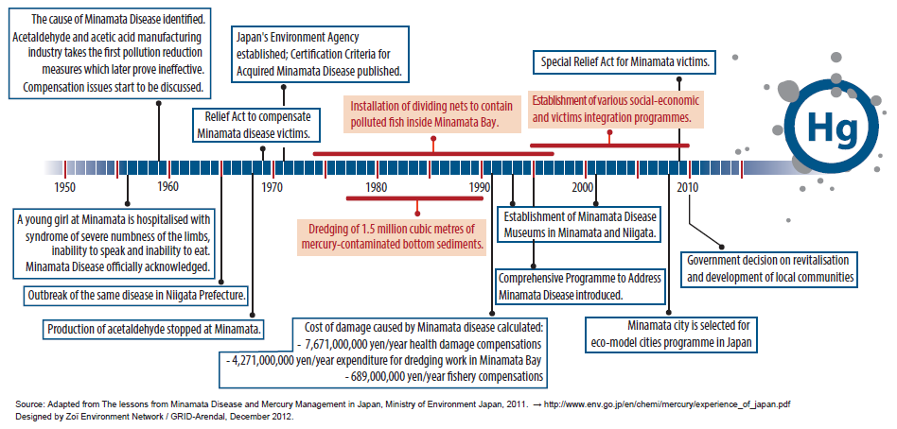
UN Minamata Convention

Slide 8
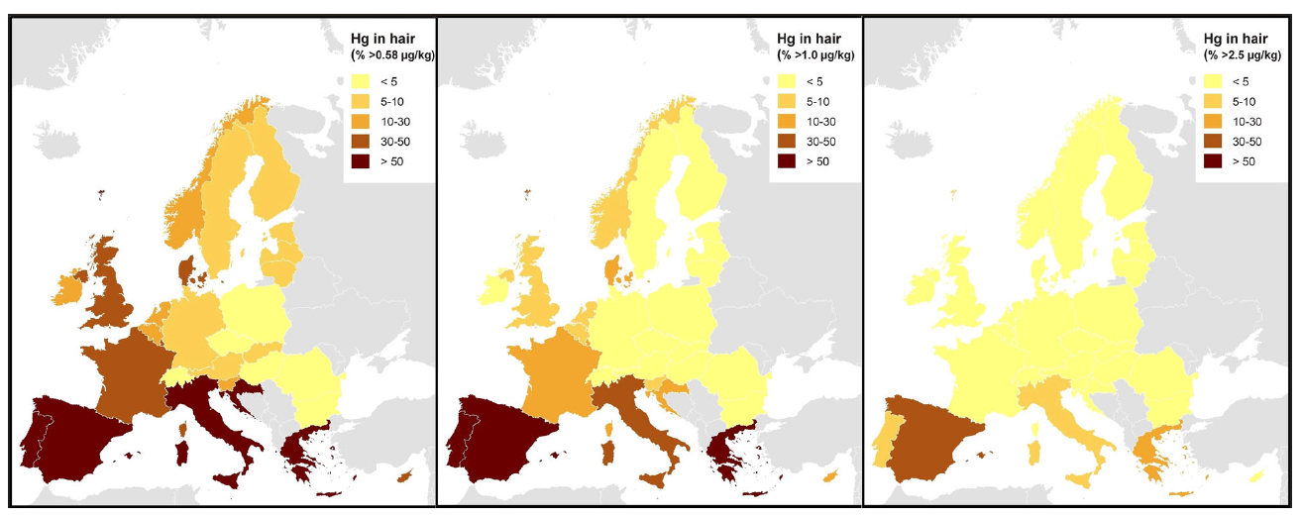
Mercury impact in Europe – a HBM survey
Over 1.8 million children (35%) are born every year in the EU to mothers whose mercury level exceeds a reference level of 0.58 µg/g hair
900,000 (17%) children are borne to mothers with mercury in hair exceeding the US EPA limit of 1.0 µg/g
The benefits of exposure prevention are estimated around 600,000 IQ points per year
Percent of population exceeding cut-off values for total Hg in hair:
0.58 µg/g 1.0 µg/g (US EPA) 2.5 µg/g (WHO)
DEMOCOPHES project
Bellanger et al 2013

Slide 9
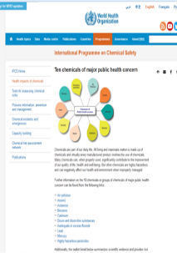
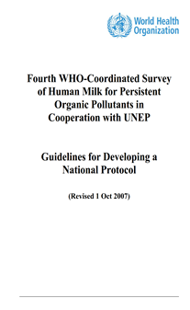
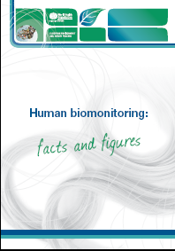
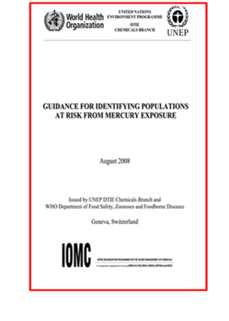
WHO work on human biomonitoring (HBM)
reflects cumulative exposure from various sources
exposure biomarkers are linked with health effects
allows identification of highly exposed population groups
enables assessing geographical and temporal trends in exposure
facilitates evaluation of the effectiveness of risk reduction measures
provides basis for cost-effectiveness analysis and social-economic impact assessment
Notes:
Experience gathered in previous and on-going studies:
- WHO/UNEP monitoring of contamination of breast milk with POPs
- DEMOCOPHES and COPHES
- national biomonitoring programs (USA, Canada, Germany…..)
Mercury – 10 chemicals of major public health concern

Slide 10
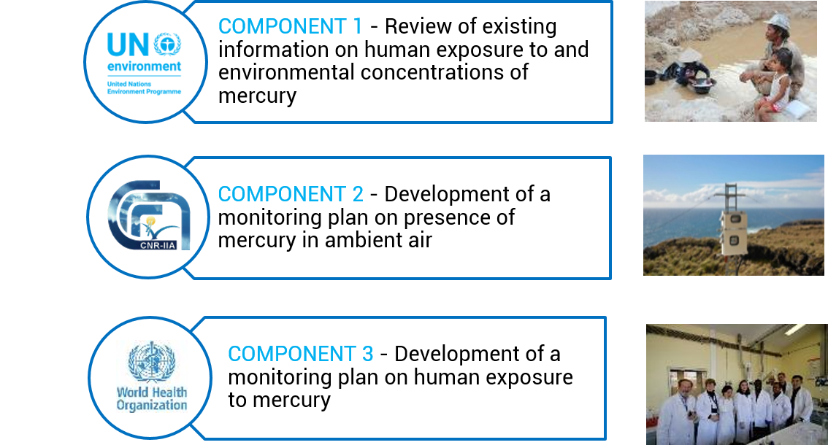
UNEP/WHO project - development of a global plan for monitoring of exposure to and environmental concentration of mercury
To harmonize approaches for monitoring mercury in humans and the environment, and strengthen the capacity for mercury analysis in humans and the environment to accurately determine their concentrations globally
Notes:
Overlap with the air monitoring component (in 2 sties)
Demonstration and refinement of survey protocol, capacity building
Country selection, identification of survey areas, agreements with national institutions, translation of materials, development of national survey protocols
Assessment of laboratory capabilities
Experienced labs – survey size ~ 250 women, subset of duplicate samples for external QC
Labs that need further capacity building – all samples are collected in duplicate and analyzed at a national lab and at a reference laboratory. Sample size may be reduced.
Initial training in data collection
External QC and technical support
Collaboration on data analysis and reporting.

Slide 11
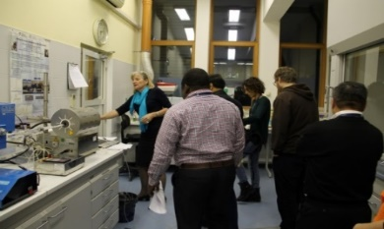
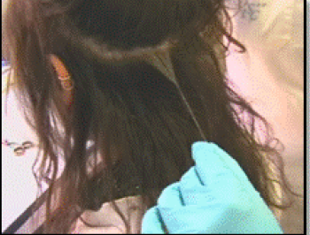
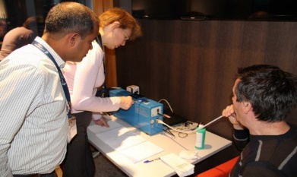
Project activities to assess human exposure to mercury
Focus: prenatal exposure to mercury
Study sample: ~ 250 women per country
Recruitment: mothers delivering in hospitals serving population in selected study sites
SOPs for human biological matrices:
  total mercury in hair
  total mercury in cord blood
  total mercury in urine
Standard survey protocol
Capacity building
Notes:
SOP on fish
Focus on prenatal exposure due to the foetal vulnerability to neurotoxic effects of mercury
General principles
Sampling of biological materials (hair, cord blood and urine) should not harm or be an undue burden on recruited women
Be practical, feasible, and sustainable
Put emphasis on proficiency
Quality assurance of the results should be independently confirmed
Ethical review, including prior informed consent, should be respected
Confidentiality of information has to be safeguarded

Slide 12
Pilot countries and sites
Ghana (Accra City) - marine fish
Russia (Russian Karelia) - freshwaters fish
India (Chennai Metropolitan area) - multiple (e-wastes, coal burning)
Kyrgyzstan (Aidarken) –primary mercury mining
China (Wanshan) - other food (rice)
Mongolia (Selenge Province) - ASGM
Costa Rica (Central Valley) - unknown
Overlap with the air monitoring component (in 2 sties)

Slide 13
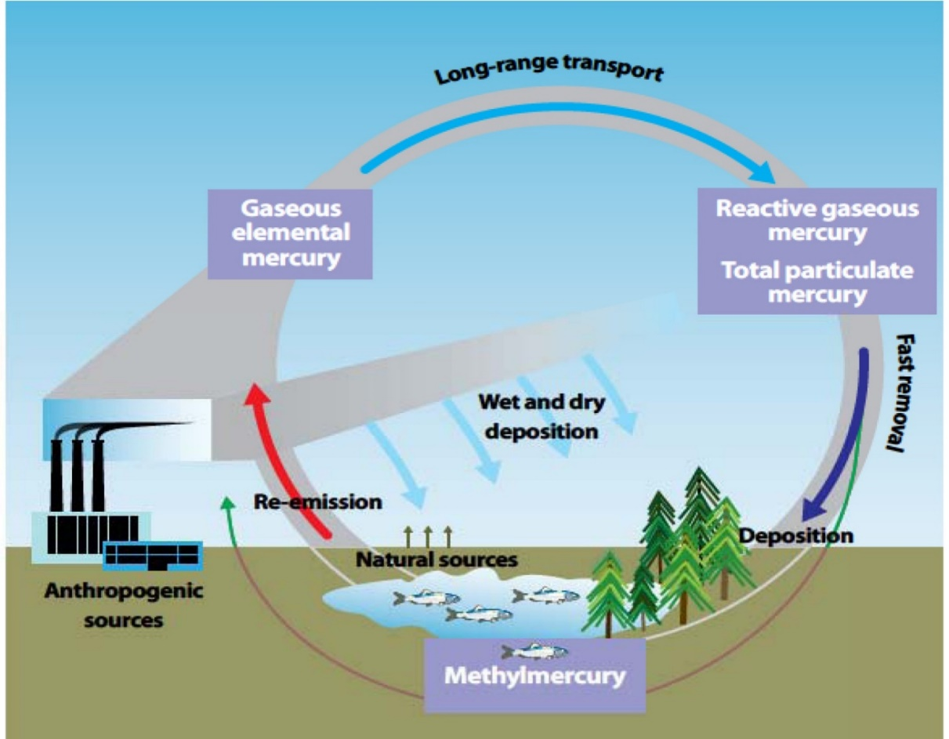
Mercury HBM – challenges in the use, interpretation and communication
HBM survey aims to answer a number of questions
Are the observed levels of exposure significant in terms of health risk?
How are specific biomarkers are distributed among different survey population strata/sub-groups?
Are elevated Hg levels linked with specific sources of exposure?
What is the spatial variability in exposure levels in participating countries?
Notes:
Interpretation and evaluation of the HBM results will be dealt with in separate steps.

Slide 14
HBM and the Minamata Convention
Art. 7 development of national action plan on ASGM
Art. 12 identification, characterization and assessment of health
risks in contaminated sites
Art. 16 development and implementation of strategies and
programmes to identify and protect populations at risk
Art. 17 exchange of information on health impacts associated
with exposure to mercury and mercury compounds
Art. 18 provision of information to public on mercury health
effects
Art. 19 research, development and monitoring
Art. 22 effectiveness evaluation via “monitoring data … on
trends in levels of mercury ... in vulnerable populations”
Notes:
HBM can facilitate the assessment of the progress towards achieving the main objective of the Convention “to protect the human health and the environment”
Minamata Convention on Mercury (incl. health sector obligations)
WHA Resolution 67.11
Promote the development and implementation of strategies and programmes to identify and protect populations at risk, particularly vulnerable populations (art. 16);
Establish and strengthen, as appropriate, the institutional and health professional capacities for the prevention, diagnosis, treatment and monitoring of health risks related to the exposure to mercury and mercury compounds (art. 16);
Research, development and monitoring (art.19)

Slide 15
HBM and the Minamata Convention
Recognition of mercury HBM as an instrument for the effectiveness evaluation of international and national measures;
Policy at national level - implementation of national HBM programs
Capacity building/strengthening (strong support from national scientific community)
Synergy with other monitoring systems (air, biota, fish)
Effective management of international databases
Notes:
HBM as a potential indicator for evaluation of effectiveness of the Minamata Convention

Slide 16
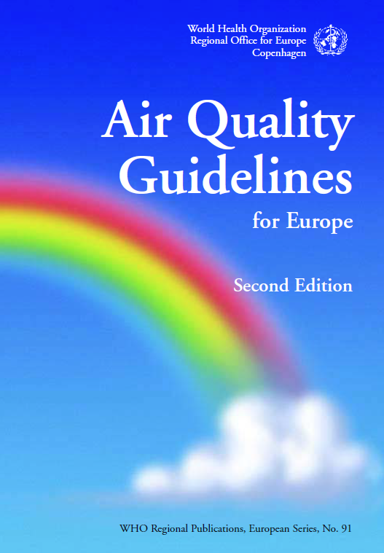
Mercury in WHO air quality guidelines
Guideline value for Inorganic mercury vapour: 1 µg/m³ (annual average)
Increase in ambient air levels of mercury => increase in deposition in natural bodies of water => elevate concentrations of methylmercury in freshwater
To prevent possible health effects in the near future, ambient air levels of mercury should be kept as low as possible
(2000)
Source: http://www.euro.who.int/en/health-topics/environment-and-health/air-quality/publications/pre2009/air-quality-guidelines-for-europe
Notes:
the two most important mercury species : elemental mercury vapour (Hg0) and methylmercury (MeHg).
Exposure to Hg0 is mainly via inhalation of dental amalgam fillings (about 50% mercury by weight).
Exposure to MeHg occurs by gastrointestinal absorption (about 90%), from dietary consumption of food – fish, in particular.
It is well known that long-term occupational exposure to Hg0 may affect the kidney and the central nervous system adversely.
According the WHO Regional Office for Europe air quality guidelines for 2000, LOAELs for occupational settings are air levels of 15–30 μg/m3.
An increase in ambient air levels of mercury will result in an increase in
deposition in natural bodies of water, possibly leading to elevated concentrations
of methylmercury in freshwater fish. Such a contingency might
have an important bearing on acceptable levels of mercury in the atmosphere.
Unfortunately, the limited knowledge of the global cycle and of the
methylation and bioaccumulation pathways in the aquatic food chain does
not allow any quantitative estimates of risks from these post-depositional
processes. Therefore, an ambient air quality guideline value that would
fully prevent the potential for adverse health impacts of post-depositional
methylmercury formation cannot be proposed. To prevent possible health
effects in the near future, however, ambient air levels of mercury should be
kept as low as possible.

Slide 17
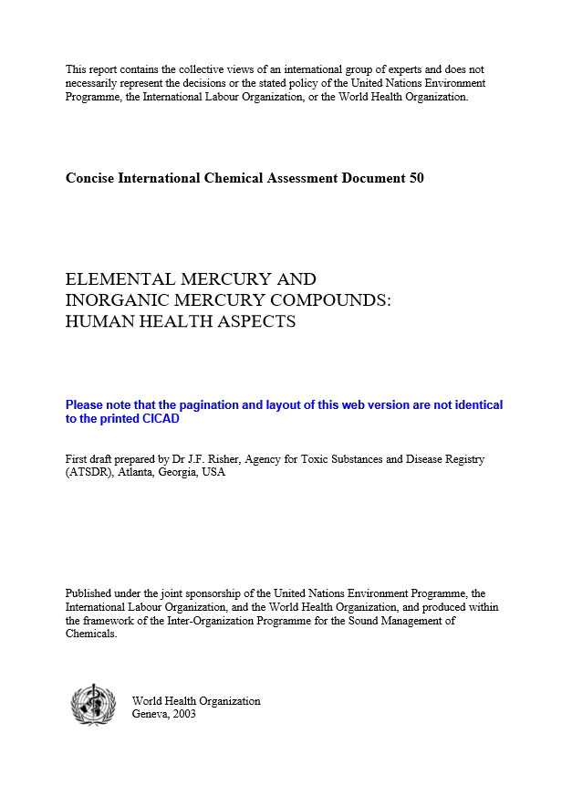
WHO activities on mercury
Subtle effects on the central nervous system of long-term occupational exposure to Hg0 to be the result of about 20 μg/m³ of Hgº
For inhalation by the general public, this corresponds to 5 μg/m³, and an uncertainty factor of 30 resulted in a tolerable concentration of 0.2 μg/m³.
(2003)
Source: http://www.who.int/ipcs/publications/cicad/en/cicad50.pdf?ua=1

Slide 18
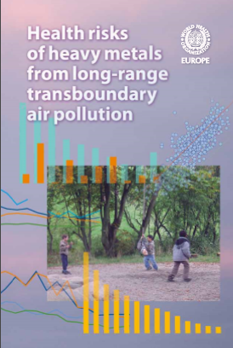
Health risks of mercury in the context of LRTAP
Airborne concentrations of mercury in Europe and globally, are generally well below the levels known to cause adverse health effects from inhalation exposure.
Concentrations of inorganic mercury species in surface water and groundwater are generally well below the levels known to cause adverse health effects from water consumption.
Human biomonitoring and diet-modelling data indicate that tolerable dietary intakes of methylmercury are exceeded among subpopulations that consume large amounts of fish, e.g. in Scandinavia, North America and France.
For several species of (mainly large predatory) freshwater and marine fish and mammals, a mercury level of 0.5 mg/kg, the value used as a guideline in many countries, is often exceeded.
Little information is available on the provenance of methylmercury in marine fish and on the contribution of long-range transport to the process.
Evidence exists showing increasing levels of mercury in marine fish and mammals in the Arctic, indicating the impact of long-range transport.
(2007)
Source: http://www.euro.who.int/en/health-topics/environment-and-health/air-quality/publications/pre2009/health-risks-of-heavy-metals-from-long-range-transboundary-air-pollution-2007
Notes:
Emissions of mercury to the air from both anthropogenic and natural sources are
in inorganic forms that can be converted biologically to methylmercury in soil
and water. Methylmercury bioaccumulates and enters the human body readily
via the dietary route. Airborne concentrations of mercury in Europe, and also
globally, are generally well below those known to cause adverse health effects
from inhalation exposure. Concentrations of inorganic mercury species in surface
water and groundwater are generally well below those known to cause adverse
health effects from drinking water.
Methylmercury is a potent neurotoxic chemical. Unborn children (i.e. fetuses)
are the most susceptible population group, the exposure being mainly from fish
in the diet of the mother. Methylmercury is also excreted in mothers’ milk. Human
biomonitoring and diet-modelling data indicate that tolerable dietary intakes
of methylmercury are exceeded among subpopulations that consume large
amounts of fish, e.g. in Scandinavia, North America and France. For several species
of (mainly large predatory) freshwater and marine fish and mammals, a mercury
level of 0.5 mg/kg, the value used as a guideline in many countries, is often
exceeded.
Historical data, e.g. from lake sediments in Scandinavia, show a two- to fivefold
increase in mercury concentrations with respect to the pre-industrial era,
reflecting anthropogenic emissions and long-range transport. Methylmercury in
freshwater fish originates from inorganic mercury in the soil and direct atmospheric
deposition. Anthropogenic emissions of mercury in Europe decreased by
approximately 50% after 1990, and a similar decrease is predicted by modelling
and limited monitoring data on the deposition of mercury in the region. However,
a concomitant decrease in the concentration of methylmercury in freshwater
fish has not been observed.
Little information is available on the provenance of methylmercury in marine
fish and on the contribution of long-range transport to the process. Evidence exists
showing increasing levels of mercury in marine fish and mammals in the
Arctic, indicating the impact of long-range transport. In general, fish consumption
has important beneficial effects on health. However, in some populations
consuming large amounts of fish, or consuming contaminated fish, the intake of
methylmercury may reach hazardous levels. Thus, reducing the concentrations
in fish should be given a high priority. Reducing emissions to the atmosphere
and long-range transport of pollution represents a means of achieving this aim.

Slide 19
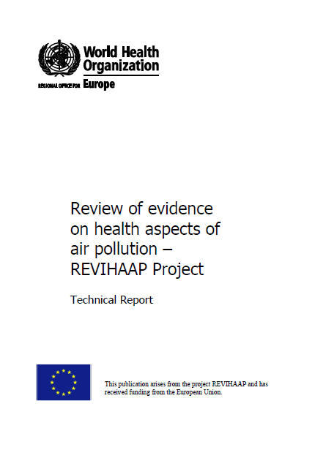
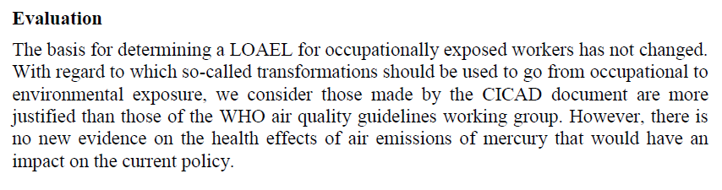
Mercury in REVIHAAP project
Source: http://www.euro.who.int/en/health-topics/environment-and-health/air-quality/publications/2013/review-of-evidence-on-health-aspects-of-air-pollution-revihaap-project-final-technical-report

Slide 20
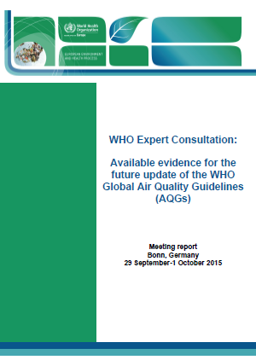
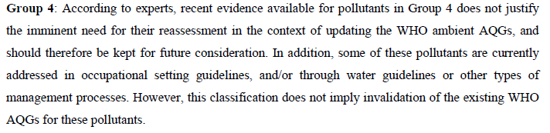
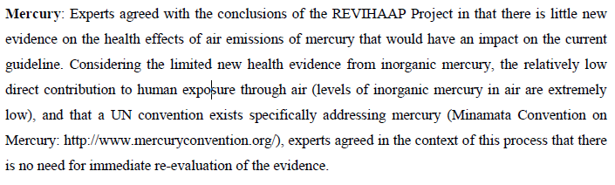
Mercury consideration in the context of the update of WHO global AQG
Group 4
Mercury
(2016)
Source: http://www.euro.who.int/en/health-topics/environment-and-health/air-quality/publications/2016/who-expert-consultation-available-evidence-for-the-future-update-of-the-who-global-air-quality-guidelines-aqgs-2016

Slide 21
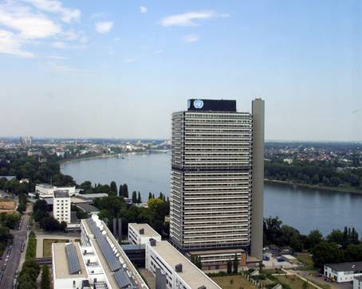
Thank you for your attention
http://www.euro.who.int/en/health-topics/environment-and-health
Notes:
21

