Slide 1
Assessment of LRT contribution to cities in Europe using uEMEP?
Hilde Fagerli, Bruce Denby, Peter Wind

Slide 2
Content
What is uEMEP?
How can it be used?
What is needed to extend it to a large number of European cities?

Slide 3
The uEMEP Concept
Downscaling of EMEP/MSC-W model results to resolutions in the order of 100m (while keeping consistent with the EMEP model results)
Why?
Consistent picture from European to local scale
To know how important the long range transport component is, we also need to know the local component (?)
Policy focused on health effects
Not only urban
NH₃
Depositions
Verification of emissions
Show how the regional model should compare to (urban) observations

Slide 4
The uEMEP Concept - a downscaling methodology
Start with coarse (0.1°x0.1°) EMEP grid
Calculate local contribution from each sector in each grid
(The local fraction method)
Use ‘proxy data’ + gaussian model to redistribute the local contribution)
Add non-local from EMEP to the new local:
Notes:
Financed by another project, but with EMEP in mind

Slide 5
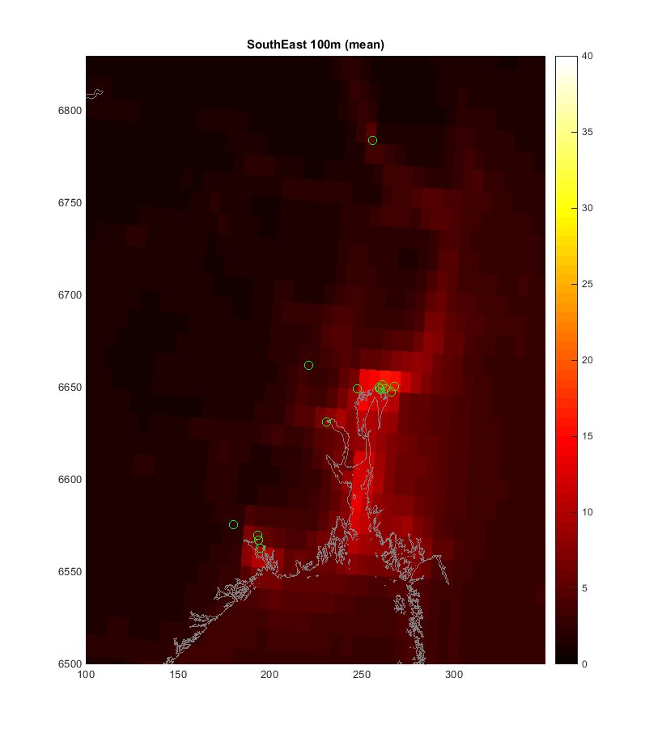
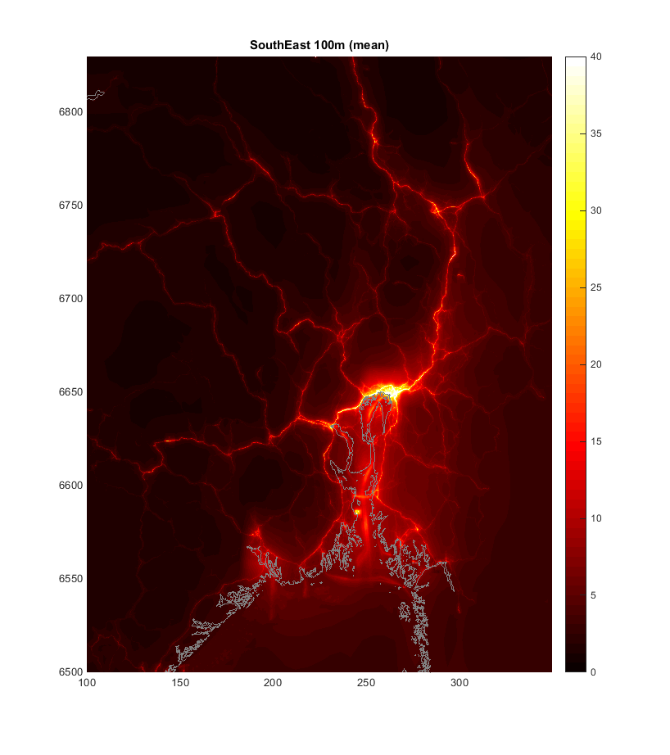
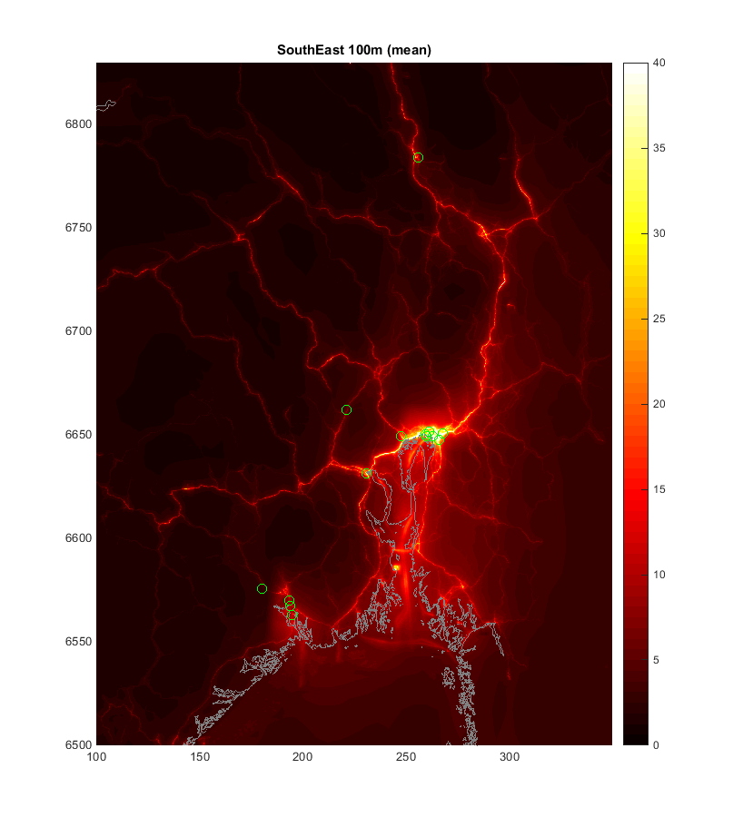
East Norway NO₂ (2013)
EMEP 0.1º (2013)
uEMEP 100 m (2013)

Slide 6
The Local Fraction method
The flux of primary pollutants is tracked in every grid cell (for each sector) for some predefined distance (typically 20-30 grid cells away in each direction)

Slide 7
NOx concentrations. Any can be chosen with the cursor

Slide 8
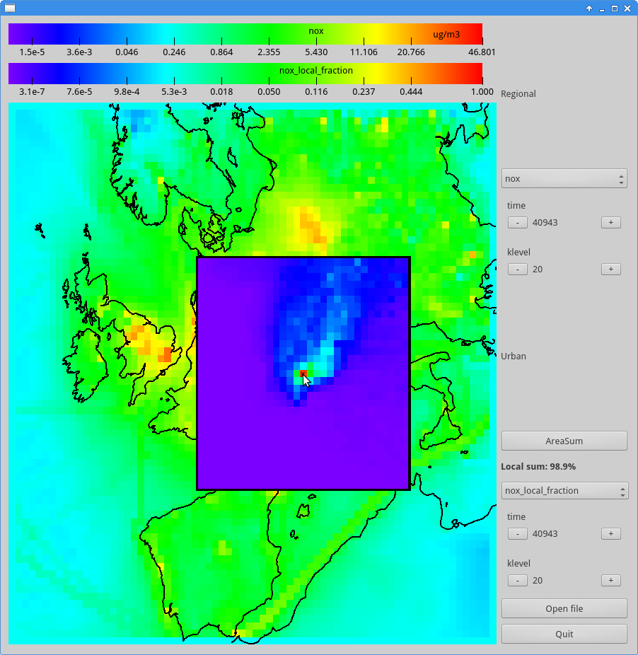
Local fraction of NOx from all sectors, showing the origin of the pollutant

Slide 9
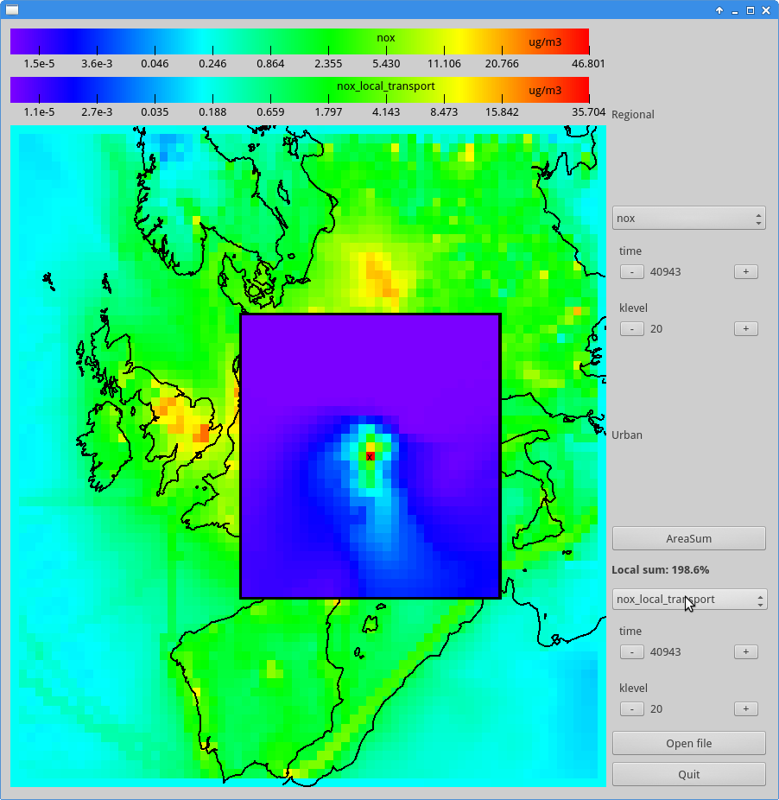
Transport of NOx from that point to the surrounding area

Slide 10
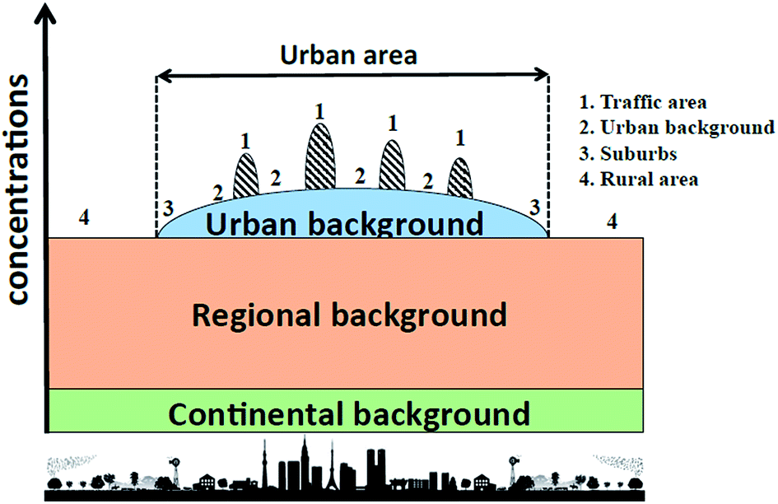
What do you get from the local fraction method?
For a city, or a part of a city
What is missing:
The local contribution is averaged
over the city domain (per grid), so do not give the gradients in the ‘local’ concentrations in
the city (horisontally and vertically)
Do not include tracking of secondary components, but possible
uEMEP downscaling (need only sorrounding grid cells)
Could also used as input to local modelling because it gives you directly the non-local contribution (avoid double counting)
Notes:
You could do this ‘manually’ today

Slide 11
Can uEMEP be expanded to a large number of European cities?
Alternative 1:
Collaborate with European cities/partners that have detailed information (proxy data or emissions, measurements) and develop step by step (candidates UK, NL,..FAIRMODE)
Alternative 2: European approach
Proxy data for NOx:
Traffic: open street map (capacity), transport modeller, (google, TomTom,…)
Ship traffic: AIS (Harbours difficult)
Industry, point sources (Less important)
Proxy data for PPM:
Traffic
Ship traffic
Industry
Wood burning/Coal burning (population?)
Consistency between top-down and bottom-up emissions inventories for cities is an issue

Slide 12
Summary
The local fraction method can provide for any city (point) in Europe the local versus non-local contribution of primary components – but only for ‘urban background’
The downscaling methodology can be applied for all of Europe, but the quality of the results depend on the input data -where there are some challenges
uEMEP results are consistent from regional scale to local scale

Slide 13
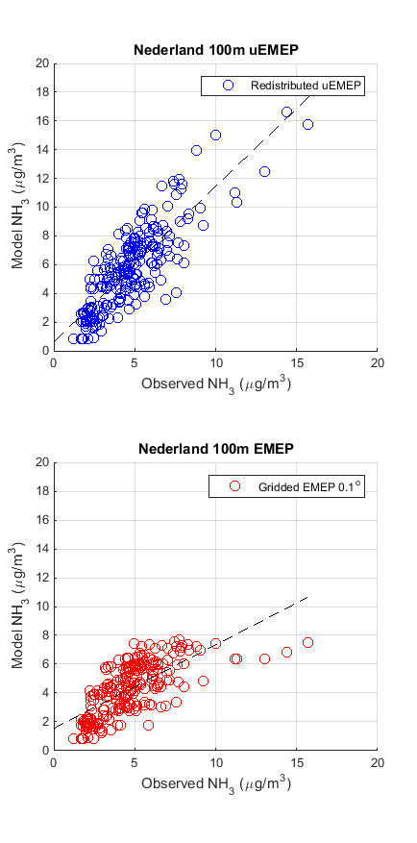
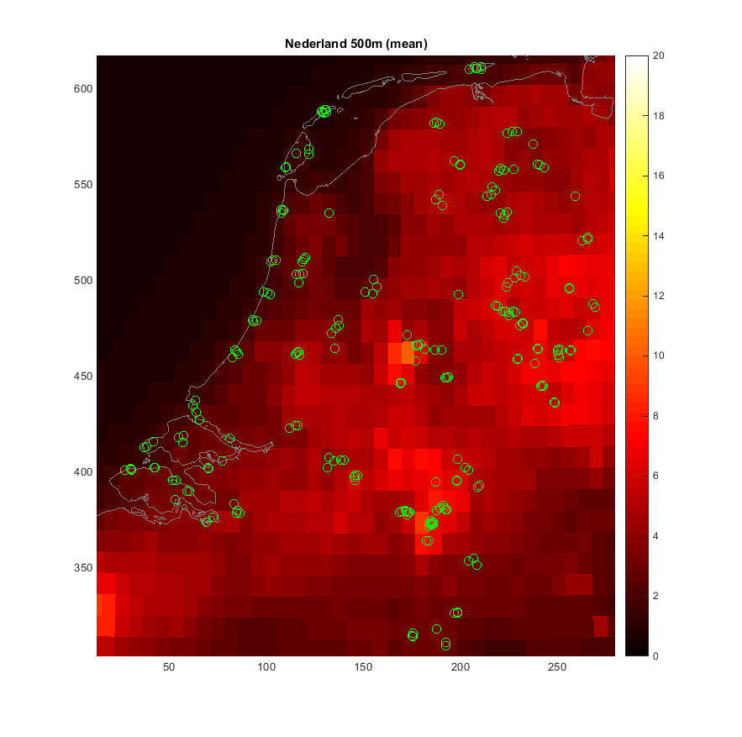
100 m uEMEP for ammonia with RIVM emissions (0.1x0.1) in EMEP (compared to 235 obs in NL)
r²=0.7
r²=0.5
WP 18/19: Pilot countries?
Cooperation with RIVM

