Slide 1


Joint thematic session: from hemispheric to local scale air pollution;
Twin Site project
Task Force on Measurements and modelling
A. Colette (TFMM), M. Pandolfi (CSIC, SP), G. Kiesewetter (CIAM), P. Thunis (JRC), H. Fagerli (MCS-W)
Joint EMEP & WGE Steering Body, Geneva, Sept 13th 2017

Slide 2
TFMM « Twin SITE » project
Scope
  Assessment of the contribution of long range transport of air pollution to urban air quality
  Better understanding of
    Health impacts of LRTAP
    Efficiency of local/regional/national/international mitigation strategies
Methodology
  Measurements
    Observed increments between pairs/triple of remote/suburban/urban/traffic supersites
    Fine chemical analysis of PM
  Modelling
    Isolate urban/external contribution in surrogate of chemistry-transport models (GAINS, SHERPA, CAMS City allocations)

Slide 3
OBSERVations
Methodology (CSIC, Spain)
  PM chemical speciated data simultaneously collected at pairs of traffic/urban/suburban/remote sites
  Positive Matrix Factorization (PMF) model to identify and quantify the sources of PM at a receptor location
  Lenschow approach to the obtained PMF source contributions (Determination of the urban increments by activity sector)

Slide 4
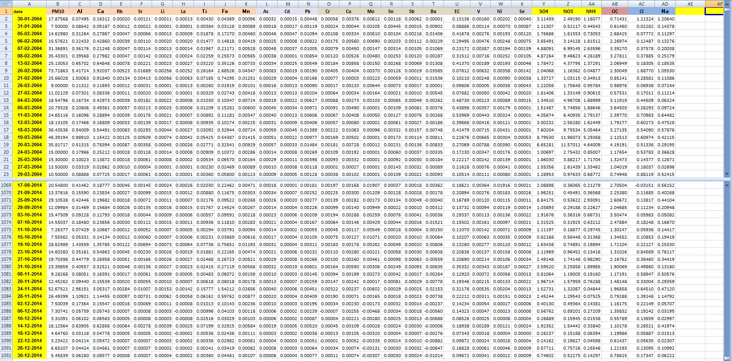
Positive Matrix Factorization for particulate matter
Source contribution
Source profile

Slide 5
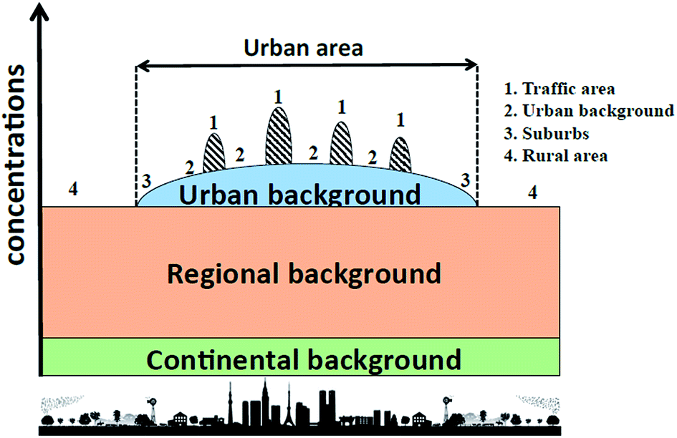
LENSCHOW: increments
Concept
  Additivity of urban/regional/continental contributions
Well known limitations:
  contribution of urban pollution to regional levels
Should be considered as a qualitative technique, only provides indication on relative contribution of local or not-local sources, for instance when comparing different sites

Slide 6
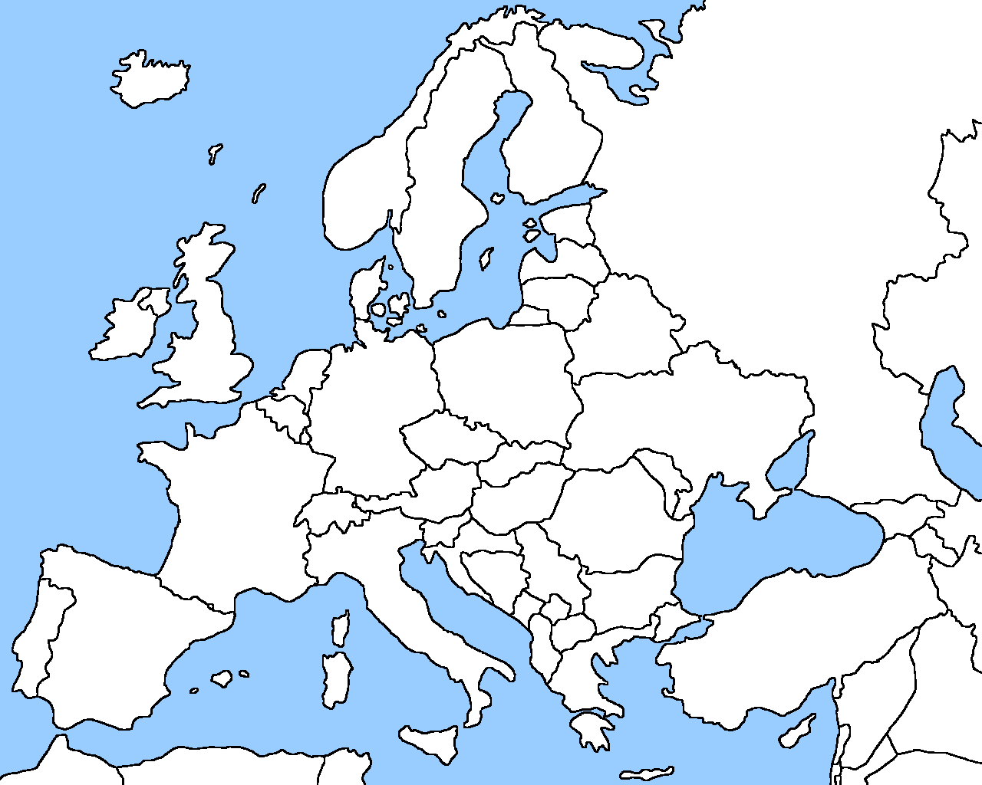
Candidate sites
Done:
  Spain: Barcelona (UB), Montseny (RB), Montsec (Mountain)
  Switzerland: Zurich-Kaserne (urban background), Paierne (rural).
  France: Revin (RB), Lens (UB), Roubaix (traffic).
  Germany: Leipzig (traffic-urban)/Melpitz (regional)
Pending
  United Kingdom (collecting more data)
  Netherlands
  Non European sites: Proposal received from Bolivia, South Korea, South Africa and Mexico, in collaboration with GAW/WMO.
Notes:
I will mention orally that there are difficulties for Bolivia, but it is out of the scope for EMEP, just to mention international contacts have been made

Slide 7
2010 – 2014 Barcelona, annual
LOCAL
REGIONAL
Traffic (2.8; 12%)
TRANSBOUNDARY
Marine (4.3; 17% of PM₁₀ mass)
Vehicles in
Barcelona
Barcelona measuring
station 5 km far from
the coast
PM₁₀ (24.6 μg/m³)
μg/m³; %
BCN
BCN
Sec. sulfate (2.4; 10%)
Industrial (0.2; 1%)
Emissions from the Barcelona
Metropolotan Area and valley
BCN
Strong summer
formation and
recirculation
BCN
BCN
Mineral (3.8; 15%)
Heavy-oil (3.6; 15%)
Sec. nitrate (2.7; 11%)
Organic (4.5; 18%)
Saharan dust
(summer)
Local dust
resuspension
Port of Barcelona
Strong summer
formation and
recirculation
BCN
BCN
Agriculture/
farm
BCN
BCN
NO₂ + availability
of NH₃ In Barcelona

Slide 8
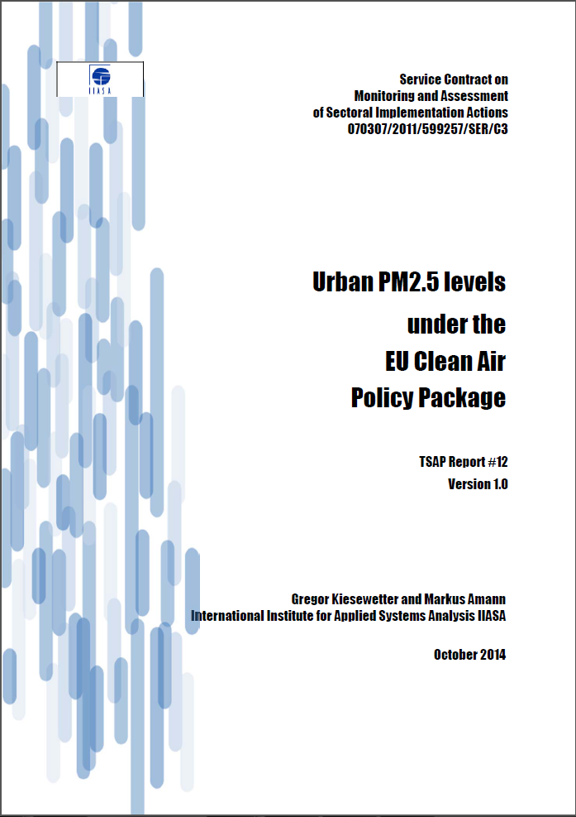
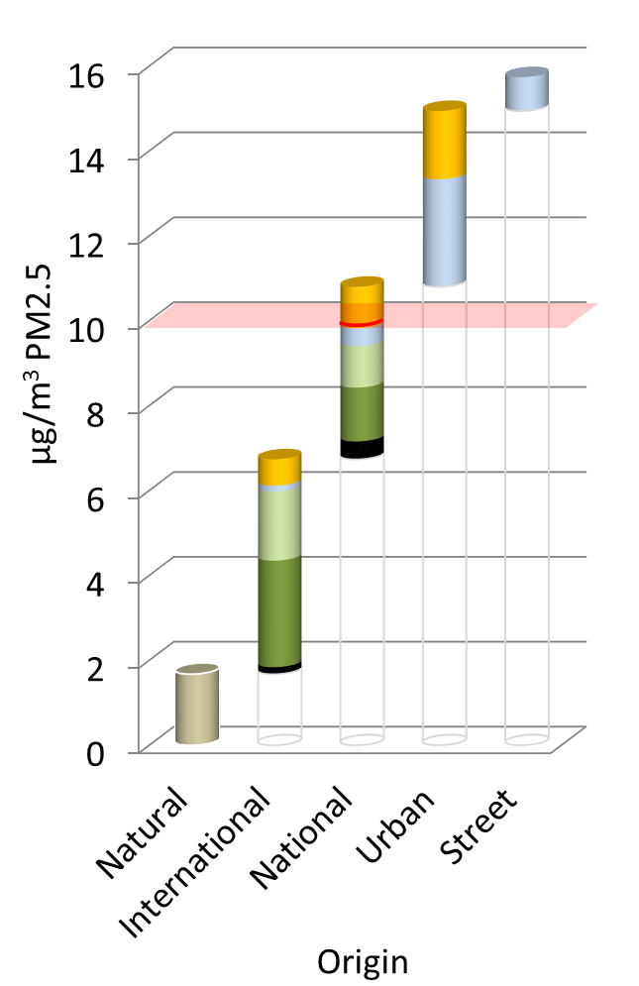
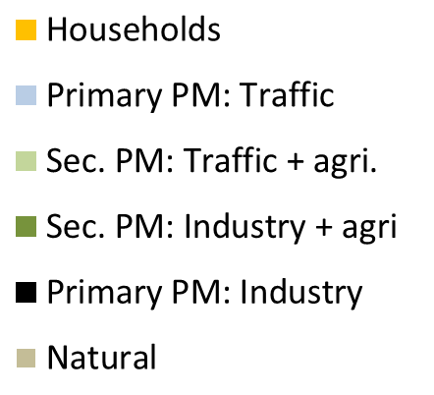
Modelling: GAINS
TSAP methodology, apportionment of
  Natural, international, national, urban, street
  Residential, traffic, industrial, agriculture, primary/secondary
  Based on EMEP&CHIMERE models and AIRBASE observations
Primarily communicated for country averages
Also available at ~1900 AirBase stations
Zurich, CH

Slide 9
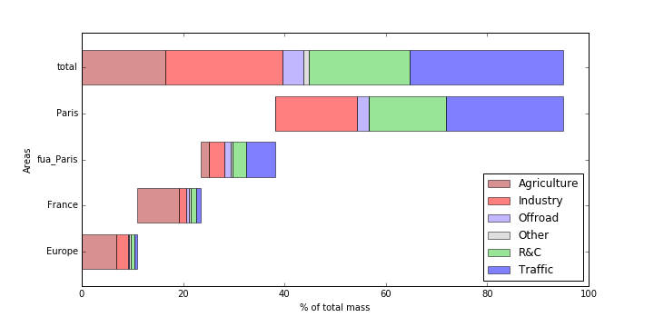
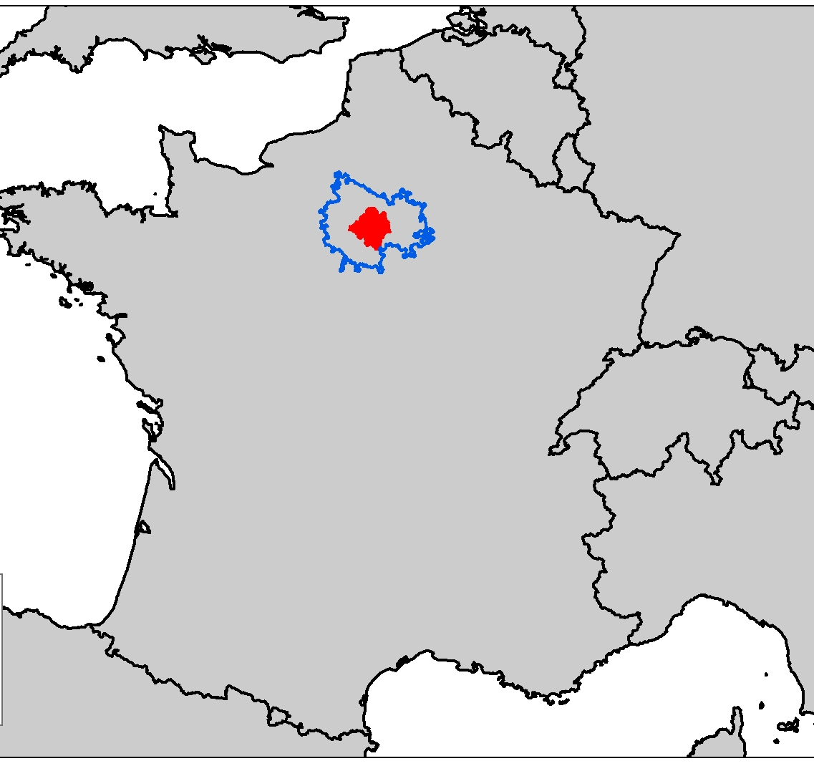
Modelling: sherpa
Sectoral allocation
SHERPA
  Screening for High Emission Reduction Potentials on Air quality
  Developed by JRC, based on CHIMERE model
Sectoral/Spatial allocation:
  Core city, Functional Urban Area, Country, Transboundary
  Available for any location in the EU
Total
Agri
Industry
Resident
Traffic
City
Commuting area
Spatial allocation
Country
Europe

Slide 10
CAMS: City Allocation
Copernicus Atmospheric Monitoring Service
  Source allocation available throughout the year in selected European cities
  Based on the EMEP model, also including LOTOS-EUROS for selected episodes
  city/national/international contributions for O3, PM, and chemical components
http://policy.atmosphere.copernicus.eu/CitySourceAllocation.html

Slide 11
conclusion
Scope:
  Better understanding of long range transport to urban air pollution
  Bringing together a range of complementary approaches
  Showcase the added value of fine chemical analyses at monitoring supersites
  Clarify the meaning of various modelled « city allocation » estimates
Measurements
  PMF + Lenschow
  Available as annual mean, but also for the monthly variation
  Several sites available: Spain, France, Switzerland, Netherlands, Germany
Modelling
  Conceptual differences between GAINS/CAMS/SHERPA « increments »
  Define common definitions of city/external sources
  Assess the sensitivity of the integrated models to the underlying CTMs
  Investigate the consistency between models estimates and observed increments at the twin sites
Next steps:
  Report on Observations being drafted
  Technical modelling Workshop in Paris 19/9/2017

