Slide 1


Progress report 2016-2017
Johan Tidblad & Pasquale Spezzano

Slide 2
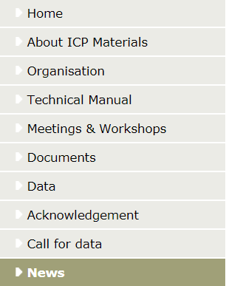
Web page update
No changes in layout, focus on new content
  Maintaining it as “barrier free” to visually impaired persons
Organisation / ICP Materials Task Force
  Mailing list
Technical manual
Data
Acknowledgement
  Active organisations
  Past organisations
  Supporting organisations

Slide 3
Publications and presentations (2016-2017)
Kreislova K and Geiplova H (2016). Prediction of the long-term corrosion rate of copper alloy objects. Materials and Corrosion, 67(2), 152-159
Christodoulakis J, Tzanis C, Varotsos C A, Ferm M and Tidblad J (2016). Impacts of air pollution and climate on materials in Athens, Greece. Atmospheric Chemistry and Physics Discussion, doi:10.5194/acp-2016-196
Tidblad J and Thierry D (2016). Evaluation of corrosion products and trends in corrosion rates for aluminium exposed at different atmospheric environments in Europe, EUROCORR 2016, 12-15 September, Montpellier, France
Tidblad J, Kreislová K, Faller M, De la Fuente D, Yates T, Verney-Carron A, Grøntoft T, Gordon A and Hans U (2017). ICP Materials Trends in Corrosion, Soiling and Air Pollution (1987–2014). Materials, 10(8), 969; doi:10.3390/ma10080969 (registering DOI)
Tidblad J, Spezzano P, Kreislova K, De la Fuente D, Faller M, Yates T, Verney-Carron A and Grøntoft T (2017). Air pollution effects during 30 years of research within ICP Materials (1987-2017), EUROCORR 2017, 4-7 September, Prague, Czech Republic.

Slide 4
33rd Task Force (Hämeenlinna, 10-12 May 2017)
18 participants from 12 countries: Austria, Croatia, Czech Republic, Finland, France, Germany, Italy, Norway, Spain, Sweden, Switzerland, and the UK;
Main items discussed were
  UNESCO Call for data
  Report on trends in environment, corrosion and soiling 1987-2015
  New exposure for trend analysis 2017-

Slide 5
UNESCO Call for data (presented separately)
Six countries participating: Croatia, Germany, Italy, Norway, Sweden and Switzerland
Twenty different sites discussed
Dedicated page on ICP Materials web site

Slide 6
Report on trends in environment, corrosion and soiling 1987-2015
Special issue of Materials, invited publication
  Tidblad J, Kreislová K, Faller M, De la Fuente D, Yates T, Verney-Carron A, Grøntoft T, Gordon A and Hans U (2017). ICP Materials Trends in Corrosion, Soiling and Air Pollution (1987–2014). Materials, 10(8), 969; doi:10.3390/ma10080969 (registering DOI)
Open access
Supplementary material: all data used in the publication released in xls format
Also posted at ICP Materials web site

Slide 7
Report on trends in environment, corrosion and soiling 1987-2015. Trends in 4-year corrosion data

Slide 8
Report on trends in environment, corrosion and soiling 1987-2015. Trends at individual sites

Slide 9
New exposure for trend analysis 2017 -
One and four years of exposure
Corrosion
  zinc
  carbon steel
  stainless steel
  limestone
  copper
  aluminium
Soiling
  modern glass
  stone materials (limestone and marble) - New
  coil coated materials (brown and white) - New
New site in Russia and two new sites in Croatia

Slide 10
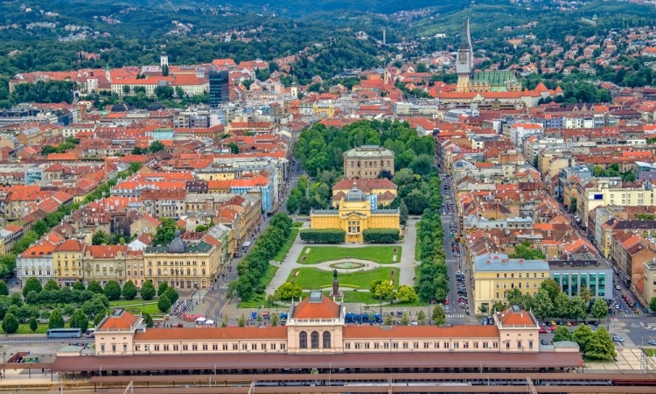
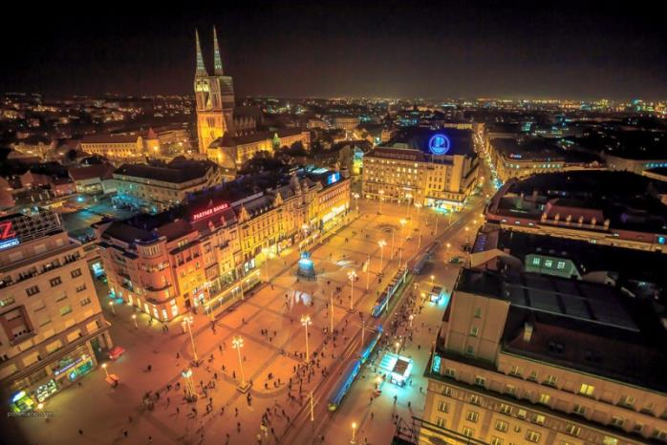
34th Meeting of the Task Force
Welcome to Zagreb, Croatia
25-27 April 2018!

