Slide 1
TFIAM progress
Rob Maas, 21/22 March 2017

Slide 2
Workplan 2016-2017
1131 Increase linkages with local scale air policy
(report 2017)
1132 Analyse effectiveness of hemisperic control strategies (report 2017)
Analyse synergies and trade-offs between air
pollution, climate and nature policies
+ several workplan items refer to collaboration with TFIAM
+ contribution Scientific Assessment Report 2016

Slide 3
1131 Local strategies
Workshop Utrecht, 15-16 February 2017
Local experiences (e.g. Antwerp, Berlin, Birmingham, Copenhagen, Helsinki, Kassel, Lisbon, Madrid, Paris)
Regional and national coordinated strategies (e.g. Emilia Romagna, Liguria, Lombardia, Flanders, Netherlands)
European wide analyses (e.g. Urban Partnership/JRC, Urban pilot/EEA, Claircity, Icarus, Transphorm, GAINS/Chimere )
Report: www.iiasa.ac.at/TFIAM-FAIRMODE.html

Slide 4


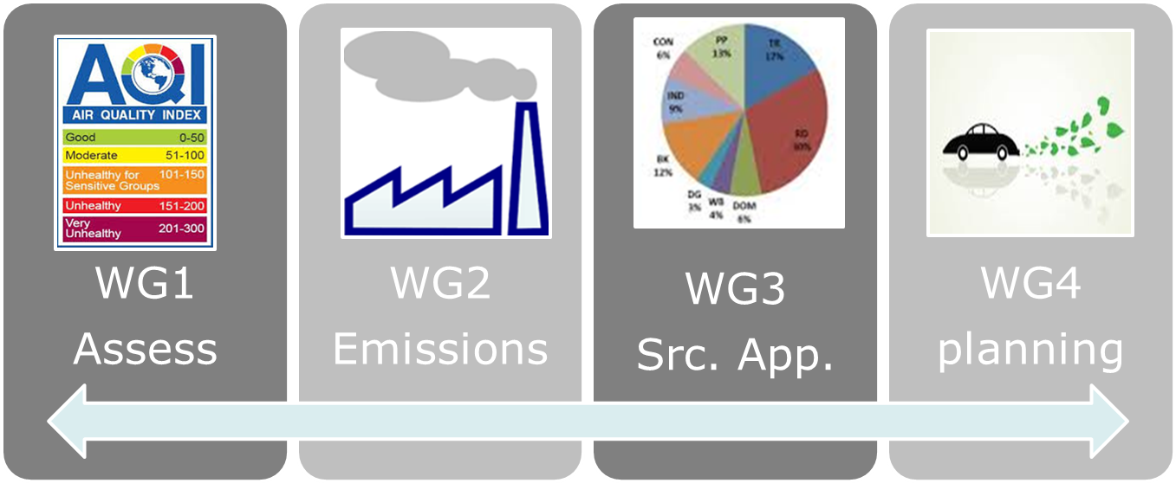
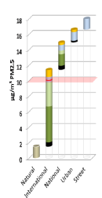
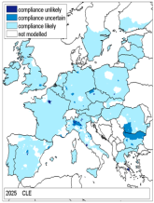
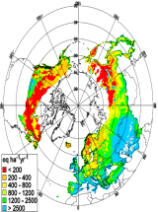
Joint TFIAM / FAIRMODE workshop
Harmonisation of practices
Quality Assurance & robustness
Tools to assess effectiveness
of local actions
TFIAM
Efficiency of national &
International actions

Slide 5
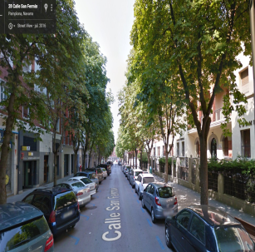
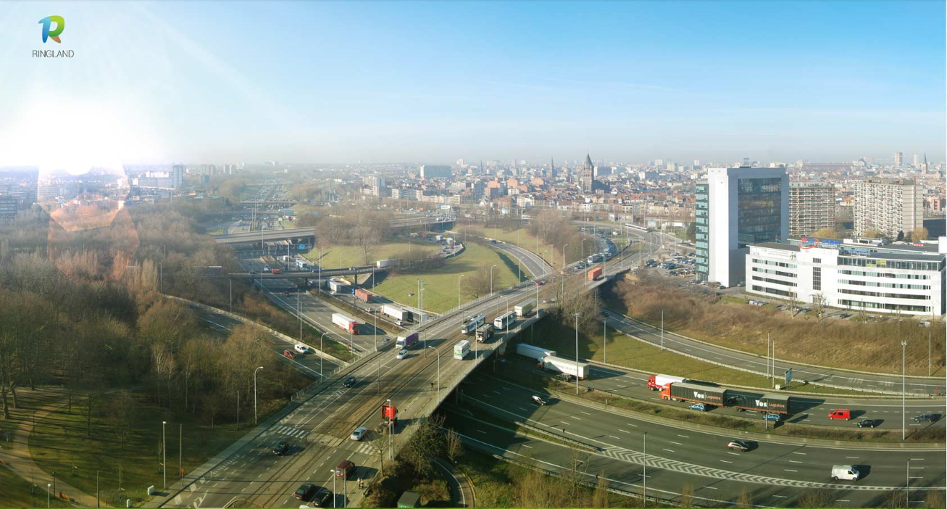
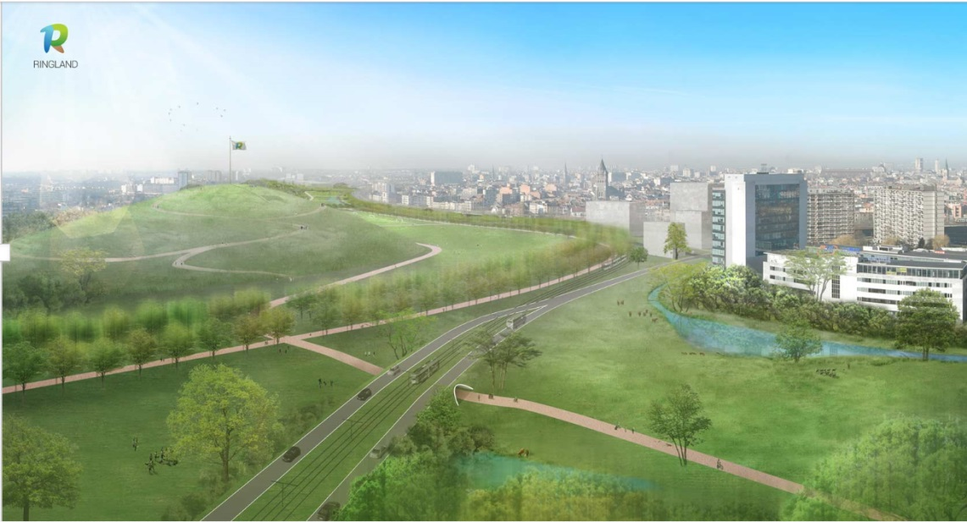

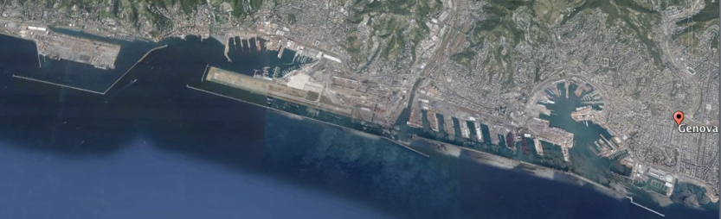
NO₂

Slide 6
1131 Main conclusions on local strategies
Regional and transboundary policy coordination remain needed (e.g. to reduce NH₃)
Cost-effectiveness of local measures can be increased if combined with energy, traffic, noise, health and urban planning policies
Focus local measures not only on exceedances of AQLVs, but also assess the cost-effectiveness for life years gained
Further development of multilevel strategies requires more local knowledge in international networks

Slide 7
1131 Other findings on local strategies
There are no effective local measures to reduce air pollution during episodes
Mostly used local measure = LEZ, more recently also EVs
Traffic management: public transport, bicycles in several cities
For harbours: shore side electricity is (cost-) effective
Shipping emission reductions entail significant health benefits
Agricultural emissions are seldom addressed in air quality plans
Limiting biomass burning is becoming an issue in many regions
Road dust & tyre wear are a persistent problem
Marginal impacts of photocatalytic paint and vegetation
Organize a comparable workshop for natural areas ?

Slide 8
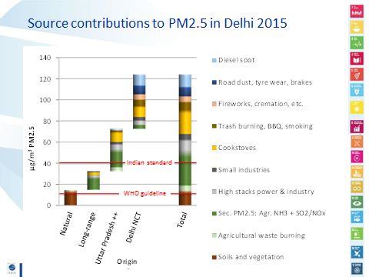
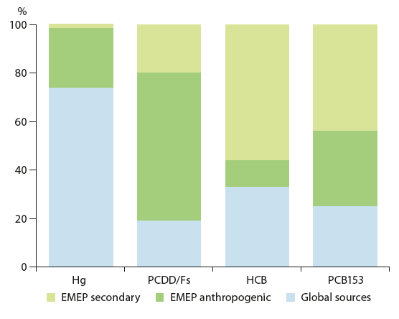
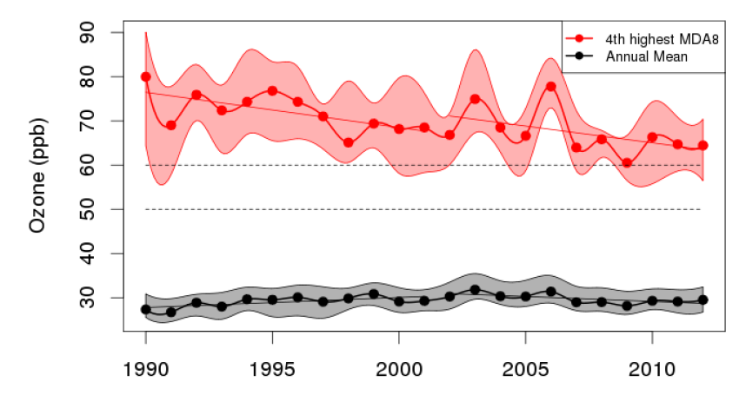
1132 Hemispheric strategies
TFIAM46 meeting - Paris, 2-3 May
+ joint session with TF HTAP
Output:
recommend further scenario analyses to
WGSR/EB (2017-2018)
Draft agenda
  Available scenarios: GAINS, FASST, CCE, IMO,
  ICCT, CCAC, IPCC, INMS, CGAM, EMEP(?) …
  Which scenarios do customers need?
  National abatement scenarios for SLCPs

Slide 9

1133 Air-Climate-Nature strategies
Recommendation ECLAIRE project (2016): the most effective way forward is to reduce:
  emissions of NH₃ in Europe to reduce PM-exposure and halt the loss of biodiversity, and
  Emissions of CH₄ at the hemispheric scale to limit the speed of temperature increase and reduce ozone damage to ecosystem services.
Recommendation AR2016:
Integrated approach to avoid antagonistic
effects of climate measures (e.g. wood burning,
diesel, direct gasoline injection, biodigestion)

Slide 10
Recommendations for the Bureaux
(Local): call upon parties to stimulate participation of
local/regional experts
1132 (Hemisperic): reconfirm TFIAM mandate to outreach
to countries and organisations beyond the UNECE-domain
1133 (Air-climate-nature): give guidelines for further
work in 2017-2018, e.g.:
  Compare cost-effectiveness of local nature management vs transboundary NH₃-abatement strategies to halt biodiversity loss
  What about a joint 2018 Scientific Assessment Report (focus on health-climate-biodiversity or ozone-BC-NH₃)?

