Slide 1
Progress in 2017
Work-plan elements
Transition of modeling to the new EMEP grid
Strategy to improve emission inventory:
Review and improvement of HM emission data for modeling
(CEIP/MSC-E joint report)
Cooperation with countries:
Case studies - Spain, Poland, Italy
Cooperation with international bodies:
Exchange of information with AMAP/UNEP, HELCOM

Slide 2
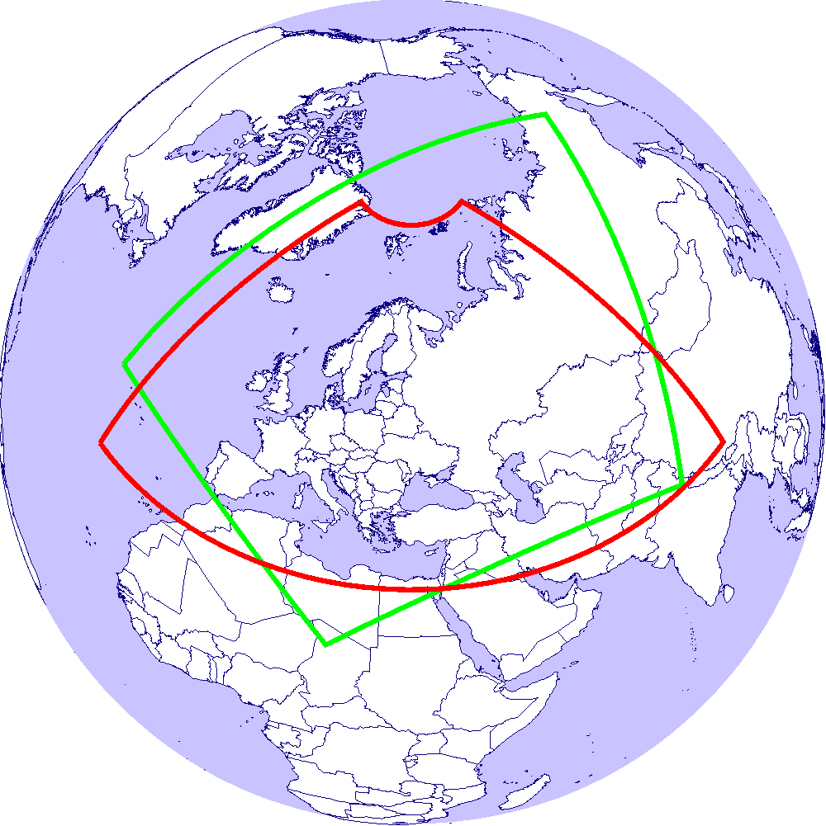
Transition to the new EMEP grid (lat, long)
Current and new EMEP domains
Activities on implementation of the new grid:
Current EMEP domain
Adaptation of HM and POPs modules for simulations on the new EMEP grid
Preparation of experimental emission data with fine resolution (0.1ºx0.1º) for model testing
Pilot simulations of Pb, Cd, Hg, BaP and evaluation against measurements
New EMEP domain

Slide 3
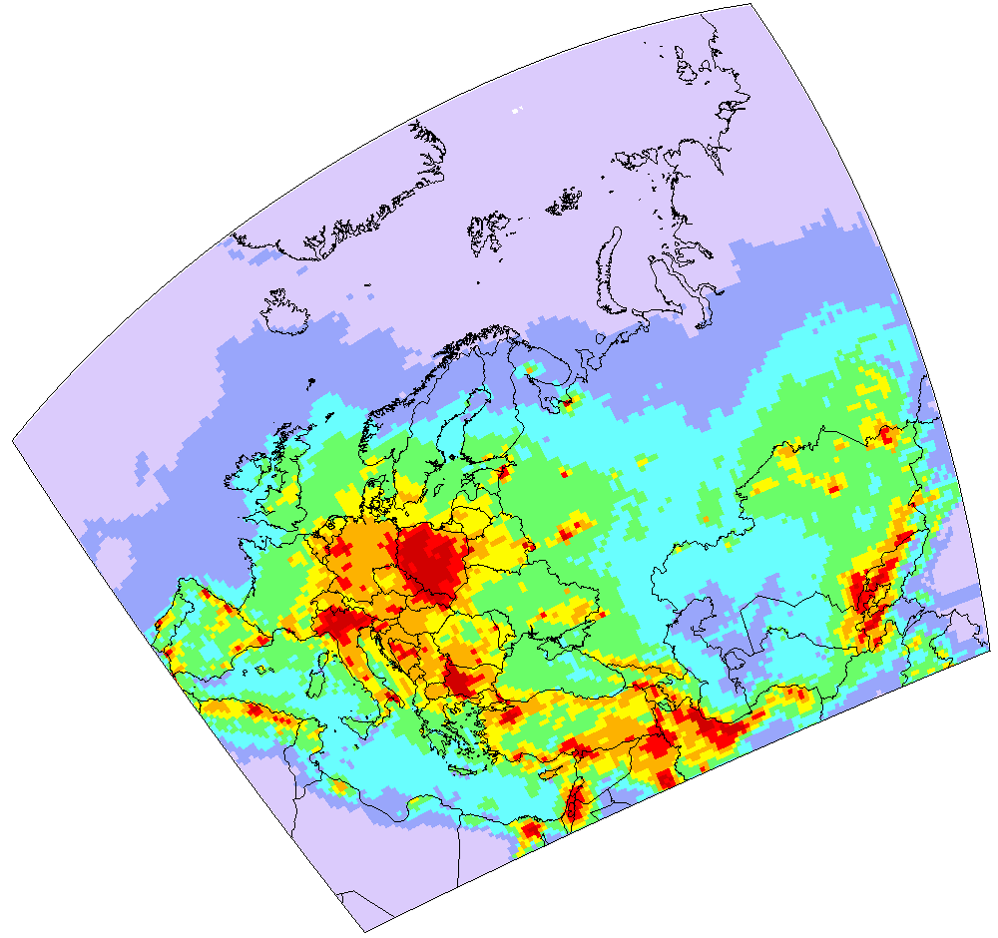
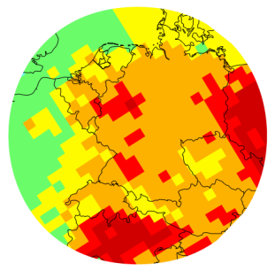
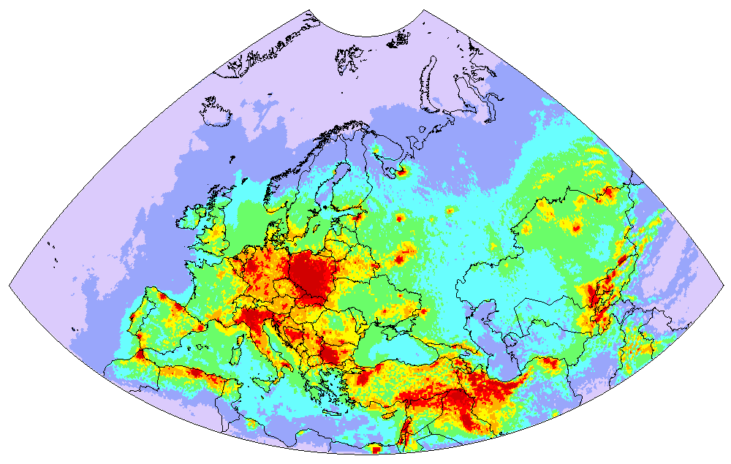
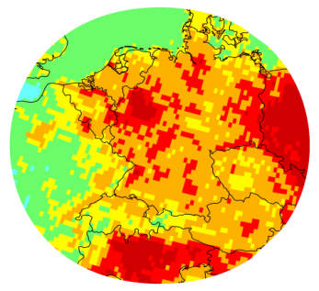
Transition to the new EMEP grid (lat, long)
Pilot simulations of Pb, Cd and Hg
experimental emissions - 2014
Pb deposition
Hg air concentration
Old grid
New grid
Hg | Old grid | New grid
Correlation | 0.72 | 0.92
Reg. slope | 1.40 | 1.35
Modeling on the new grid show good agreement with previous results of the old grid

Slide 4


GLEMOS: open-source software
under preparation
Scheme of GLEMOS modules
Content:
GLEMOS source code (FORTRAN 95)
A set of control scripts for compilation and running the model (c-shell)
A set of input data for test simulations
Technical documentation
The GLEMOS open source version will be posted at the GitHub repository

Slide 5
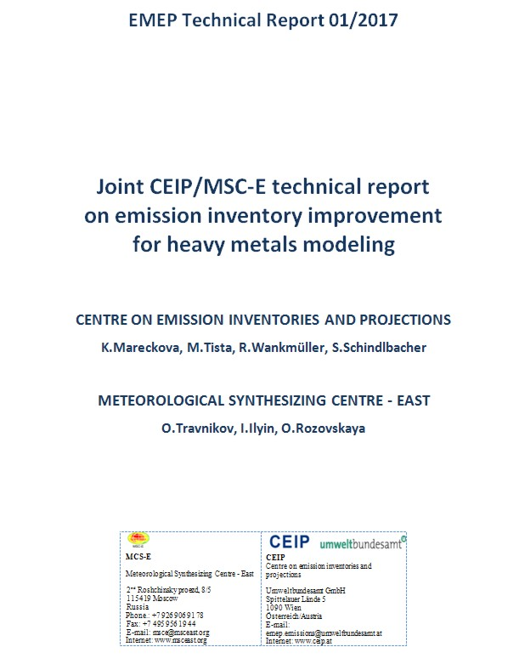
Review and improvement of HM emissions data for modeling (CEIP/MSC-E joint report (Part I))
CONTENTS
Introduction
Chapter 1 Data assessment, methodologies and
improvements to deal with heavy metals in
the EMEP region (CEIP contribution)
Chapter 2 Emission data for heavy metals modeling
(MSC-E contribution)
  Сhemical composition of emissions
  Temporal variation of emissions
  Vertical distribution of emissions
  Global emission inventories
  Historical and natural emissions
Recommendations

Slide 6
Review and improvement of HM emissions data for modeling (CEIP/MSC-E joint report (Part I))
Recommendation of the report for the development of emission strategy
List of priorities
Key emission parameters affecting quality of model estimates
Emission parameter | Pb and Cd | Hg
Quality of gridded anthropogenic emissions | 1 | 2
Chemical composition | - | 1
Temporal variation | 2 | 6
Vertical distribution | 3 | 7
Global emissions inventory | 4 | 3
Historical emissions | 5 | 4
Emissions to other media | 6 | 5
First priority Second priority Third priority Priority level for the emission parameters determines order of their implementation
Topics for discussion with TFEIP

Slide 7
Review and improvement of POP emissions data for modeling (CEIP/MSC-E joint report (Part II))
under preparation
Key emission parameters affecting quality of POP model estimates
Coverage of source categories (e.g. burning of agricultural residues)
Speciation of POP emissions (reporting emissions of B(a)P, B(b)F, B(k)F, IP)
Vertical profiles of emissions
Temporal disaggregation (seasonal, weekly, daily time factors)
Uncertainty range of emissions (e.g. totals, emission factors)

Slide 8
Cooperation with countries
Spain
New item included in the work plan – 2017
Objective: Analysis of B(a)P pollution on a country level using EMEP fine resolution modeling and national data (emissions, measurements and national modeling)
Poland
Case study
Objective: Preparation of detailed country-specific information of Cd pollution with fine (0.1° x 0.1°) resolution for Poland based on national emission and monitoring data
Italy
Country proposal
Objective: Assessment of HM pollution for Italy by GLEMOS and national model
(Minni model)
HM of the second priority : As, Ni, Cr, Cu, Zn, Se

Slide 9
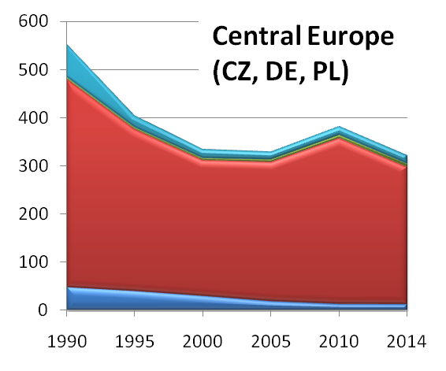
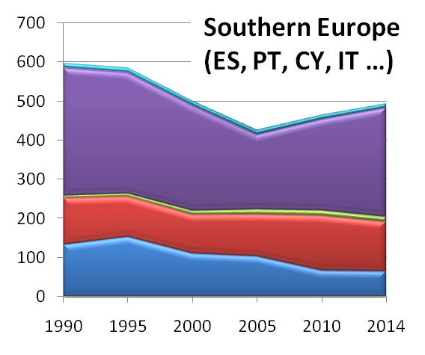
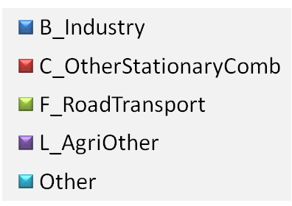
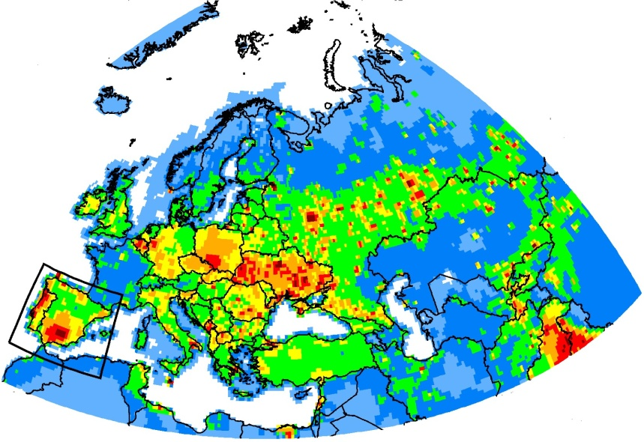
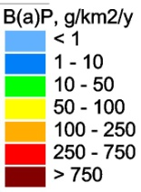
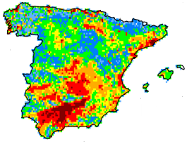
Cooperation with countries
Analysis of B(a)P pollution levels in Spain
Peculiarities of PAH emission changes in the EMEP region
EMEP countries (Spain) B(a)P emissions 2014 (experimental data)

Slide 10
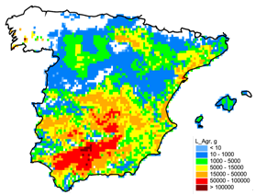
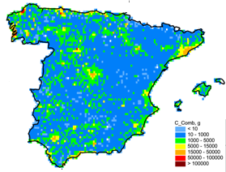
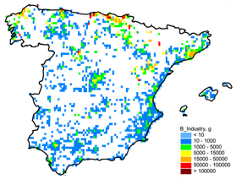
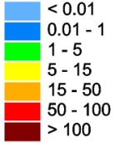
Cooperation with countries
Spain
B(a)P emissions (2014): Main sectors
Emission data prepared by MSC-E in cooperation with national experts
Agriculture
Stationary Combustion
Industry
kg
kg
kg
Road
Other
Stationary
Transport
1%
Emission information needed for model assessment
Combustion
4%
10%
Coverage of burning of agricultural residues
Speciation of PAH emissions
Vertical profiles
Temporal disaggregation
Uncertainty range of emissions
Industry
18%
Agriculture
67%

Slide 11
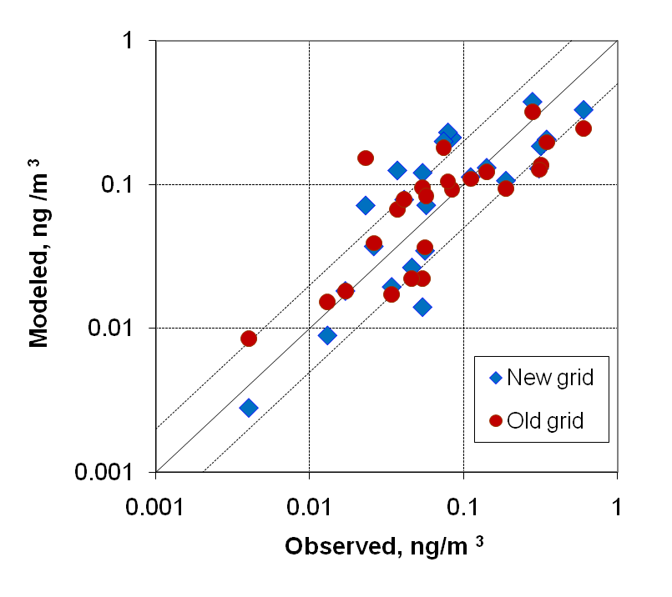
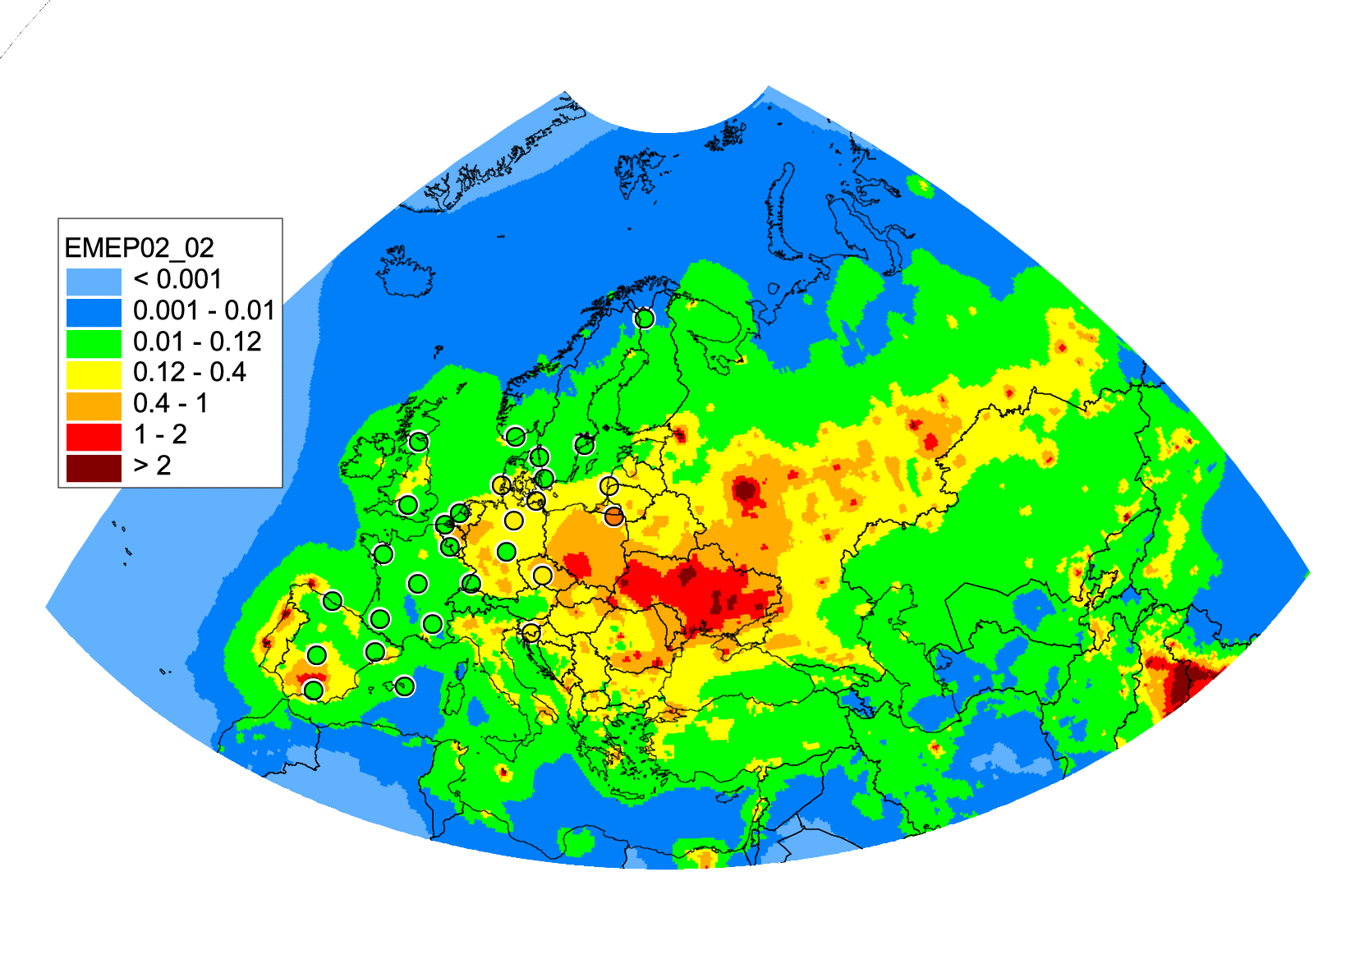
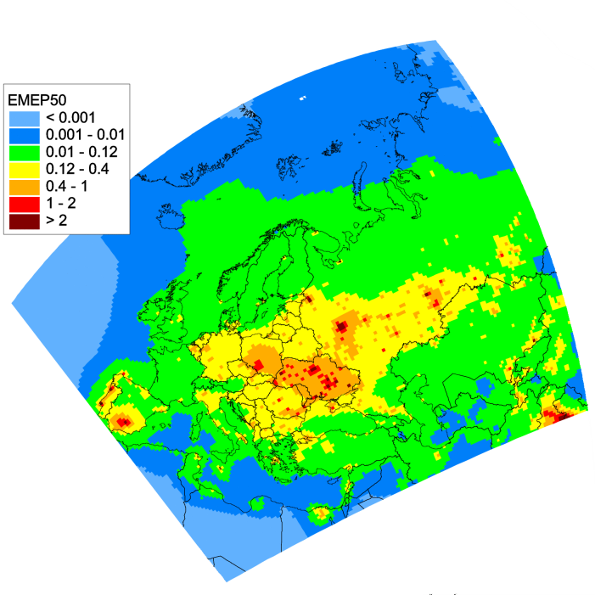
Cooperation with countries
Spain
Validation of GLEMOS modeling of B(a)P against measurement
Modeling results for B(a)P (2014)
New EMEP grid
Old EMEP grid
 | New grid | Old grid
Bias | -5 % | -20 %
Correlation | 0.73 | 0.73

Slide 12
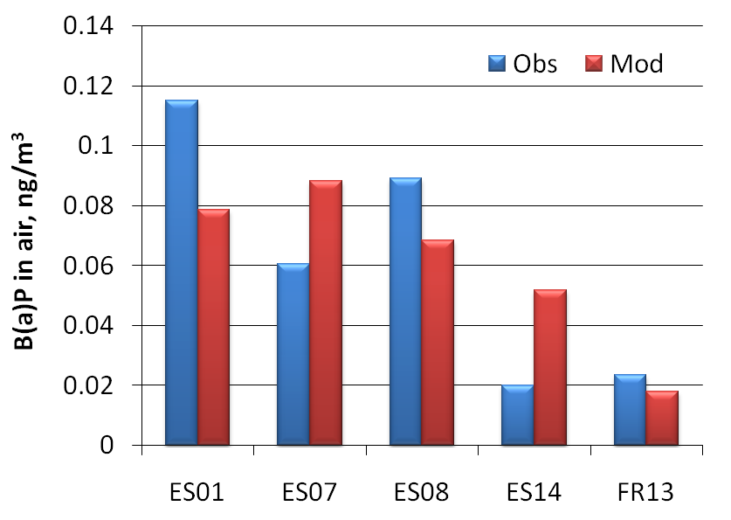
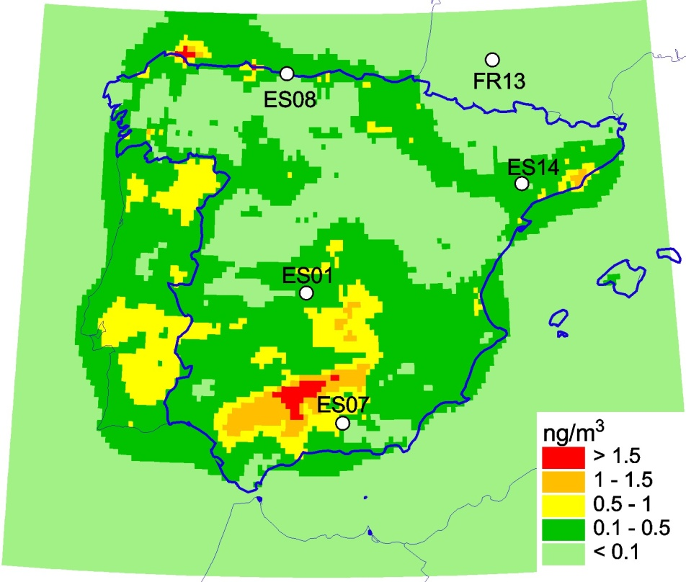
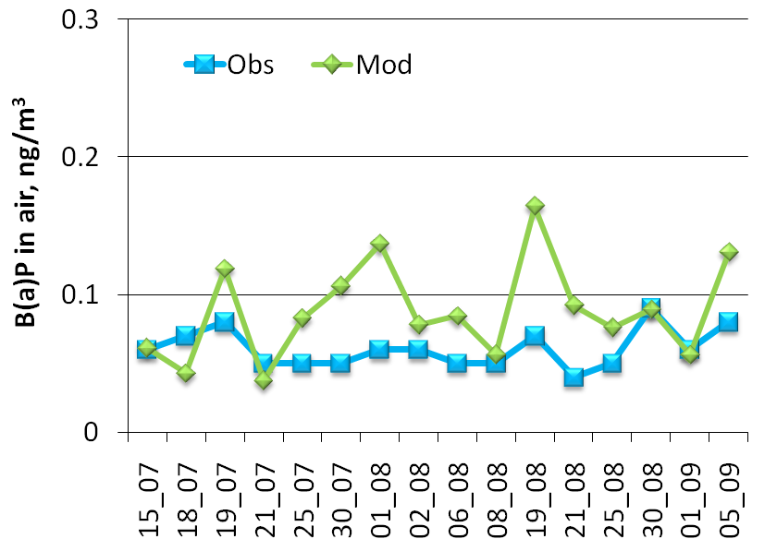
Cooperation with countries
Spain
Comparison with measurements of EMEP monitoring sites
B(a)P air concentrations, 2014
ES07
EMEP monitoring sites

Slide 13
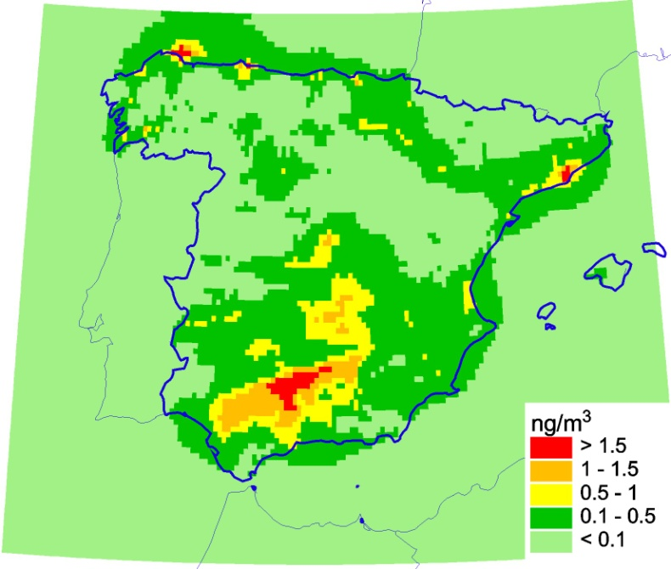
Cooperation with countries
Spain
Preliminary results of B(a)P air concentrations (2014)
obtained by GLEMOS and national experts (CHIMERE model)
GLEMOS (0.1º x 0.1º)
CHIMERE (0.1º x 0.1º)

Slide 14
Cooperation with countries
Spain
Model assessment of B(a)P pollution levels
Further work (2017/2018)
  Further work of refinement of emission data sets
  Comparison with various sets of national measurements
  Analysis of pollution levels using GLEMOS and CHIMERE modeling results
  Sector-specific modeling using national emissions and scenarios
  Source-receptor modeling for administrative regions
  Joint report
Evaluation of B(a)P pollution levels in Spain with fine spatial resolution
will be submitted to TFMM in Prague

Slide 15
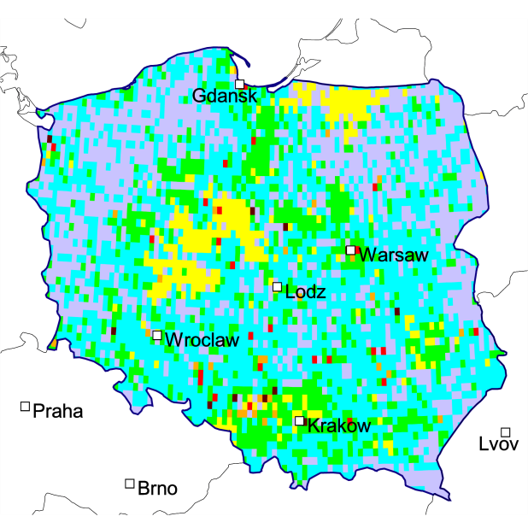
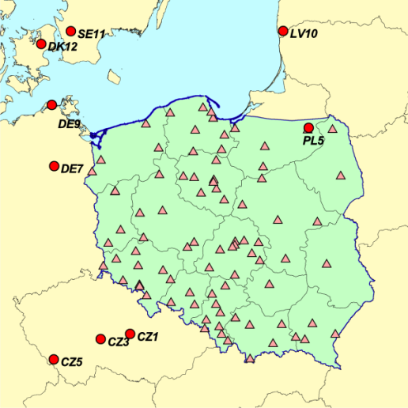
Cooperation with countries
Case study: Evaluation of Cd pollution levels in Poland
Main goals:
Evaluation of Cd pollution levels in Poland with fine (0.1° x 0.1°) resolution in close
cooperation with national experts
Preparation of detailed country-specific information for Poland based on
national emission and monitoring data
National input data
Road
Transport
3%
Fugitive
4%
Remaining
1%
Public
Power
5%
Stationary
Combastion
17%
Industry
70%
Monitoring stations (Air)
Gridded Cd emissions
(total: 13.9 t)
Main emission source categories
10 EMEP sites (1 in Poland)
84 national stations

Slide 16
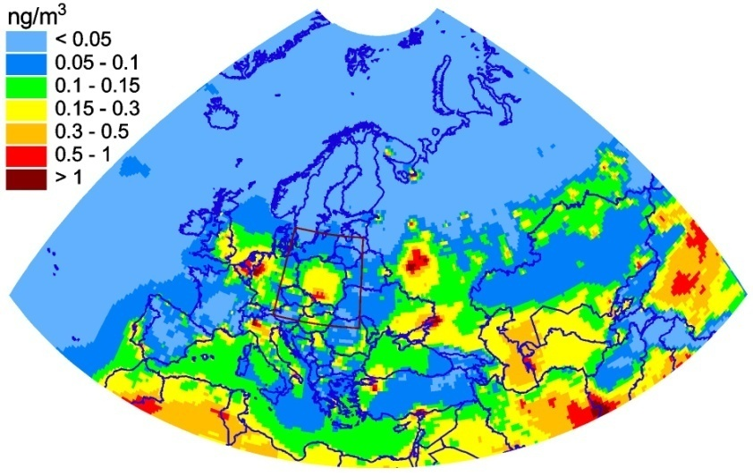
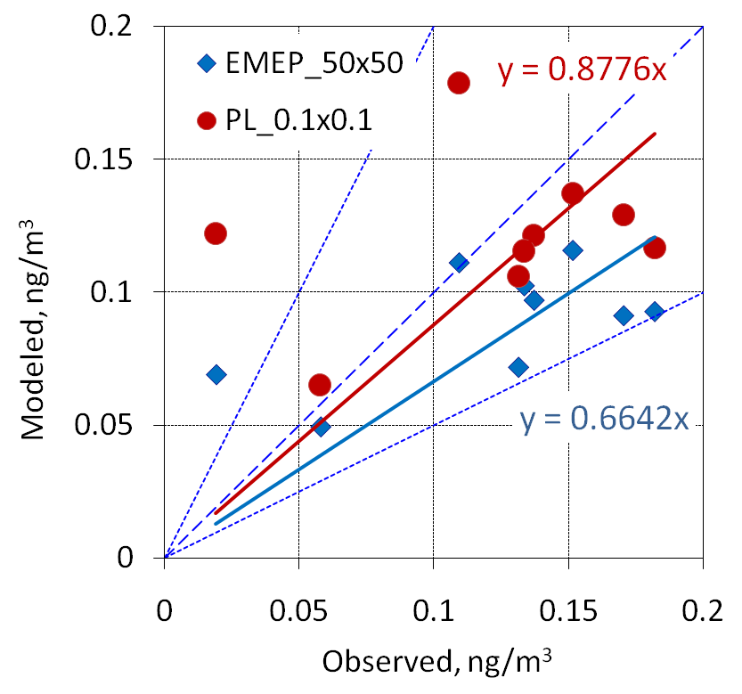
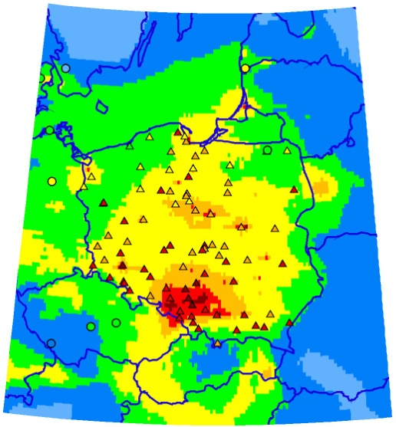
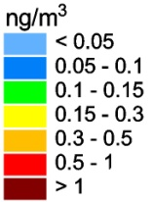
Cooperation with countries
Poland
Model assessment of Cd pollution levels (0.1°x0.1°)
Spatial distribution of calculated and observed Cd air pollution, 2014
Comparison with EMEP sites
Results have been submitted to national experts

Slide 17
Cooperation with countries
Poland
Evaluation of Cd pollution levels
Expected output (2017/2018):
  Analysis of pollution levels using GLEMOS modeling results and various sets
  of measurement data in Poland
Deposition and concentration fields with resolution 0.1°x 0.1°
Pollution levels in particular Polish provinces (voevodships)
Source-receptor matrices for particular provinces
Contribution of emissions of source categories to pollution levels in Poland
and its voevodships
Contribution of particular LPS to pollution in Poland
Evaluation of Cd pollution levels in Poland with fine spatial resolution
will be submitted to TFMM in Prague

Slide 18
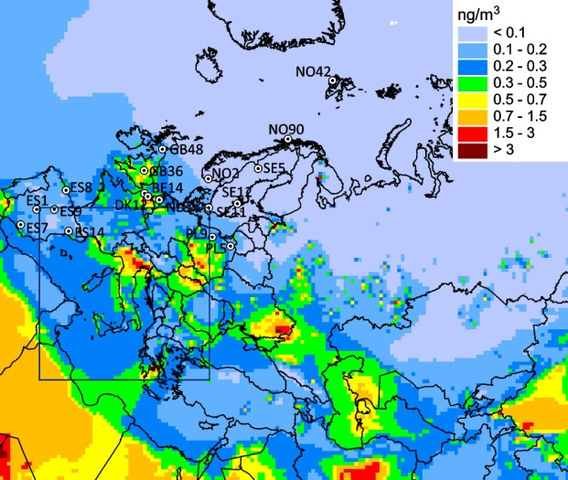
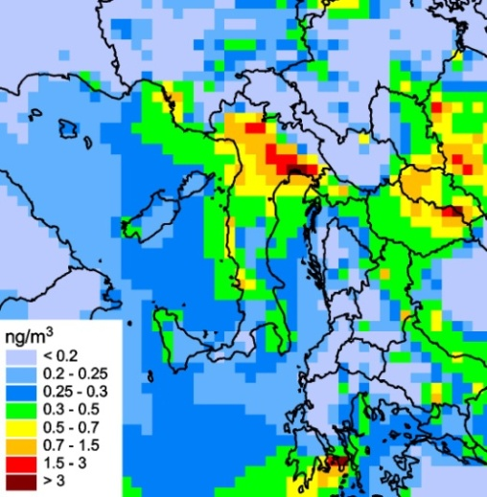
Cooperation with countries
Italy: Assessment of HM and POP pollution by GLEMOS
for national modeling
HM of the second priority: As, Ni, Cr, Cu, Zn, Se
EMEP domain
Agreed domain
Concentrations of As in air, 2014
Preparation of boundary concentrations for modeling HM pollution levels
by national model Minni (ENEA, Italy)
This work was funded by Italy

Slide 19

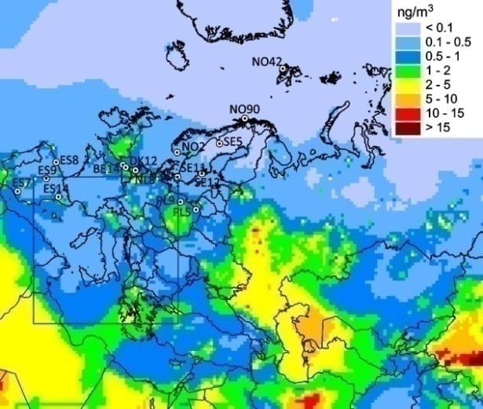
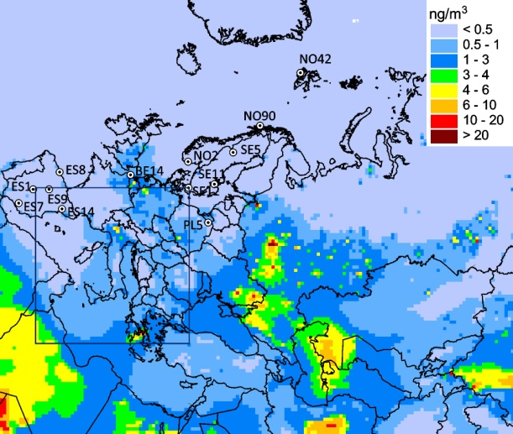
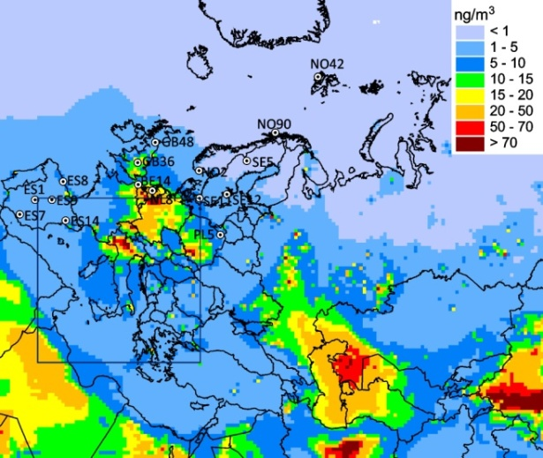
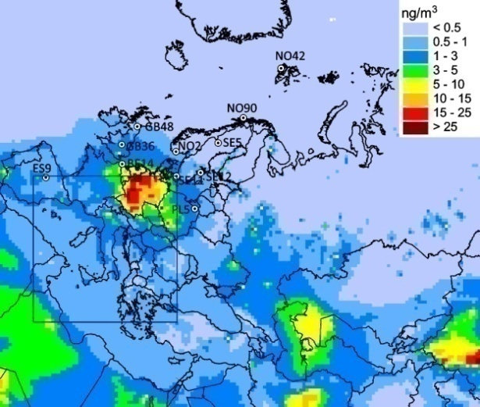
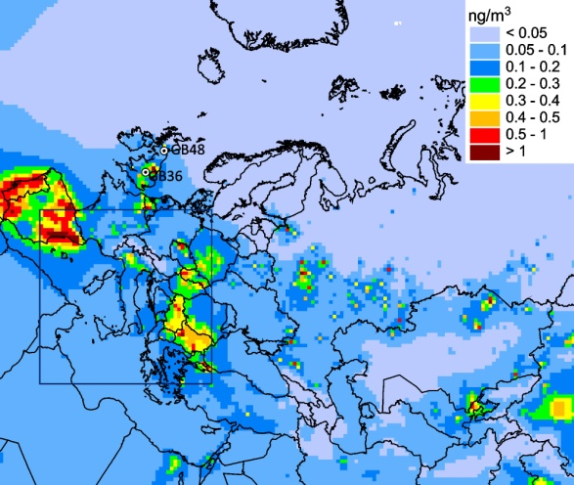
Cooperation with countries
Additional information for EMEP/WGE community
Pollution levels of the second priority metals (As, Ni, Cr, Cu, Zn, Se)
over the EMEP region
Input data
Emissions: EMEP official data - 37 countries (2014)
Measurements: ~ 60 EMEP monitoring sites (2014)
Modeled vs. observed
As air concentrations
Bias = -17%
Rcorr = 0.8
As
Ni
Cr
Zn
Model performance for air concentrations
(As, Ni, Cr, Cu, Zn)
Cu
Se
Mean Relative Bias | ± 20%
Correlation coeff. | 0.6 – 0.8

Slide 20
Cooperation with UNEP & Minamata Conv.
Participation in the UNEP Global Mercury Assessment 2018
Major activities of MSC-E:
(funded by UNEP/AMAP)
Leading the work of international group of modelling experts (CNR-IIA (Italy), HZG (Germany), MIT (USA), Lamar Univ. (USA), Environment Canada, Cambridge (UK))
Coordination of simulation and drafting activities aimed at support Global Mercury Assessment (GMA) 2018 with new modeling results
Global Mercury Assessment 2018
Meeting of Project Coordination Group of GMA 2018 (Geneva, April 2017)

Slide 21
MSC-E peer-reviewed publications
on further model development (2016/2017)
Travnikov et al. (2017) Multi-model study of mercury dispersion in the atmosphere:
Atmospheric processes and model evaluation. Atmos. Chem. Phys., in press.
Bieser et al. (2017) Multi-model study of mercury dispersion in the atmosphere:
Vertical distribution of mercury species. Atmos. Chem. Phys., in press.
Nickel et al. (2017) Modelling and mapping heavy metal and nitrogen concentrations in moss in 2010 throughout Europe by applying Random Forests models. Atmos. Environ., 156, 146–159.
Gencarelli et al. (2016) Sensitivity model study of regional mercury dispersion in the atmosphere. Atmos. Chem. Phys., 17, 627-643.
Pacyna et al. (2016) Current and future levels of mercury atmospheric pollution on global scale. Atmos. Chem. Phys., 16, 12495-12511.
Angot H. et al. (2016) Chemical cycling and deposition of atmospheric mercury in polar regions: review of recent measurements and comparison with models. Atmos. Chem. Phys., 16, 10735-10763.
Pandolfi et al. (2016) Trends analysis of PM source contributions and chemical tracers in NE Spain during 2004–2014: a multi-exponential approach. Atmos. Chem. Phys., 16, 11787-11805.

Slide 22
Main directions of work in 2018/2019
Assessment of HM and POP pollution on the new EMEP grid 2017/2018
(official emission data)
Update GLEMOS parametrization of Hg and PAH atmospheric chemistry and exchange processes
Review and improvement of POP emissions data for modeling
(CEIP/MSC-E joint report)
Cooperation with countries (Case study):
  - to continue: Spain (B(a)P), Poland (Cd), UK (Pb)
  - new proposal: France (B(a)P)
Cooperation with international bodies:
  - updating information on modeling of atmospheric transport of mercury
  (Global Mercury Assessment 2018) – AMAP/UNEP
  - exchange of information on POP with Stockholm Convention
  - evaluation of pollution of the Baltic Sea by HMs and POPs (HELCOM)

